Slide 1
STROKE PATIENT HEALTHCARE USING DEEP LEARNING
An overview of data preprocessing, visualization, and modeling.
By Athira Viju

Slide 2
Contents
Objective | A summary of the project goals and aim
Project Overview | Define the outline of the project
Milestone 1 | Details the initial steps, such as data collection, cleaning, and preprocessing.
Milestone 2 | Covers data visualization used to understand patterns and trends.
Milestone 3 | Covers encoding techniques
Milestone 4 | Focuses on tuning, optimizing, and finalizing model performance metrics.
Dataset Concusion | Summarizes insights drawn from the dataset analysis
Model Final Evaluation | Highlights the final model's performance and weakness based on key metrics
Final Insights | Presents the overarching conclusions,

Slide 3

Objective of the project:
The central aim of this project is to conduct a comprehensive analysis of healthcare data to uncover significant patterns and develop a high-accuracy predictive model to assess the likelihood of health conditions, such as stroke. By leveraging robust data exploration, insightful visualizations, and machine learning techniques, this project aims to derive actionable insights and reliable predictions.

Slide 4
Our aim
The goal
To analyze the dataset and build a machine learning model that predicts stroke occurrence based on patient health data.
To derive meaningful insights from the data through preprocessing and visualization, and to evaluate the performance of various models to identify the most effective one for accurate predictions.

Slide 5
Project Overview
01
02
03
04
The project focuses on analyzing healthcare data to uncover patterns and build a high-accuracy predictive model for assessing stroke risk. It encompasses four milestones that systematically progress from data exploration to model development.
Data Preparation
Data Visualization
Data Encoding
Machine Learning Models

Slide 6

01
Data
Preparation

Slide 7
Dataset Characteristics
The dataset consists of 5110 entries across 12 attributes, incorporating both numerical and categorical features.
Key columns include age, gender, hypertension, heart_disease, work_type, avg_glucose_level, bmi, and the target variable stroke.
Exploratory Analysis:
Analysis | Definition | Observation
df.shape() | Returns a tuple representing the number of rows and columns in the dataset. | The dataset contains 5110 rows and 12 columns, indicating sufficient data for analysis and modeling.
df.info() | Displays a concise summary of the DataFrame, including non-null counts and data types. | Identified bmi as the only column with missing values. Other columns are complete, with data types categorized as int, float, or object.

Slide 8
df.describe() | Provides statistical summary (mean, std, min, max, etc.) for numerical columns. | Key numerical features like age, avg_glucose_level, and bmi were analyzed. The values show a wide range, with notable outliers in glucose levels and BMI.
df.describe (include=object) | Provides statistical summary for categorical columns (e.g., count, unique values, top category, frequency). | The dataset has higher representation of females (2,994 occurrences) and married individuals (3,353 occurrences). Private employment is the most common work type, urban areas are slightly more prevalent (2,596 occurrences), and the majority of participants have never smoked (1,892 occurrences).
df.smoking_status.unique() | Displays unique values in the smoking_status column. | The unique values are: ['formerly smoked', 'never smoked', 'smokes', 'Unknown']. These categories will need encoding for model compatibility.
df.isnull().sum() | Counts the number of missing values for each column. | Only bmi has 201 missing values. These were handled by imputing the median, ensuring no missing data remained.

Slide 9
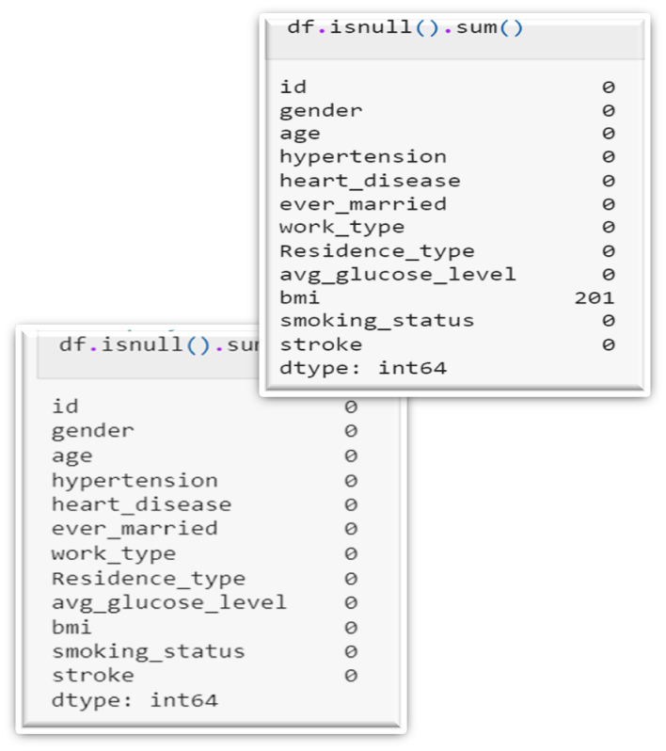
(Q) Is it good to have null values in dataset ?
No, null values can hinder data analysis and model performance. They represent missing or incomplete information, which can lead to inaccuracies, biases, or errors if not properly handled. Addressing null values ensures the dataset is clean and reliable for analysis or model training.
Handling Null Values

Slide 10

02
Data Visualization

Slide 11
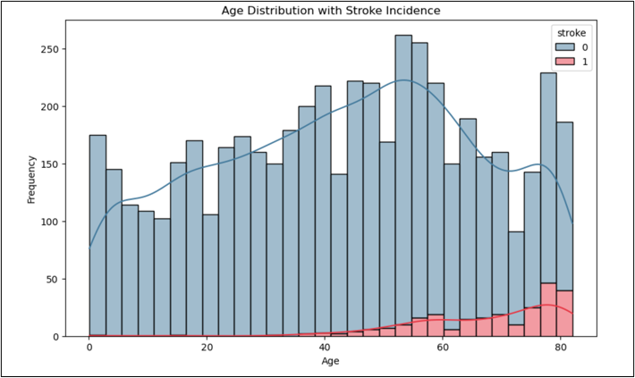
Age Distribution with Stroke Incidence
This part focuses on exploring the dataset visually to uncover meaningful patterns and relationships between variables. Through graphs and plots, we analyze trends and distributions, helping identify key insights related to stroke prediction. Additionally, data encoding ensures that categorical variables are transformed into a format suitable for machine learning models.
Visualization: A histogram with KDE overlay showing the distribution of age with stroke incidence.
Observation:
Stroke incidence increases significantly in older age groups.
Younger individuals have a relatively low frequency of strokes.

Slide 12
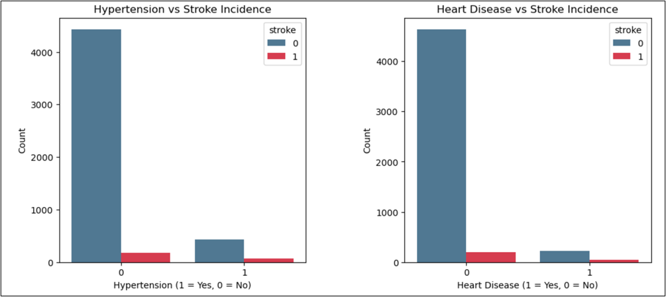
Hypertension and Heart Disease vs Stroke Incidence
Visualization: Two side-by-side bar plots depicting the correlation of hypertension and heart disease with stroke incidence.
Observation:
Hypertension and heart disease are strong predictors of stroke.
Individuals with either condition have a higher likelihood of experiencing a stroke.

Slide 13
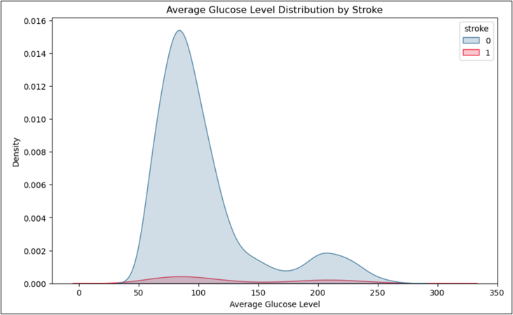
Average Glucose Level Distribution by Stroke
Visualization: A KDE plot illustrating the distribution of average glucose levels for stroke and non-stroke cases.
Observation:
Higher average glucose levels are associated with increased stroke incidence
A clear separation in glucose levels exists between stroke and non-stroke groups.

Slide 14
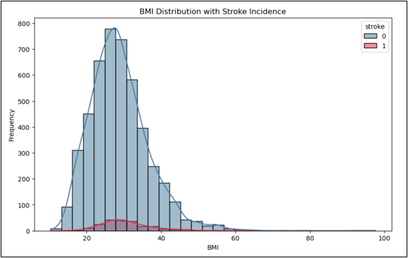
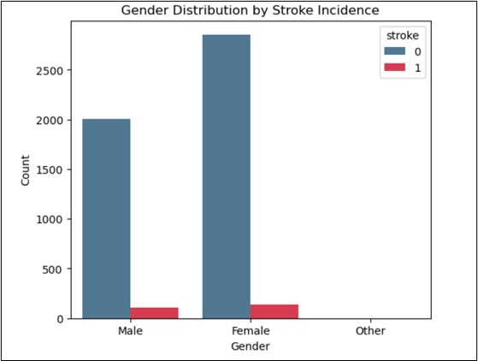
BMI Distribution with Stroke Incidence
Gender Distribution by Stroke Incidence
Visualization: A histogram with KDE overlay depicting BMI distribution for stroke and non-stroke cases.
Observation:
Stroke cases are slightly more frequent among individuals with higher BMI.
BMI alone does not show a strong correlation with stroke.
Visualization: A count plot showing the distribution of stroke cases by gender.
Observation:
Both genders show comparable stroke incidence rates, though slight variations exist.

Slide 15
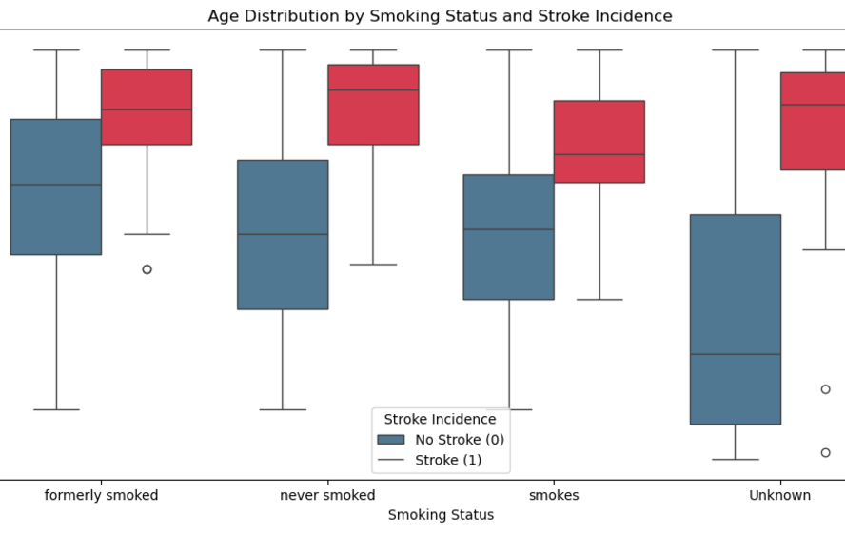
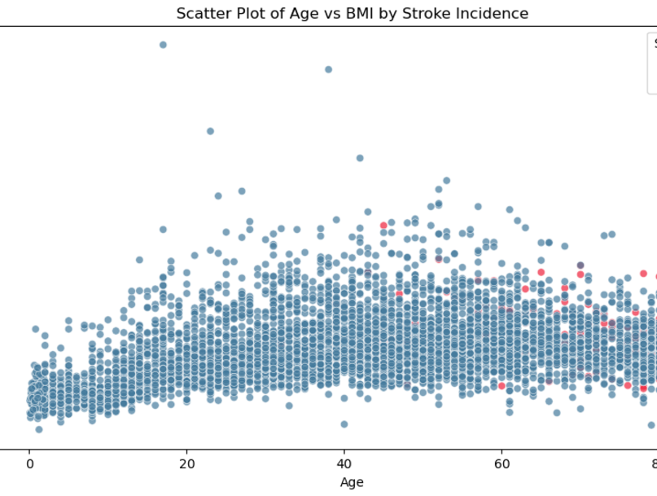
Age Distribution by Smoking Status and Stroke Incidence
Scatter Plot of Age vs BMI by Stroke Incidence
Visualization: A boxplot showing age distribution across different smoking statuses with stroke incidence.
Observation:
Stroke is more prevalent among older individuals, regardless of smoking status.
Smoking does not directly correlate to stroke in younger age groups but shows an impact in older populations.
Visualization: A scatter plot showing the relationship between age, BMI, and stroke incidence.
Observation:
Most stroke cases cluster in older individuals with a range of BMI values.
No distinct pattern emerges in BMI but age is a significant factor.

Slide 16

03
Data Encoding

Slide 17


Data Encoding
Data encoding is the process of converting categorical data into numerical formats so that machine learning algorithms can interpret it.
Residence_type
Work_Type
Smoking_status
0-Rural
1-Urban
work_type_Never_worked
work_type_Private
work_type_Self-employed
smoking_status_never smoked
smoking_status_formerly smoked
smoking_status_smokes

Slide 18

04
Machine Learning Models

Slide 19
Linear Regression
Ridge Regression
Logistic Regression
Lasso Regression
Machine Learning (ML) models are algorithms that enable computers to learn patterns from data and make predictions or decisions without being explicitly programmed. Common models are :

Slide 20
Preprocessing and Data Preparation for Regression Models
Handling Missing Values
Encoding Categorical Variables
Feature Selection
Train-Test Split
Standardization

Slide 21

Maths Behind Ridge Regression Model
In a Ridge Regression model, the relationship between the dependent variable y and the independent variables x1,x2,x3....xp is also assumed to be linear, similar to linear regression. However, Ridge Regression introduces a regularization term to prevent overfitting by penalizing large coefficients, which helps improve the model's generalization.
The model can be expressed mathematically as:
yi: Actual value of the target variable for the ith observation
yi^: Predicted value for the ith observation
n: Number of observations
p: Number of features
Bj: Coefficient for each feature
sigma(yi-yi^)^2: Residual sum of squares
sigma Bj^2: Penalty term

Slide 22
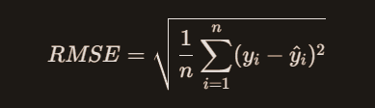
Maths Behind Ridge Regression
Root Mean Squared Error (RMSE): RMSE is a commonly used metric to evaluate the accuracy of a regression model. It measures the average magnitude of the error between predicted values and actual values.
n: is the number of data points
yi: is the actual value for the i-th data point
yi^: is the predicted value for the i-th data point.

Slide 23
Model Performance Summary: RMSE and Accuracy
Model | Accuracy | RSME
Ridge Regression | 92.5 | 18.128
Logistic Regression | 96.13 | 19.67
Linear Regression | 96.23 | 18.12
Lasso Regression | 96.23 | 18.95

Slide 24
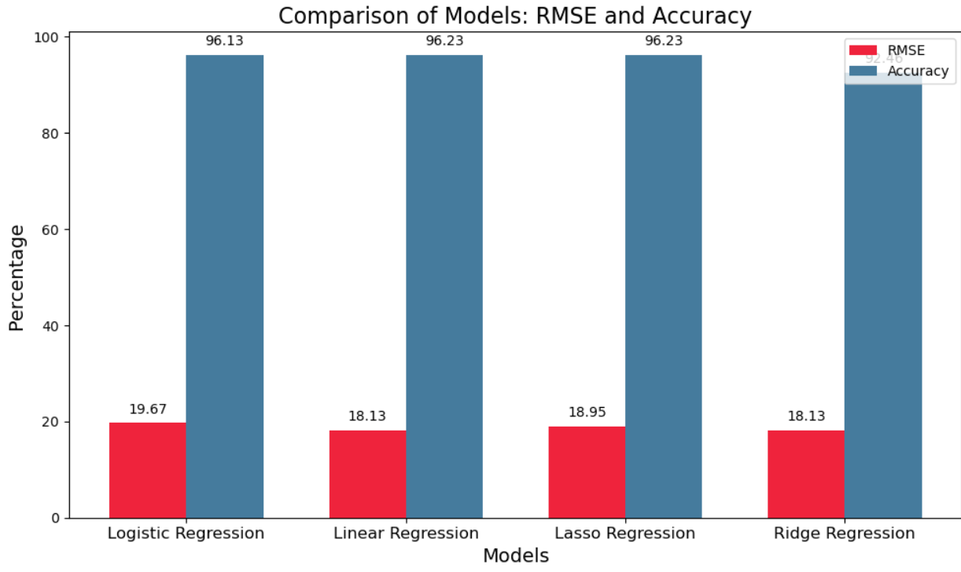
Visualizing Different Models
Key observations
RMSE Insights: Linear and Ridge models have the lowest RMSE, indicating the most accurate predictions, while Lasso has slightly higher errors, and Logistic Regression performs the worst with the highest RMSE.
Accuracy Insights: All models show high accuracy (above 92%), with Linear and Lasso achieving 96.23%, Ridge at 92.46%, and Logistic Regression slightly behind at 96.13%.

Slide 25
Precision, Recall, F1 Score, and Accuracy Across Models

Slide 26
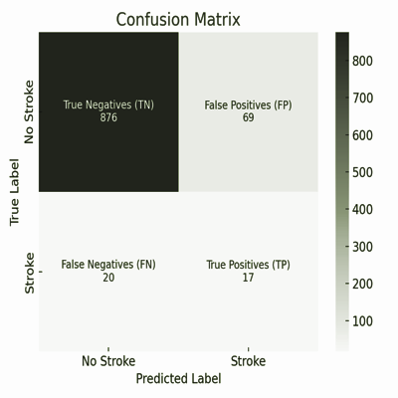
Precision (P): Measures how many predicted "Stroke" cases are correct.
P= TP/[TP+FP]
Recall (R): Measures how many actual "Stroke" cases are correctly identified.
R=TP/[TP+FN]
F1 Score: Harmonic mean of Precision and Recall, providing a balance between both.
F1 Score= 2*(P x R/P+R)
Accuracy: Overall correctness of the predictions.
Accuracy=(TP+TN)/(TP+TN+FP+FN)

Slide 27
Observations
Model | Precision | Recall | F1 Score | Accuracy
Ridge Regression | 0.253 | 0.513 | 0.339 | 0.92
Linear Regression | 0.333 | 0.054 | 0.093 | 0.96
Lasso Regression | 0.197 | 0.459 | 0.276 | 0.90
Logistic Regression | 0.333 | 0.0270 | 0.05 | 0.96
Ridge Regression: Best recall with balanced performance overall.
Linear Regression: High accuracy but poor recall, struggles with the minority class.
Lasso & Logistic Regression: High accuracy but very low recall and F1 scores, indicating poor minority class detection.

Slide 28

Is accuracy a factor for model performance?
Accuracy alone is not a reliable metric for evaluating model performance, especially in cases of class imbalance. While high accuracy values (e.g., Logistic Regression: 96.13%, Linear Regression: 96.02%) might seem impressive, they can be misleading when the minority class is poorly identified.
For instance:
Ridge Regression, despite having lower accuracy (92.46%), achieves the highest recall (51.35%), making it more effective at detecting the minority class.
Logistic Regression has the highest accuracy (96.13%) but extremely low recall (2.7%), failing to identify most minority cases.

Slide 29

Is the dataset biased?
Class 0 (No Stroke): 95.74%
Class 1 (Stroke): 4.26% This severe imbalance skews the model toward predicting the majority class, leading to poor detection of the minority class.
Steps to mitigate bias:
- Changing random state
- Threshold tuning
- Adjusting class weights
- Resampling

Slide 30
Ridge Regression Model Evaluation
Strengths:
High Recall (51.35%): Ridge effectively identifies positive cases (true positives).
Good Accuracy (92.46%): Performs well overall in correct predictions.
Weaknesses:
Low Precision (25.33%): Many false positives, reducing precision.
Moderate F1 Score (33.93%): Indicates an imbalance between precision and recall.
Conclusion:
Ridge Regression excels in recall but requires improvement in precision to balance performance.

Slide 31

Final Insights
Class Imbalance: Dataset is heavily skewed (95% "No Stroke", 5% "Stroke"), causing bias towards the majority class.
Impact on Performance: High accuracy but poor detection of strokes due to the imbalance.
Evaluation Metrics: Metrics like recall and F1-score are more reliable than accuracy for evaluating minority class detection.
Analysis Conducted: Data preprocessing, visualizations, and modeling plays significant role in this project.

Slide 32
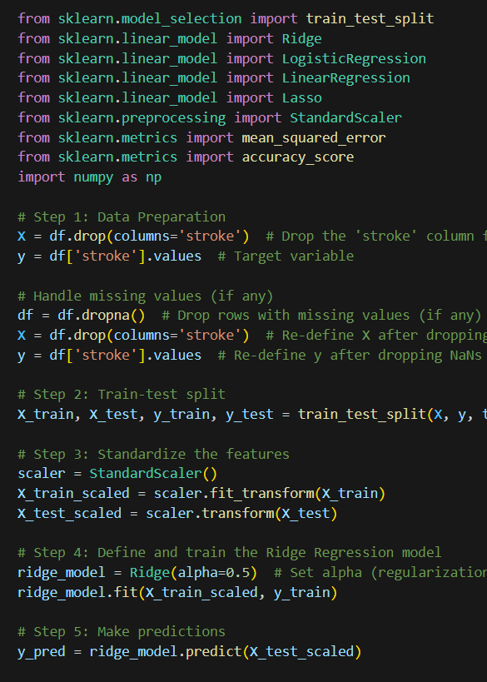
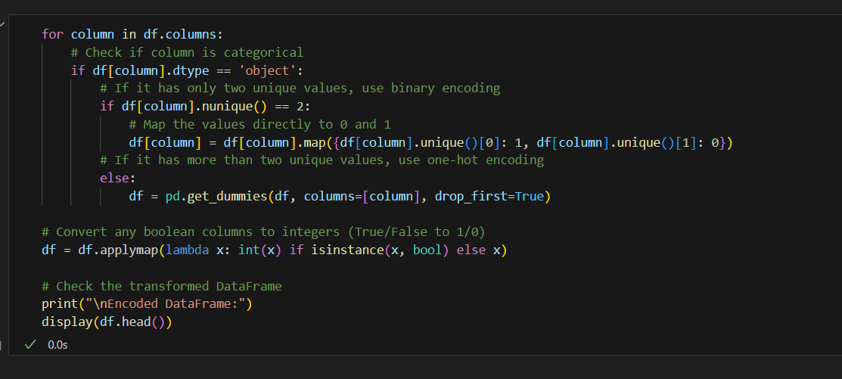
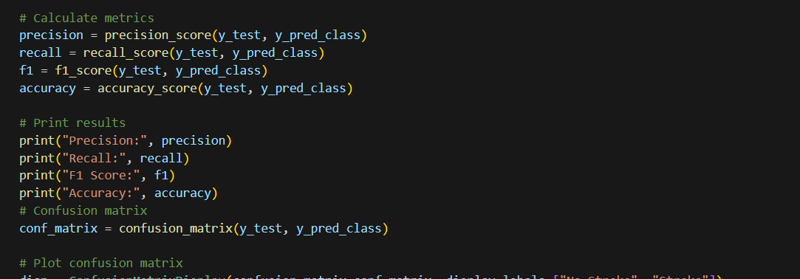
Code

Slide 33
Thanks!

