Slide 1
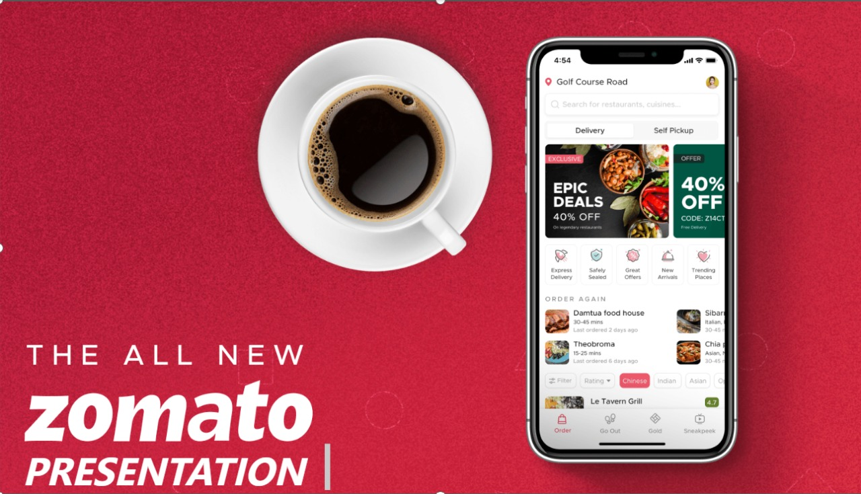
Presented by: Group 5 # Dipak Sanap # Priyanka Jain # Mansi Bhoite # Amit Gupta # Athira Binu # Suvedha Date: 13 : 3 : 2025
Zomato restaurants analysis & Insights
A Dashboard-Driven Approach Using
Power BI, Excel & Tableau

Slide 2
Objectives & Aim
Objectives of Zomato Data Analysis:
To analyze customer preferences and ordering patterns.
To evaluate restaurant performance and market trends.
To assess delivery efficiency and service quality.
To identify areas for business improvement.
Aim of the Presentation:
To showcase key findings from data visualization in Power BI, Excel, and Tableau.
To provide actionable insights for business growth.
To recommend data-driven strategies for Zomato’s operations.

Slide 3
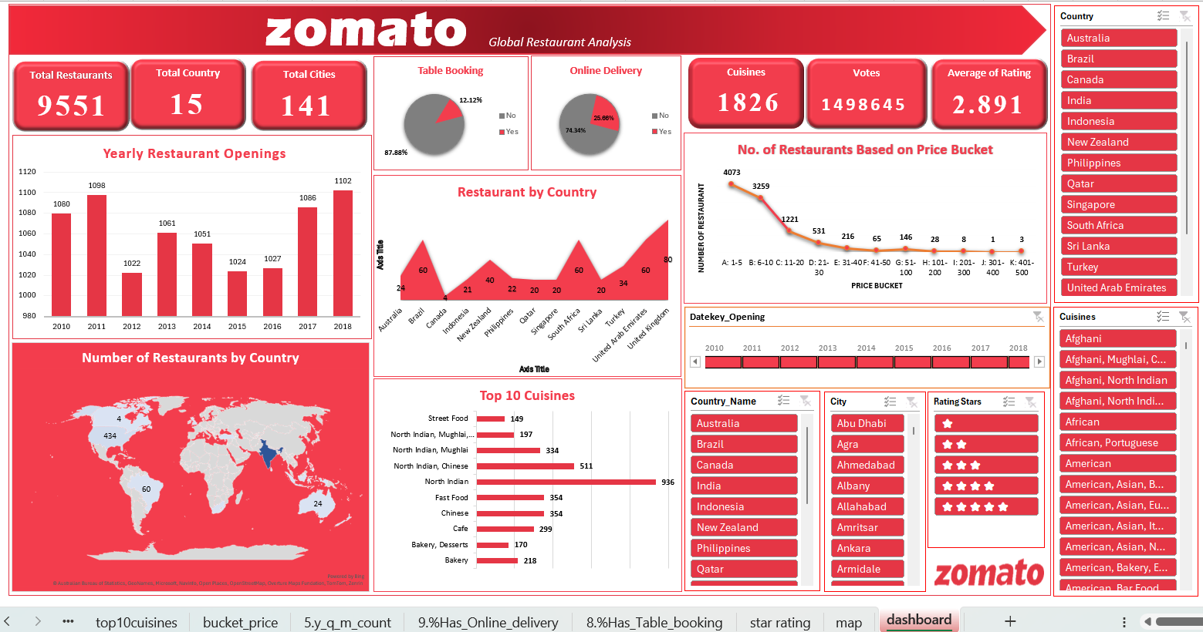
Zomato Restaurants analysis using Excel

Slide 4
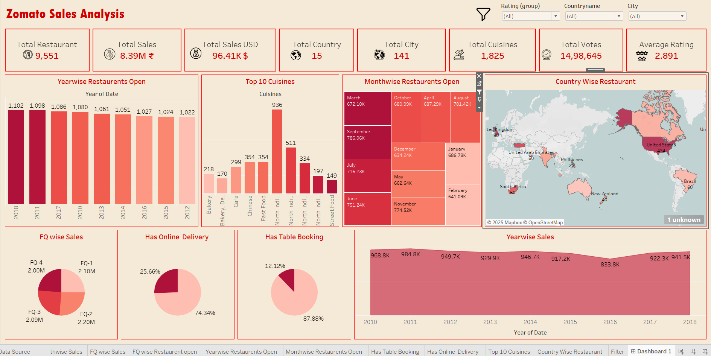
Zomato Restaurants analysis using Tableau

Slide 5
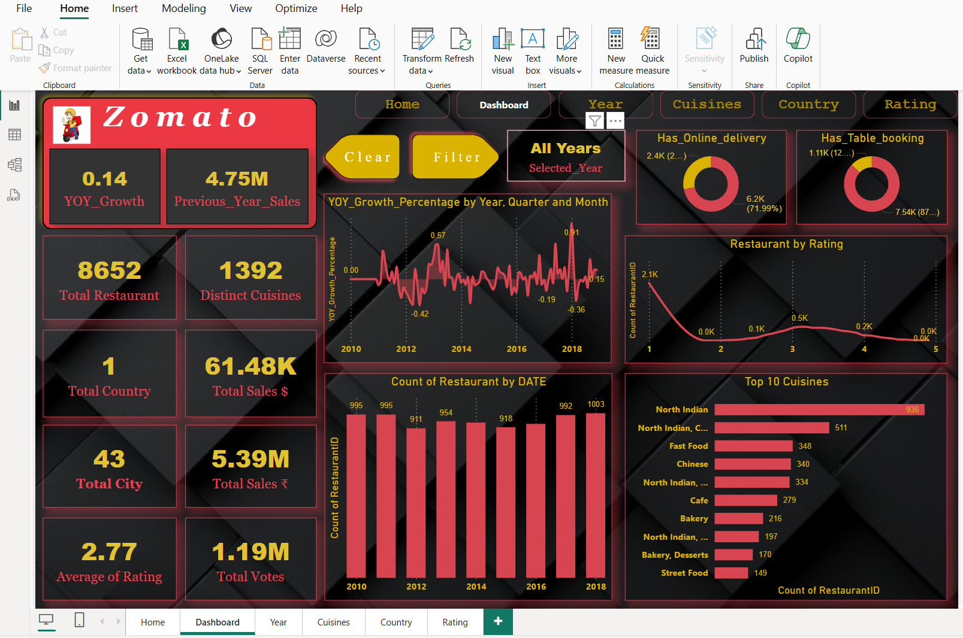
Zomato restaurants analysis using Power bi

Slide 6
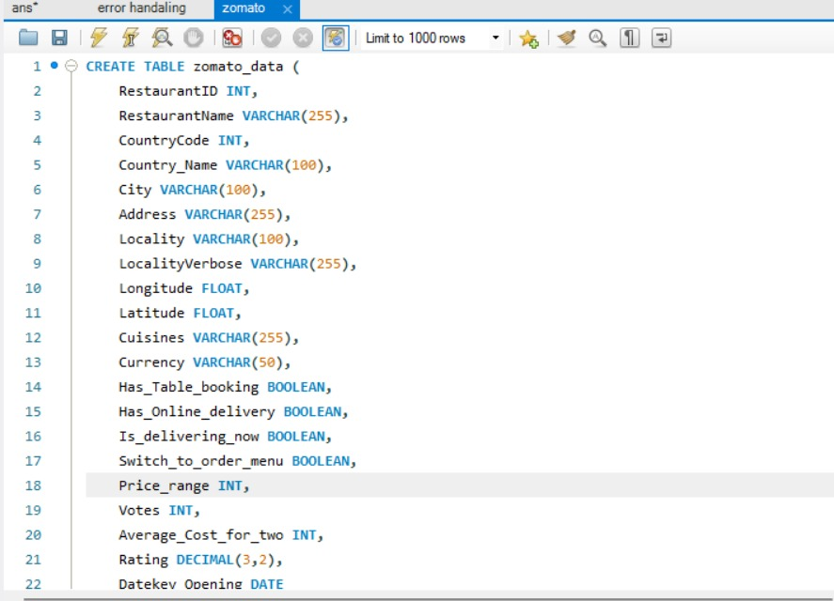
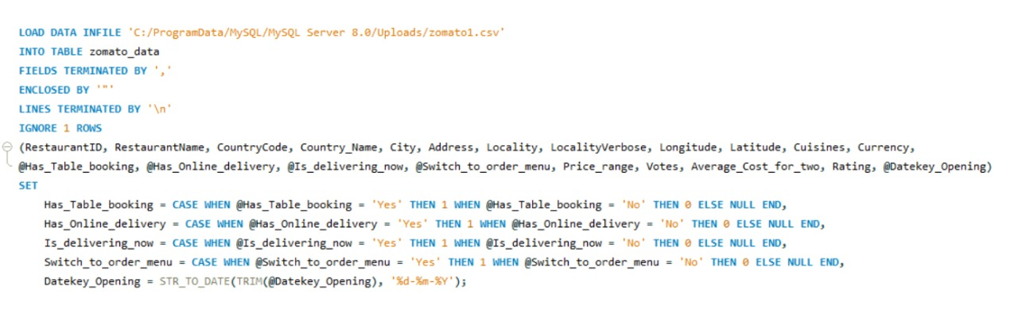
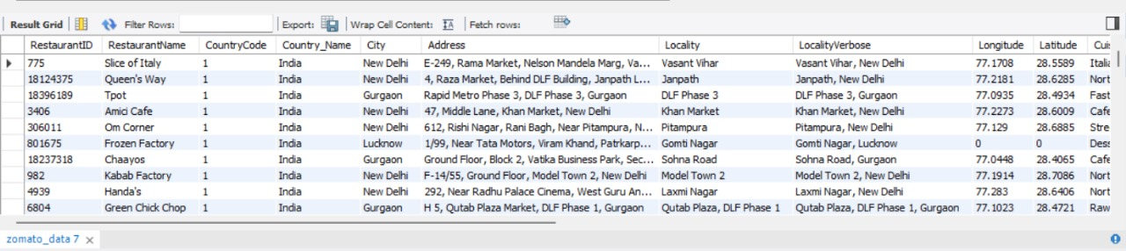
Zomato restaurants analysis using SQL

Slide 7
Conclusion & Recommendations
Conclusion:
The analysis revealed trends in customer behavior, peak ordering times, and top-performing restaurants.
Delivery efficiency and rating analysis helped understand customer satisfaction factors.
Revenue growth patterns and competitor benchmarking provided market insights.
Recommendations: ✅ Improve delivery time by optimizing routes. ✅ Enhance restaurant listings based on customer preferences. ✅ Offer dynamic pricing strategies for peak hours. ✅ Focus on loyalty programs and personalized recommendations. ✅ Expand in high-demand locations based on data insights.

Slide 8
Thank You,

