Slide 1
StudyInSchool ECM3099 – INDUSTRIAL INTERNSHIP
Submitted by
ATHIRA V AJIT
17BLC1163

Slide 2
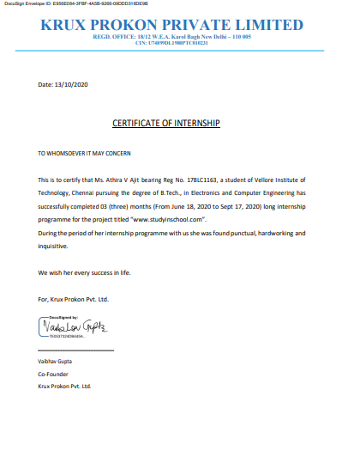
Certificate
Krux Prokon Pvt Ltd
Mr Vaibhav Gupta
studyinschool2020@gmail.com
9999909619

Slide 3
Agenda
Objective
Introduction To StudyInSchool.
Learning Outcomes
Conclusion

Slide 4
Objective
Creating an online platform to display 20k schools and allowing users to compare , shortlist , apply to different schools.
Create an admin dashboard
Create an client dashboard(currently pursuing)

Slide 5
About the company
Krux Prokon Private LTD is a Non-govt company, incorporated on 25 Feb, 1980. It's a private unlisted company and is classified as'company limited by shares'. Company is registered in Delhi (Delhi) Registrar Office. Krux Prokon Private LTD registered address is 18/12 Wea Pusa Lanekarol Bagh New Delhi Dl 110006 In.

Slide 6
Project
StudyinSchool is an upcoming brand under the umbrella company, Krux Prokon Pvt. Ltd. The intent is to create technology products to assist parents in enrolling their children to their dream schools.
Reference Link
https://studyinschool.com/

Slide 7
Technologies used
NodeJS
Express
MongoDB
jQuery
Ajax
JavaScript
Google Cloud Platform(App Engine & Storage)

Slide 8
Learning Outcomes
Ability to grasp new technologies faster
Exposure of live projects
Gained experience in hosting platforms
Gained insights on user-experience
Co-ordinating with team members of different roles
Exposure to agile practices
Understanding the importance of efficient, clean , understandable coding
Exposure to prioritising tasks and focusing on code efficiency in memory and speed.

Slide 9
Conclusion
I have gained experience in different levels both personally and professionally during my tenure with the company. The way I code and envision a product has changed to a great extent. I have learnt many things which are outside the scope of a classroom while working on this project , in the same way I was extremely happy to be able to use the insights gained through my lectures on software engineering in the given project.

Slide 10
References
https://docs.mongodb.com/manual/crud/
https://en.wikipedia.org/wiki/JQuery
https://en.wikipedia.org/wiki/Ajax_(programming)
https://en.wikipedia.org/wiki/JavaScript
https://en.wikipedia.org/wiki/MongoDB
https://en.wikipedia.org/wiki/Node.js
https://www.diva-portal.org/smash/get/diva2:1161166/FULLTEXT01.pdf
https://www.toptal.com/nodejs/why-the-hell-would-i-use-node-js
https://cubettech.com/resources/blog/combining-nodejs-and-nosql-why-mongodb-is-the-best-choice/

