Slide 1
REACT NATIVE

Slide 2
WHAT IS REACT NATIVE ?
It is the next generation of React - a Javascript code library developed by Facebook and Instagram, which was released on Github in 2013.
It helps developers reuse code across the web and on mobile.

Slide 3
WHY REACT NATIVE
application logic is written and runs in JavaScript, whereas your application UI is fully native( ie. for a particular OS).
novel, radical and highly functional approach to constructing user interfaces.
write-once run-anywhere, tool.
aiming to be learn-once write-anywhere.

Slide 4
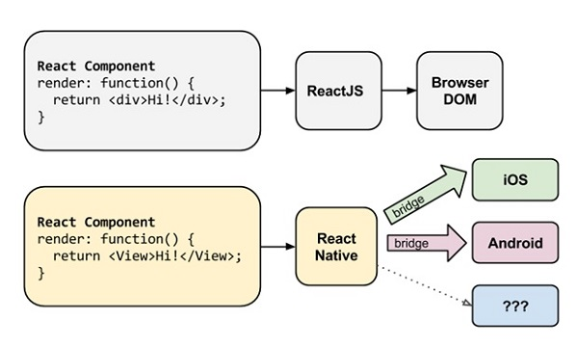
HOW IT WORKS WITH ANDROID
uses Node.js, a JavaScript runtime, to build your JavaScript code.
Download and install in any OS.

Slide 5
CHALLENGES
Android and iOS codebases were managed in two different repositories at Facebook.
JavaScript packager server to run Android code from the iOS repository.
a huge tax when testing changes on two platforms.

Slide 6
Using react native
only one copy of common JavaScript code will be necessary, and syncs will be a thing of the past.
When making changes, every engineer must be careful to test on both platforms.
it's harder to lay things out on the screen, so, manually compute the size and position of all our views.

Slide 7
NECESSITY OF REACT NATIVE
we have access to platform-specific UI components, like maps, date pickers,etc.
possible to reimplement these components on the web, but our reimplementations never feel exactly like their native counterparts.
No developer discipline needed to build a system that gets this right.

Slide 8
BUILDING REACT NATIVE
Using WebViews
Porting React to native
Scripting native

Slide 9
OPEN SOURCE REACT NATIVE
At Facebook-mission is to make the world more open and connected.
React Native satisfies the above scenario.
Open source React Native for IOS is possible on Github. It will be the case with android too soon.

Slide 10
MERITS
Can be used for web development or app development using the same set of code.
all native UIViews are possible.
React.js is the right way to build apps.

Slide 11
FUTURE SCOPE
Each and every application will be based on react native such that each could be used in any software.

