Slide 1
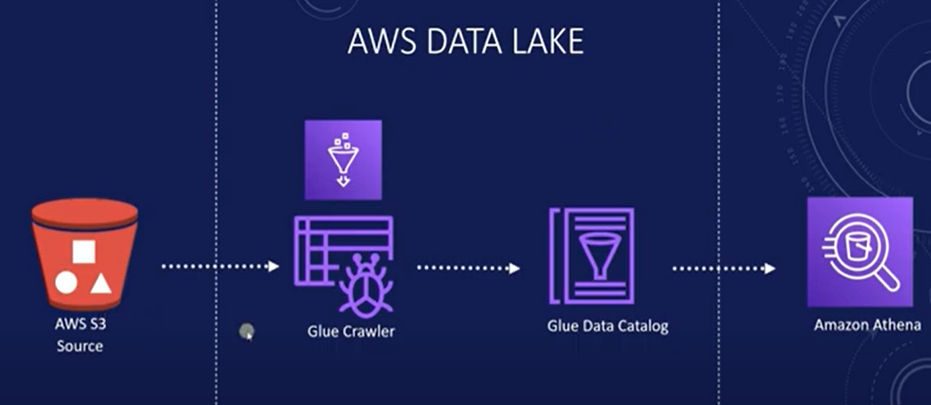
Lab -5: Building a Data Lake: AWS vs Open-Source On-Premise Deployment

Slide 2
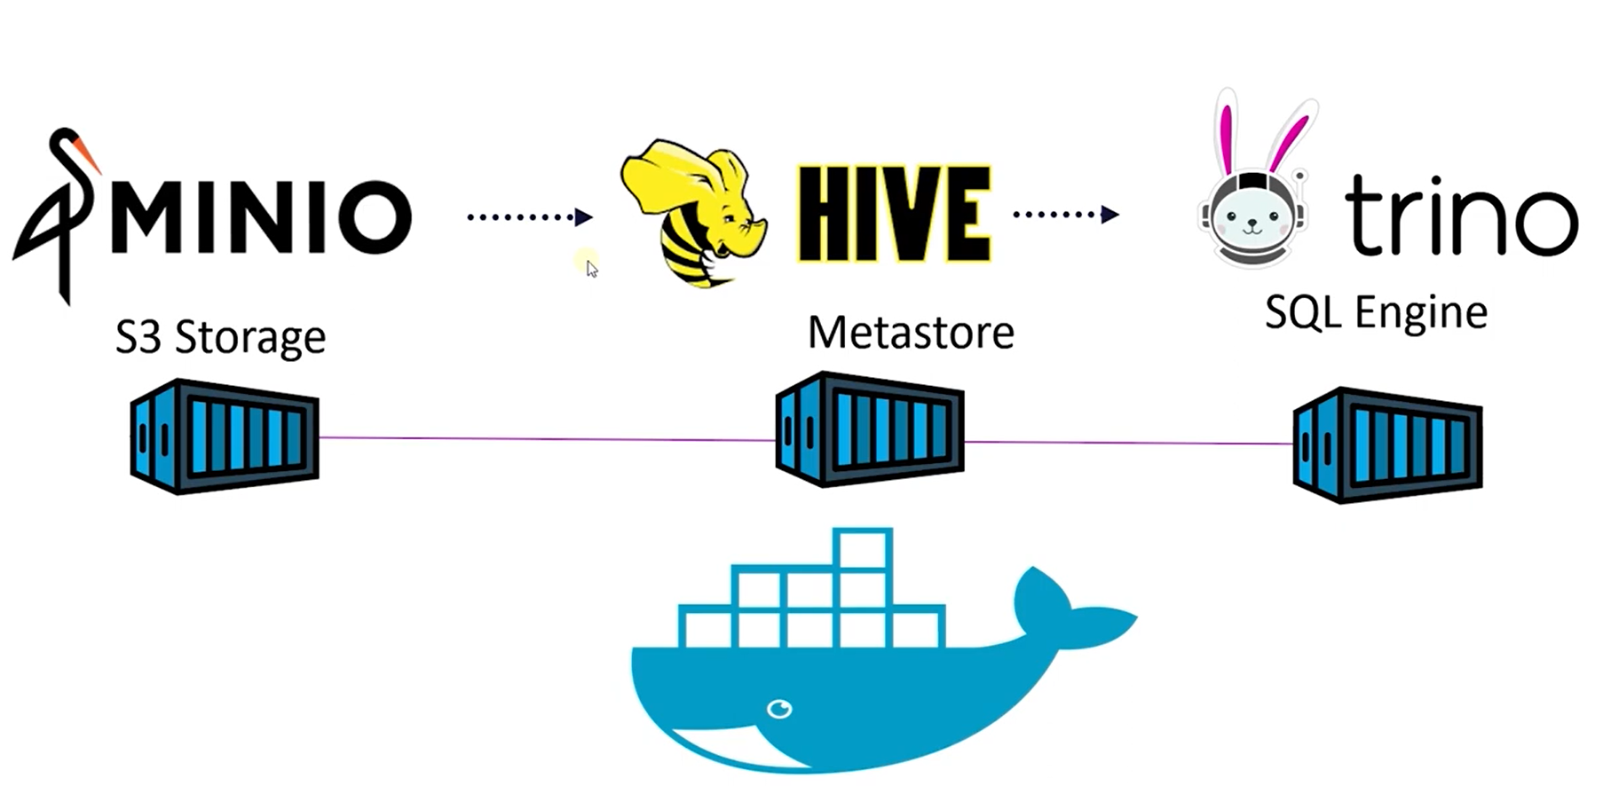

Slide 3
MinIO
Type: Object Storage
Description: MinIO is a high-performance, open-source object storage system compatible with Amazon S3 APIs. It stores unstructured data such as images, videos, logs, backups, and large datasets.
Hive Metastore – stores metadata about datasets: table schema, partitions, file locations in MinIO.
Trino Query Engine – executes SQL queries using metadata from Hive and reads the actual data from MinIO.

Slide 4
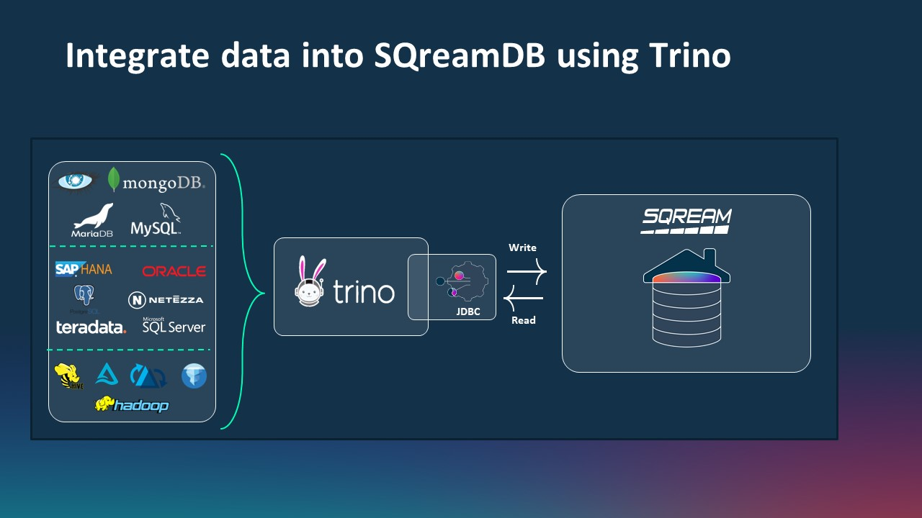

Slide 5
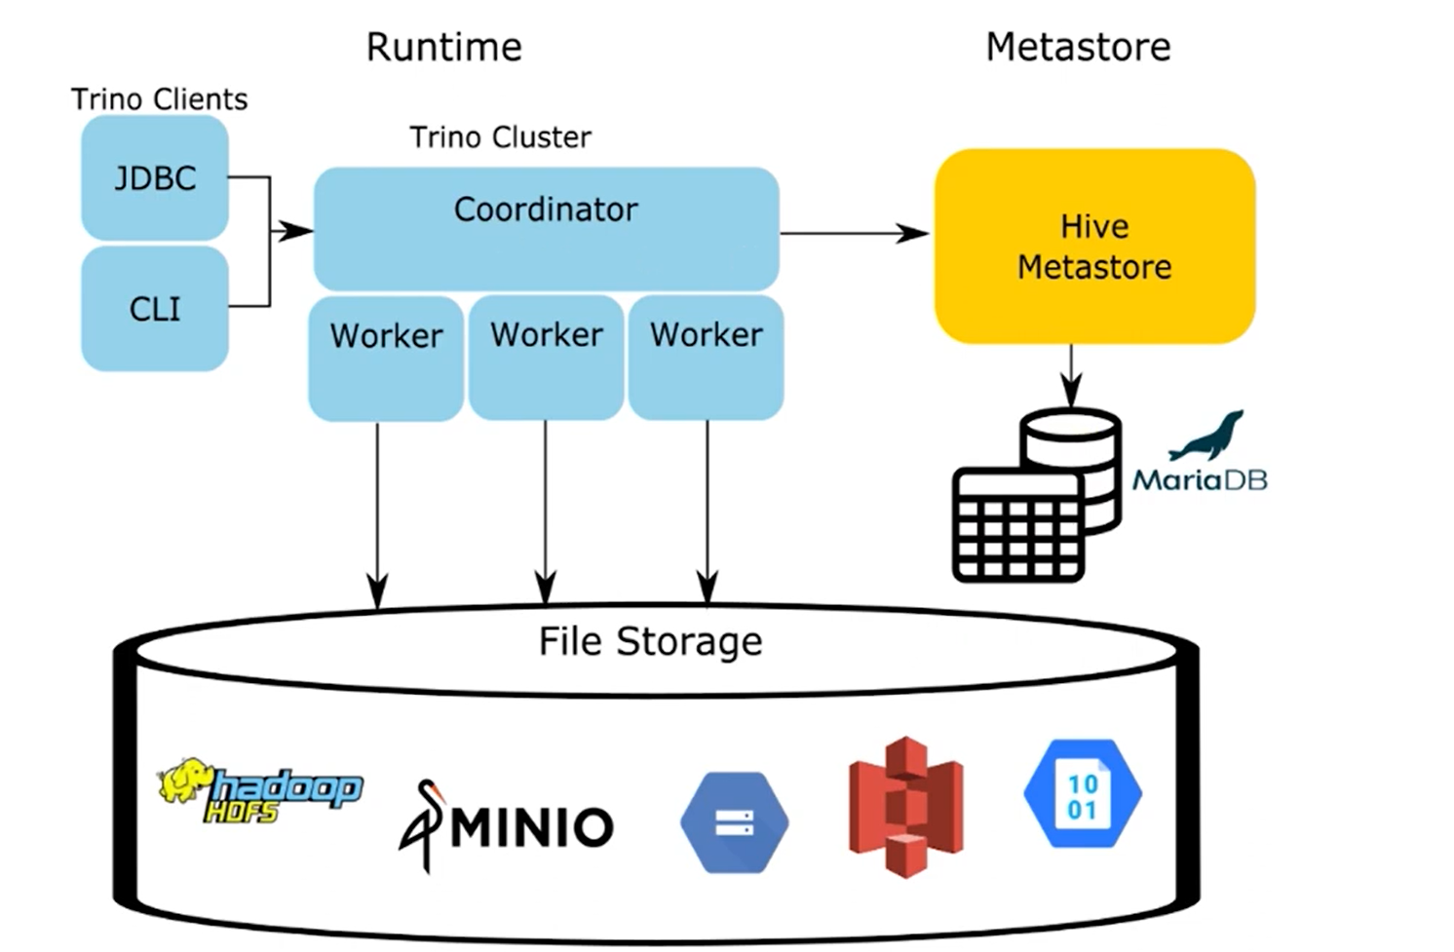
Client → Submits SQL queries.
Coordinator → Manages queries (planning + task distribution)
.Workers → Execute tasks in parallel by reading data and processing it.

Slide 6
Install Docker Desktop on Windows
https://docs.docker.com/desktop/setup/install/windows-install/

Slide 7
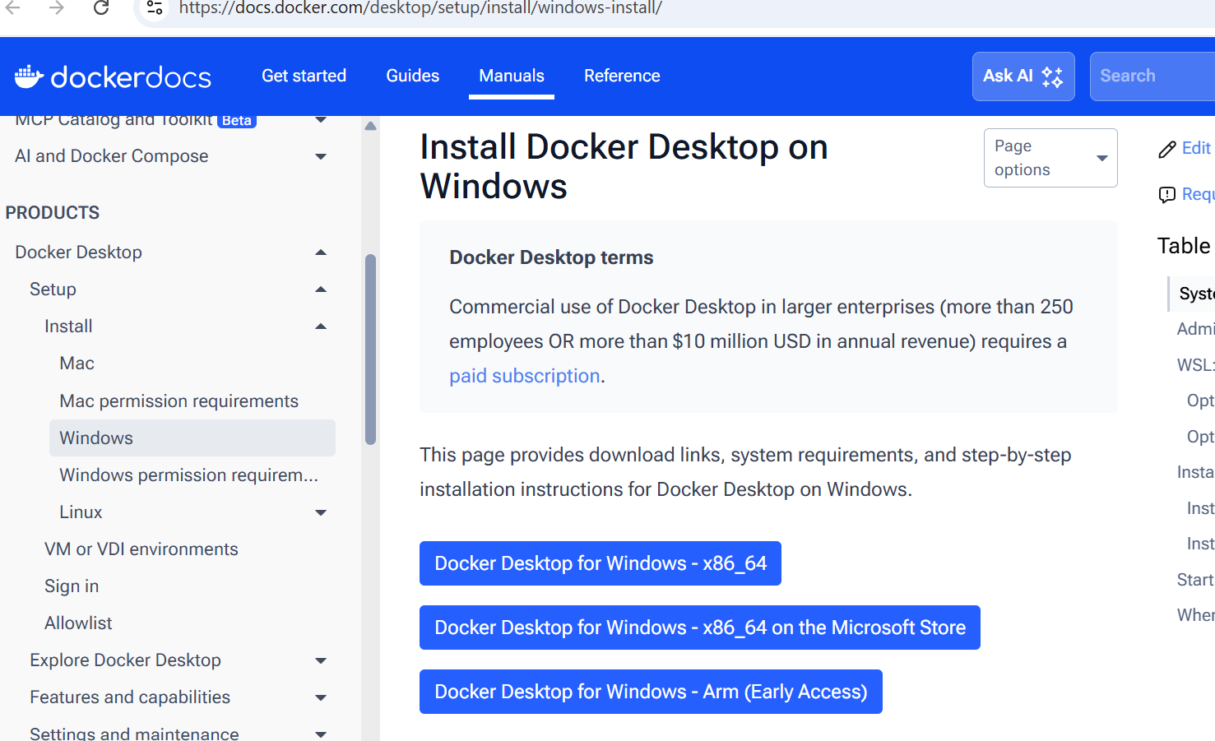

Slide 8
docker-compose up
Mino:
http://localhost:9001/
User name : minio_secret_key
Password:minio_secret_key

Slide 9
Trino
http://localhost:8086/
User Name:trino

Slide 10
Install Dbeaver Community editions:
Download | DBeaver Community

Slide 11
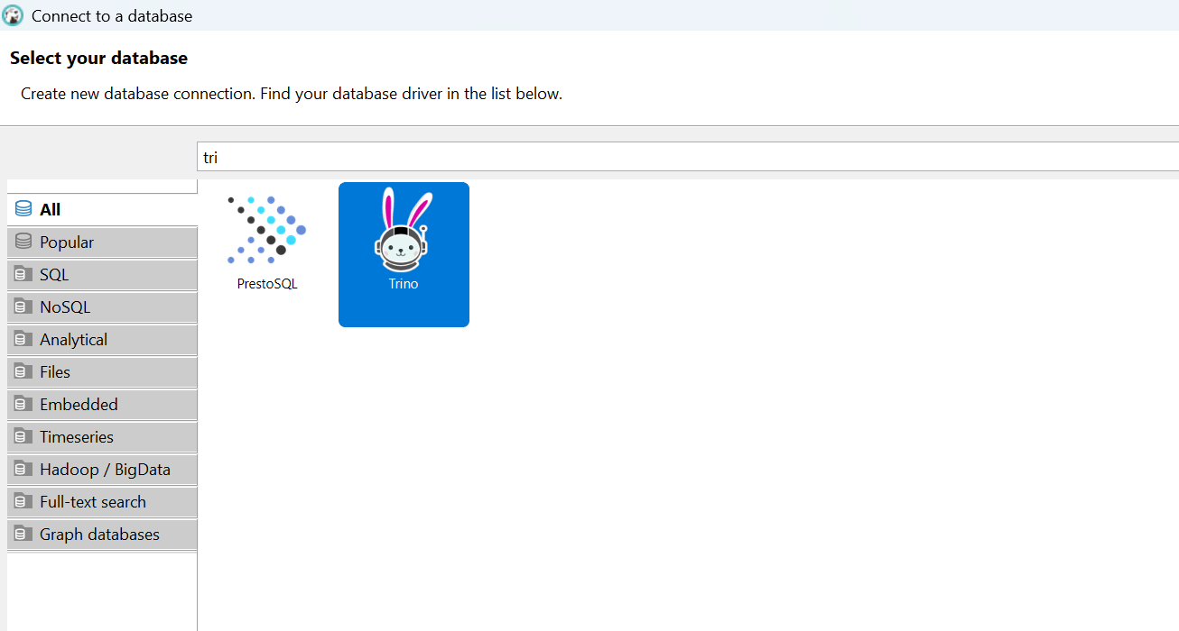

Slide 12
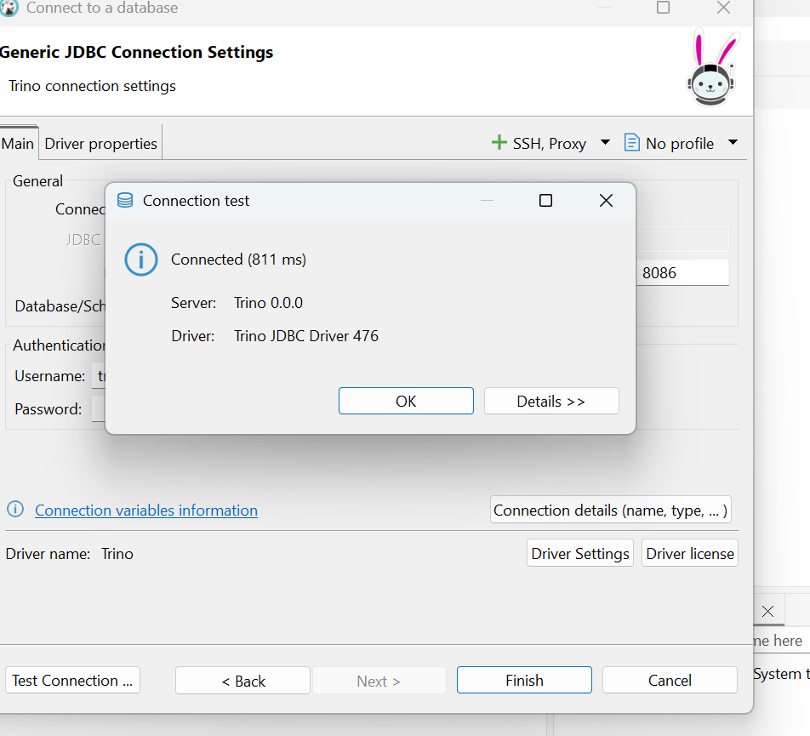

Slide 13
CREATE SCHEMA IF NOT EXISTS hive.sales
WITH (location = 's3a://sales/');

Slide 14
CREATE TABLE IF NOT EXISTS minio.sales.sales_tz (
productcategoryname VARCHAR,
productsubcategoryname VARCHAR,
productname VARCHAR,
country VARCHAR,
salesamount DOUBLE,
orderdate timestamp
)
WITH (
external_location = 's3a://sales/',
format = 'PARQUET'
);

Slide 15
select * from minio.sales.sales_tz limit 10;

