Slide 1


HOTEL DATABASE MANAGEMENT SYSTEM Prepared By – Vaibhavi More & Sweta Gupta

Slide 2
Table of contents
Introduction
ERR Diagram
Tables & Relationships
Normalization
Queries, Views, Triggers
Challenges
Questions
In a nutshell, this shows what we are going to cover today in our presentation of “Hotel Database Management System”.
It will be around 10 minutes presentation. We would be more than happy to answer your questions at the end of the presentation!

Slide 3


The main objective of this project is to create a database management system for a hotel.
We have build this project as a group.
The group members are:
Dhruv Bajaj
Piyush Mohan
Shubham Patil
Mohit Patidar
It was fun working together, overcoming each other’s flaws together and learning from each other's strengths in respective areas of Database Design & Management.

Slide 4
A Hotel consists of a wide areas to manage. We tried to include the main areas for a hotel management system in this project.
ROOMS
BOOKINGS
HOTEL
EMPLOYEES
GUESTS

Slide 5

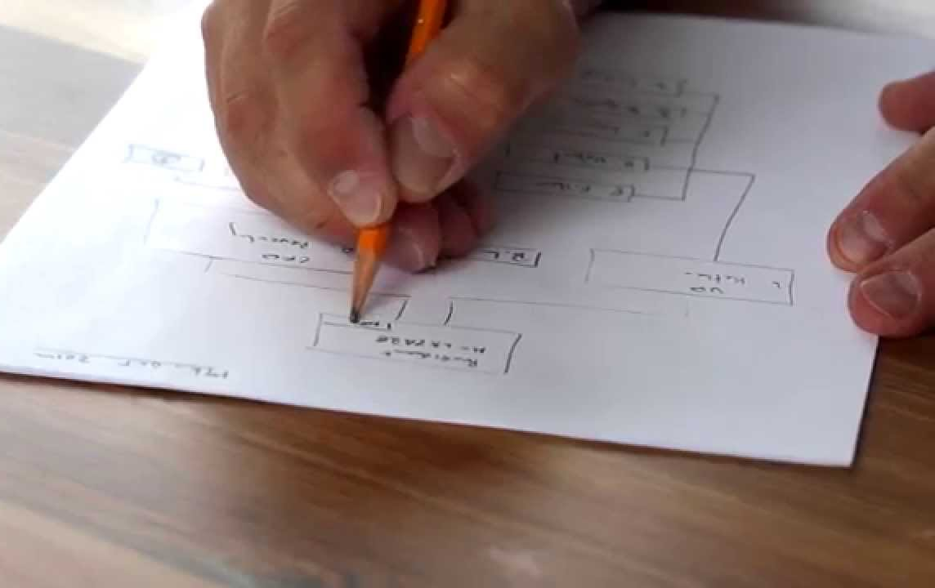
Step:1
ERR-Diagram
We drew the ERR diagram on a paper, noting down all the tables required

Slide 6
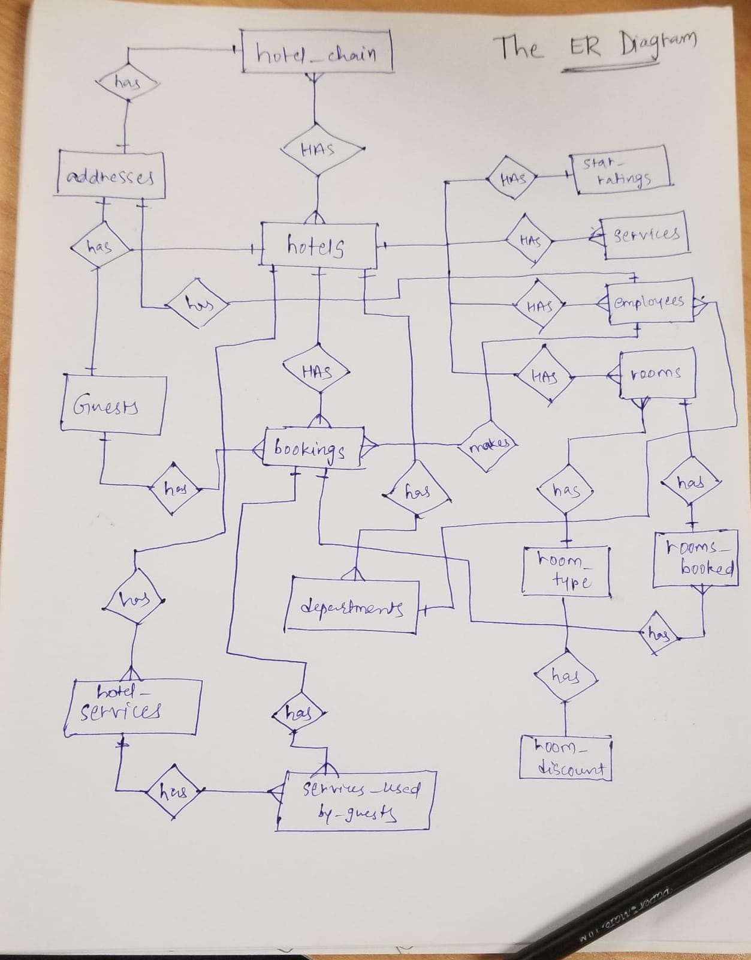

It looks messy, right? Yeah, we better look at the ERR diagram !

Slide 7
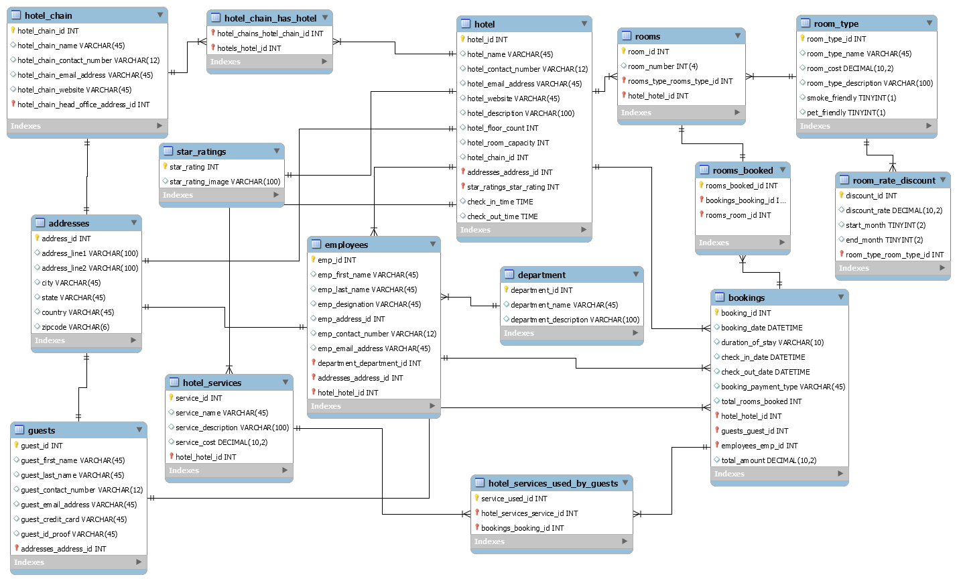

Slide 8
Let us begin exploring the TABLES

Slide 17
There were indeed a lot of tables to design and a lot of relationships to manage..
Relationships..
A tricky business, eh?

Slide 18
Normalization Process We achieved the first normal form by keeping the data scalar. Coming to the second normal form, we tried to make the relationships depend on the primary key. On the third normal for, we made sure that all the dependencies are only on the primary key of the tables.
Third Normal Form
Second Normal Form
First Normal Form

Slide 19
QUERIES
To execute the required tasks and fetch the data from one or more tables.
And the came our favourite part.. Writing queires was fun ☺ We also made two views and two triggers.
VIEWS
To view the details of employees along with their departments and also the details of the guests.
TRIGGERS
To create a Booking Audit table and store information about insert and delete bookings records.

Slide 20
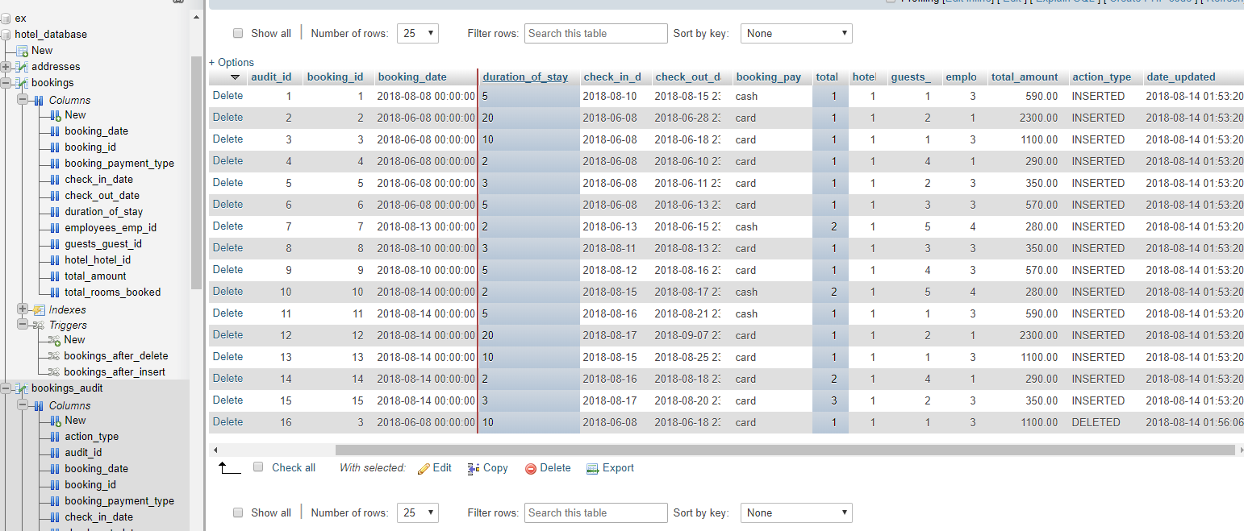

Slide 21
Challenges Faced
We faced most of the challenges in creating relationships among tables.
We need to make sure that all the relationships created among tables are logical and follow the normalization rules.
The most challenging part was creating the booking and the rooms table and its relationships with other respective tables.

Slide 22
A successful DBA
makes the data
easy to access
and
hard to lose!

Slide 23

That’s it! Thank you very much for your time!
If you have any questions regarding the presentation, please feel free to ask us!
We will be more than happy to answer you ☺

