Slide 1
Introduction to CT

Slide 2
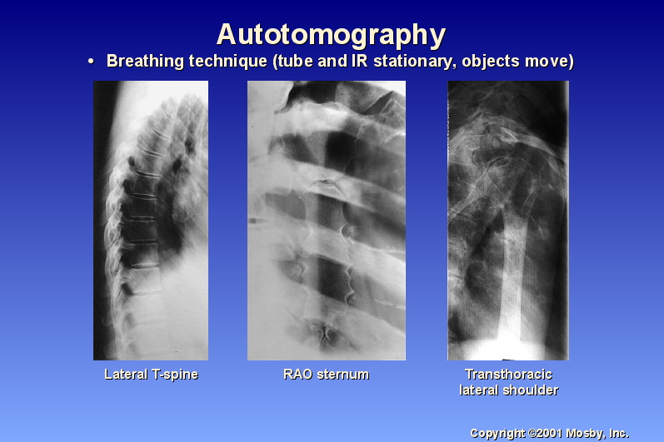
Solutions

Slide 3
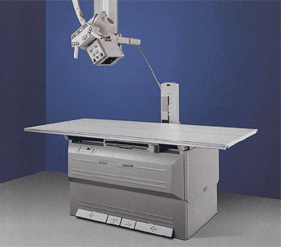
Conventional Tomography
Tomography is imaging by sections or sectioning.
A device used in tomography is called a tomograph, while the image produced is a tomogram

Slide 4
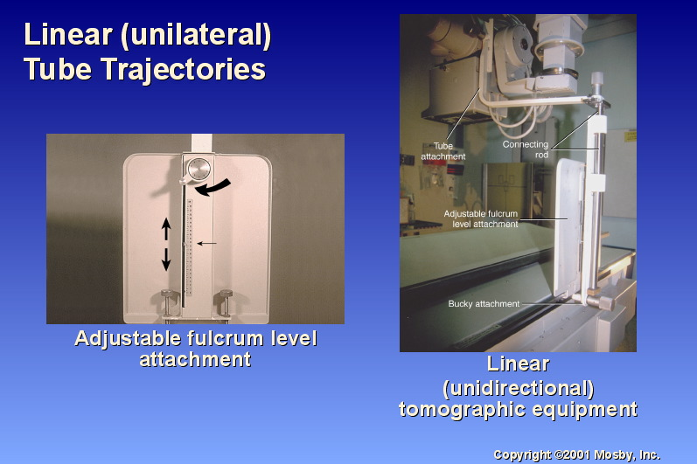

Slide 5
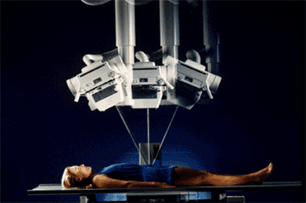
Linear movement

Slide 6
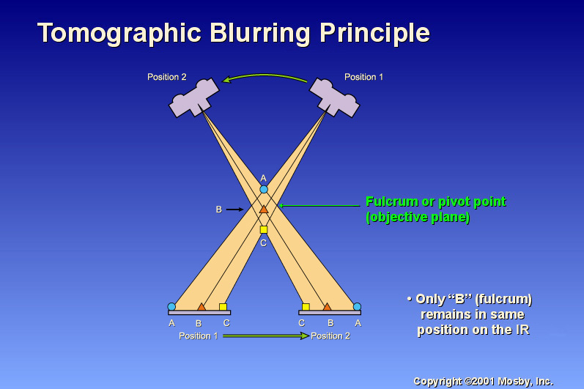
How is blurring achieved?

Slide 7
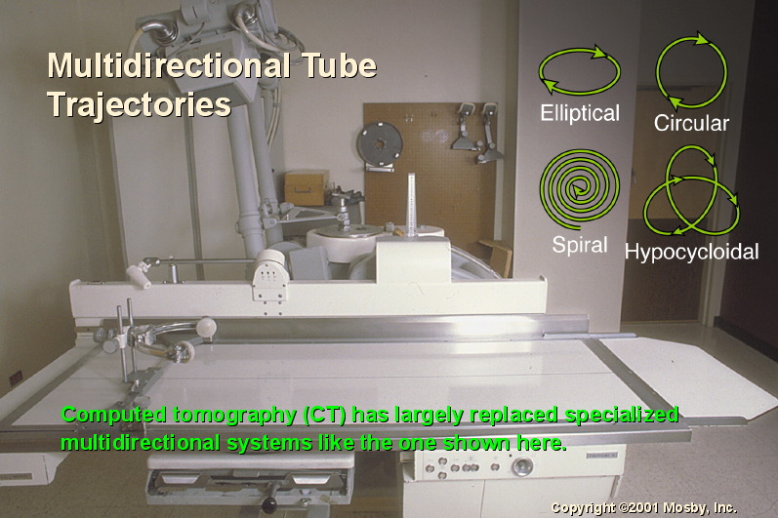

Slide 8
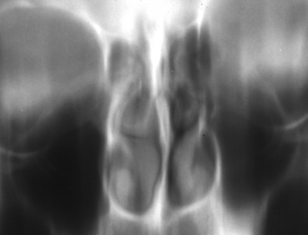
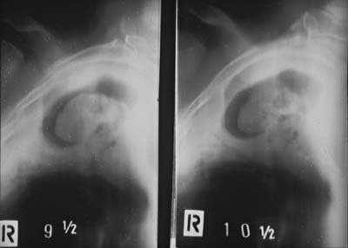
Conventional tomography images

Slide 9
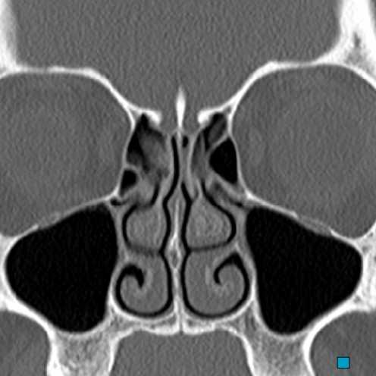
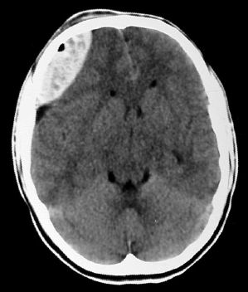
Computerized Tomography
Compare this image with that of the same area in previous slide

Slide 10
Definition of CT
Computerized Tomography is the process of scanning a patient to gather x-ray absorption coefficients taken from thin sections through the body, obtaining multiple measurements from these coefficients and reconstructing these measurements into an image that displays that section’s anatomy.
This can be broken down to five components:
Scanning a patient
Gather x-ray absorption coefficients taken from thin sections through the body
Obtaining multiple measurements from these coefficients
Reconstructing these measurements into an image
Display’s that section’s anatomy

Slide 11
This can be broken down to five components
Scanning a patient - Involves the movement of the tube and the detectors
Gather x-ray absorption coefficients taken from thin sections through the body – selection of slices (Tomo)
Obtaining multiple measurements from these coefficients - involves the computer and computing
Reconstructing these measurements into an image - - involves the computer and computing
Display’s that section’s anatomy – using computer

Slide 12
Evolution of the term: Computed Tomography
Computerized transverse axial tomography (CTAT)
Computer assisted tomography (CAT)
Computerized axial tomography (CAT)
Computerized reconstruction (CR)
Reconstructive tomography (RT)
Computerized Tomography (CT)
Computed tomography (CT) – commonly used now?

Slide 13
Pioneers
Original research that formed the groundwork for CT was not for diagnostic imaging, but in the domain of measurements and reconstruction.
Advent of computer facilitated this experimentation and quickly lead to techniques that could be applied to medicine
There are five instrumental pioneers in the field.

Slide 14
1917 – Johann radon
Austrian professor in mathematics at the University of Vienna, working with gravitational theory.
He proved that three dimensional object could be produced from a large number of projections or views of that object.
The mathematical process was long and tedious.

Slide 15
1956 – Ronald Bracewell
Australian researching astronomy and a professor of electrical engineering at Stanford University.
Used Radon’s technique to reconstruct a solar microwave emission map by measuring the total radiation from a ribbon-like strip and then repeating the process in many different directions.

Slide 16
1963- William Oldendorf
American neurologist at University of California
First researcher to apply these construction techniques to the medical field.
Used a collimated source of gamma rays to scan a three dimensional object and reconstruct an image from that scan
The object was a small concentric ring of nails and one scan took one hour

Slide 17
1963- Allen Cormack
South African nuclear physicist at Tufts University in Massachutts.
Built laboratory models of CT scanners
Lack of funds prevented the development of a production unit
His articles were published in the Journal of Applied Physics.
These expedited the research work of the next pioneer

Slide 18
1967 – Godfry Hounsfield
British research engineer with Central Research Laboratories at EMI (Electric and Musical Industries) in London.
Worked on digital pattern reconstruction techniques.
Conceived the idea of producing images of the humen body from a set of transmission measurements taken in a slice of an object.
Initial plans were for whole body examinations, but
Uk Dept. of Health indicated the greatest potential of scanning the brain.
The first scanner used a gamma source with exposure times up to 9 days and reconstruction times of 2.5 hours per slice.

Slide 19
The first tissues used in these experiments was a bullock’s brain
Working with Dr. J.Ambrose, a consultant radiologist at Wimbledon’s Atkinson Morley’s Hospital, the first clinical scanner was installed there in September 1971
For his contribution to the science of diagnostic imaging, Hounsfield received
the MacRobert award from the Royal Academy of Engineering in 1972,
the Ziedses des Plantes Tomography Medal from Germany in 1974,
The Nobel Prize for medicine, together with Cormack in 1979
Died in August 2004

Slide 20
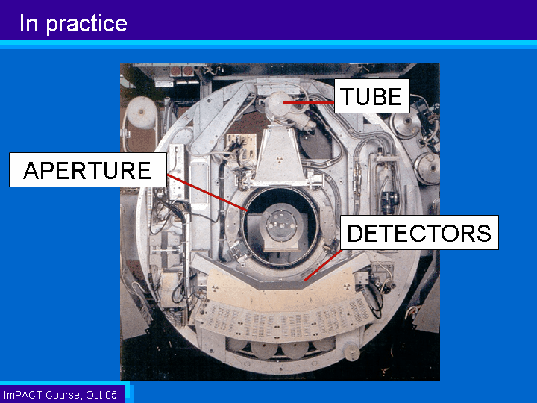
CT Gantry

Slide 21
Basic Processes
The basic processes of CT consists of for steps
Data acquisition
Image reconstruction
Image display
Image archive (recording)

Slide 22
Data acquisition
This is done with:
the patient properly placed in the scanner
the selection of correct protocols and technical factors
At the initialization of the scan x-rays passing through the patient are attenuated depending on the tissue type.
A detector system located opposite the x-ray tube measures the attenuation values as an analogue signal
This signal is transmitted to the Analogue to digital converter (ADC)
The ADC converts the signal of attenuated values from analog to digital, preparing it for processing by the computer.

Slide 23
Image reconstruction
The minicomputer reads this digital data and employs a mathematical formula, called a reconstruction algorithm, to generate the cross-sectional image.
The image reconstruction, involving millions of data points, is usually performed in less than a second by a group of array processors.

Slide 24
Image display
The reconstructed image, still in its digital form, is displayed on a LCD monitor as an image suitable for manipulation by the operator

Slide 25
Image archive
This includes
Image manipulation
Archiving on a Picture Archiving and Communication System (PACS)
Storage
A wide range of software is available to enhance the image on the monitor before storage. These include:
Altering the density and brightness
Changing the plane of the image from axial to sagittal or coronal
Producing three dimensional images
Demonstrating detailed angiography
The Image can be stored on the computer’s hard drive or an external medium such as a versatile optical disk or as a hard copy on a photosensitive film

Slide 26
Highlights of Development Trends
1971
Installation of first clinical scanner at Atkinson-Morley’s hospital by Hounsfield and Ambrose
Consisted of an x-ray tube and two detectors
Initially the scan time was about 5 minutes per slice
Digital data was recorded on a magnetic tape and was sent to a factory for overnight reconstruction
Upon return to the hospital the images were printed as an array of numbers

Slide 27
1972
The first publication of a grey scale image by Hounsfield and Ambrose
The image was of a brain of a living patient
Showed a cystic lesion in the frontal lobe
This was followed by a popular exhibit at the 1972 RSNA (Radiological Society of North America) annual meeting in Chicago

Slide 28
1973
The original scanner was updated with its own microprocessor
It reduced the data acquisition time and the reconstruction time to 4.5 minutes each.
The smallest detail that could e visualized was about 3mm
1974
Fist whole body scanner installed at Georgetown University Washington
Introduction of the 2nd generation scanners using 3 detectors.

Slide 29
1975
Use of Scanners with more detectors up to 30, and with reduced scan times up to 20 seconds.
1976
A ring of detectors is employed resulting scan times down to 5 seconds.
1979
EMI left the field of CT, while other companies enter into market producing scanners with more detectors from 280 t0 2400 reducing scan times to 2 seconds and with resolution of 0.4mm.

Slide 30
1983
Goitein and Abrams described multidimensional treatment planning based on CT images using a Beams eye view created from a divergent projection through the CT study data
1987
Continuous rotation slip ring technology was introduced
After a brief hiatus, during which MRI stole the limelight, CT came back with vengeance.
Time was cut down to one second scanning.
The use of CT data for treatment planning increased and began top influence the total radiation oncology treatment planning effort.

Slide 31
1988
Multiplanar and three-dimensional reconstruction software was developed, proving beneficial to not only radiologists but also orthopaedic and plastic surgeons.
1990
Helical scanning permitted acquisition of data by volume, thereby improving the ability to scan without misregistration and to produce superb quality 3D images.
The work station, a boon to the area of post-processing, was made available.
Software functions create a virtual simulator for radiation therapy

Slide 32
1993
CT simulation was pioneered and made available for use by major CT manufacturer.
1995
Helical scanning, with its tremendous amount of heat build-up during a 30-second scan, led to the development of the 6.0 unit tube.
1996
Demonstrated the wide use of CT utilizing successfully in other areas including geology, anthropology, archeology, Egyptology, art restoration, and oil exploration.

Slide 33
1997
Reconstruction times are reduced to microseconds, enabling a display of 6 images per second.
This resulted in the clinical introduction of CT fluoroscopy and real time helical scanning.
1998
Scan times dropped to 0.7seconds per rotation and workstations became standard equipment.
1999
The multi-slice helical scanner, introduced briefly in the early 90’s, became widespread and revolutionized patient throughput time and image manipulation with 0.5 –second scanning and real-time reconstruction

Slide 34
2000
Invented by Dr. Ron Nutt and Dr. David Townsend, the PET/CT scanner was named the Invention of the year by Time Magazine.
2004
The 64 slice multi-slice scanner is introduced and becomes the standard with full body coverage at high resolution, providing superb vascular imaging, both cardiac and peripheral.
2007
Toshiba launches their 320 slice scanner which allows the imaging of 16 cm length in a single 0.35sec rotation, thereby enabling ‘dynamic volume scanning’ or functional imaging.

