Slide 1
NumPy
Lecture 8.1

Slide 2

Packages and modules
A module is a piece of software that has a specific functionality
Packages are ways of structuring multiple modules/ other packages into a well organized hierarchy

Slide 3
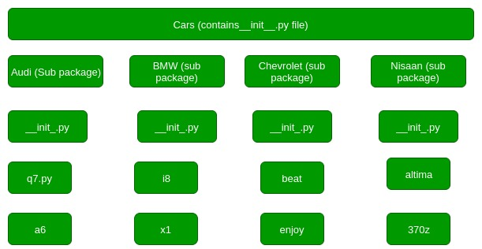
Packages and modules
Numpy
polynomial
random
fft

Slide 4
Numpy – A fundamental package for scientific computing
a powerful N-dimensional array object
sophisticated (broadcasting) functions
tools for integrating C/C++ and Fortran code
useful linear algebra, Fourier transform, and random number capabilities

Slide 5
CLASS numpy.ndarray
Attributes (Memory layout)
Shape – tuple of integers which gives the shape of the array
Ndims – number of array dimensions
Itemsize – length of one array element in bytes

Slide 6
CLASS numpy.ndarray
Other attributes (Not exhaustive)
T – the transposed array
Real – the real part of the array
Imag – the imaginary part of the array
Flat – 1-D iterator over the array

Slide 7
Some useful FUnctions
Zeros – ndarray of zeros with dimensions determined by the tuple given as parameter
Ones - ndarray of ones with dimensions determined by the tuple given as parameter
Full – creates a constant array (some constant instead of 1)
Eye – 2 – dimensional identity matrix
Random.random – array filled with random values (refer to documentation for more information of properties of random values)

Slide 8
Array indexing
Supports all list operations like slicing, etc
Copy by reference
1D numpy arrays – quite messy to use, and lead to confusing errors (Refer to Andrew Ng’s video) – better to stay away from them

Slide 9
datatypes
Numpy arrays can have various datatypes
Float
Int
String
Bool
void

Slide 10
Mathematical operations
Most operations are performed elementwise
Multiplication
Elementwise
Matrix
dot

Slide 11
broadcasting
powerful mechanism that allows numpy to work with arrays of different shapes when performing arithmetic operations.
Gives a multifold speedup to computation
drastically reduces the amount of code required
Can make debugging difficult at times

Slide 12
TENsors
Tensor – rank 0 – scalar
Tensor – rank 1 – vector
Tensor – rank 2 – matrix

