Slide 1
PROJECT PRESENTATION
AKSHAYA SAHAYI
MASTER OF COMPUTER APPLICATION
KANNUR UNIVERSITY
2016-2019

Slide 2
AKSHAYA SAHAYI
Athma Joseph

Slide 3
INTRODUCTION
Akshaya sahayi is a web application for akshaya centers in kerala.
One of the main problem in akshaya center is management of large customers.
Most of the common peoples are not known that what type of services are
getting from akshaya centers.
Akashaya sahayi is helpful not only in akshaya centers it also helpful for
common people.

Slide 4
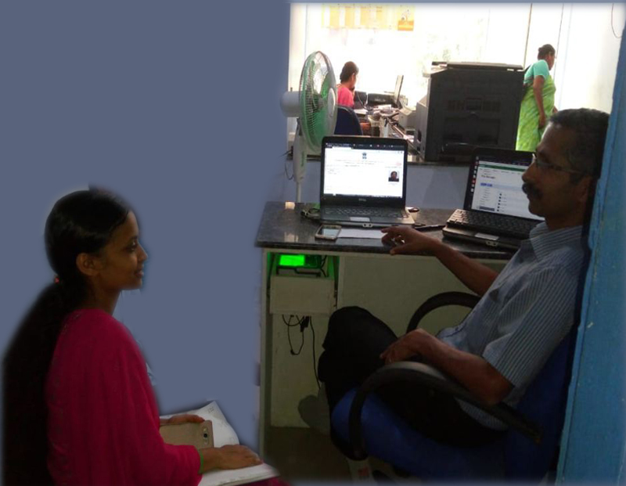
SYSTEM ANALYSIS
Several methods were available for collecting the requirements.
I choose the methods ‘Interview’ and Site visit .
Interview with Mr.Shaji(VLE @Angadikadavu akshaya center)

Slide 5
EXISTING SYSTEM
The existing system is manual.
Customers have to wait a long time in queues for getting services from akshaya.
VLE and staff facing difficulty to manage customers.
VLE facing difficulty to manage staff.

Slide 6
DRAWBACKS OF EXISTING SYSTEM
Customers has to wait a long time in queues for getting services from akshaya.
Customers unaware of the services provided by various akshaya centers.
Customers did not know what type of documents are needed for particular
services.
No record for keep staff details.
Take the attendance of the staff through manually.
Customers can't communicate with association directly.

Slide 7
PROPOSED SYSTEM
The proposed system follows the computerization of the existing system. The proposed system computerizes the token generation and the customers get services from akshaya. It uses Database Management System to store staff and customer records and details.

Slide 8
ADVANTAGES OF PROPOSED SYSTEM
Staff can generate a token for customers.
Staff can store customer details and also generate bill, based on their service.
Customers have feedback facility.
Customers can directly mail to association and also customers can ask their
doubts through the enquiry
Customers, Staff and VLE can participate live chat and they can pass
or share information.
VLE can add new staff and manage their personal information
VLE can record the attendance of customers. Staff can apply for leave.

Slide 9
FEASIBILITY STUDY
FEASIBILITY STUDY is a test of system proposal according to its workability, impact of the organization, ability to meet needs and effective use of the resources.
Economical feasibility
Technical feasibility
Behavioral feasibility
Legal feasibility

Slide 10
IDENTIFICATION OF ACTORS
1 | Who will use the main functionality of the system? | Admin, VLE,Staff and Customers
2 | Who will lead support from the system and do their daily tasks? | VLE
3 | Who will maintain and administrate the system? | Admin
4 | Which hardware devices does the system need to handle? | Desktop computer, printer
5 | With which other systems, does this system need to interact? | Database
6 | Who was interested in the result produced by the system? | Admin, VLE, Staff and Customers

Slide 11
The answers to these questions bring out the actors of the system:
Administrator
VLE
Staff
Customers

Slide 12
USE CASE DIAGRAM FOR ASSOCIATION
APPROVE/ REJECT VLE
REMOVE VLE
REPLY TO ENQUIRY
CHANGE PASSWORD
VIEW VLE LIST
ADMIN

Slide 13
USE CASE DIAGRAM FOR VLE
ADD EMPLOYEE
UPDATE EMPLOYEE
DELETE DETAILS
MARK ATTENDANCE
VIEW ATTENDANCE
APPROVE/REJECT
VLE
VIEW FEEDBACK
SEND MESSAGE
VLE
VIEW CUSTOMER DETAILS
UPDATE PROFILE
CHANGE PASSWORD

Slide 14
USE CASE DIAGRAM FOR STAFF
CUSTOMER REGISTRATION
BILL PRINT
APPLY LEAVE
STAFF
GIVE SERVICE

Slide 15
USE CASE DIAGRAM FOR CUSTOMER
SUBMIT QUERIES
SEND MAIL
LIVE CHAT
SEND MESSAGE
CUSTOMER
VIEW AKSHAYA CENTERS

Slide 16
ACTIVITY DIAGRAM
Activity diagram is an important diagram in UML to describe dynamic aspects of the system.
Activity diagram is basically a flow chart to represent flow from one activity to another activity.
The activity can be described as an operation of the system

Slide 17
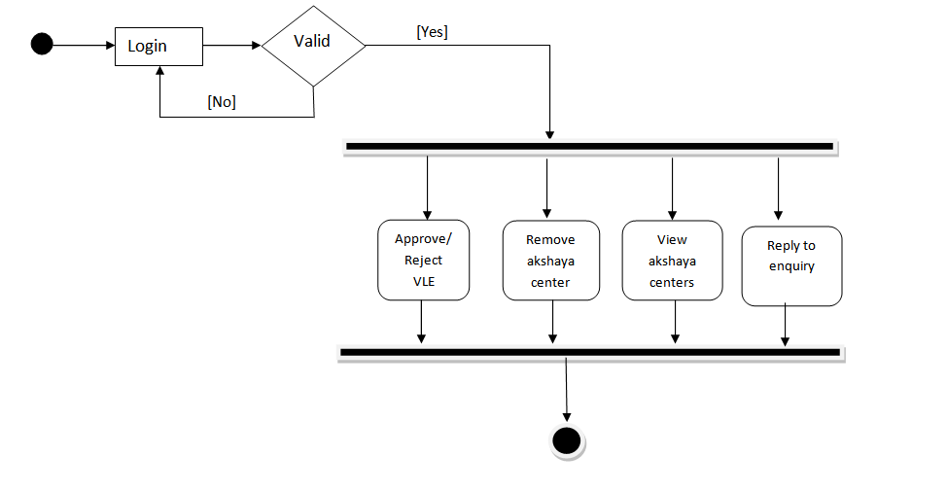
Activity diagram for Association

Slide 18
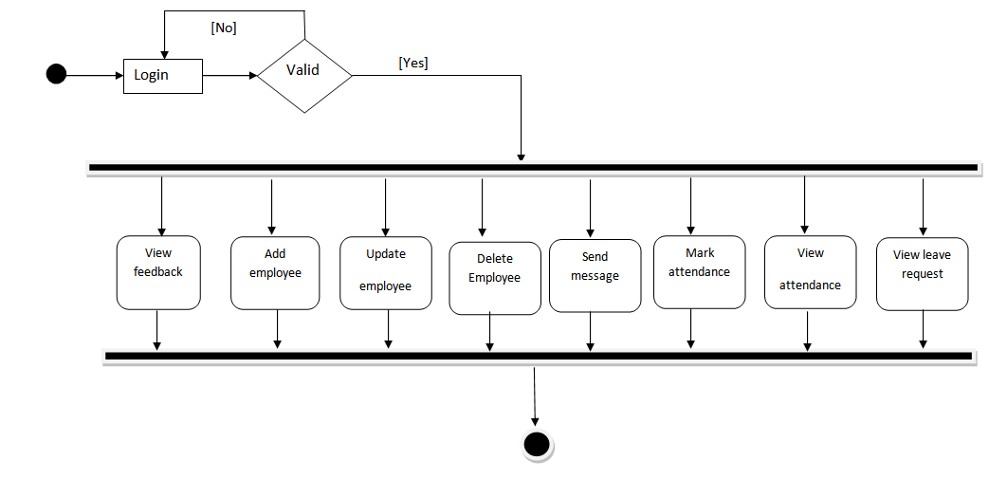
Activity diagram for VLE

Slide 19
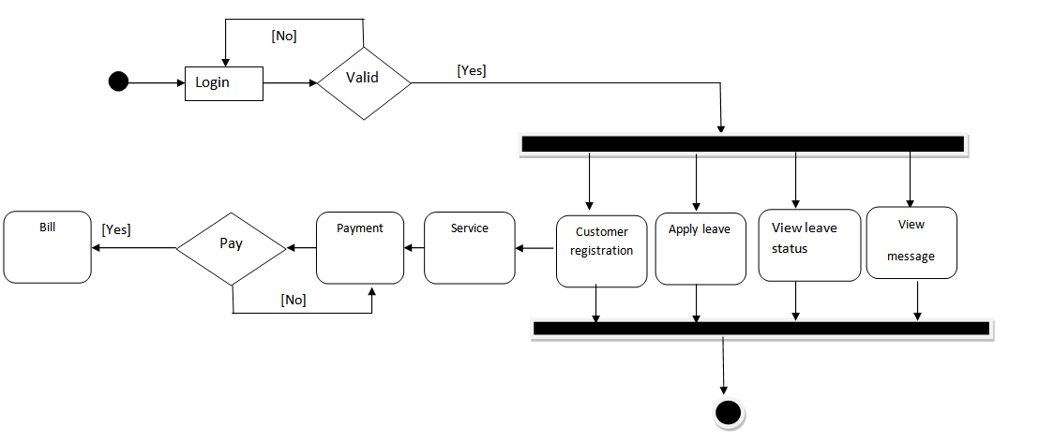
Activity diagram for STAFF

Slide 20
Activity diagram for CUSTOMER
Submit quires
Send Mail
Live Chat
View Akshaya centers
Send Message to VLE

Slide 21
TABLES
vle
Field | Data type | Key | Description
id | Int | Primary Key | Unique identification of vle
name | Varchar(20) |  | VLE name
centerlocation | Varchar(20) |  | Location
landmark | Varchar(20) |  | Landmark
panchayath | Varchar(20) |  | Panchayath
block | Varchar(20) |  | Block
district | Varchar(20) |  | District
email | Varchar(20) |  | Email
phone | Varchar(20) |  | Phone
mobile | Varchar(20) |  | Mobile
password | Varchar(20) |  | Password
photo | Varchar(20) |  | Photo of VLE
status | Varchar(20) |  | Approved/Reject

Slide 22
enquiry_tb
Field | Data type | key | Description
Id | Int | Primary Key | Unique identification
Name | Varchar(20) |  | Name of user
Email | Varchar(20) |  | Email of user
Subject | Varchar(20) |  | subject
Question | Varchar(20) |  | Question
Reply | Varchar(20) |  | Reply
Date | Date |  | Date

Slide 23
association
Field | Data type | key | Description
username | Varchar(20) | Primary key | Username
Password | Varchar(20) |  | Password

Slide 24
staff_reg
Field Name | Data Type | Key | Description
Id | Int | Primary | Unique identifier for staff
centercode | Varchar(220) | Foreign Key | Primary key of vle table
firstname | Varchar(50) |  | First name
lastname | Varchar(20) |  | Last name
phone | Long int |  | Phone
Place | Varchar(60) |  | Place
Email | Email |  | Email
gender | Varchar(30) |  | Gender
designation | Varchar(20) |  | Designation
Grade | Varchar(20) |  | Grade
Salary | Int |  | Salary
marital_status | Varchar(20) |  | Marital status
blood_group | Varchar(20) |  | Blood group
qulification | Varchar(20) |  | Qualification
experience | Varchar(20) |  | Experience
password | Varchar(20) |  | Password
Photo | Varchar(500) |  | Photo
d&t | Date |  | Date of joining

Slide 25
attendance
Field | Data type | key | Description
Id | Int | Primary Key | Unique identification of attendence
Date | Date |  | Date
centercode | Varchar(20) | Foreign Key | Primary key of vle table
empid | int | Foreign Key | Staff_reg
Status | Varchar(20) |  | Status (P,A,H)

Slide 26
customer_reg
Field | Data type | key | Description
Id | Int | Primary | Unique identification of customer
Date | Date |  | date
centercode | Varchar(20) | Foreign key | Primary key of vle table
Tockenid | Varchar(20) |  | Token id
Name | Longint |  | Name
Mobile | Varchar(20) |  | Mobile
Place | Varchar(20) |  | Place
Email | Varchar(20) |  | Email
housename | Varchar(20) |  | House name
Gender | Varchar(20) |  | Gender
Item | Varchar(20) |  | Item
Cash | Varchar(30) |  | Cash for the service

Slide 27
message
Field | Data type | key | Description
Id | Int | Primary key | Unique identification
Empid | Int | Foreign key | Primary key of staff_reg
Message | Varchar(20) |  | Message
Date | Date |  | Date

Slide 28
feedback
Field | Data type | key | Description
Id | Int | Primary key | Unique identification
vleid | Int | Foreign key | Primary key of vle table
name | Varchar(20) |  | Name
feedback | Varchar(20) |  | Feed back
d&t | Date |  | Date

Slide 29
tblleaves
Field | Data type | key | Description
Tid | Int | Primary key | Unique identification
LeaveType | Varchar(20) |  | Leave type
FromDate | Date |  | Leave starting date
ToDate | Date |  | Leave ending date
Description | Varchar(220) |  | Reason for leave
Postingdate | Date |  | Leave apply date
Status | Varchar(20) |  | Approve/Reject
Empid | Int | Foreign key | Primary key of staff_reg
centercode | Varchar(20) | Foreign key | Primary key of VLE

Slide 30
DATA FLOW DIAGRAM
A data flow diagram is a graphical technique that depicts data flow and transforms that are applied as data move from input to output.

Slide 31
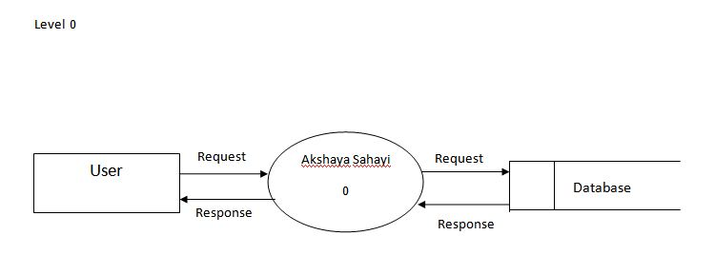

Slide 32
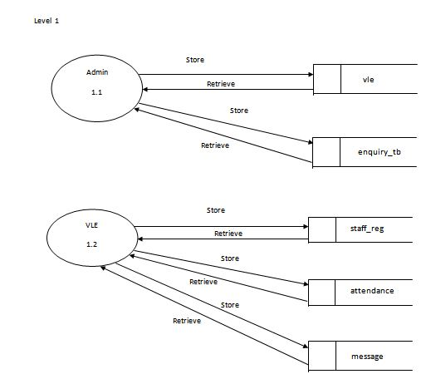

Slide 33
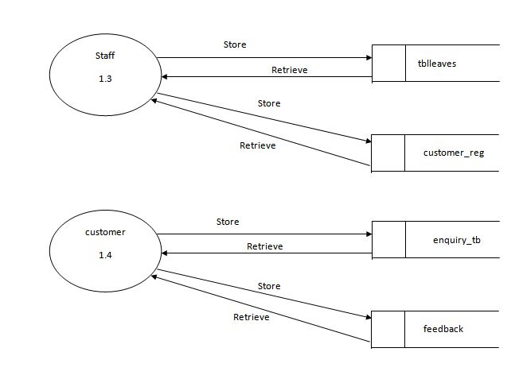

Slide 34
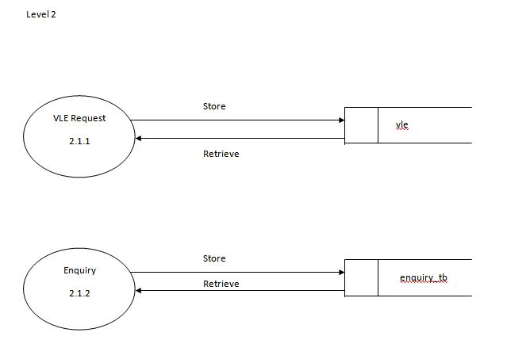

Slide 35
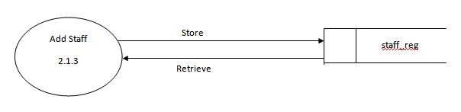

Slide 36
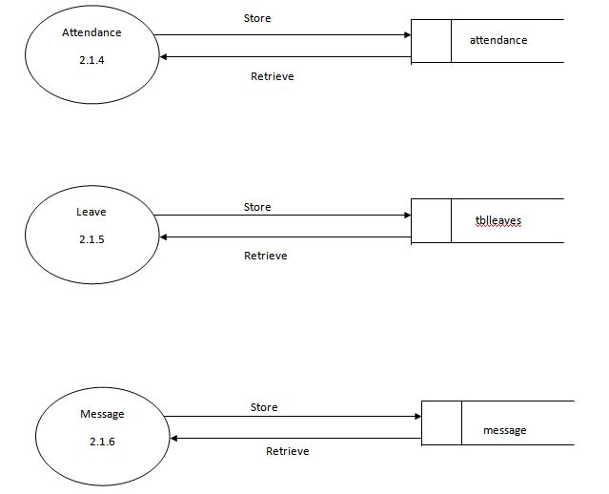

Slide 38
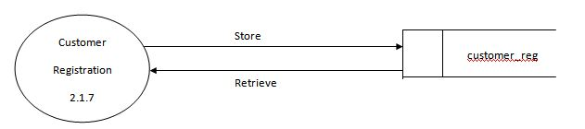
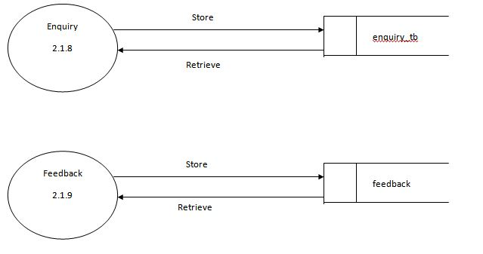

Slide 39
CONCLUSION
Akshaya Sahayi is a online application. The main objective of the system was brought into effect. This system can be used by wide range of common peoples in the society, employees, VLE and akshaya association. It helps customer to know the what type of services are given from the different akshaya centers and also avoid queue for getting service from akshaya center.

Slide 40
THANK YOU

