Slide 1
Sujit has an overall experience of more than 4+ years in android based Smart phone and Information Technology.
Certified HCI from IIT Bombay in CEP course.
In smart phones has worked on horizontal features like selection mechanism and keypad.
He has completed around 24 projects following in IT service industry.
He was involved in architecting high performance user interfaces across various domains for customers in the US and Europe.
Provided UI consulting services for Enterprise Application, Websites, Portals and Handheld.
He has hands-on experience in UI Engineering methods like Heuristic Evaluation, conducting user analysis, conducting UI Testing, Participative Task Analysis, telephonic interviews and has developed paper prototypes, low-fidelity prototypes and high-fidelity prototypes using tools.
Has excellent knowledge and business process understanding in various domains like Insurance, Healthcare, Banking & Financial Services, Manlog, Retail and Life Science

Slide 2
Royal Bank of Scotland – AXR app
Modifying the profile to view with a different parameter combination

Slide 3
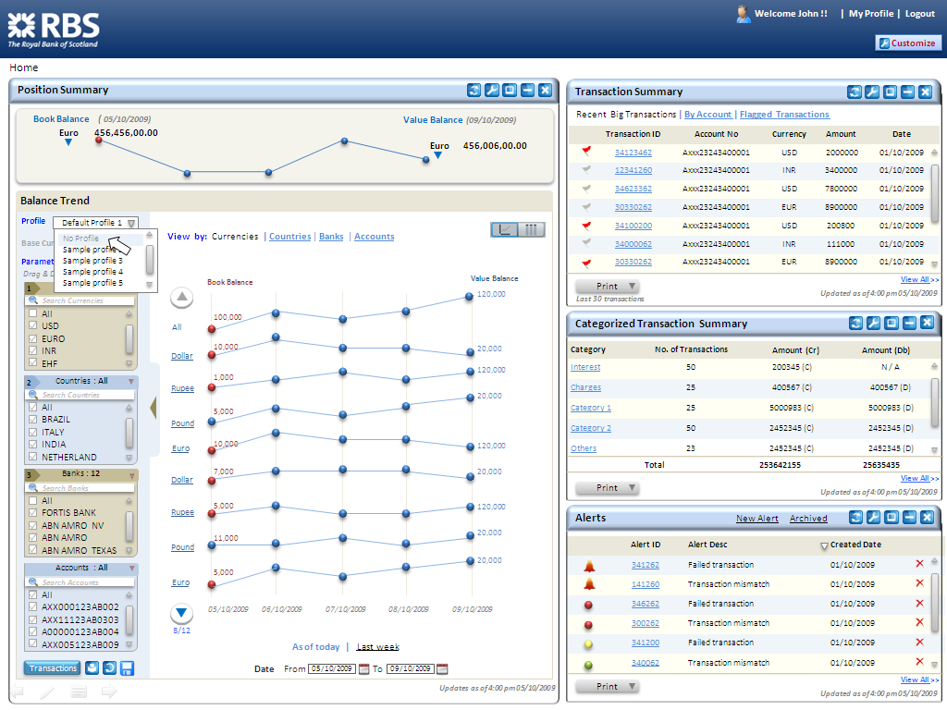

Slide 4
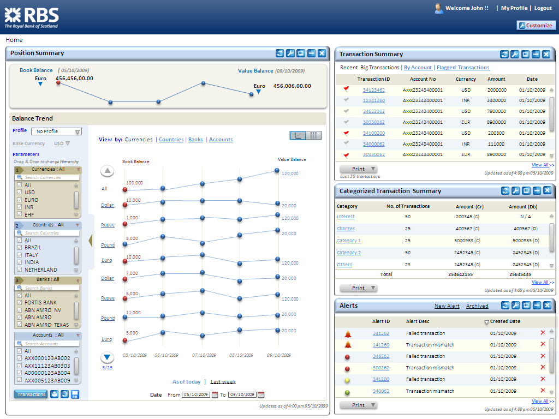

Slide 5


Slide 6
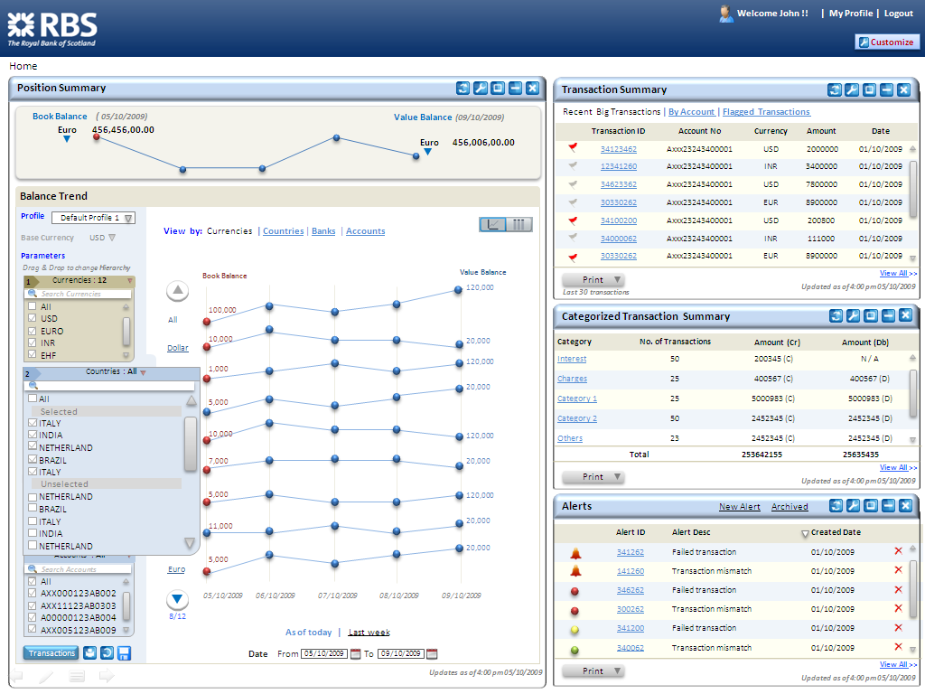

Slide 7


Slide 8
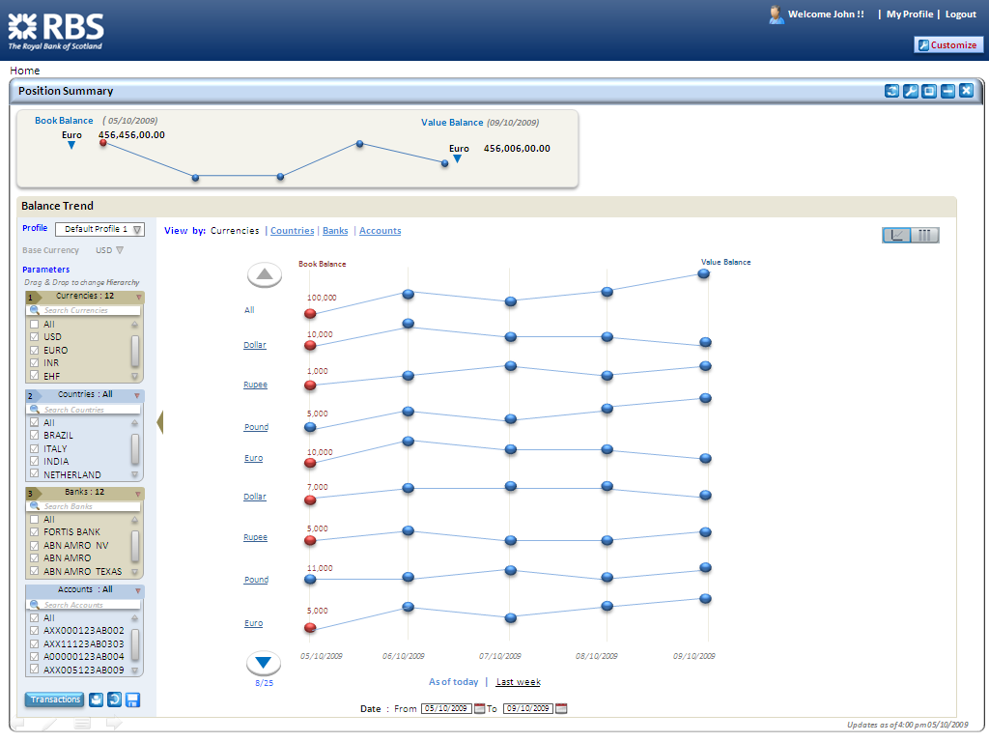

Slide 9
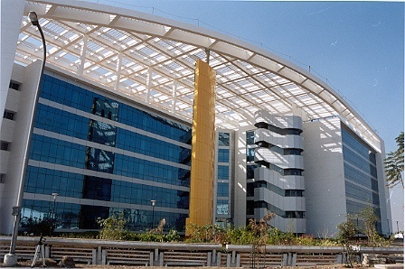
Wal-Mart HEP – Customer Pickup

Slide 10
Customer Pick Up – Screen Flow
Enter Login details
Select Site to store Pickup
Scan ASN
Enter Walmart.com order Number
Enter Customer Name
Enter Customer Phone Number
Enter Customer Alternate Pickup name
Search & Select Order
View Order Details
Pull the order & Update status
View the receipt
Get the customer Signature
Print Receipt

Slide 11
Customer Pick Up - Home
Home
Welcome to Site to Store !
Site to Store Pickup
Search Receipt
Set Printer

Slide 12
Customer Pick Up – Find Order
Find Order
Press Scan button or Enter ASN
|
or
Search by any one of the following:
Walmart.com Order Number
Customer’s Name
Customer’s Phone Number
Alternate Pickup Name
Back
OK

Slide 13
Customer Pick Up - Find Order
Find Order
Press Scan button or Enter ASN
0000511873114946
or
Search by any one of the following:
Walmart.com Order Number
Customer’s Name
Customer’s Phone Number
Alternate Pickup Name
Back
OK

Slide 14
Customer Pick Up – Customer Details
Customer Information
Order # 2677987654321
Name : J Smith
Alternate Pickup: D Smith
Ph : 479 899 2046
Customer :
Phone :
Address :
City :
State :
Zip :
Pay type :
4798992046
1407 Hullet Ave # 105 Rogers
AR
72758
***5445
John Smith
Alternate Pickup:
David Smith
Customer Verification !
Verify customer with any government issued ID
Item Info
Customer Details
Next

Slide 15
Customer Pick Up – Order Details
Purpose of screen
Filter Items by
Show All
A - Available
N - Not Available
P - Picked up
R - Refunded
Order Details
Order # 2677987654321
Name : J Smith
Alternate Pickup: D Smith
Ph : 479 899 2046
Item Information
Filter Items by
ALL
Status :
A - Available
PKG 3 Location : 007 12/10/09
ASN : 3435363543624
Item Description | Status
Candles UPC CS 001
PKG 4 Location : 007 12/10/09
ASN : 3435363543625
Soap UPC CS 045
P - Picked up
R - Expired
R - Missing from box
R - Lost in store
R - Damage in store
R - Customer remorse
A - Available
Actions On Screen
Status :
N - Not Available
N -Not Available
A - Available
P - Picked up
R - Expired
R - Missing from box
R - Lost in store
R - Damage in store
R - Customer remorse
Customer Details
Item Info
Back
Done
Messages:

Slide 16
Customer Pick Up – Order Details
Purpose of screen
Order Details
Order # 2677987654321
Name : J Smith
Alternate Pickup: D Smith
Ph : 479 899 2046
Item Information
Filter Items by
A - Available
PKG 3 Location : 007 12/10/09
ASN : 3435363543624
Item Description | Status
Candles UPC CS 001
Bulbs UPC CS002
Bat UPC CS012
A - Available
A - Available
Actions On Screen
A - Available
Customer Details
Item Info
Back
Done
Messages:

Slide 17
Customer Pick Up – Order Details
Order Details
Order # 2677987654321
Name : J Smith
Alternate Pickup: D Smith
Ph : 479 899 2046
Item Information
Filter Items by
A - Available
PKG 3 Location : 007 12/10/09
ASN : 3435363543624
Item Description | Status
Candles UPC CS 001
Bulbs UPC CS002
Candles UPC CS001
P – Picked up
A - Available
Do you want to mark all 3 items in this package to PICKED UP?
Not Available
No
Yes

Slide 18
Customer Pick Up – Order Details
Purpose of screen
Order Details
Order # 2677987654321
Name : J Smith
Alternate Pickup: D Smith
Ph : 479 899 2046
Item Information
Filter Items by
A - Available
PKG 3 Location : 007 12/10/09
ASN : 3435363543624
Item Description | Status
Candles UPC CS 001
Bulbs UPC CS002
Bat UPC CS012
P – Picked up
P – Picked up
Actions On Screen
P – Picked up
Customer Details
Item Info
Back
Done
Messages:
Previous Screens: Customer Information Screen
Next Screens: Order Details Screen, Receipt Screen

Slide 19
Walmart- HEP project
Kiosk platform Design

Slide 20


Site to store Pick Up
Price Verifier
Gift Registry
Express Credit
Walmart.com Department List
Walmart.com

Slide 21



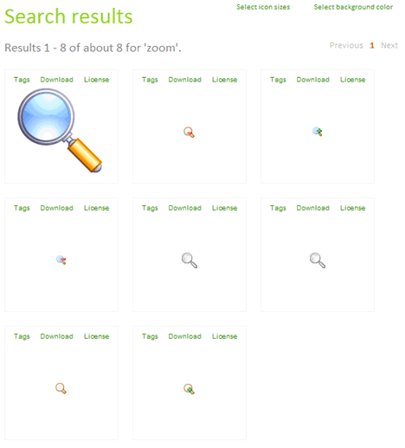



Find order
Scan email barcode
Order Number
Membership details
Customer Details
Exit
Request for associate Assistance

Slide 22

Back
Find Order
Select Items
Confirm
Find Order by
Order Number:
1234567890123
1
2
3
Retrieve Order Details
4
5
6
7
8
9
0
Clear
Exit
Request for associate Assistance

Slide 23
Back
Find Order
Select Items
Confirm
Order Details
1-2 of 6 (Package)
Name : John Doe
Order No :
Order Date :
2677445309870
17-Jun-2009
Select all
packages
PKG no
Item Description
Status
Total Package:
Picked up Package:
Available Package:
6
1
1
1
Fisher-Price Brilliant Basics
Available
Badger Basket Classic Wicker
Available
Barbie dolls
Available
Other Available orders
Order No: 2677445309869
Order Date:(16-June-2009)
Order No:2677445309868
Order Date:(14-June-2009)
4
Kawasaki Dual Screen Portable DVD Player
Available
Philips Noise the-Neck Headphones
Available
3
iLo 256MB digital-audio MP3 player
Picked
Moto Razor Mobile
Refunded
I would like to pick up selected items at
Delivery Counter
Drive Thru Counter
Exit
Request for associate Assistance

Slide 24

DFS Galleria UI Screens for Mobile

Slide 25
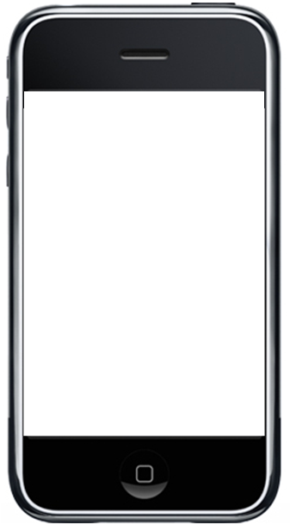

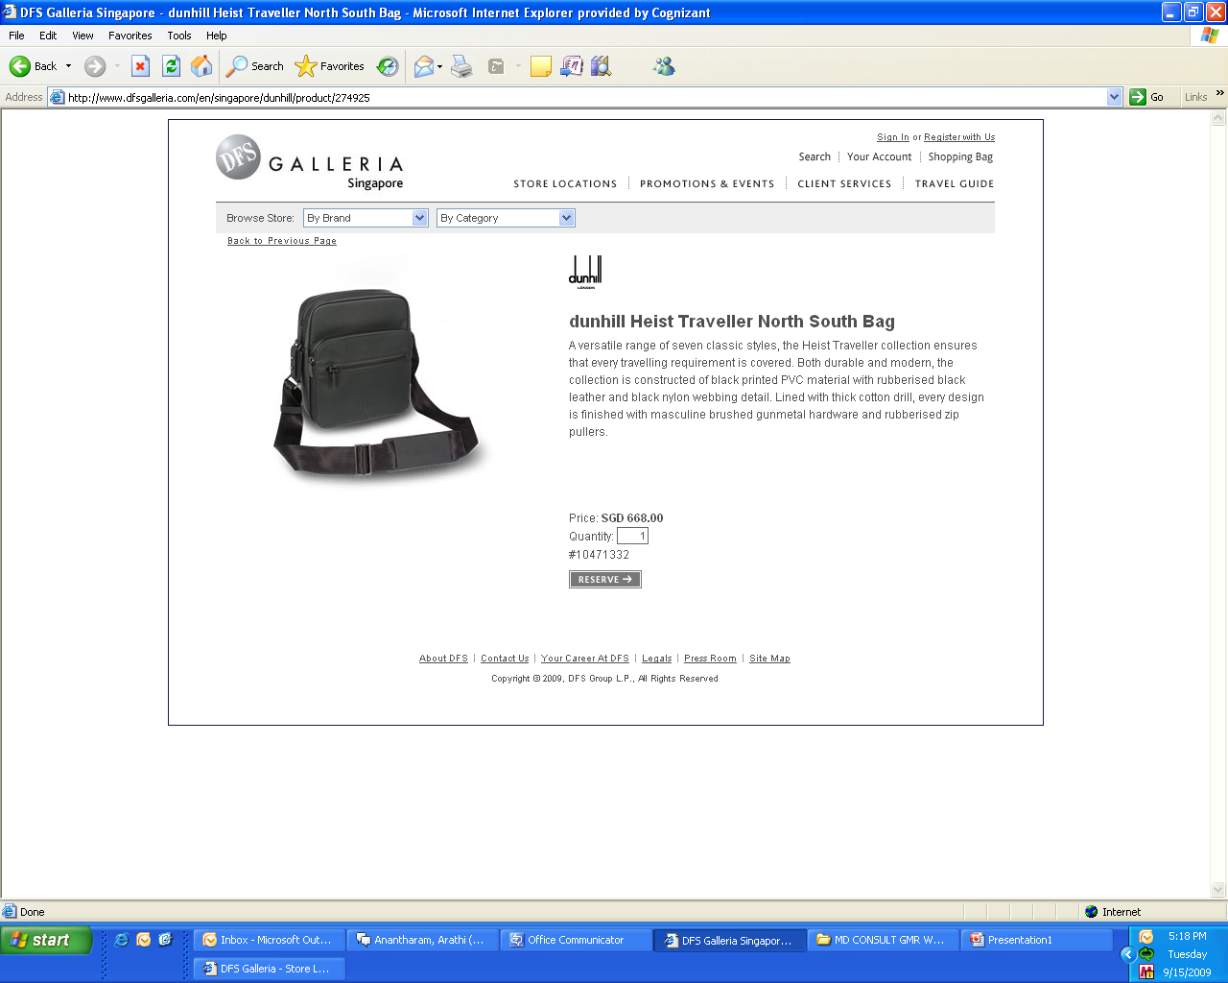
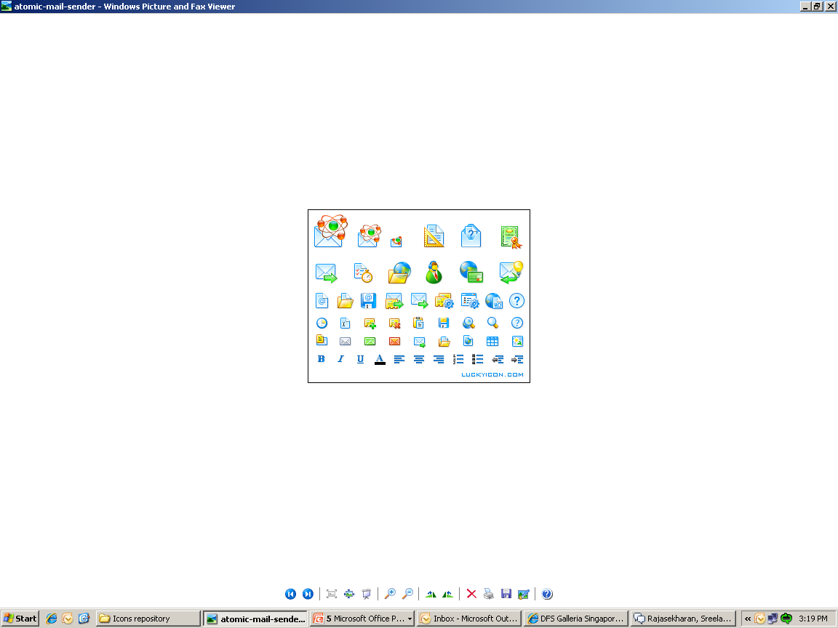















DESTINATION SELECTION
http://m.dfsgalleria.com
Search Galleria
Select Your destination
Abu Dhabi
Australia
Guam
Saipan
Hawaii
Hong Kong
Macao
New Zealand
North America
Okinawa
Bali
Singapore
Taiwan
Vietnam
User Action: User selects a destination “Singapore”

Slide 26

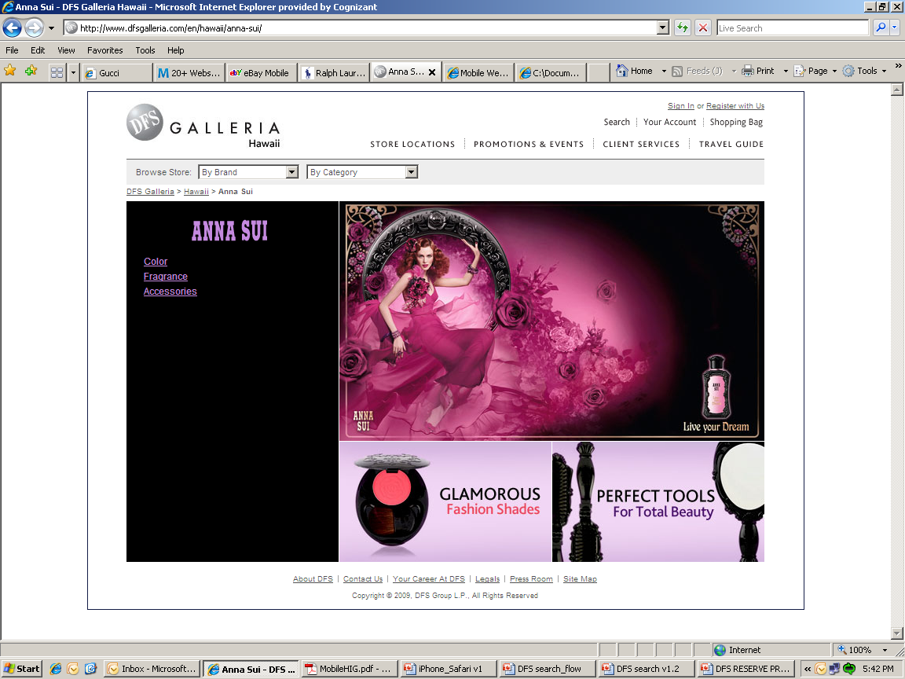
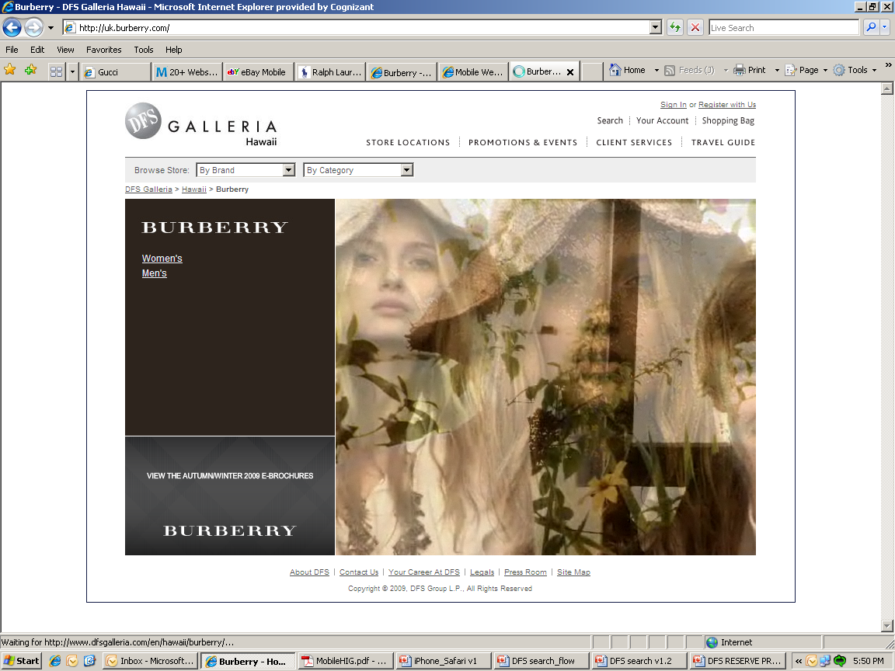
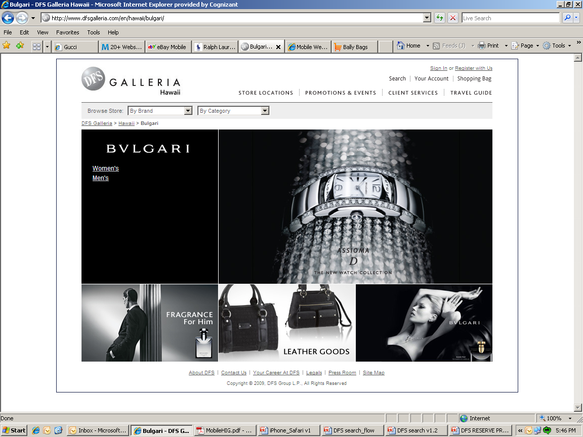
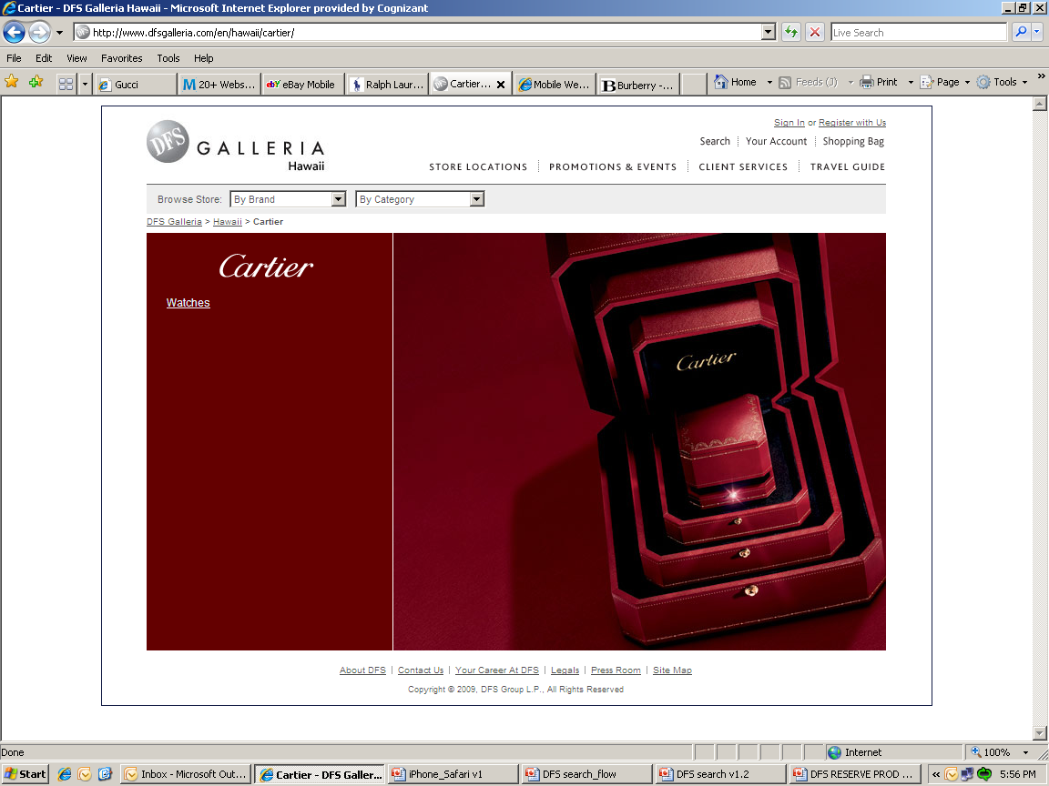
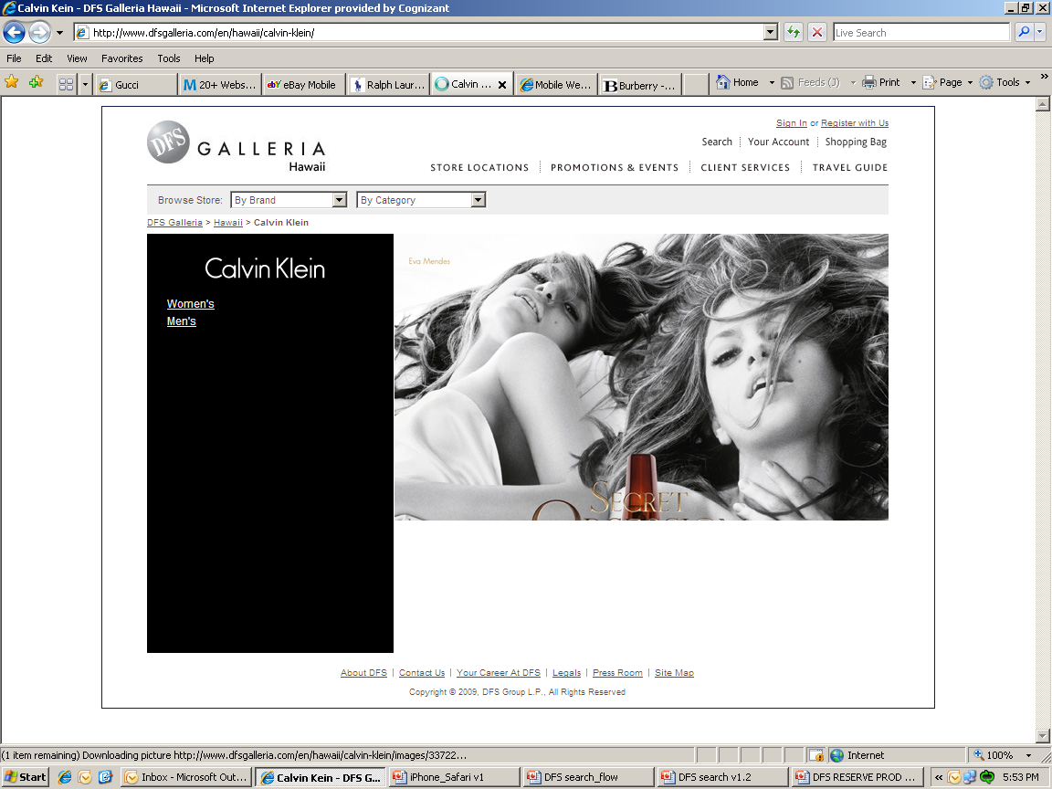

http://m.dfsgalleria.com
Search Galleria
Quick Links
Brand (43)
Category (10)
Glamorous Fashion Shades/Perfect Tools for total Beauty - Women
Unique collection of superior leather Bags – Men/Women
His – Fragrance, Leather Goods
Her’s- Fragrance , watches ,Jewelry…
State of the art watches for Men
His – Fragrance, Leather Goods
Her’s- Fragrance,watches,Bags
--No items in Cart--
(0)
User Action: User selects a brand “ BVLGARI”

Slide 27


http://m.dfsgalleria.com
Search Galleria
Quick Links
BVLGARI
Men (2)
Women (5)
Leather Goods
Key Case , Card Case , Wallet
Price Range : 1900 to 3200 SGD
Total No. of Items : 4
Fragrance
Price Range : 435 to 765 SGD
Total No. of Items : 9
~End Of List ~
--No items in Cart--
(0)
User Action: User selects a Category “ Leather Goods”

Slide 28
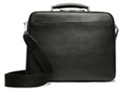

http://m.dfsgalleria.com
Search Galleria
Quick Links
Quick Links
Shopping preferences
BVLGARI
Men Leather Goods
Milano large Tote
Dimensions : 52*37*25
Price : SGD 9,990.0
Milano Computer Brief
Dimensions : 50*35*22
Price : SGD 7,960.0
Next >>
Lenny small overnighter
Dimensions : 70*36*25
Price : SGD 7,669.0
(Currently Not available)
--No items in Cart--
(0)
User Action: User selects “ Milano Large Tote”

Slide 29
http://m.dfsgalleria.com
Search Galleria
Quick Links
BVLGARI – Milano Large Tote
BVLGARI Men
List View | Gallery View
Leather Goods
Soft contemporary design
Contrasting leather trim
Refined stitching mixed with modern zipper, pocket and hardware instruments
Price : SGD 7,669.0
#12606065
Next >>
1/4
Quantity:
1
Bally Milano Large Tote
Dimensions : 70*36*25
Price : HKD – 7,669.0
Continue Shopping
Add to Cart
--No items in Cart--
(0)
User Action: User Clicks on “Add to Cart”

Slide 30
http://m.dfsgalleria.com
Search Galleria
Quick Links
Quick Links
BVLGARI
Men Leather Goods
Milano Large Tote
Dimensions : 52*37*25
Price : SGD 9,990.0
Milano Computer Brief
Dimensions : 50*35*22
Price : SGD 7,960.0
Next >>
Lenny small overnighter
Dimensions : 70*36*25
Price : SGD 7,669.0
(Currently Not available)
Added “BVLGARI Milano Large Tote”
SGD 7,669
(1)
--No items in Cart--
User Action: User clicks on the “Cart”

Slide 31

http://m.dfsgalleria.com
Quick Links
My shopping Cart
Product
Quantity
Amount
1
7,669.0
Reserve
Dimensions
70*36*25
Price : SGD 7,669.0
Milano Large Tote
Total
SGD : 7,669.0
Continue Shopping
Reserve
Added “BVLGARI Milano Large Tote”
SGD 7,669
(1)
User Action: User clicks on “Reserve” to reserve product(s)

Slide 32
http://m.dfsgalleria.com
Search Galleria
Pick Up Information
Pick up information
*Pick Up Details
I’ll personally pick it up
Will be picked by some one else
*Reservation will be picked up between:
and
Optional Information
Provide us with optional information so that we serve you better.
Arrival in Singapore
Airline
Flight No.
Date
SGD 7,669
(1)
User Action: User Scrolls down to view rest of the form

Slide 33
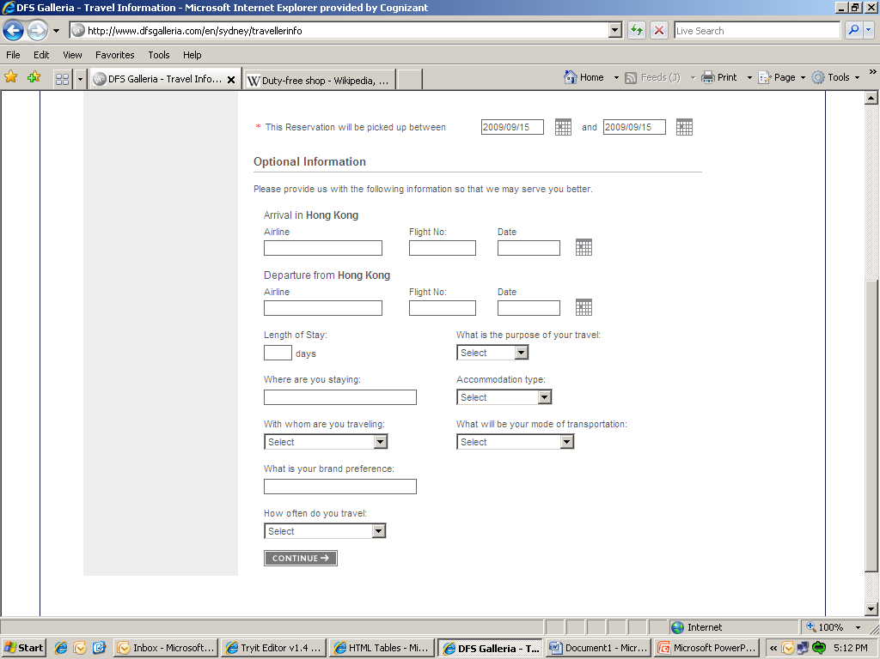
http://m.dfsgalleria.com
Search Galleria
Pick Up Information
Pick up information
Arrival in Singapore
Airline
Flight No.
Date
Departure from Singapore
Airline
Flight No.
Date
Length of Stay:
What is Your purpose of Travel:
days
Where are you staying :
Accommodation Type:
With whom are you travelling :
What will be your mode of transportation :
SGD 7,669
(1)
User Action: User Scrolls down to view rest of the form

Slide 34
http://m.dfsgalleria.com
Search Galleria
Pick Up Information
Pick up information
What will be your mode of transportation :
What is your brand preference :
How often do you travel:
Proceed
SGD 7,669
(1)
User Action: User clicks on “Proceed” button

Slide 35
RESERVATION CONFIRMATION
http://m.dfsgalleria.com
Search Galleria
Pick Up Information
Reservation Confirmation
Reservation Details :
Reservation Number : #1298
Name on Reservation: Mr. John
Pick Up Location :DFS galleria Scotts Road
25 Scotts Road
Singapore 228220
Change
Thank you for reserving these items at DFS galleria
Singapore.
We look forward to seeing you at DFS galleria between “27-09-09” and “27-10-09 “. Should there be any issues with Your reservation our reservation coordinator will Keep in touch with you. You’ll receive an e-mail confirmation shortly
Continue Shopping
SGD 7,669
(1)

