Slide 1
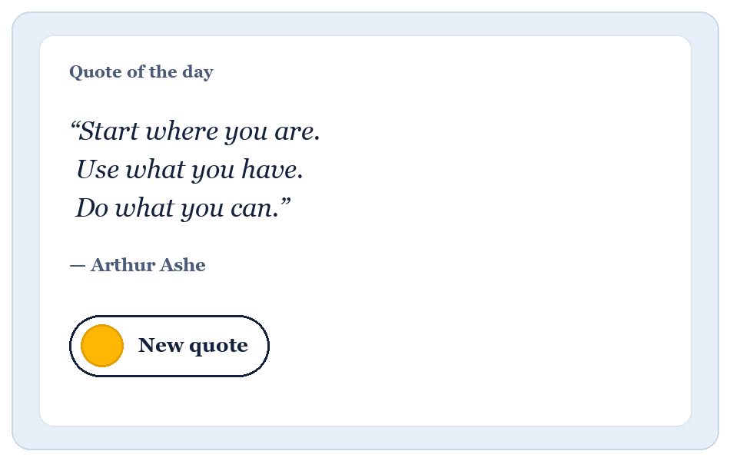
PROJECT PRESENTATION • OCTOBER 2026
Quote of the Day
Start each morning with clarity and intent — one simple click for timeless wisdom, perspective, and daily focus.
Python (Flask) • HTML5 & CSS3 • JavaScript • REST API
one click. A little more inspiration.
Presenter: Athul

Slide 2
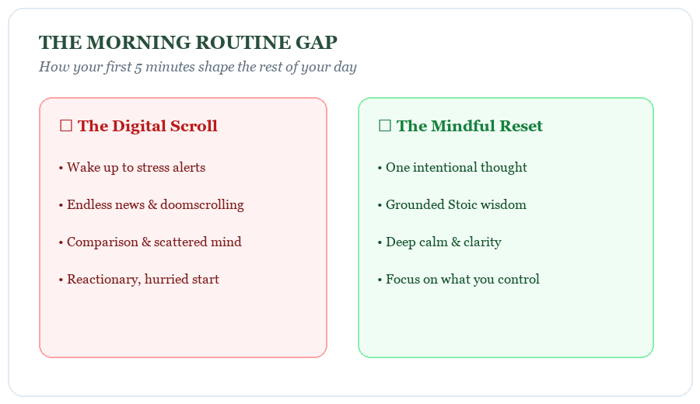
01 | THE PROBLEM
Digital noise drains daily motivation
• Mornings set the tone: How we start our first 10 minutes dictates stress levels, focus, and productivity for the day.
• Notification overload: People wake up straight to emails, social feeds, and sensory fatigue.
• Cluttered alternatives: Existing quote websites are packed with intrusive ads, paywalls, and anonymous quotes.
• The mindful reset: A clean, distraction-free space to ground your mindset in under 5 seconds.

Slide 3
02 | THE SOLUTION
Simple, intentional, and inspiring
🏛️ Timeless Wisdom
Curated collection of profound insights spanning stoicism, mindfulness, creativity, and perseverance.
No generic fluff — thoughts that give real emotional grounding.
✍️ Authentic Attribution
Every single quote credits the philosopher, athlete, author, or leader who said it.
Displays author name clearly beneath the quote with a gentle fade transition.
🔄 Anti-Repeat Engine
Built-in randomization algorithm prevents consecutive duplicate quotes.
Guarantees fresh inspiration every time you click the morning sun.

Slide 4
03 | TECHNICAL ARCHITECTURE
Lightweight Python engine, responsive frontend
Step 1: The Morning Sun
User clicks the sun button.
• Smooth CSS rotation on hover
• Keyboard spacebar shortcut
• Instant response without page reloads
Step 2: Flask REST API
Asynchronous GET /api/quote.
• Python randomly selects quote
• Avoids last_quote duplication
• Returns JSON {quote, author}
Step 3: Gentle Reveal
Client DOM updates seamlessly.
• Text updated via JavaScript
• CSS keyframe fade animation
• Author credit displayed below

Slide 5
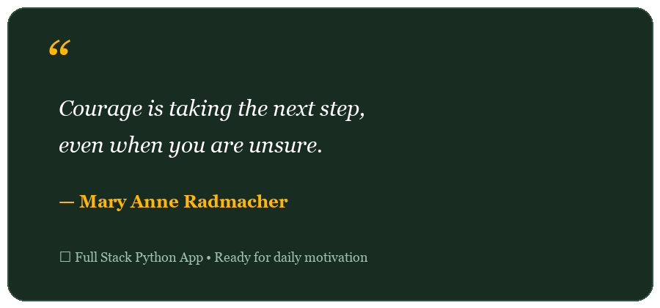
04 | IMPACT & CONCLUSION
Small steps every day add up to big changes
✔ Clean Full-Stack Flow: Seamless connection between a Python web service and a responsive UI.
✔ Credible Motivation: Adding the author makes each quote authentic and thought-provoking.
✔ Fast & Distraction-Free: Zero bloat, under 100ms response time, accessible on any device.
✔ Ready for Future: Easily expandable with categories, speech synthesis, and dark mode.

