Slide 1
FINAL PROJECT
V:N:M sparsity for
NEAT-evolved CNNs
Evolving CNNs with CoDeepNEAT, then compressing every convolution with VENOM’s V:N:M format and running it on Sparse Tensor Cores
CIFAR-10 · CIFAR-100 · ImageNet-100 · 3× RTX 6000 Ada
Notes:
The project in one line: take networks found by neuro-evolution and test whether VENOM’s V:N:M sparsity, so far shown on transformers, works on them.

Slide 2
THE QUESTION
Does V:N:M sparsity work on CNNs found by neuro-evolution? Yes, as compression
0.3 pt
5.4 MB
≤ 1.27×
median accuracy loss at 2:4 (3× smaller convs) across 15 trained CNNs
best evolved model at 2:8, down from 33.7 MB; 76.5% → 74.4% on CIFAR-100
whole-network speedup with Spatha at large batch; none at batch 1
V:N:M for NEAT-evolved CNNs · 2
Notes:
Lead with the answer. Compression works well: 2:4 is near-lossless, and 2:8 costs about 2 points for a 6× smaller model. Speed is the weak part: the full network is at most 1.27× faster.

Slide 3
BACKGROUND
Two ingredients: an architecture search and a sparse format
CoDeepNEAT
VENOM’s V:N:M format
Co-evolves modules (small layer graphs) and blueprints (graphs of modules)
Each candidate scored by validation accuracy after 3–10 epochs
Finds irregular nets: odd widths, big kernels, multi-way merges
Blocks of V rows × M columns: keep 4 columns, then 2:4 per row
Density 2/M: 2:4, 2:8, 2:16, 2:32 = 50–94% sparse
Spatha kernel runs it on Sparse Tensor Cores (SpMM only, no conv)
V:N:M for NEAT-evolved CNNs · 3
Notes:
VENOM was shown on transformers. Nothing in the format is transformer-specific, but Spatha only multiplies matrices, so convolutions must be expressed as GEMMs first.

Slide 4
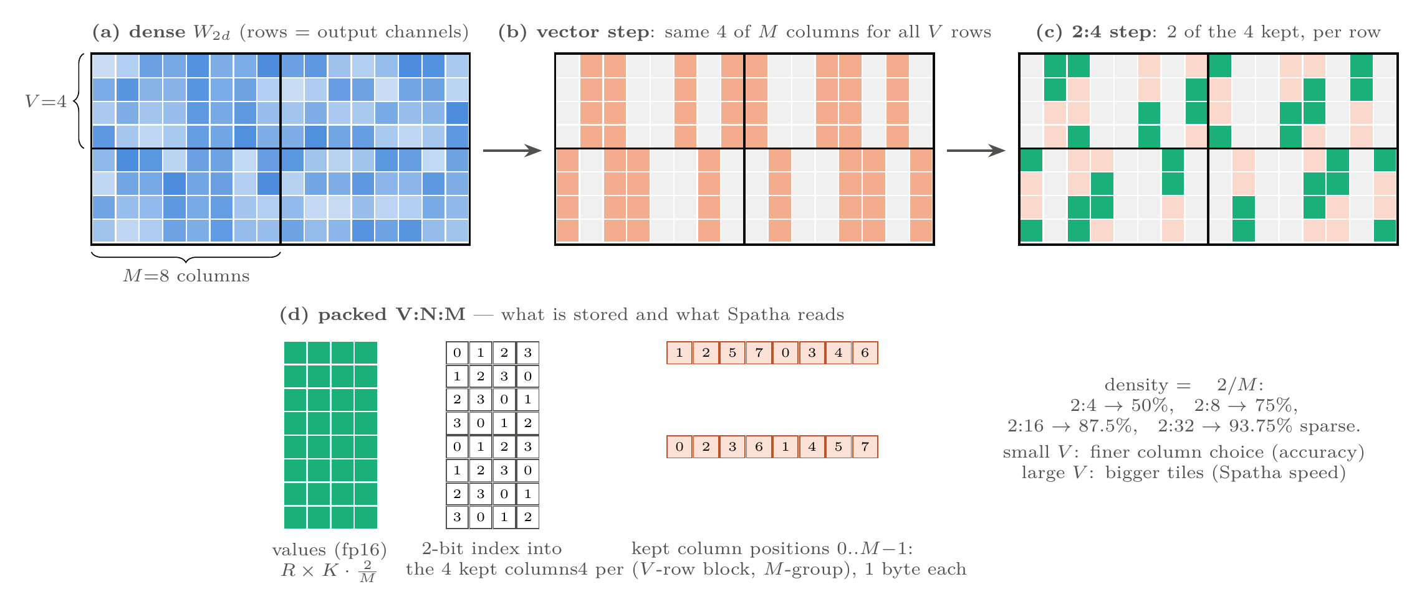
HOW V:N:M WAS APPLIED
The format: a column choice per block, then 2:4 per row
Stored: fp16 values + a 2-bit index per value + 1 byte per kept column. Small V = finer choice (accuracy); large V = bigger tiles (speed).
V:N:M for NEAT-evolved CNNs · 4
Notes:
Walk left to right: dense block, the vector step keeps the same 4 columns for all V rows, then each row keeps 2 of those 4. The packed form is what Spatha reads.

Slide 5
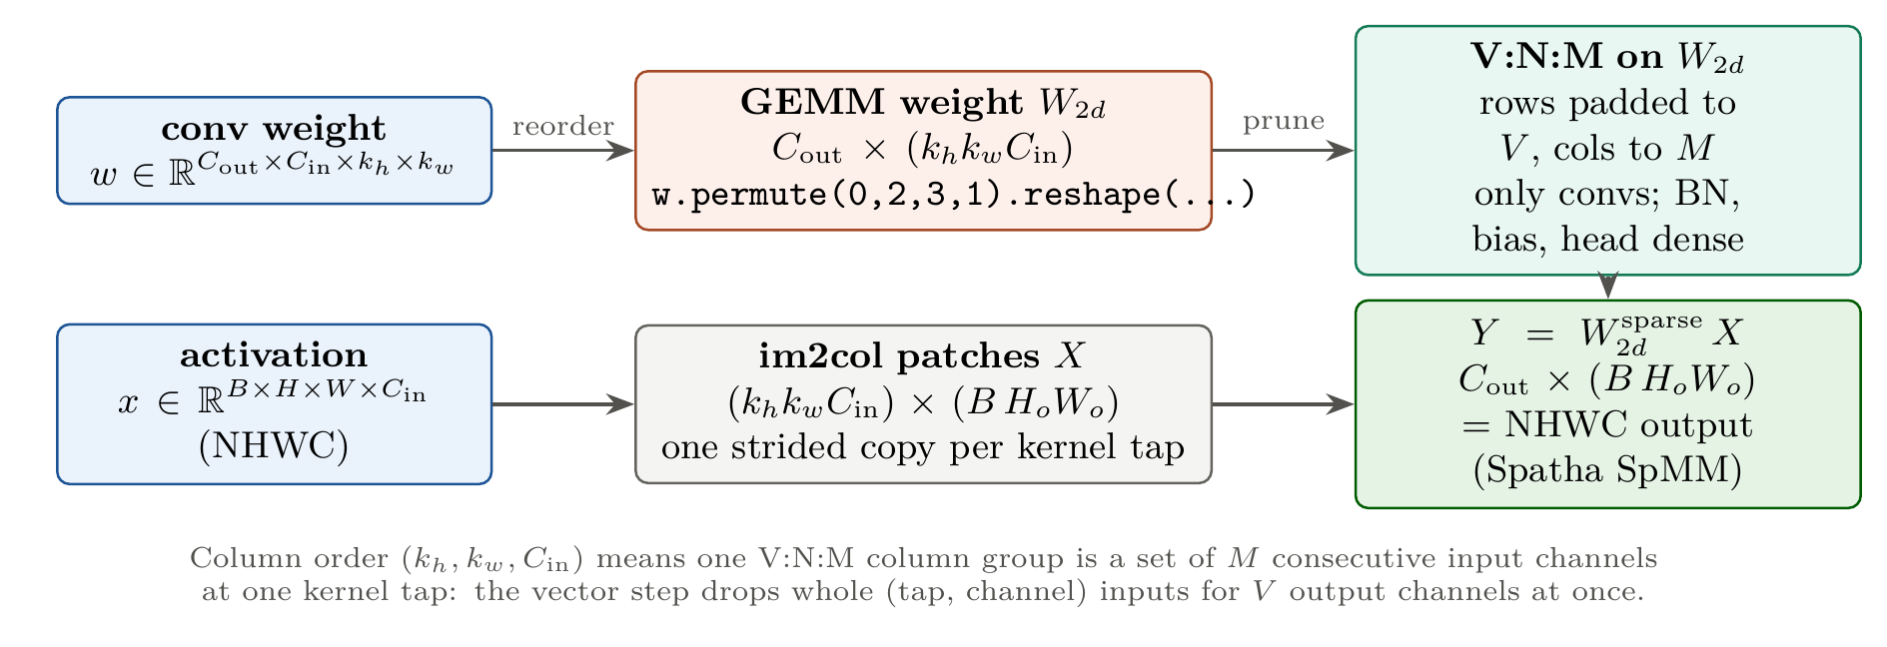
HOW V:N:M WAS APPLIED
Each convolution becomes a matrix that V:N:M can prune
Layout. Columns ordered (kh, kw, C_in): a column group = M input channels at one kernel tap.
Scope. Only convs are pruned; BN, biases and the head stay dense.
Recovery. 30-epoch fine-tune with distillation from the dense model; mask re-applied after every step.
V:N:M for NEAT-evolved CNNs · 5
Notes:
W2d = w.permute(0,2,3,1).reshape(C_out, kh*kw*C_in). Because input channels are innermost, the vector step drops whole (tap, channel) inputs for a group of V output channels, which convolutions tolerate well.

Slide 6
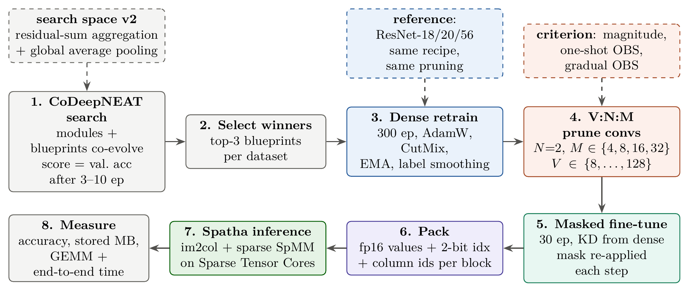
HOW V:N:M WAS APPLIED
The pipeline: evolve, retrain, prune, fine-tune, run on Spatha
12 experiments in all: 4 searches, 3 retraining recipes, full V × M grids, 3 pruning criteria, 288 end-to-end timing runs.
V:N:M for NEAT-evolved CNNs · 6
Notes:
Dashed boxes are things added along the way: a new search space, a ResNet reference, and the second-order pruning criteria. Grids cover V in 8 to 128 and M in 4 to 32.

Slide 7
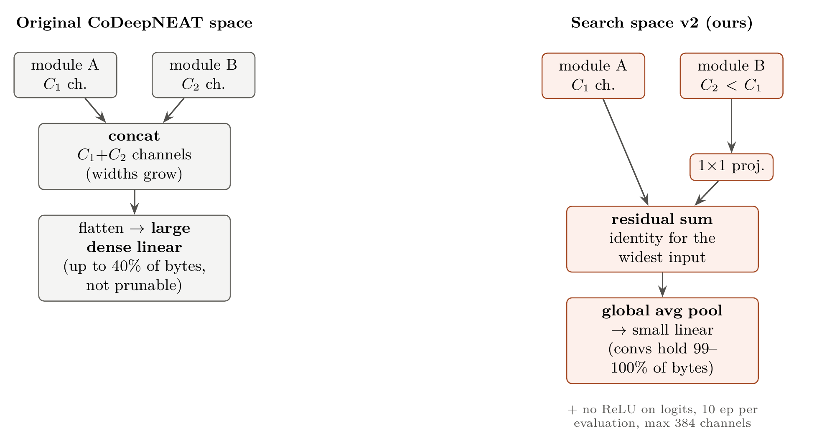
HOW V:N:M WAS APPLIED
We changed the search space so the parameters sit in convolutions
Problem. The flatten + linear head held 34–77% of the bytes, and V:N:M cannot prune it.
Fix. Residual-sum aggregation and global average pooling, searched again with 10-epoch evaluations.
Effect. Over 99% of bytes in convs, and +4 pt dense accuracy (72.4% → 76.5%).
V:N:M for NEAT-evolved CNNs · 7
Notes:
This is the change to CoDeepNEAT itself. Inputs already at the widest channel count pass through an identity; narrower ones get a 1x1 projection before the sum.

Slide 8
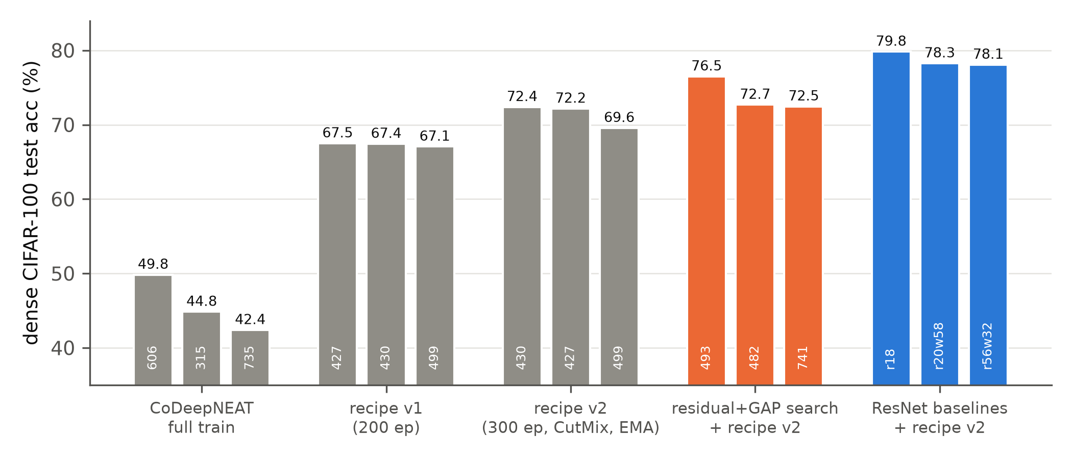
RESULTS
Before pruning: training mattered more than the search
Same architectures, better recipe: at most 50% → 72.4% on CIFAR-100 (300 epochs, CutMix, EMA).
New search space: best evolved model bp493 reaches 76.5%.
Why it matters: pruning results on under-trained models understate what V:N:M keeps.
V:N:M for NEAT-evolved CNNs · 8
Notes:
ImageNet-100 shows the same: bp230 went from 29.6% to 52.3% from retraining alone. Short evaluations in the search favour shallow, wide networks with 5x5 and 7x7 kernels.

Slide 9
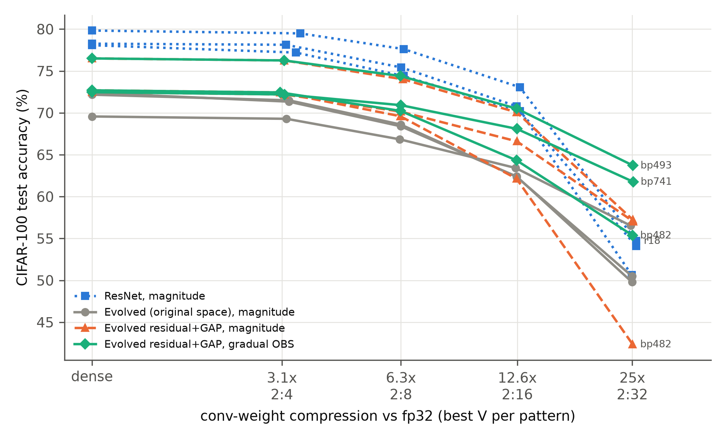
RESULTS
Evolved CNNs keep their accuracy until 2:16
bp493, CIFAR-100
pattern | acc. % | size
dense | 76.50 | 33.7 MB
2:4 | 76.26 | 10.8 MB
2:8 | 74.40 | 5.4 MB
2:16 | 70.50 | 2.8 MB
2:32 | 63.72 | 1.4 MB
2:4 costs 0.24–1.05 pt on every evolved model; 2:8 and beyond use gradual OBS here.
V:N:M for NEAT-evolved CNNs · 9
Notes:
Best V is almost always 8. The green lines are the gradual-OBS evolved models; at 25x they sit above every magnitude-pruned curve, including the ResNets.

Slide 10
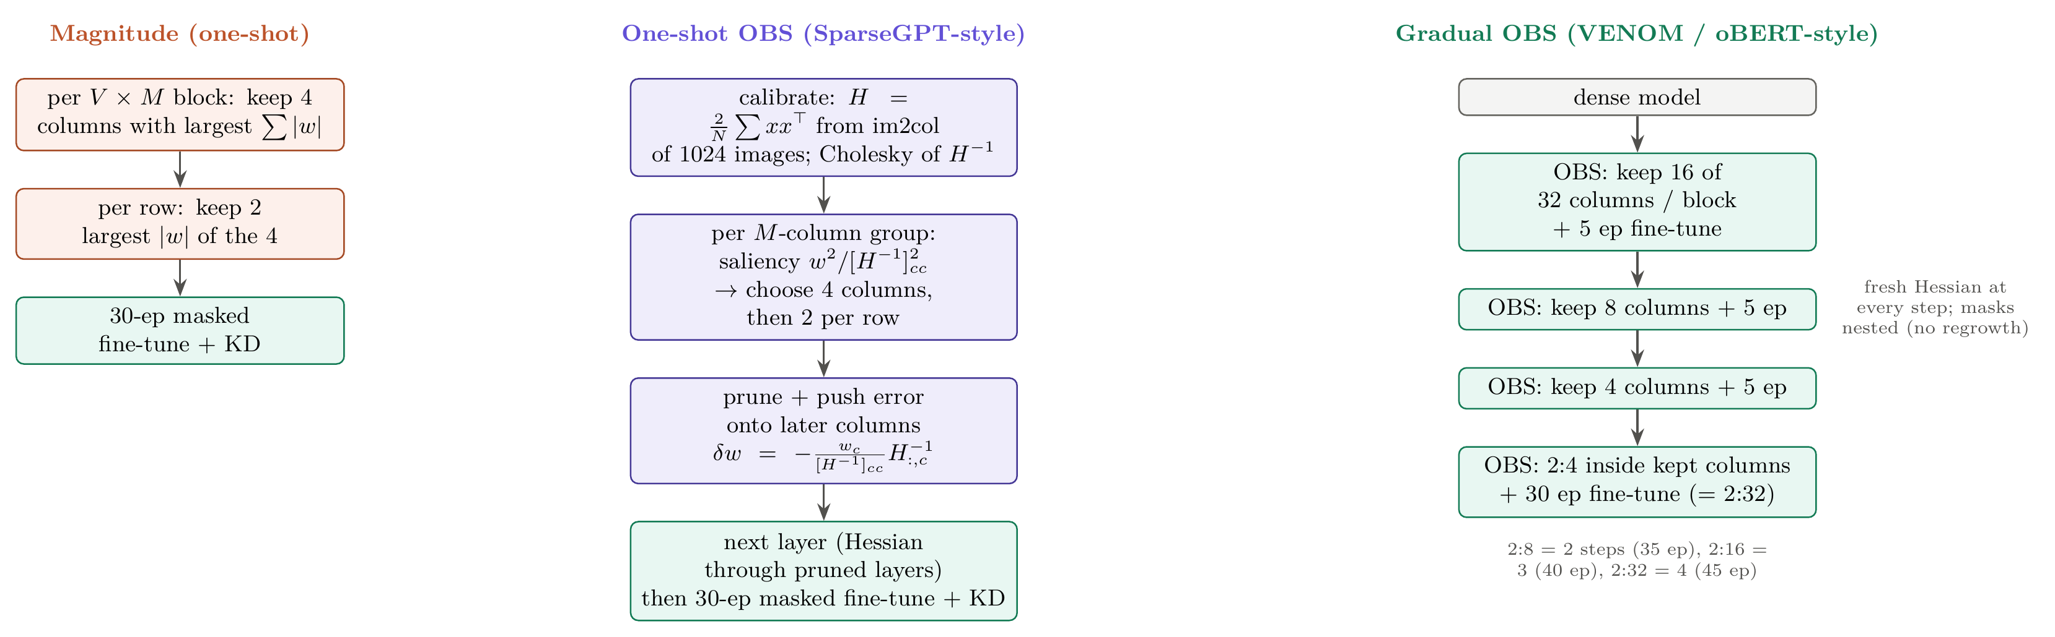
RESULTS
Three ways to choose which weights to keep
V:N:M for NEAT-evolved CNNs · 10
Notes:
Magnitude keeps the largest weights. One-shot OBS uses the layer Hessian to choose the mask and corrects the remaining weights, SparseGPT-style, adapted to the V:N:M block structure. Gradual OBS is what VENOM itself uses: several smaller steps, each with a fresh Hessian and a short fine-tune.

Slide 11
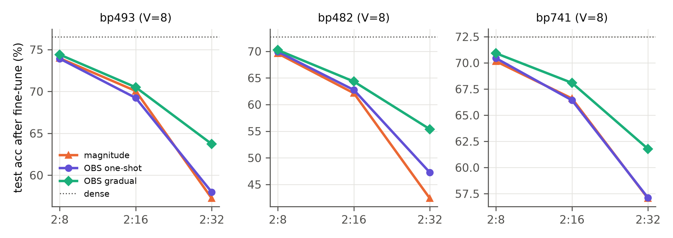
RESULTS
Gradual second-order pruning decides high sparsity
Gradual vs magnitude (mean of 9 runs)
pattern | gain
2:8 | +0.62 pt
2:16 | +2.48 pt
2:32 | +9.18 pt
One-shot OBS lifts zero-shot accuracy by up to 48 pt, but fine-tuning erases the gain. Moving into the sparse subspace step by step is what helps.
V:N:M for NEAT-evolved CNNs · 11
Notes:
Gradual wins 26 of 27 comparisons. Caveat: gradual OBS had 35–45 fine-tune epochs against 30; a gradual-magnitude control was not run.

Slide 12
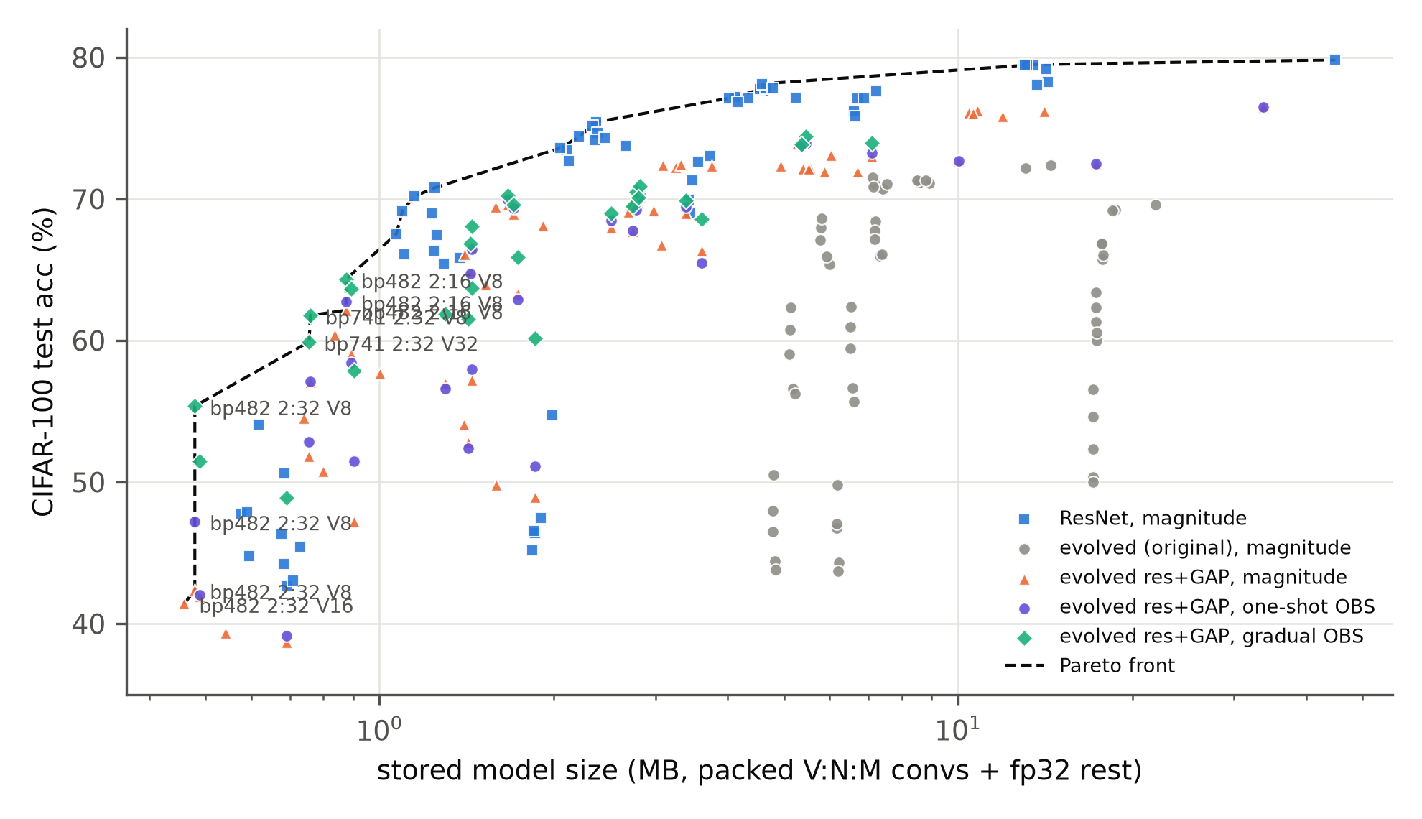
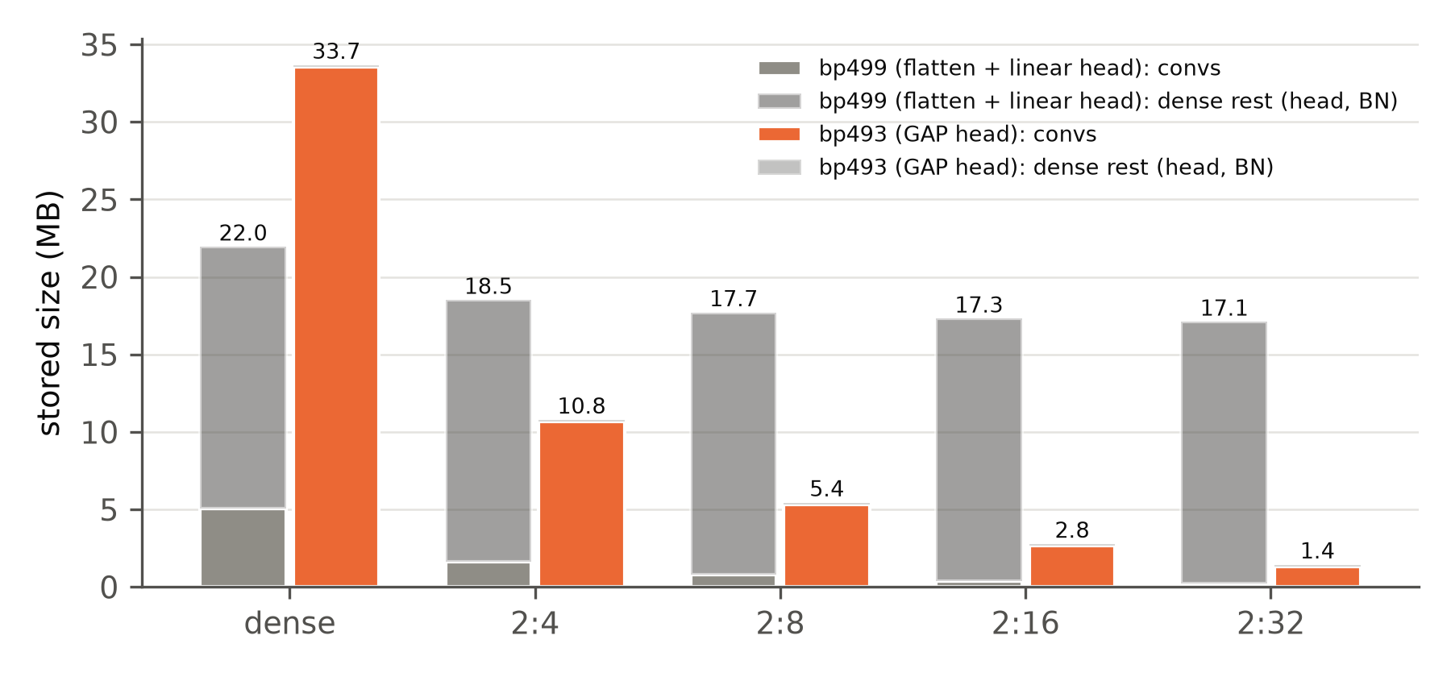
RESULTS
Conv compression only shrinks the model with a GAP head
bp499 stays at 17 MB (head is dense); bp493 goes 33.7 → 1.4 MB
Below about 1 MB the Pareto front is made of gradual-OBS evolved models
V:N:M for NEAT-evolved CNNs · 12
Notes:
Above about 2 MB, the size-matched ResNets dominate the front. At the smallest sizes, gradual-OBS evolved models are the best we found.

Slide 13
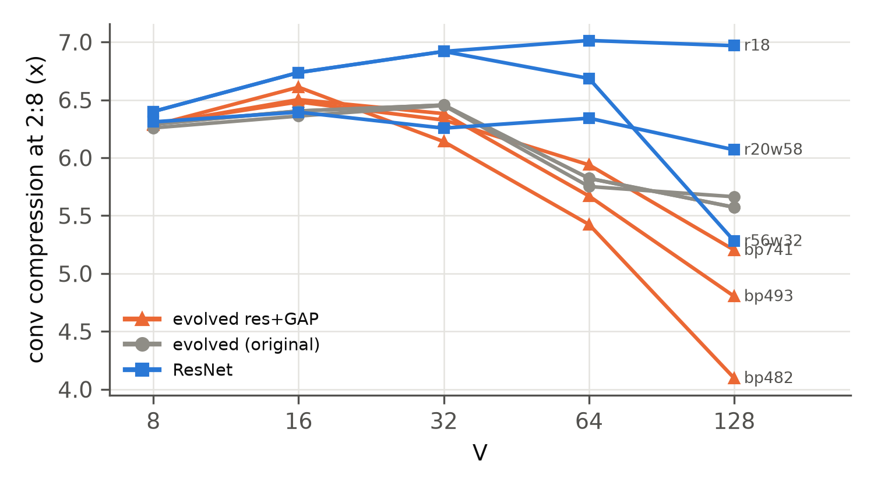
RESULTS
Irregular evolved widths clash with large V
Evolved widths like 142, 171, 211, 269 are padded up to V rows: 2:8 drops from 6.3× to 4.1× (bp482, V = 128).
Power-of-two ResNets gain from large V instead (6.4× → 7.0×), since column ids are shared by more rows.
Accuracy also prefers small V: V = 128 costs 1–3 pt at 2:8. Spatha only runs V ≥ 32.
V:N:M for NEAT-evolved CNNs · 13
Notes:
A V:N:M-aware search should constrain channel counts to multiples of V. That is a cheap change to the mutation operators.

Slide 14
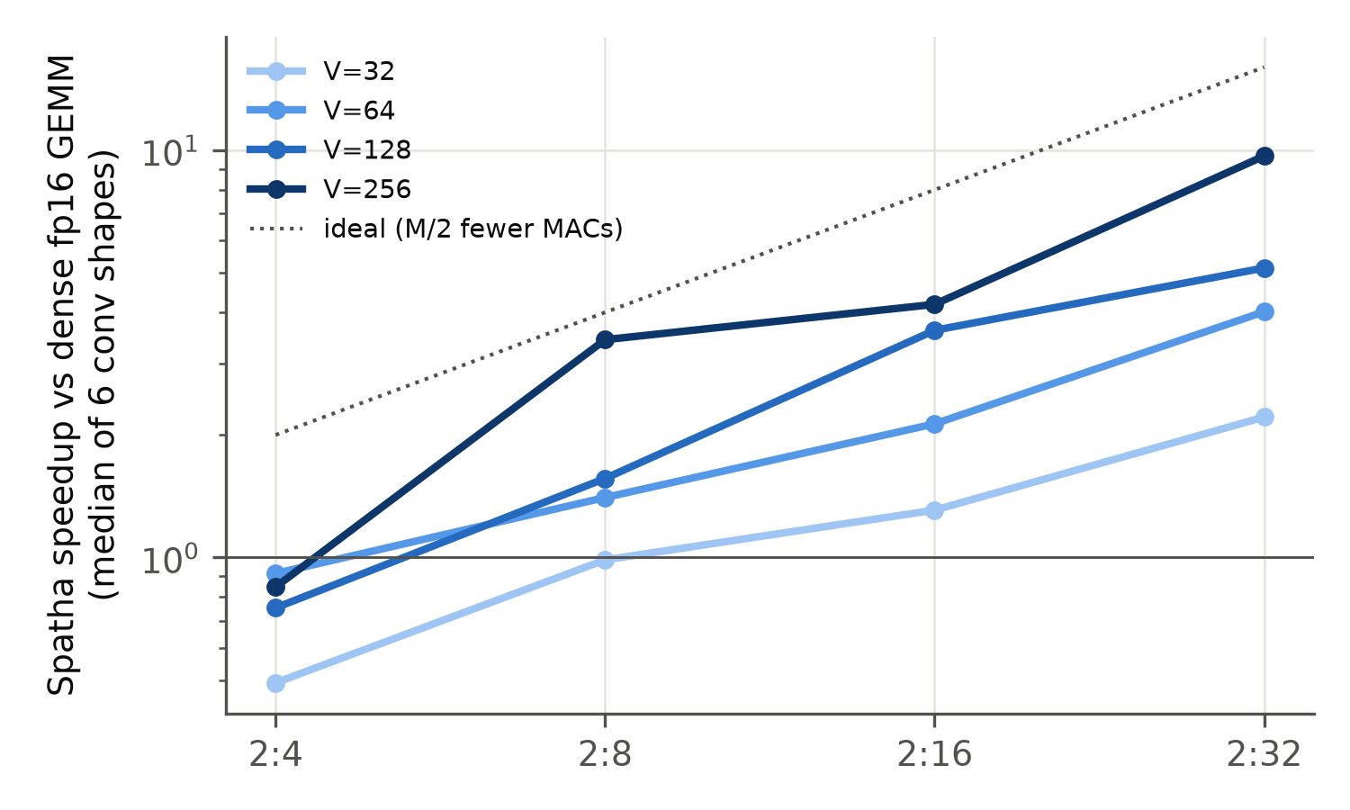
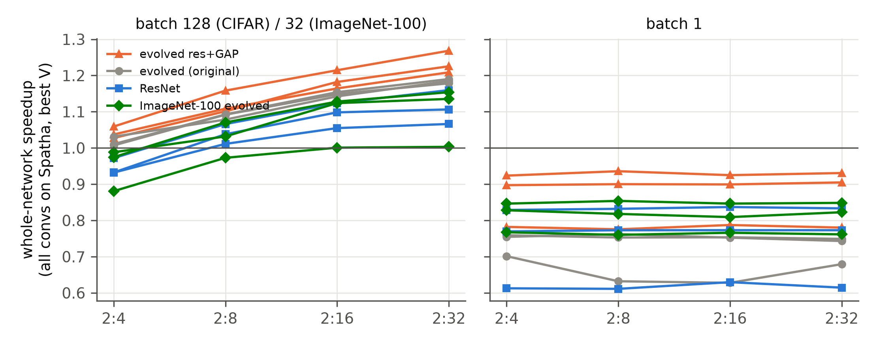
RESULTS
Fast sparse GEMMs, small whole-network gains
Conv GEMMs alone: 1.4–2.6× at 2:8, up to about 8× at 2:32
Full forward pass: 1.0–1.27× at large batch, slower at batch 1
V:N:M for NEAT-evolved CNNs · 14
Notes:
All 288 end-to-end runs matched cuDNN (top-1 agreement at least 99.2%). Baseline is dense-best: per layer, the faster of cuDNN and the same im2col path with a dense GEMM. At 2:4 Spatha is slower than dense for most V.

Slide 15
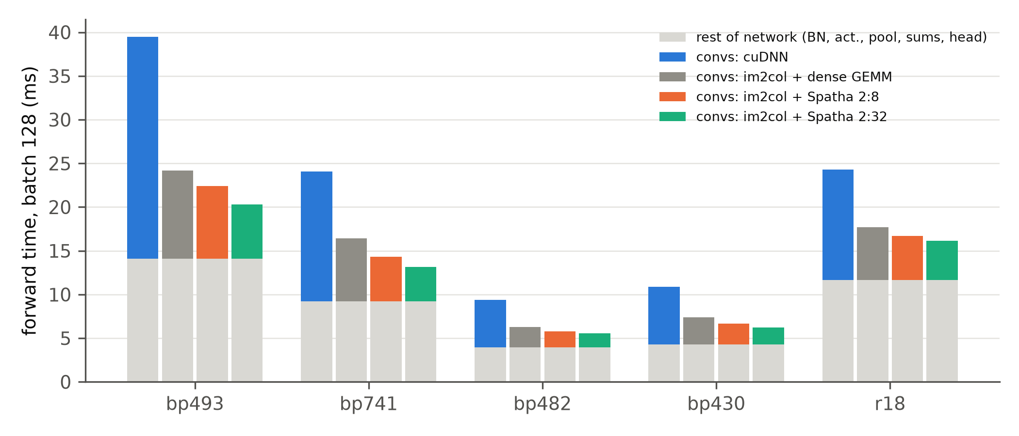
RESULTS
Why: Amdahl’s law, applied twice
1. Convolutions are only 34–42% of the forward time. BN, activations, pooling and sums are untouched.
2. Inside each conv, the im2col copy costs as much as the sparse GEMM.
Fix: an implicit-GEMM sparse conv and fused epilogues.
V:N:M for NEAT-evolved CNNs · 15
Notes:
For bp493 at 2:32 the GEMM is about 8x faster, but im2col plus Spatha is only 1.6x faster than im2col plus dense GEMM. Evolved models still gain more than ResNets (1.27x vs 1.16x) because their convs are wide with large kernels.

Slide 16
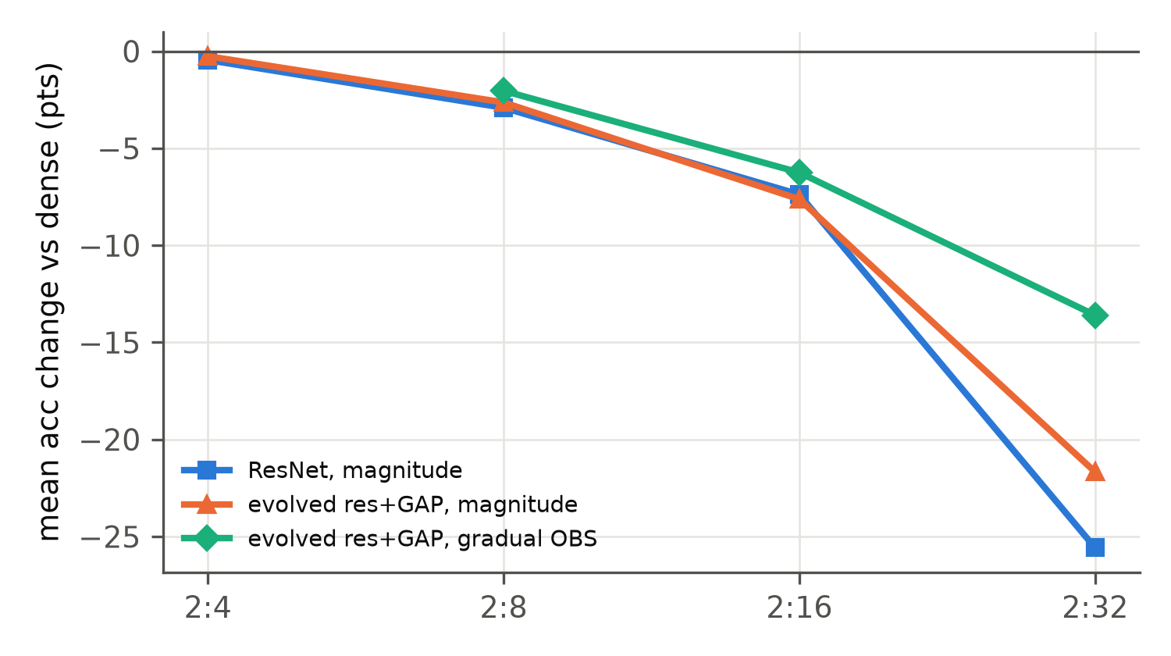
SIDE CHECK
Against hand-designed ResNets, briefly
Dense: size-matched ResNets are 1.6–1.8 pt more accurate, trained with the same recipe.
2:4 to 2:16: both families lose about the same. Evolved nets are not harder to sparsify.
2:32: gradual-OBS evolved (63.7%) beats every magnitude-pruned ResNet (54.7%), but OBS was not run on ResNets.
V:N:M for NEAT-evolved CNNs · 16
Notes:
A sanity check, not the main objective. ResNet-18, ResNet-20 width 58 and ResNet-56 width 32, all trained from scratch with recipe v2 and pruned the same way.

Slide 17
NOVEL FINDINGS
What we learned that was not known before
V:N:M transfers to CNNs
Search space decides
Widths vs V
Via the (kh, kw, C_in) layout: 2:4 loses a median 0.3 pt on 15 CNNs.
Residual sum + GAP: 1.3× → 24× whole-model compression, +4 pt dense.
Irregular evolved widths lose up to a third of 2:8 compression at V = 128.
Gradual beats one-shot
Evolved nets suit Spatha
Two silent Spatha bugs
+9.2 pt at 2:32; one-shot OBS gains vanish after fine-tuning.
Wide, large-kernel convs gain 1.27× end to end; thin ResNet-56 gains nothing.
K must be a multiple of 256 at M = 32; at most 65,535 column tiles per call.
V:N:M for NEAT-evolved CNNs · 17
Notes:
White cards are about accuracy and compression; tinted ones about pruning method and speed. Both Spatha bugs return wrong results or corrupt later kernels without raising any error. Also: training mattered more than the search for final accuracy.

Slide 18
LIMITS AND NEXT STEPS
What this study does not show yet
Limitations
Next steps
Single seed; models and V picked on the test set
Gradual OBS got 35–45 fine-tune epochs vs 30
OBS not run on the ResNets
Shared GPUs, eager PyTorch 1.13; V = 8/16 not timeable
Gradual-magnitude control; multiple seeds
VENOM-aware search: score after pruning, V-aligned widths
Implicit-GEMM sparse conv, fused epilogues, V = 8/16 kernels
Full ImageNet
V:N:M for NEAT-evolved CNNs · 18
Notes:
The most important missing control is gradual magnitude pruning on the same schedule, to separate the second-order criterion from the extra fine-tune epochs.

Slide 19
CONCLUSION
V:N:M compresses NEAT-evolved CNNs well; speed needs a sparse conv kernel
bp493, CIFAR-100 | accuracy | size | whole-network speedup
dense | 76.50% | 33.7 MB | –
2:8, gradual OBS, V = 8 | 74.40% | 5.4 MB | not timeable (V = 8)
2:8, magnitude, V = 32 | 74.01% | 5.4 MB | 1.08×
2:32, gradual OBS, V = 32 | 61.50% | 1.4 MB | 1.19×
Two conditions made it work: put the parameters in convolutions (residual sum + GAP), and reach high sparsity gradually with second-order pruning.
V:N:M for NEAT-evolved CNNs · 19
Notes:
Close on the two conditions and the open problem: turning 4–8x sparse-GEMM speedups into network speedups needs a sparse convolution that avoids im2col.

