Slide 1
Barcode Reader Using Matlab
3105 Athulkrishna Pramod
Msc DA Part – 1
Project Guide – Prof. Yogesh Kene

Slide 2
Table of content
Sr. No | Title | Page No
01 | Introduction | 03
02 | Objectives | 04
03 | Methodology | 05
04 | User Interface | 06
05 | Applications | 07
06 | Advantages | 08
07 | Conclusion | 09

Slide 3
Introduction
MATLAB App Designer barcode detection tool.
User-friendly interface for identifying barcodes in images.
Load, display, and decode barcodes with a single click.
Relies on the 'readBarcode' function for accuracy.
Simplifies barcode detection without coding expertise.

Slide 4
Project Objective
Develop an efficient barcode recognition system.
Ensure high accuracy in decoding various barcode symbologies.
Create a user-friendly interface for easy interaction.
Handle diverse image types and qualities for barcode scanning.
Integrate the reader into specific applications like inventory management or retail systems.
Optimize speed and accuracy for real-time or batch processing.
Implement robust error handling and feedback mechanisms.
Allow for customization and scalability across different industries.

Slide 5
Methodology
Image Selection
Image Loading
Barcode Detection
Result Display

Slide 6
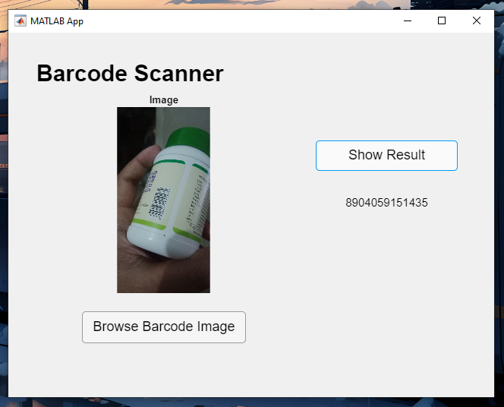
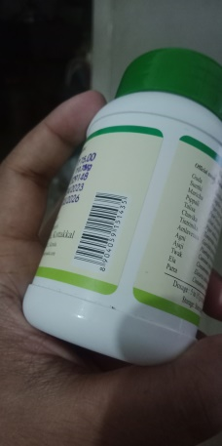

User interface

Slide 7
Applications
Retail and Inventory Management
Warehousing and Logistics
Healthcare
Food and Beverage Industry
Access Control and Security

Slide 8
Advantages
Efficiency
It allow for rapid and accurate data entry, reducing manual data input errors.
Accuracy
Barcode scanning is highly accurate, minimizing the risk of human errors associated with manual data entry.
Cost Saving
Reduces labor costs associated with manual data entry and error correction.
User-Friendly
It is easy to learn and use, reducing the need for extensive training.

Slide 9
Conclusion
This Barcode reader project effectively detects barcodes with a user-friendly GUI.
Demonstrates the practicality of software tools in addressing real-world challenges.
Offers potential applications in inventory management and document processing.
Highlights the versatility of MATLAB App Designer features for interface development.

