Slide 1
PlantCare Lite
Offline-first plant disease detection using on-device deep learning
20IMCAP501 — Mini Project 2 | Review 1
Team members: Athul Mathew , Gowrinanda K.B , Riya Sicil Jacob
Guide: Ms.GODLY ELIZABATH GEORGE
Saintgits College of Engineering (Autonomous) — Department of Computer Applications

Slide 2
Abstract
PlantCare Lite is a mobile application that helps home gardeners and small-scale farmers detect common plant diseases directly from a leaf photo. A MobileNetV2-based convolutional neural network, converted to TensorFlow Lite, runs the diagnosis entirely on-device — so the app works even without an internet connection. Each scan returns a predicted disease, a confidence score, and simple treatment guidance, and is stored locally so a user can track a plant's health over time. When a connection is available, history can optionally sync to a lightweight backend for backup across devices.
Target users
Home gardeners & small farmers
Core technique
MobileNetV2 + TFLite quantization
Key benefit
Fast, offline, low-cost diagnosis

Slide 3
System study — feasibility analysis
Technical feasibility
Economic feasibility
Operational feasibility
MobileNetV2 is lightweight enough for mobile inference; TensorFlow Lite with quantization keeps the model under ~10 MB. React Native + a native TFLite bridge give cross-platform reach with a single codebase. SQLite handles offline-first local storage reliably.
Uses free/open datasets (PlantVillage) and open-source frameworks (TensorFlow, React Native, SQLite). No paid APIs are required for core functionality — optional cloud sync uses low-cost or free-tier backend hosting.
Designed for low-connectivity environments common in rural farming areas. Minimal input required from the user (a photo), and results are explained in plain language with actionable treatment steps.

Slide 4
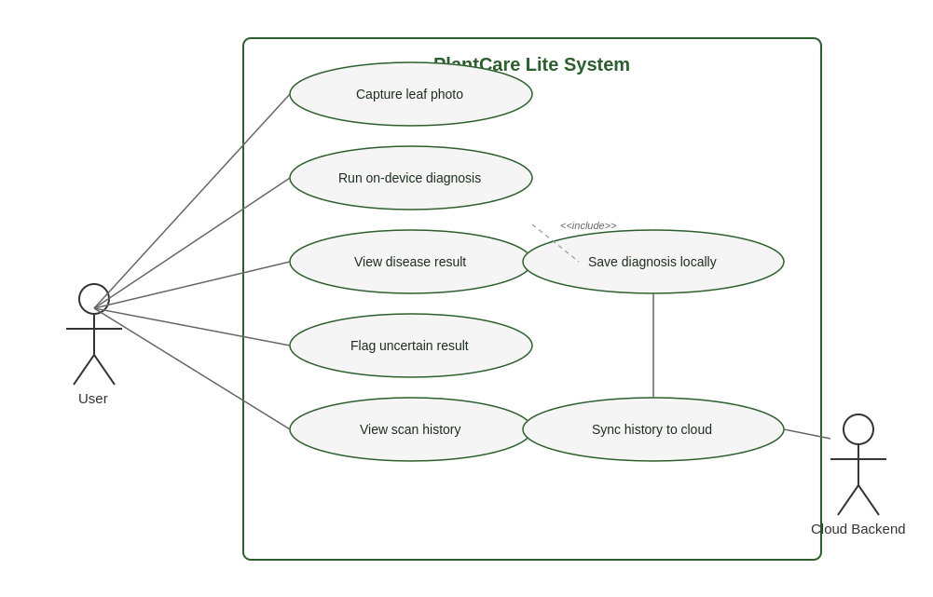
UML diagram — use case

Slide 5
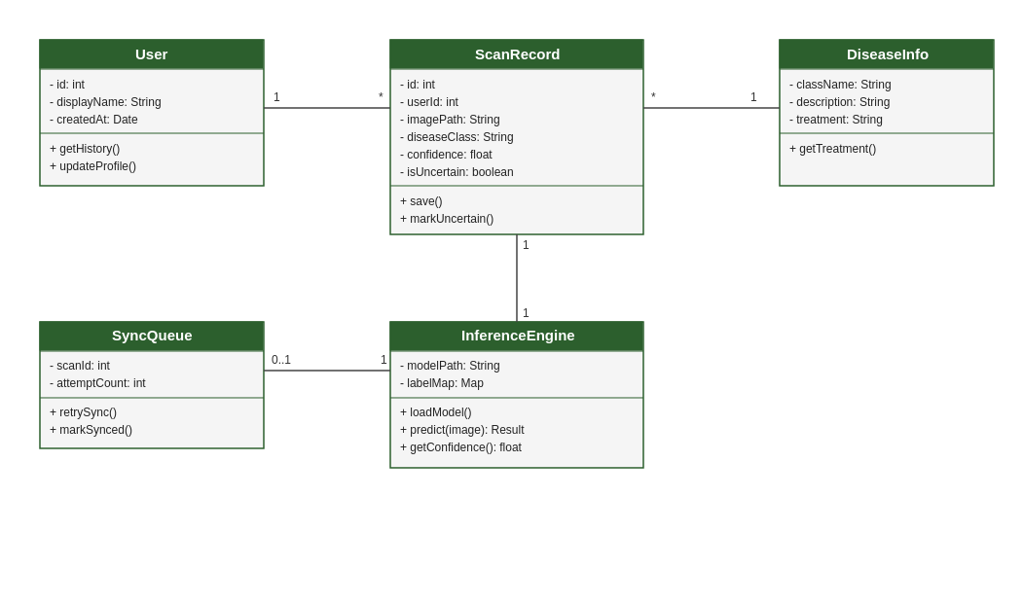
UML diagram — class diagram

Slide 6
Database design
SQLite — local-first storage
users
scan_history
id
INTEGER PK
id
INTEGER PK
display_name
TEXT
user_id
FK -> users.id
created_at
DATETIME
image_path
TEXT
disease_class
TEXT
confidence
REAL
synced
BOOLEAN
disease_info
sync_queue
class_name
TEXT PK
id
INTEGER PK
description
TEXT
scan_id
FK -> scan_history.id
treatment
TEXT
attempt_count
INTEGER
severity
TEXT

Slide 7
UI design
Low-fidelity wireframes — capture, result, and history screens
PlantCare Lite
leaf image
Scan history
leaf photo
preview area
Late blight
Today
Healthy
Late blight
87%
Yesterday
Recommended care:
- Remove affected leaves
- Apply copper fungicide
Bacterial spot
2 days ago
Camera
Gallery
Save to history
1. Capture
2. Result
3. History

Slide 8
Project completion status
~15%
Completed
Abstract & synopsis approved
System study & feasibility analysis
Requirement gathering & user stories
UML diagrams (use case, class)
Initial database schema
UI wireframes
complete as of Review 1
Up next
ML training pipeline execution (Colab)
React Native app scaffolding
On-device TFLite integration
Backend sync API

