Slide 1

A Study on Climate Change and Environment Indicators

Slide 2
Why climate is changing? Should we be concerned!
https://climate.nasa.gov/effects/

Slide 3
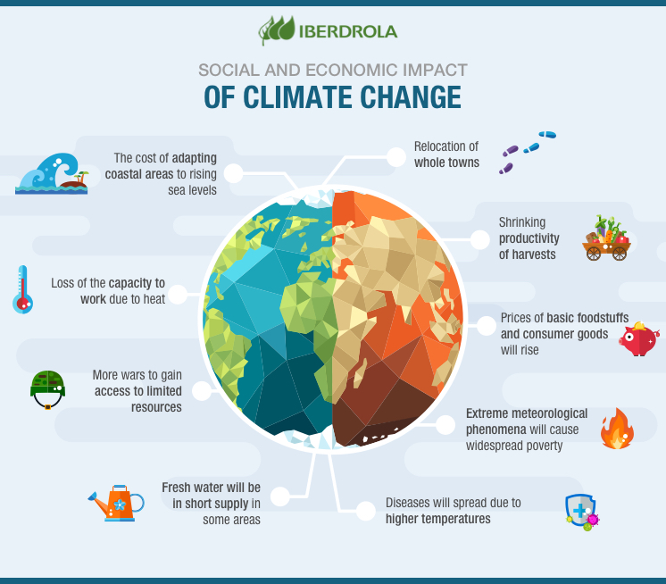
The change in the climate is visible at both the largescale and microscopic levels. These changes caused by mankind have started costing at a terrifying level
Ref : Image

Slide 4
Datasets used :
https://www.kaggle.com/datasets/berkeleyearth/climate-change-earthsurfacetemperatur-data
https://www.kaggle.com/datasets/cityapiio/world-cities-air-quality-and-water-polution
https://www.kaggle.com/code/deepshah16/environmental-indicators-natural-disasters/data?select=Air+and+Climate

Slide 5
Datasets Exploration and Cleaning :
Scattered Data
Grouping according to relevant columns
Merging with common columns
Formatting date
Removing null

Slide 6
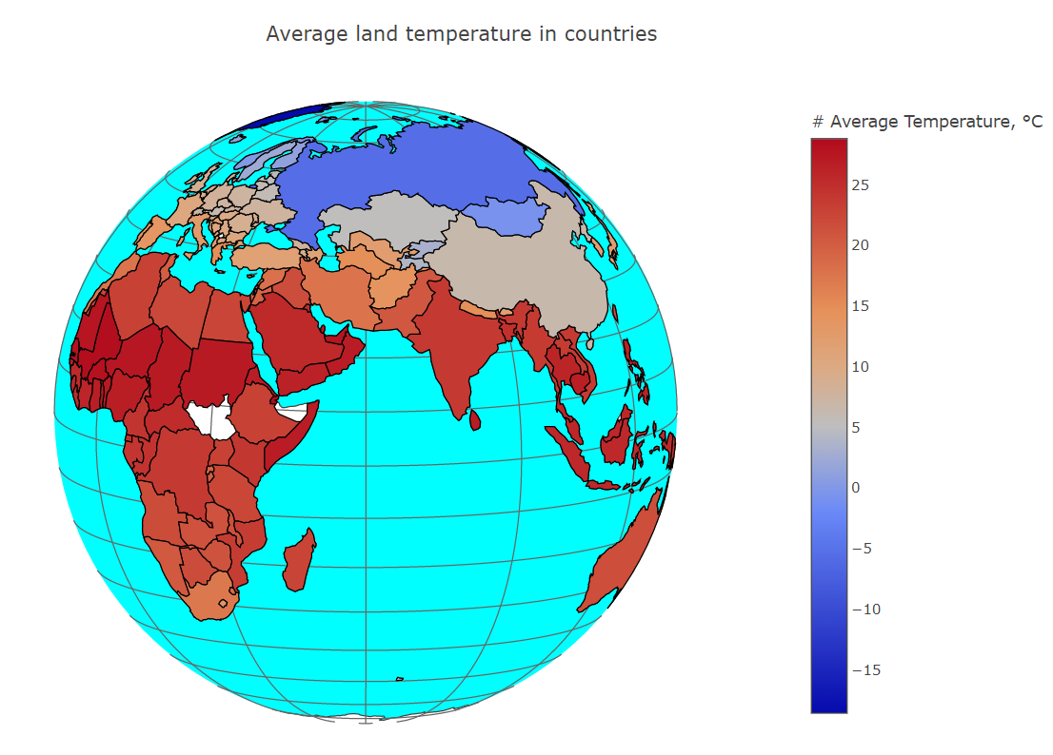
Temperature Around the World
March 2022 , recorded as the hottest in 122 years : India
Ref: Hyperlink

Slide 7
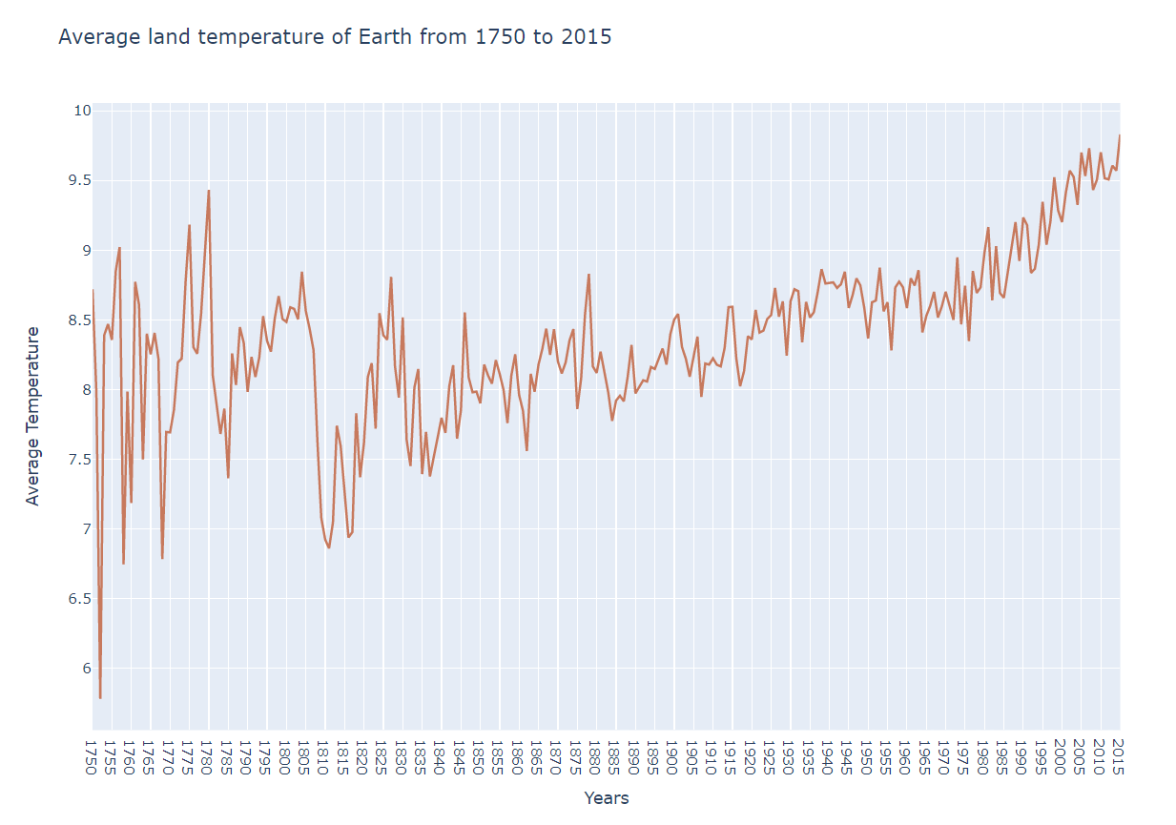
Earths Temperature over the past two centuries

Slide 8
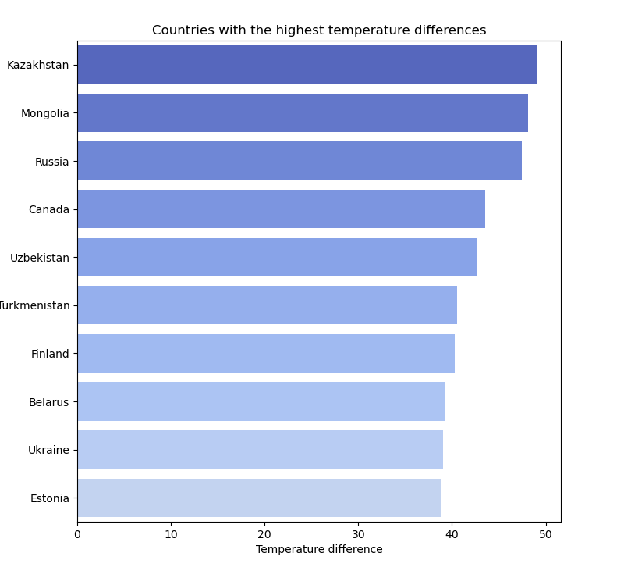
Countries with highest temperature difference

Slide 9
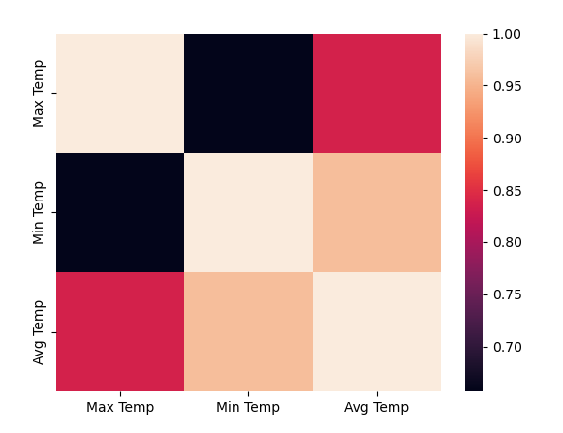
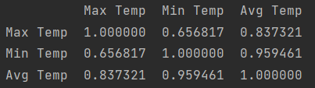
Correlation between maximum, minimum and average temperature per country

Slide 10
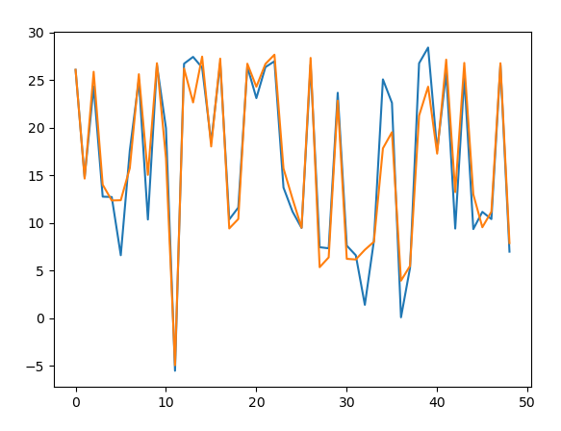
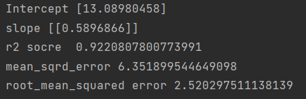
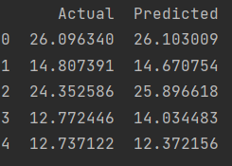
Linear Regression Model: Predicting average temperature from the minimum temperature of a country

Slide 11
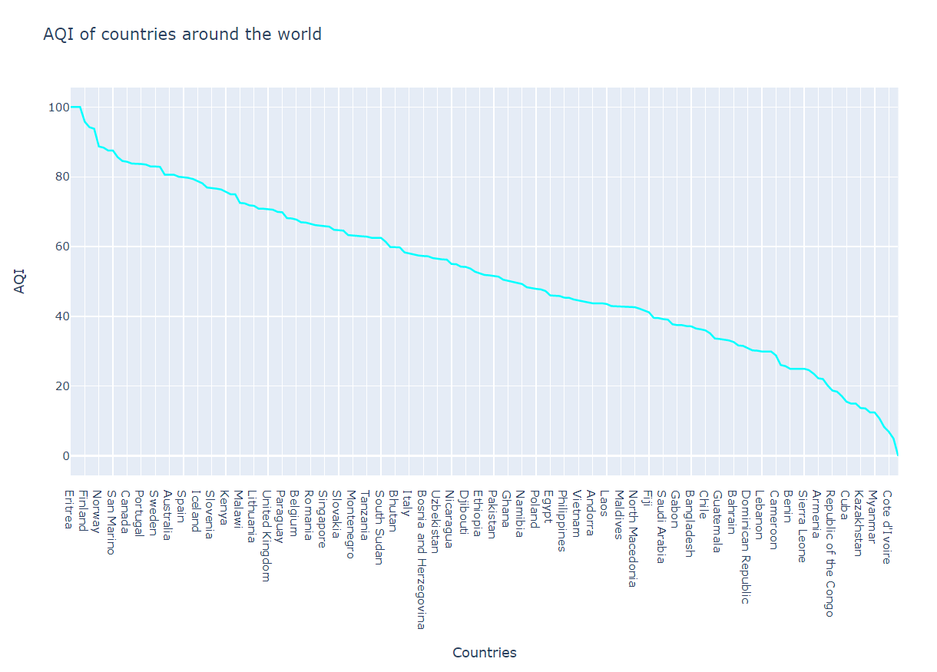
Countries around the world in the order of AQI

Slide 12
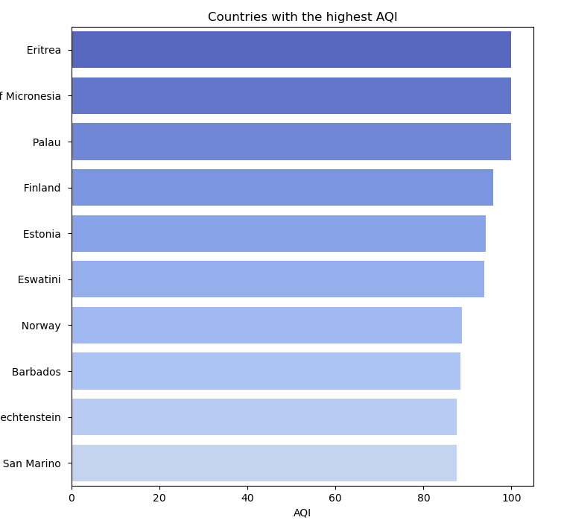
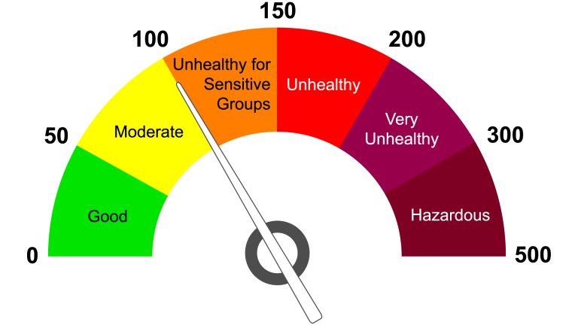
Countries with the highest AQI
Ref: AQI SCALE

Slide 13
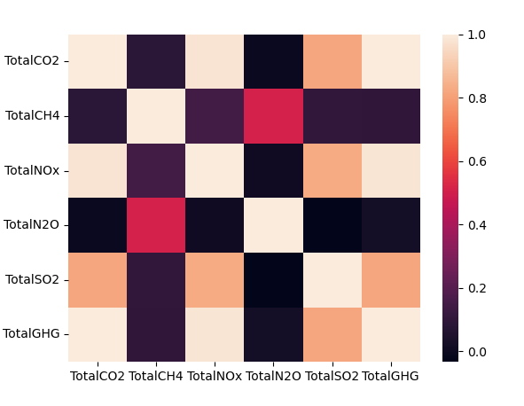
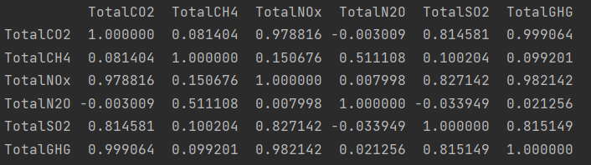
Correlation between different air pollutants

Slide 14
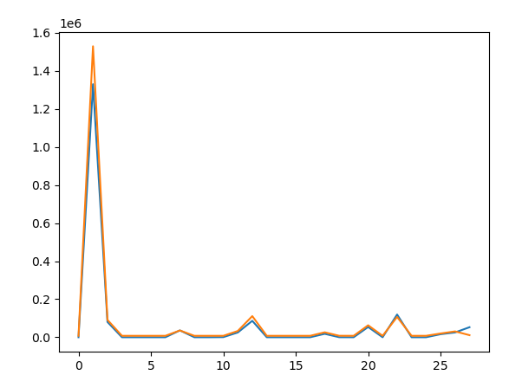
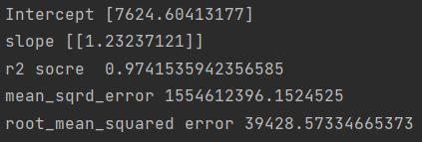
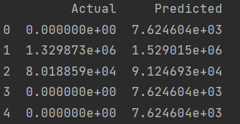
Linear Regression Model: Predicting GHG from CO2

Slide 15
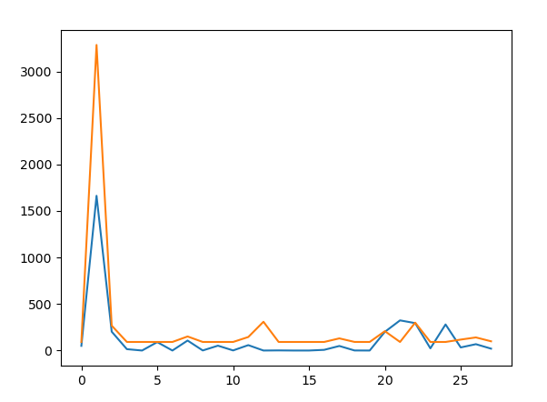
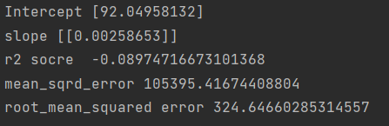
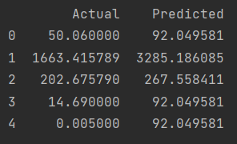
Linear Regression Model: Predicting NOx from CO2

Slide 16
Further Analysis Scope
Acquisition of data
Connecting more environmental indicators
Finding their dependency
Using various models to prediction
Forecasting future data

Slide 17
Thank You
Athulya Shaji
B00873604
MSc Computer Science
Ulster University

