Slide 1

Real-Time Sign Language Interpreter
Athulya Shaji

Slide 2

Content
Societal Challenge
Project Development
Software and Libraries used
Data Collection
Model Development
Model Testing
Real-Time Prediction
Conclusion
Future Enhancements

Slide 3
Societal Challenge
Sign language interpretation is the sole method to connect with the world of verbally disabled and hearing impairment people
The rest of the society has very less understanding of the sign language
Bridge the gap between both worlds is of great importance but difficult at the same time

Slide 4
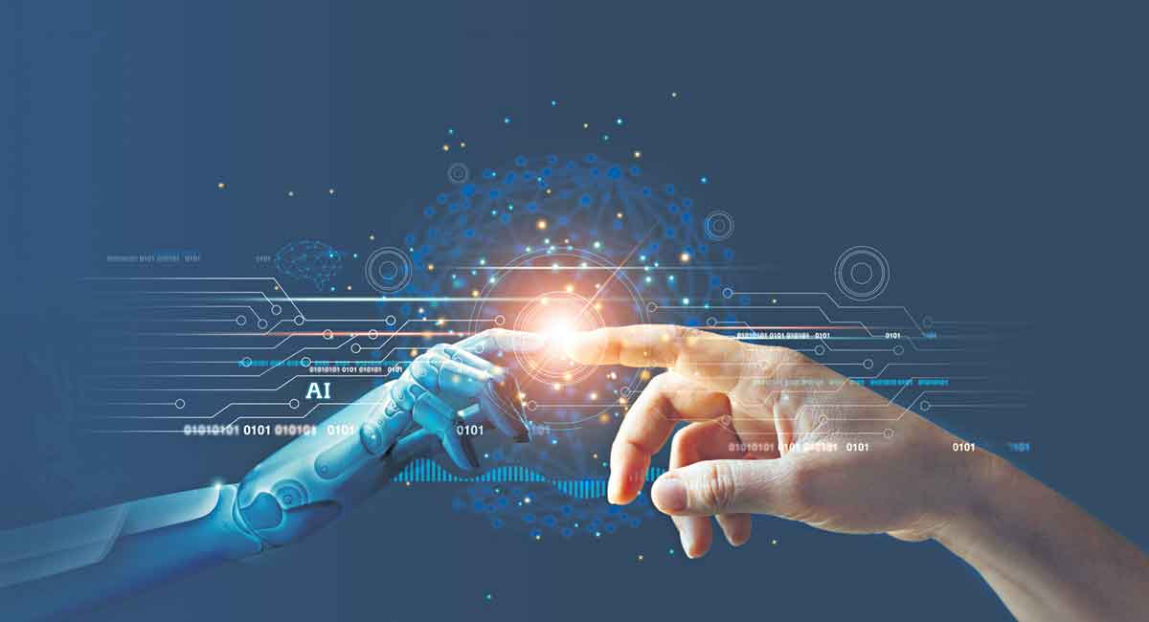
An AI-based interpreter which could capture real-time signs and recognize their respective meaning will be a great solution to the problem
Ref: https://telanganatoday.com/wp-content/uploads/2022/02/AI-1.jpg

Slide 5
Project Development
Overview:
In this project, I have tried to interpret sign language numbers from the real-time image captured

Slide 6
Software and Libraries used
Python: Powerful machine learning (ML) libraries in python make it the best when it comes to feature extraction and creating classifiers
cv2 (OpenCV) : Computer vision analysis has a great role in this project and OpenCV has a lot to offer for the same
TensorFlow: the creation of ML models becomes easy with the libraries in TensorFlow
Keras: Contains high-level neural networking library used to create the model in this project

Slide 7
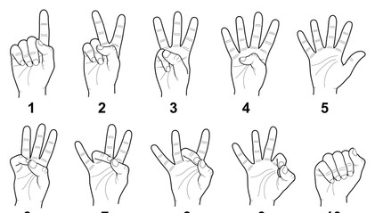
Data Collection
Dataset required to train and test the model is captured from live cam feed with the help of a python program.
Using OpenCV, images of hand signs for different sign language numbers are taken and stored in respective directories for each execution of the code
Ref: https://telanganatoday.com/wp-content/uploads/2022/02/AI-1.jpg

Slide 8
Data Collection
The images of hand signs are captured from the live cam by defining a region of interest on the frame and detecting the object in the frame
The background is separated out by calculating the cumulative weighted average of the background and deducting the object
Cv2.contour is used to find the contour to identify the object in the ROI
The identified image is converted to grayscale and is started saving in the respective library

Slide 9
Model Development
Using Keras function ImageDataGenerator the test and train dataset created in the previous module is loaded and classes are labeled for each image.
A Convolutional Neural Network (CNN) model using the Sequential class of Keras has been created to do the task in the project.

Slide 10
Model Development
A three-layer Conv2D is designed with few trials of hyperparameters to achieve the best result. The activation function used is Relu
The model is compiled with SGD optimizer
The model is fitted to the training batch created in the previous module with 10 epochs

Slide 11
Model Testing
The model is then used to predict the values on the test batch and compared against the actual results
The accuracy and loss score is also calculated here
The created model is saved

Slide 12
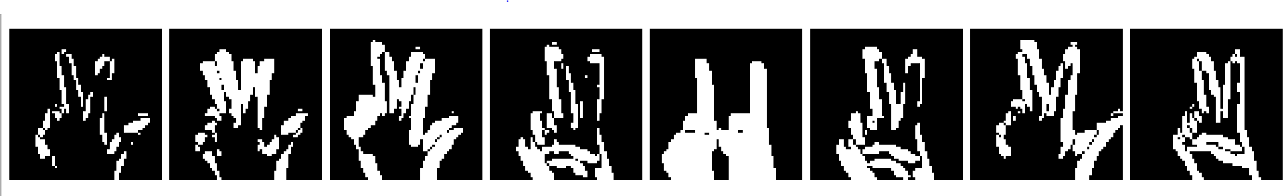
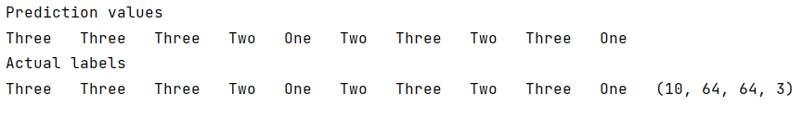
Model Testing

Slide 13
Real-Time Prediction
OpenCV is used to get real-time images of hand gestures
In this module, the image with hand gestures is identified in a similar way as done in the dataset creation module
The background is separated out by calculating the cumulative weighted average of the background and deducting the object. Cv2.contour is used to find the contour to identify the object in the ROI

Slide 14
Real-Time Prediction
The model created in the previous module is invoked
The live image captured and processed is fed to the model to predict the respective value of the sign
The meaning of the hand signs (numbers in our case) is displayed on the screen using a word directory that contains the respective words for each label predicted by the model

Slide 15
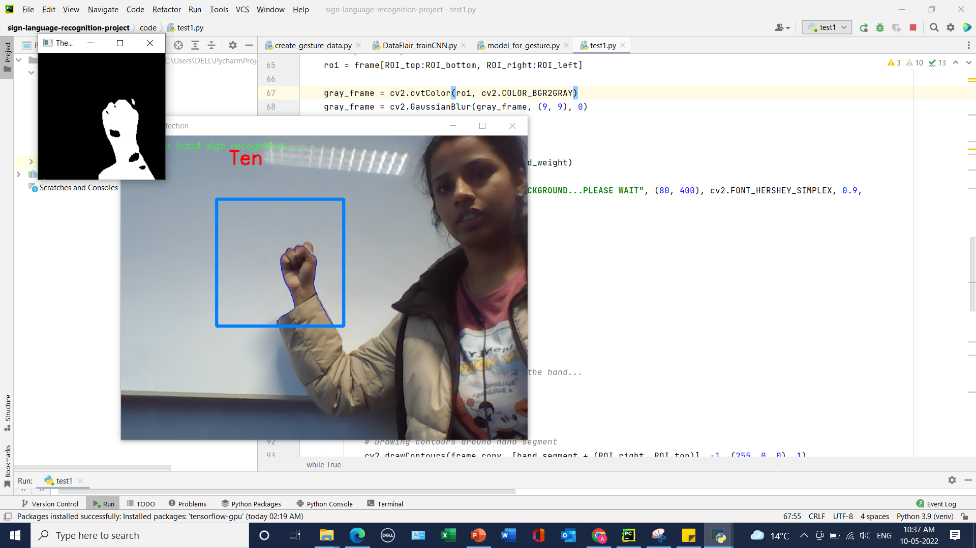

Slide 16

Review
The model was doing a good job with respect to the dataset fed to train the model
The image processing had challenges like identifying the hand in the region of interest
The contour determination and differencing hands and other objects in the frame were difficult many times
The grayscale image was sensitive to light and sometimes misinterpret due to variation in the frame lighting during training and actual prediction

Slide 17
Conclusion
An AI interpreter that aids the differently abled group of people to effectively communicate with the rest of the world is a wonderful discovery for us as a society
I have tried to achieve a miniature prototype of the same through this project by detecting sign language numbers

Slide 18
Future Enhancements
The project has the scope to be explored and expanded to a huge extent to cover the vast number of other signs and hand gestures including alphabet
An interesting enhancement of this project is to achieve continuous sign language recognition, which will allow the person to write using gestures. This would be done using a hybrid model of convolutional and recurrent neural network

Slide 19
Thank You
Athulya Shaji
B00873604
Shaji-A@ulster.ac.uk

