Slide 1
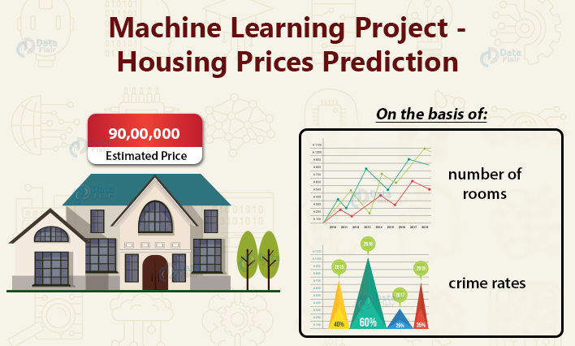
PREDICTING HOUSE PRICE USING MACHINE LEARNING

Slide 2
AGENDA
ABSTRACT
PROBLEM DESCRIPTION
KEY OBJECTIVES
EXPECTED OUTCOMES
BENEFITS
CONCLUSION

Slide 3
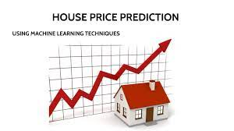
INTRODUCTION
In this project, we will delve into the fascinating world of house price prediction using machine learning techniques . we will explore how historical data ,comprising a multitude of features like location , amenities , size and market trends can be harnessed to create predictive models that estimate the market value of a house. This endeavor not only empowers individuals in the real estate market but also showcases the potential of machine learning to solve complex real-world problems.

Slide 4
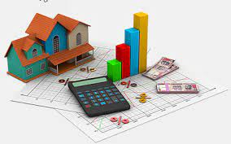
PROBLEM DESCRIPTION
The challenge is to develop a robust machine learning model that can accurately estimate the selling price of a house based on various features.
We will be working with a dataset containing historical data on houses, including attributes such as square footage, number of bedrooms, location, and more.
The goal is to create a predictive model that can assist homebuyers in making informed decisions and help sellers set competitive prices.

Slide 5
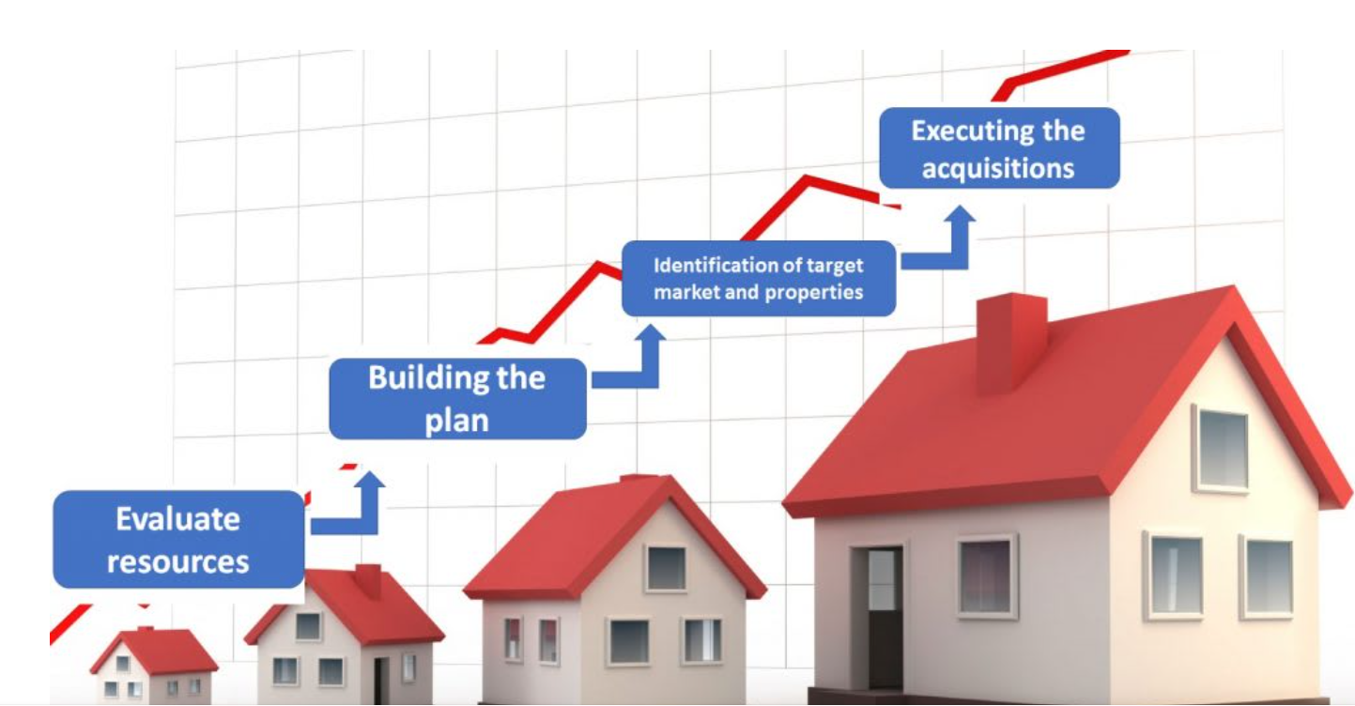
KEY OBJECTIVES
1.Data Collection: Gather a comprehensive dataset of housing information, including both numerical and categorical features.
5.Model Training: Train the selected model(s) on the prepared dataset, using techniques such as cross-validation.
6.Evaluation: Assess the model's performance using relevant metrics (e.g., mean squared error, R-squared) and fine-tune it for optimal results.
7.Prediction: Deploy the trained model to predict house prices for new listings or scenarios.
8.Interpretability: Provide insights into how the model makes predictions, ensuring transparency and trustworthiness.
3.Feature Selection: Identify the most relevant features that contribute significantly to house price predictions.
4.Model Selection: Choose appropriate machine learning algorithms for the task.
2.Data Preprocessing: Clean and prepare the data by handling missing values, encoding categorical variables, and scaling numerical attributes.

Slide 6
EXPECTED OUTCOMES
A machine learning model capable of accurately predicting house prices based on various attributes.
Improved decision-making for both buyers and sellers in the real estate market.
Insights into the key factors influencing house prices in the given dataset.

Slide 7
BENEFITS
Predicting house prices using machine learning offers several benefits:
1.Empowering stakeholders in the real estate industry with a reliable tools for pricing homes.
2.Enhancing the efficiency of real estate transactions.
3.Potential for wider applications in property valuation and investment strategies.
4. It helps assess the risk associated with property investments, allowing investors to make more informed decisions about buying, selling, or holding properties.
5. By analyzing historical data, the project can provide insights into market trends, helping users understand whether property values are likely to appreciate or depreciate in a given area.

Slide 8
CONCLUSION
In conclusion, our ongoing project on house price prediction using machine learning holds great promise in revolutionizing the real estate industry. Through the application of advanced algorithms and data-driven insights, we aim to provide accurate and reliable predictions for property values. This project has the potential to benefit various stakeholders, including homebuyers, sellers, and investors, by facilitating informed decision-making in the housing market. As we continue to refine our models and analyze additional data, we anticipate even greater accuracy and utility in our predictions. Ultimately, our goal is to contribute to a more transparent and efficient real estate market, where everyone can make well-informed choices when it comes to buying or selling a property.

