Slide 1
22CSP72 – PROJECT WORK II PHASE I
A Cross-Attention-Based Multimodal Framework For Hate Speech and Offensive Content Detection in Tamil and Telugu Memes
Date : 27.07.2026
Team Number : A08
Team Guide : Dr. P. S. Nandhini ASP/CSE
Team Members :
Athvaitha E(23CSR030)
Ashifa K (23CSR024)
Agatheeshwaran S V (23CSR014)

Slide 2
Introduction
Social media memes combine images and text to express opinions, humour, emotions, and social messages, making them a widely used form of online communication.
Some memes contain hate speech, abusive language, sarcasm, and offensive content, which can negatively impact individuals and online communities.
Detecting such content is challenging because its meaning depends on both the image and the text.
The multilingual nature of memes, especially in regional languages like Tamil and Telugu, increases the complexity of automated analysis, making offensive meme detection an important research area in Natural Language Processing (NLP) and Computer Vision.

Slide 3
Literature Survey
S.No | Author | Year | Algorithm Used | Performance Metrics | Limitations
1 | Rahul Ponnusamy, et al. | 2026 | Fuse-MD with 8-bit LLM quantization & Macro-F1 calibration | Tamil 81.82%, Malayalam 90.10% | OCR spelling noise; Binary classification only
2 | Radhika Bohra, et al. | 2026 | CLIP ViT + MuRIL, XLM-RoBERTa, mBERT ensemble | Multi-task Macro F1: 0.56-0.61 | Lower performance on complex social contexts like sarcasm
3 | Asif Ekbal, et al. | 2025 | Multi-Task Learning (MTL) with CLIP, UNITER, BERT | Accuracy 84% | Primarily high-resource English datasets; Binary classification only
4 | Jasraj Singh Sehmbey, et al. | 2025 | Late-Fusion: Inception-ResNet-V2 + RoBERTa | Accuracy 55%, Macro F1 0.51 | Low recall for offensive memes

Slide 4
Literature Survey
Sno | Author(s) | Year | Algorithm Used | Performance Metrics | Limitations
5 | M. Shahiki Tash, et al. | 2024 | CNN text classification | Binary F1-score 0.76 | No hyperparameter tuning; No ensemble learning
6 | Selam Abitte Kanta, et al. | 2024 | SVM, RL, CNN with character N-gram TF-IDF | Weighted F1-score 0.77 | Limited to binary classification; Small dataset
7 | Kirti Kumari, et al. | 2024 | iLSTM (Bidirectional LSTM) | Best Macro F1-score 84% | Struggles with code-mixed slang and class imbalance
8 | Ameer Hamza, et al. | 2024 | VisualBERT with ResNeXT-152 Mask R-CNN | Accuracy 70.60%, F1-score 65.73% | Requires large datasets; High computational resources

Slide 5
Literature Survey
Sno | Author(s) | Year | Algorithm Used | Performance Metrics | Limitations
9 | Shraman Pramanick, et al. | 2022 | DISARM with CLIP context encoders & low-rank bilinear pooling | Better than existing | Performance drops with unseen target entities
10 | Manoj Balaji J, et al. | 2021 | ResNet-50 with transfer learning | Training F1: 0.87, Test F1: 0.48 | Uses only image features; Struggles with sarcasm
11 | Shardul Suryawanshi, et al. | 2021 | Ensembled dual-encoders (mBERT + ResNet) | Weighted avg F1-score 0.55 | Small dataset; Code-mixed Tamil text
12 | Nikhil Kumar Ghanghor, et al. | 2021 | BERT + pretrained CNNs | Tamil 75%, Malayalam 95% | Unimodal processing; Cannot fully understand memes

Slide 6
Literature Survey
Sno | Author(s) | Year | Algorithm Used | Performance Metrics | Limitations
13 | Shardul Suryawanshi, et al. | 2020 | CNN baseline utilizing image classification | F1-score 52% | Uses only images; Ignores text; Limited to Tamil
14 | Douwe Kiela, et al. | 2020 | ResNet-152, CNN, BERT, Late Fusion, VisualBERT | VisualBERT-COCO Accuracy 84.7% | Only English memes; Binary classification only
15 | Shardul Suryawanshi, et al. | 2020 | Deep CNN (ResNet & MobileNet) | Troll precision 0.28-0.37 | Imbalanced dataset; Poor troll identification

Slide 7
Research Gap
Gap | Description | Our Solution
Language Limitation | Existing systems mainly focus on English datasets. | Context-aware analysis for Tamil and Telugu memes.
Binary Classification | Most existing studies perform only binary classification. | Multi-task prediction of Sentiment, Sarcasm, Vulgarity, Abuse and Target.
OCR Challenges | Stylized meme text often leads to OCR errors. | Gemini generates contextual descriptions combining OCR, caption and semantic understanding.
Context Understanding | Existing models fail to understand implicit sarcasm and meme context. | XLM-RoBERTa learns from Gemini-generated contextual descriptions.
Computational Complexity | End-to-end multimodal models require high computational resources. | Text-based classification after Gemini preprocessing reduces complexity.

Slide 8
PROBLEM STATEMENT
The Challenge of Multimodal Hate Speech in Tamil and Telugu
Hate speech detection has advanced for English but remains limited for South Asian languages like Tamil and Telugu.
Memes combine text and images, making harmful content harder to detect.
Meaning often comes from how text and image work together, not from each alone.
Tamil and Telugu have complex grammar and scripts, challenging for AI models.
Understanding sarcasm, vulgarity, and targets requires deep cultural knowledge.
The problem is not just hate/no-hate but involves multiple dimensions.
These dimensions include abuse, target, vulgarity, sarcasm, and sentiment.
Automated systems are urgently needed to moderate content in these languages.

Slide 9
Objectives
Aims of the Proposed Work
The main aim is to develop an automated context-aware hate speech detection system that leverages Gemini-generated contextual descriptions and XLM-RoBERTa to identify sentiment, sarcasm, vulgarity, abuse, and target categories in Tamil and Telugu memes.
Develop an automated hate speech detection system for Tamil and Telugu memes.
Use Gemini 1.5 Flash Lite to generate contextual descriptions combining OCR, image caption and semantic understanding.
Fine-tune XLM-RoBERTa using Gemini-generated contextual descriptions. Perform multi-task classification for:
Sentiment
Sarcasm
Vulgarity
Abuse
Target Identification
Improve contextual understanding while minimizing OCR-related errors.
Build a scalable framework for multilingual meme analysis.

Slide 10
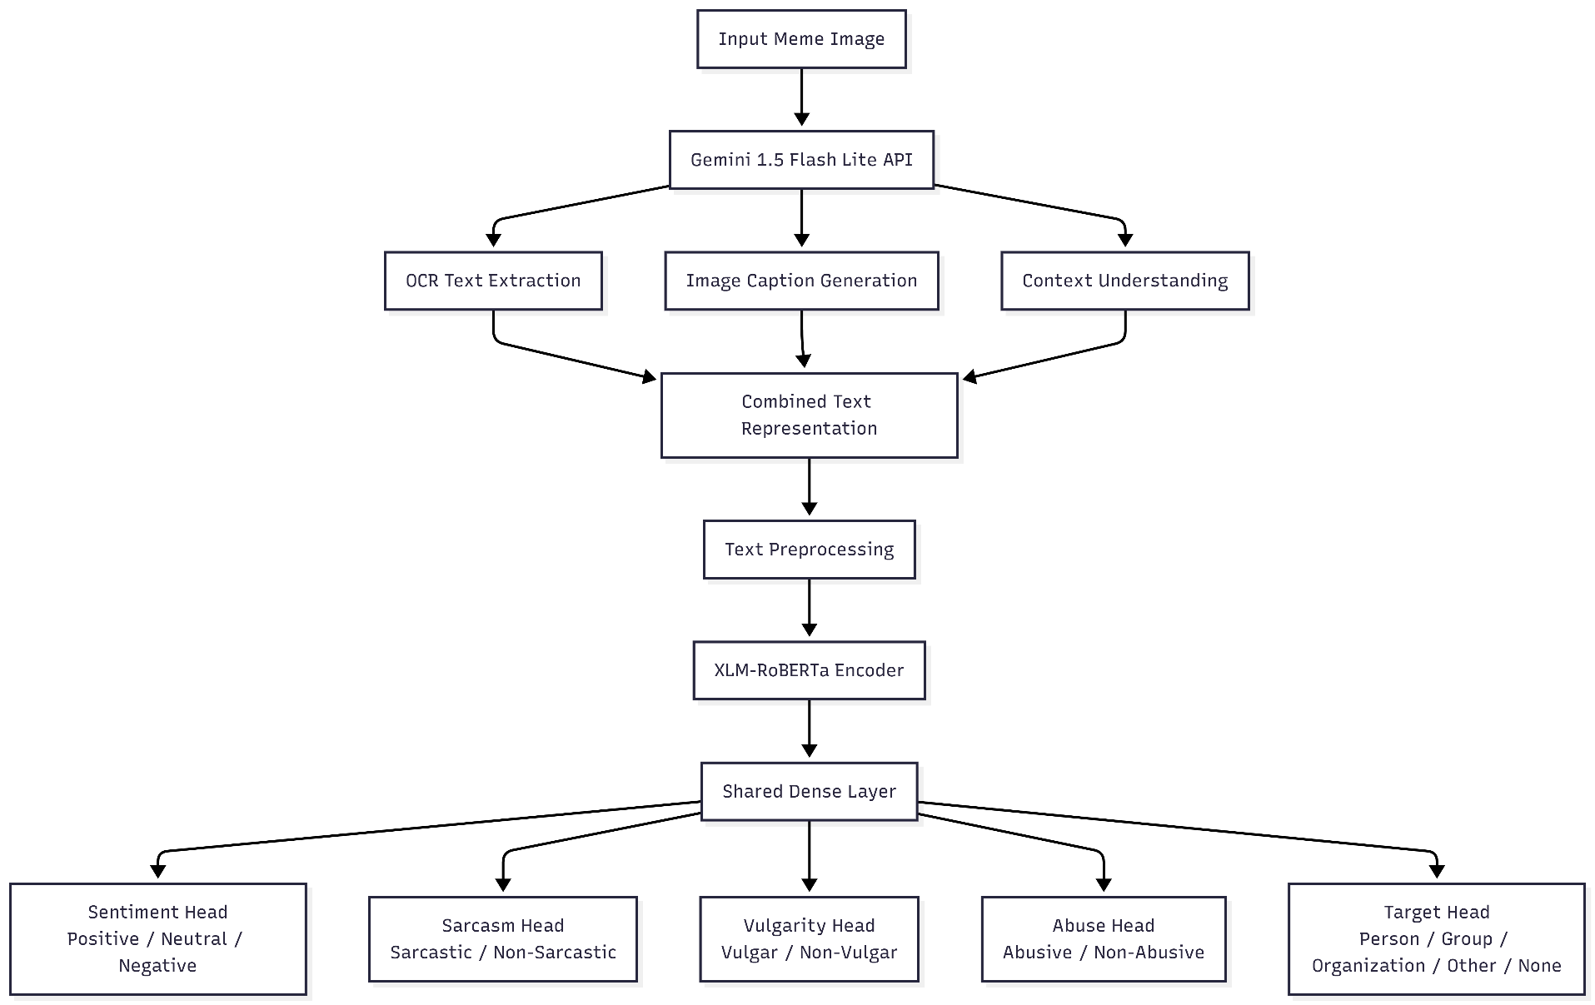
Architecture

Slide 11
Proposed Work with Planned Innovation
Stage | Component | Function
Stage 1 | Gemini 1.5 Flash Lite | Generate OCR, Caption and Context
Stage 2 | Text Preprocessing | Clean and tokenize generated text
Stage 3 | XLM-RoBERTa | Generate contextual embeddings
Stage 4 | Multi-task Classification Heads | Predict Sentiment, Sarcasm, Vulgarity, Abuse and Target
Planned Innovations
Context-aware meme understanding using Gemini.
Unified contextual description combining OCR, caption and semantic meaning.
XLM-RoBERTa for multilingual representation learning.
Multi-task prediction of five labels.

Slide 12
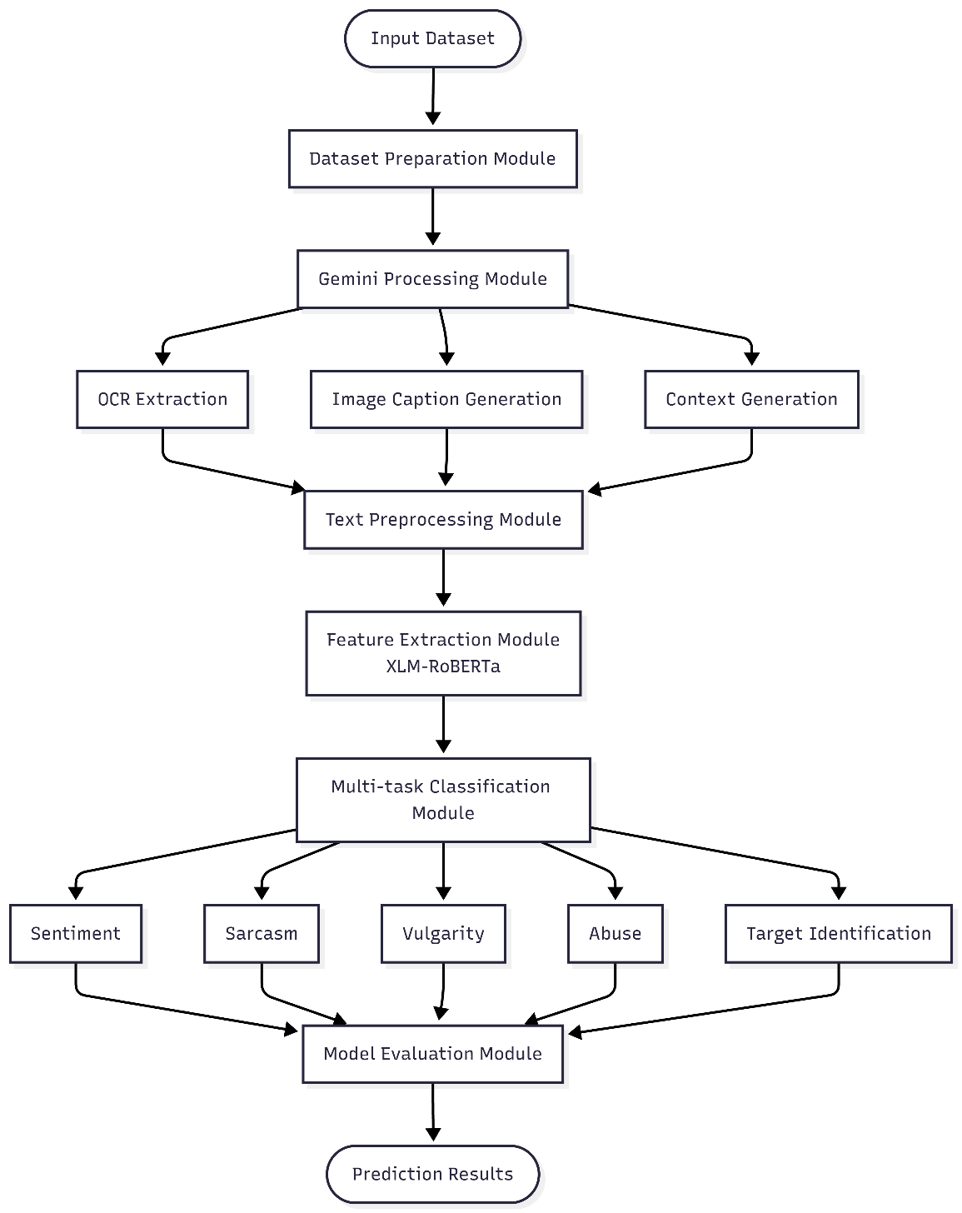
Modules of the Project

Slide 13
Novelty
Gemini 1.5 Flash Lite generates a unified contextual description by combining OCR, image caption, and semantic understanding.
XLM-RoBERTa extracts multilingual contextual features from Gemini-generated text.
A single text-based pipeline eliminates the need for separate multimodal fusion during classification.
Multi-task learning simultaneously predicts Sentiment, Sarcasm, Vulgarity, Abuse, and Target Identification.
Provides an efficient and scalable framework for hate speech detection in Tamil and Telugu memes.

