Slide 1
BESS Trading Strategies & The Role of Price Forecasting
How forecasting transforms battery storage from a scheduled asset into a trading machine
March 2026

Slide 2
BESS Revenue Streams
⚡ Energy Arbitrage
🔄 Frequency Regulation
📊 Capacity Markets
📉 Peak Shaving
⚖️ Balancing Mechanism
Buy low, sell high on spot markets
FCR, aFRR — grid stabilization
Availability premiums for peak demand
Reduce demand charges
Real-time grid balancing
Primary revenue driver Directly forecast-dependent
Contracted availability Low forecast dependency
Long-term contracts Minimal forecast need
Behind-the-meter Partial forecast benefit
High-value, unpredictable Forecasting creates edge
💡 Arbitrage + Balancing = highest forecasting sensitivity → biggest revenue uplift from better predictions

Slide 3
Day-Ahead: Known Prices ≠ Full Picture
✅ What You Know (12–36h ahead)
❌ What You Don't Know
DA auction results published ~12:42 CET for next day
All 24 hourly prices are fixed and known
Optimal charge/discharge schedule can be computed via LP
No forecasting needed for pure DA execution
→ Simple: solve LP against known prices, execute schedule
Intraday continuous prices (can deviate ±50% from DA)
Imbalance / settlement prices (can spike to 1,000+ €/MWh)
Tomorrow's DA prices (needed for multi-day planning)
Whether to reserve capacity for higher-value markets
Battery degradation trade-off: cycle today or save for tomorrow?
→ This is where forecasting creates real value

Slide 4
Five Ways Forecasting Drives Revenue
1
Capacity Allocation
How much battery to commit to DA vs. reserve for intraday/balancing?
Forecast intraday volatility & balancing prices
2
Intraday Trading
Capture spreads between DA and intraday prices
Forecast 15-min intraday prices up to delivery
3
Multi-Day Planning
Skip weak spreads today, cycle on high-spread days
Forecast DA prices beyond known window
4
Imbalance Optimization
Position for settlement price spikes
Forecast system imbalance & balancing activation
5
Negative Prices
Get paid to charge during renewable oversupply
Forecast wind/solar surplus & demand troughs

Slide 5
Forecast Horizons & Methods
Strategic
Tactical
Operational
Trading
Long-Term 1–10 Years
Medium-Term Weeks–Months
Day-Ahead 12–36 Hours
Intraday 0–4 Hours
Application
Application
Application
Application
Investment decision, site selection, PPA pricing
Hedging, maintenance planning, seasonal strategy
Dispatch optimization, auction bidding strategy
Continuous trading, position adjustment
Method
Method
Method
Method
Fundamental models, Merit-Order simulation
Weather ensembles + statistical models
ML models (LSTM, Transformer, XGBoost)
Real-time ML, order book analysis

Slide 6
Revenue Impact: With vs. Without Forecasting
📋 Without Forecasting (DA-Only)
🚀 With Advanced Forecasting
Fixed schedule based on known DA prices
1 cycle per day, no intraday trading
No multi-day optimization
Captures ~50–60% of available revenue
Misses intraday spikes & negative price events
Typical: €80–120k / MW / year
Dynamic dispatch across DA + intraday + balancing
Multi-cycle on volatile days (2–3 cycles)
Degradation-aware multi-day planning
Captures ~80–95% of available revenue
Exploits negative prices & imbalance spikes
Typical: €120–180k / MW / year (+40–60%)
For a 100 MW BESS: forecasting can add €2–5M in annual revenue

Slide 7
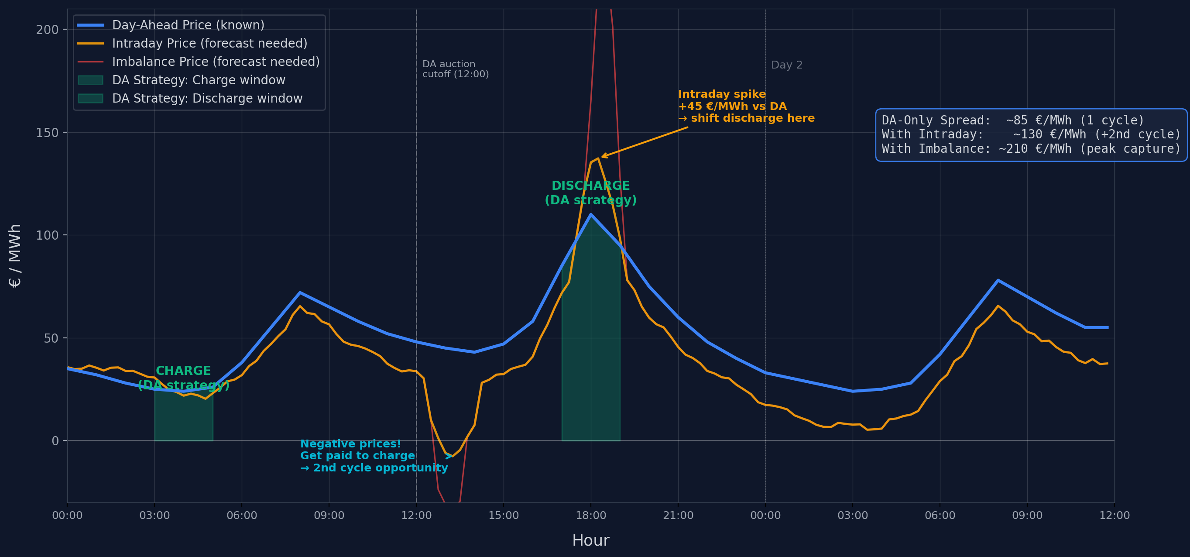
Price Curves: DA vs. Intraday vs. Imbalance — 36h View
Illustrative prices · DA = Day-Ahead (known) · Intraday & Imbalance = forecast-dependent · Spreads compound with multi-cycle and spike capture

Slide 8
Next Frontier: Reinforcement Learning
Traditional: Forecast → Optimize → Execute
Market Data
→
Price Forecast
→
LP/MPC Optimizer
→
Dispatch Schedule
⚠️ Errors at each stage compound — forecast miss → suboptimal dispatch
RL: Market Signals → Optimal Action (End-to-End)
Market Signals
→
RL Agent (PPO/SAC)
→
Optimal Action
✅ No forecast error propagation — learns patterns implicitly
+5–15% vs. traditional forecast + optimize
Best in volatile & intraday markets
Production-ready: Habitat, Tesla, Enspired

Slide 9
Key Takeaways
DA prices are known — but they're only the floor, not the ceiling
Pure DA execution captures ~50–60% of available revenue. The rest sits in intraday, imbalance, and cross-market optimization.
Forecasting unlocks 5 additional revenue levers
Capacity allocation, intraday trading, multi-day planning, imbalance optimization, and negative price exploitation.
Forecast accuracy directly impacts IRR
±5 vs. ±15 €/MWh forecast error can shift project IRR by 3–5 percentage points. For a 100 MW BESS: €2–5M annual difference.
RL is the next evolution — collapsing forecast + optimization
End-to-end learning eliminates forecast error propagation. +5–15% revenue vs. traditional approaches. Already deployed commercially.
The competitive moat in BESS is software, not hardware
Battery hardware is commoditizing. Trading intelligence — forecasting + optimization — is the differentiator.

