Slide 1
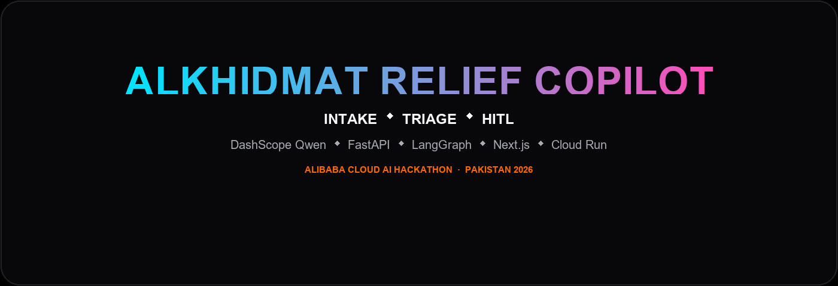
ALKHIDMAT RELIEF COPILOT
From an aid request to a verified ticket — with a human when it matters.
Multi-agent NGO aid desk · Urdu + English · Qwen via DashScope · Alibaba Cloud AI Hackathon Pakistan 2026
LangGraph
FastAPI
Next.js 14
Postgres/pgvector
Qwen / DashScope
github.com/Atif1299/alkhidmat-relief-copilot · relief-web-4idrhaffca-el.a.run.app

Slide 2
THE PROBLEM
Relief requests arrive messy. Critical cases get buried.
● Free-text Urdu/English — incomplete contact and location
● Wrong category routing (food vs medical vs shelter)
● Duplicate requests from the same phone or area
● High-risk medical cases need a human gate — fast
● The first 60 seconds after a request is the bottleneck
github.com/Atif1299/alkhidmat-relief-copilot · relief-web-4idrhaffca-el.a.run.app

Slide 3
OUR SOLUTION
An agentic operations desk that verifies, matches, and routes.
● 6-agent governed pipeline: Intake → Triage → Knowledge → Integrity → Matcher → Dispatch
● HITL supervisor gate for critical or high-risk cases
● Ticket ID + resource match + next-step visibility for everyone
● Urdu and English intake — Qwen via Alibaba DashScope
● SOP retrieval (pgvector RAG) with readable citations
github.com/Atif1299/alkhidmat-relief-copilot · relief-web-4idrhaffca-el.a.run.app

Slide 4
WINNING SIGNAL
Everyone knows what happens next.
After submission
Promise
● Ticket ID: AKD-YYYYMMDD-XXXXXX
● Resource match (inventory + volunteer)
● Or: waiting for supervisor approval
● Full agent trace + case timeline
● One minute to verified ticket
● Integrity never skipped on create
● HITL decisions are traceable
● Citizens never need a staff login
github.com/Atif1299/alkhidmat-relief-copilot · relief-web-4idrhaffca-el.a.run.app

Slide 5
PIPELINE · STEP 1 OF 7
Intake
Language detect · extract need, location, phone, name
Intake
→
Triage
→
Knowledge
→
Integrity
→
HITL Gate
→
Matcher
→
Dispatch
● Detects Urdu vs English automatically
● Extracts structured fields: need, location, phone, name
● Powered by Qwen via DashScope
github.com/Atif1299/alkhidmat-relief-copilot · relief-web-4idrhaffca-el.a.run.app

Slide 6
PIPELINE · STEP 2 OF 7
Triage
Classify: Food, Medical, Shelter, Blood, Education, Other + priority
Intake
→
Triage
→
Knowledge
→
Integrity
→
HITL Gate
→
Matcher
→
Dispatch
● Classifies into 6 categories: Food, Medical, Shelter, Blood, Education, Other
● Assigns priority: low / medium / high / critical
● LLM-based classification with Qwen
github.com/Atif1299/alkhidmat-relief-copilot · relief-web-4idrhaffca-el.a.run.app

Slide 7
PIPELINE · STEP 3 OF 7
Knowledge
Retrieve Alkhidmat SOPs (pgvector RAG or keyword fallback)
Intake
→
Triage
→
Knowledge
→
Integrity
→
HITL Gate
→
Matcher
→
Dispatch
● Retrieves relevant Alkhidmat SOPs for the category
● pgvector similarity search with keyword fallback
● Citations shown as readable purpose + bullet points
github.com/Atif1299/alkhidmat-relief-copilot · relief-web-4idrhaffca-el.a.run.app

Slide 8
PIPELINE · STEP 4 OF 7
Integrity
Duplicate phone check · risk score · fraud heuristics
Intake
→
Triage
→
Knowledge
→
Integrity
→
HITL Gate
→
Matcher
→
Dispatch
● Checks phone / area for duplicate requests
● Computes risk score with fraud heuristics
● Flags cases that need HITL supervisor approval
github.com/Atif1299/alkhidmat-relief-copilot · relief-web-4idrhaffca-el.a.run.app

Slide 9
PIPELINE · STEP 5 OF 7
HITL Gate
Pause graph — wait for supervisor approve / reject
Intake
→
Triage
→
Knowledge
→
Integrity
→
HITL Gate
→
Matcher
→
Dispatch
● Graph pauses via LangGraph interrupt_before
● Supervisor approves → pipeline resumes to Matcher
● Supervisor rejects → case closed with traceable decision
github.com/Atif1299/alkhidmat-relief-copilot · relief-web-4idrhaffca-el.a.run.app

Slide 10
PIPELINE · STEP 6 OF 7
Matcher
Match inventory + assign volunteer by category and area
Intake
→
Triage
→
Knowledge
→
Integrity
→
HITL Gate
→
Matcher
→
Dispatch
● Matches available inventory by category and area
● Assigns nearest volunteer from the pool
● Resource match stored on the case record
github.com/Atif1299/alkhidmat-relief-copilot · relief-web-4idrhaffca-el.a.run.app

Slide 11
PIPELINE · STEP 7 OF 7
Dispatch
Create ticket AKD-… · notify requester · log audit
Intake
→
Triage
→
Knowledge
→
Integrity
→
HITL Gate
→
Matcher
→
Dispatch
● Creates ticket: AKD-YYYYMMDD-XXXXXX
● Logs full audit trail + case events
● Requester sees ticket ID or 'waiting for supervisor'
github.com/Atif1299/alkhidmat-relief-copilot · relief-web-4idrhaffca-el.a.run.app

Slide 12
HUMAN-IN-THE-LOOP
Critical cases pause for human approval.
● Integrity flags duplicate / fraud / high-risk cases
● LangGraph interrupt_before pauses the graph at HITL gate
● Supervisor reviews case with full agent trace
● Approve → pipeline resumes to Matcher → Dispatch
● Reject → case closed with traceable decision and note
● Durable checkpoints survive restarts
✓ Approve
✗ Reject
Governed by LangGraph checkpoints + durable state
github.com/Atif1299/alkhidmat-relief-copilot · relief-web-4idrhaffca-el.a.run.app

Slide 13
PRODUCT DESIGN
Citizens submit publicly. Operators use staff login.
PUBLIC · /request
STAFF · /login (JWT)
● No account or password required
● Landing → Request aid → submit in Urdu or English
● Sees ticket ID or 'waiting for supervisor'
● Check status by ticket + phone on /status
● Desk operator: tickets, dashboard, case detail, PDF
● Supervisor: approve/reject HITL + all desk views
● Agent trace + SOP citations + case timeline
● Role-based API gates (JWT HS256)
github.com/Atif1299/alkhidmat-relief-copilot · relief-web-4idrhaffca-el.a.run.app

Slide 14
ARCHITECTURE
System design
Frontend
→
Backend
Next.js 14 App Router
FastAPI + SSE streaming
↓
↓
Orchestration
Database
LangGraph multi-agent pipeline
PostgreSQL + pgvector
LLM + Embeddings
Qwen via DashScope (Alibaba Cloud)
Deploy
GCP Cloud Run + Cloud SQL (live)
github.com/Atif1299/alkhidmat-relief-copilot · relief-web-4idrhaffca-el.a.run.app

Slide 15
DEMO WALKTHROUGH
Citizen → Desk → HITL → Dispatch
● Open landing (/) and click Request aid
● Submit an Urdu or English request — no account needed
● Watch live pipeline strip: each agent lights as it runs
● See ticket ID or 'Waiting for supervisor' above the fold
● Run a duplicate/critical case to trigger HITL
● Login as supervisor → approve → ticket dispatched
● Open case timeline → export PDF for ops record
● Check status as citizen: ticket + phone on /status
github.com/Atif1299/alkhidmat-relief-copilot · relief-web-4idrhaffca-el.a.run.app

Slide 16
WHAT WE DELIVER
A governed aid desk, ready for real operations.
Product capabilities
Tech stack
● Verified, prioritized ticket creation
● Duplicate detection + integrity risk score
● Resource matching + volunteer assignment
● Supervisor HITL for critical cases
● Agent trace + SOP citations + timeline
● PDF export for desk records
● LangGraph (orchestration + checkpoints)
● FastAPI + SSE real-time streaming
● PostgreSQL + pgvector (RAG)
● Qwen via DashScope (Alibaba Cloud)
● Next.js 14 (App Router)
● GCP Cloud Run + Cloud SQL (live)
github.com/Atif1299/alkhidmat-relief-copilot · relief-web-4idrhaffca-el.a.run.app

Slide 17
ALKHIDMAT RELIEF COPILOT
From messy aid request to verified ticket — with a human when it matters.
Muhammad Atif · P00627 · Alibaba Cloud AI Hackathon Pakistan 2026
github.com/Atif1299/alkhidmat-relief-copilot
Live: relief-web-4idrhaffca-el.a.run.app
github.com/Atif1299/alkhidmat-relief-copilot · relief-web-4idrhaffca-el.a.run.app

