Slide 1
Welcome to our project demonstration
Project Title- Vehicle Maintenance Log.
Demonstrators-
Atif-Ul-Quadir- 2533574042
Amman Latif Opy- 2411360042

Slide 2
Objectives of this project
To create an easy to use vehicle service logger which will keep track of when was the last time the mileage or odometer reading was updated, the last time the registration of car was renewed.
To let the users know if their Engine Oil, Brake Fluid, Transmission Fluid and Tires are needed to be changed by comparing the current odometer reading of the car to last updated odometer reading. This program also checks individually if any of the tasks are due to be done or not. Additionally allows us to renew the registration for a year if it’s due.

Slide 3
To demonstrate how the fundamentals of Object-Oriented Programming (OOP) can be implemented in various ways which are-
Encapsulation
Inheritance
Abstraction
Polymorphism

Slide 4
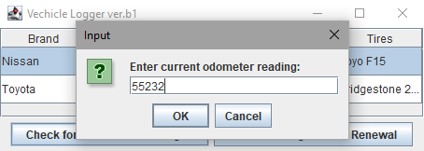
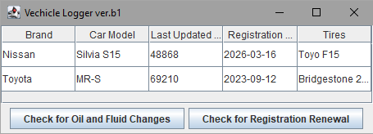
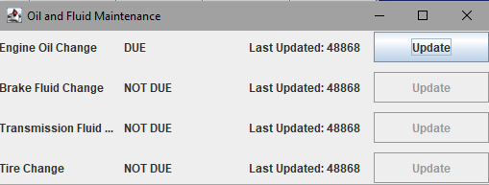
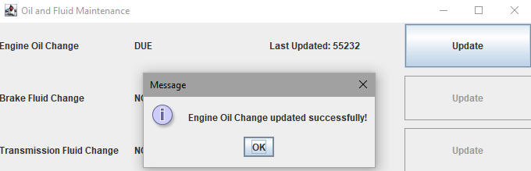
Checks odometer reading
Main screen
If isDue() is true then it lets us update by calling resetCount() for every m1[], m2[]
Calls isDue() and checks every m1[],m2[] element

Slide 5
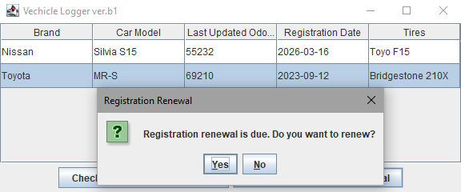
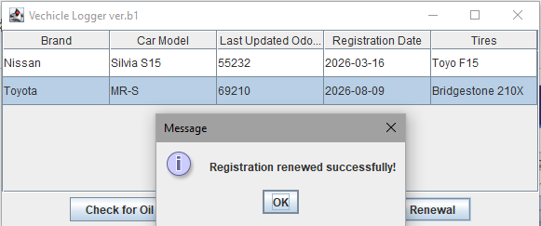
Same goes for registration check, calls isDue() in TimeTask to check every m1[], m2[] if true then returns this pop-up. If we click yes then it invokes resetCounter for m1[4] and m2[4]. To update both LastUpdatedOdometerReading and Registration Date, we have used table.setValueAt() because we could not use File I/O in this project.

Slide 6
Thank you!

