Slide 1

MAWLANA BHASHANI SCIENCE AND TECHNOLOGY UNIVERSITY
SANTOSH,TANGAIL-1902
Presentation Topic: Internet Message Access Protocol Secure (IMAPS) network protocol
Course Name: Computer Networks
Course Title: ICT-3201
Presented by: Presented to :
Name: Md. Atif Rahman Rudro Dr. Nazrul Islam
ID: IT-22002 Associate Professor
Department of ICT,MBSTU

Slide 2
Table of Contents
Email Protocol
Sending VS Receiving Protocol
Some basics of IMAP
Introduction to IMAPS
Illustration of IMAPS along with its working procedure
TLS/SSL mechanism
IMAP VS IMAPS
Application of IMAPS
Advantage of IMAPS
Disadvantages of IMAPS
Future Scope of IMAPS
Conclusion

Slide 3
Email Protocol
Email Protocols generally manage the sending and receiving of emails.
It is usually divided into two categories:
1. Sending Protocol:
SMTP (Simple Mail Transfer Protocol)
Sends email from client (device) to the server
2. Receiving Protocol:
POP3 (Post Office Protocol 3): Downloads emails to one device, usually removes from the server.
IMAP (Internet Message Access Protocol): Keeps email on the server and sync across multiple devices.
IMAPS (IMAP Secure): Secure version of IMAP using SSL/TLS encryption.

Slide 4
Sending VS Receiving Protocols
Protocol | Type | Port | Functions
SMTP | Sending | 25 (Server) 587 (Client) | Sends outgoing email
POP3 | Receiving | 110 (Plain) 995 (Secure) | Downloads mail to device
IMAP | Receiving | 143 | Syncs mail between server and devices
IMAPS | Receiving | 993 | Secure version of IMAP using encryption

Slide 5
Some basics of IMAP
IMAP refers to Internet Message Access Protocol.
IMAP allows us to access emails directly from mail server without downloading them permanently.
IMAP keeps mail on the server, so messages stay synchronized across multiple devices
It supports folders and message flags (read, unread, starred etc). The changes made on one device is reflected on all devices.
Default port: 143(unencrypted), 993(secure IMAP).
Example: Yahoo mail, Gmail, Outlook.
IMAP differ from POP3 for the following reasons:
i) Local storage
ii) Synchronization
iii) Folder structure

Slide 6
Introduction to IMAPS
Refers to Internet Message Access Protocol Secure.
Basis: IMAP over SSL(Secure Sockets Layer)/TLS(Transport Layer Security).
Function: Access email securely from the mail server.
Security: Encrypts all communication between client and server.
Protection: Keeps usernames, passwords and emails safe from hackers.
Storage: Emails remain on the server and sync across devices.
Port: Uses default port 993(secure).
Example: Yahoo, gmail, , microsoft outlook
Use case: Commonly used in professional and corporate environments for secure email handling.
Developed by: Internet Engineering Task Force (IETF) as part of standard email protocols.

Slide 7
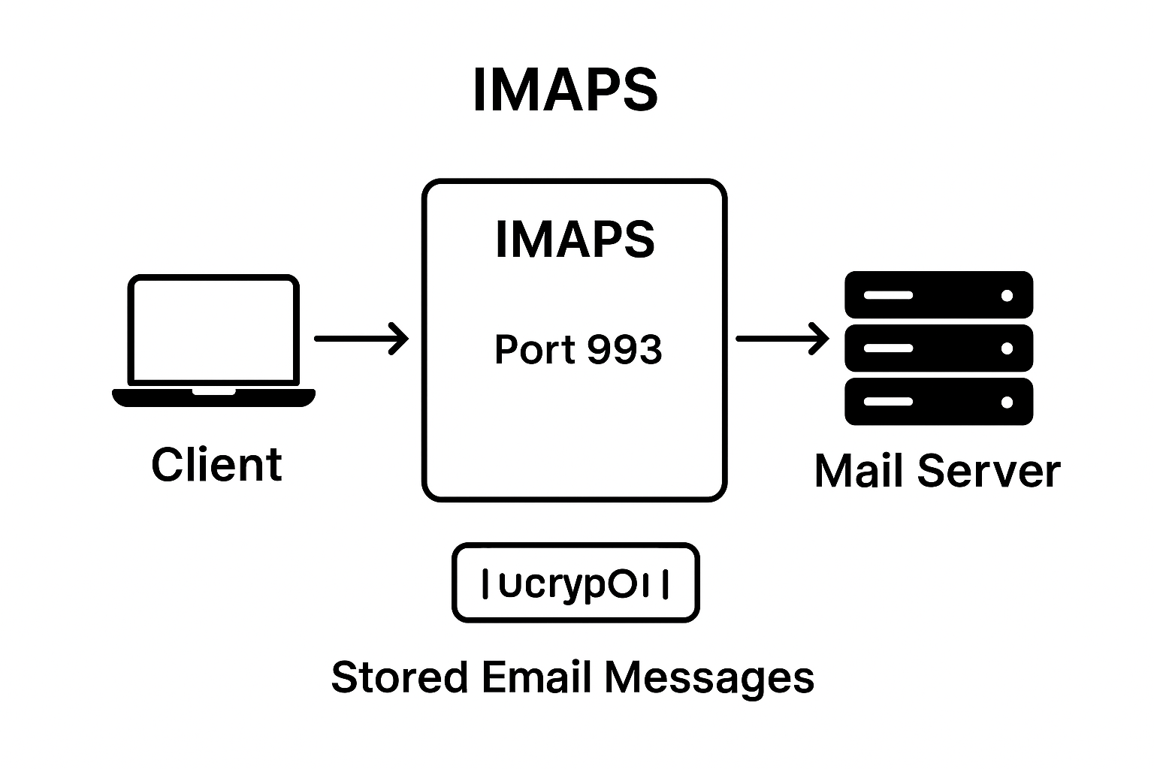
Fig: Secure Email Retrieval using IMAPS Protocol

Slide 8
Working procedure of IMAPS:
The client (user’s device or email app) connects to the mail server using the IMAPS protocol.
The connection is made through Port 993, which is the default secure port for IMAPS.
All data transferred between the client and server is encrypted using SSL/TLS.
The encryption ensures that emails, usernames and passwords remain protected from interception.
The mail server stores all email message, allowing access from any device.
The client can read, delete, or organize emails directly on the server.
All actions are synchronized across devices, providing secure and consistent email access.

Slide 9
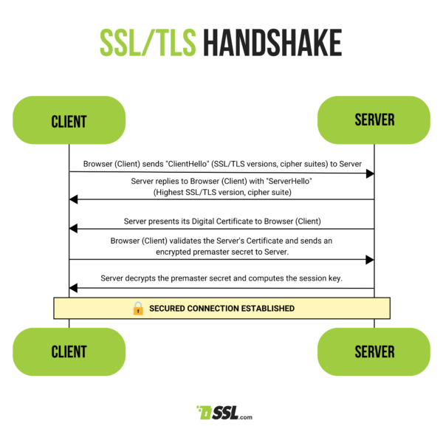
TLS/SSL mechanism

Slide 10
IMAP VS IMAPS
Feature | IMAP | IMAPS
Port | 143 | 993
Encryption | Optional (STARTTLS) | Always SSL/TLS
Security | Basic | High
Performance | Faster | Slightly slower
Usage | Basic systems | Modern secure clients

Slide 11
Applications of IMAPS
Gmail
Yahoo Mail
Outlook
Zoho Mail
AOL Mail
iCloud Mail (Apple mail service)
FastMail
GMX Mail
Tutanota
Proton Mail (privacy-focused encrypted email)

Slide 12
Advantages of IMAPS
Ensures secure communication
Server-Based Email Storage
Accessible from anywhere
Supports Folder Organization
Easy Data Backup and Recovery
Synchronizes across devices
Improved collaboration

Slide 13
Disadvantages of IMAPS
Requires Constant Internet Connection
Higher Server Storage Usage
More Bandwidth Consumption
Complex Setup for Beginners
Server Dependency
Security Dependency
Slower performance for large mail
Limited control over local storage

Slide 14
Future Scope of IMAPS
Enhanced Security Protocols
Integration with Cloud Services
AI-powered Email Management
Better performance and speed
Support for IoT and Smart Devices
Energy-Efficient Email Servers

Slide 15
Conclusion
IMAPS provides a secure way to access and manage emails by using SSL/TLS encryption, ensuring that communication remains private. Emails stay safely stored on the server, protecting data from loss or unauthorized access. Users can access their emails from multiple devices at any time, making it highly convenient. IMAPS also supports folder organization and synchronization, allowing better management of emails. It reduces the risk of email theft and ensures that sensitive information remains confidential. Additionally, it allows seamless communication across platforms, improving productivity and collaboration. Overall, IMAPS combines security, flexibility, and reliability, making it an essential protocol for modern email communication.

Slide 16
References
GeeksforGeeks – “Difference Between IMAP and IMAPS” (https://www.geeksforgeeks.org/)
Tutorialspoint – “IMAP and IMAPS Working Explained” (https://www.tutorialspoint.com/)
Microsoft Learn. “IMAP and IMAPS Email Protocols Explained.” https://learn.microsoft.com/

Slide 17


