Slide 1
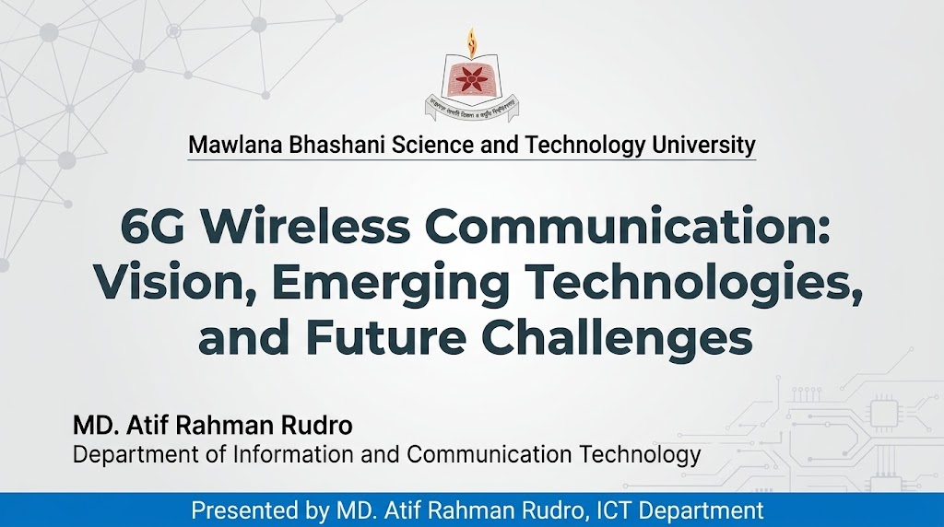

Slide 2

Presentation Outline
01
Introduction and research problem
02
Related work and research gap
03
Proposed solution and methodology
04
Experiments and results
05
Conclusion
6G Architecture & Requirements
02

Slide 3
Introduction and Research Problem
5G networks may not meet the future needs for very high data rates, low latency, and global connectivity.
01
Future applications like holographic communication, smart vehicles, and flying robots need faster and more reliable networks.
02
Traditional networks face coverage problems, signal loss at high frequencies, and difficulties supporting many connected devices.
03
To analyze a 3D Space-Air-Ground 6G architecture and evaluate its performance against current 5G networks.
6G Architecture & Requirements
03

Slide 4
Related Work and Research Gap
Study / approach | Key idea | Relevant limitation
ITU-R M.2160 [1] | Describes the future vision and goals of 6G. | Does not provide a complete performance comparison of integrated network layers.
SNS JU 6G KPI Report [2] | Defines important 6G performance indicators and targets. | Focuses mainly on KPIs mainly.
Research on AI-based 6G networks [3] | Studies AI-based network planning and high-frequency communication. | May not fully evaluate satellite, aerial, and ground networks together.
Limited comparative evaluation of integrated 3D space-air-ground 6G networks and 5G networks across different frequency bands under the same simulation conditions.
Research gap
6G Architecture & Requirements
04

Slide 5
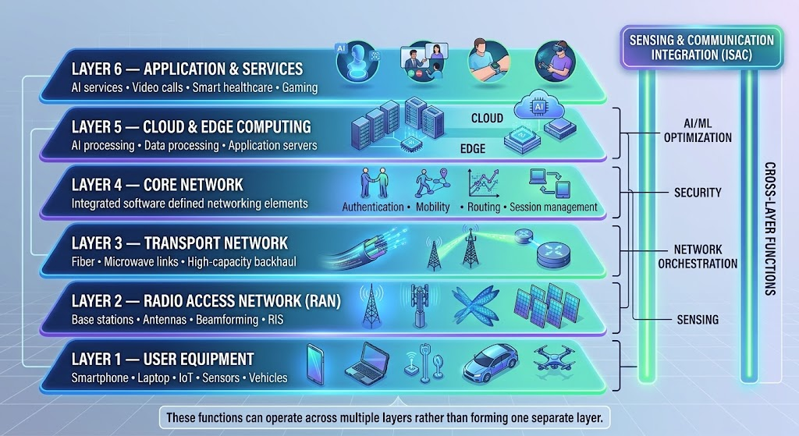
Methodology
Integrated Space-Air-Ground 6G Architecture
[Insert the solution architecture or core model]
01
[Step 1: Input preparation]
Define frequency bands, user density, and network nodes.
02
[Step 2: core procedure]
Calculate path loss, data rate, latency, and RIS performance.
03
[Step 3: output]
Compare 5G and 6G using graphs and performance metrics.
6G Architecture & Requirements
05

Slide 6
Experimental Setup
Data / study setting
Simulated network conditions using 28 GHz and 100–300 GHz frequency bands.
Baselines / comparisons
Traditional 5G network vs. 5G-Advanced vs. integrated 6G architecture.
Evaluation metrics
Peak Data Rate, Latency, Reliability, Connection Density, Energy Efficiency.
Implementation / protocol
Python or MATLAB simulations using suitable propagation models and published 5G/6G standards.
6G Architecture & Requirements
06

Slide 7
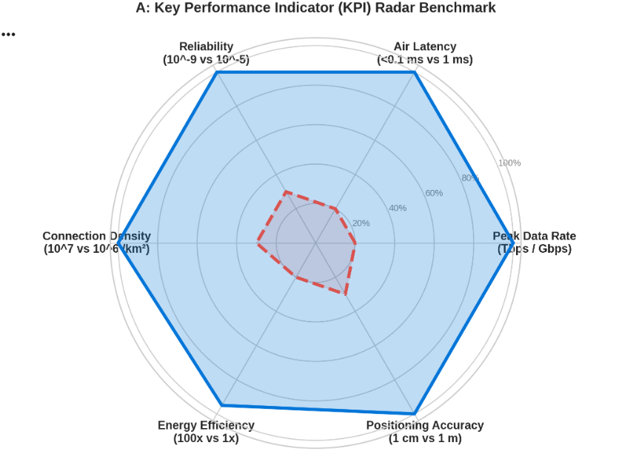
Results and Discussion
Main finding
Integrated 6G networks may provide higher data rates, lower latency, and wider coverage than traditional 5G networks.
High-frequency bands offer more bandwidth, while satellites, UAVs, and RIS may help improve connectivity.
[Insert your main results chart or figure]
6G Architecture & Requirements
07

Slide 8
Quantitative Comparison
Method | Peak Data Rate | Latency | Connection Density
5G Standard | 20 Gbps | 1 ms | 10⁶ devices/km²
5G – Advanced | Depends on configuration | Depends on configuration | 144.43
6G vision | 157.31 | < 0.1 ms | Target up to 10⁷ devices/km²
The 6G vision aims to improve data rates, reduce latency, and support more connected devices than 5G.
6G Architecture & Requirements
08

Slide 9
Conclusions and Future work
Integrated satellite, aerial, and ground networks are promising approaches for supporting future 6G communication requirements.
01
Study the architecture and performance requirements of integrated 6G networks.
02
Simulation results may differ from real-world performance because of signal loss, hardware limitations, and environmental conditions.
03
Develop more realistic simulations and investigate AI-based resource management and energy-efficient network design.
6G Architecture & Requirements
09

Slide 10
Selected References
[1] ITU-R, “Framework and overall objectives of the future development of IMT for 2030 and beyond,” Recommendation ITU-R M.2160-0, 2023.
[2] Smart Networks and Services Joint Undertaking (SNS JU), 6G KPIs – Definitions and Target Values, technical report.
[3] V. R. Farré Guijarro et al., “AI-Driven Framework for 6G Radio Access Network (RAN) Planning and Dimensioning: Theory and System-Level Simulation,” IEEE Access, vol. 14, pp. 45863–45881, 2026. https://doi.org/10.1109/ACCESS.2026.3671648
[4] N. Cheng et al., “6G Service-Oriented Space-Air-Ground Integrated Network: A Survey,” Chinese Journal of Aeronautics, vol. 35, no. 9, pp. 1–18, 2022. https://doi.org/10.1016/j.cja.2021.12.013
6G Architecture & Requirements
10
Notes:
Use a consistent reference style, preferably IEEE numbering, and match citations used in the presentation. Include the few references that the audience needs. Replace every bracketed field. Use an additional reference slide if needed rather than making the text too small.
Branding sources: official COMPAS 2026 logo and University of Dhaka crest downloaded unchanged from https://www.compasconf.org/ on 2 October 2026. IEEE Computer Society Bangladesh Chapter logo extracted unchanged from the user-supplied COMPAS2025_Oral_Presentation_Template.pptx.

Slide 11
Thank you
Questions and Discussion
MD. Atif Rahman Rudro
Mawlana Bhashani Science and Technology University
Email address : it22002@mbstu.ac.bd
6G Architecture & Requirements
11
Notes:
Replace the contact details and use this slide during questions. An optional paper, project or code link can be added if appropriate. Remove unused placeholders. Keep backup slides after this slide if they help answer questions.
Branding sources: official COMPAS 2026 logo and University of Dhaka crest downloaded unchanged from https://www.compasconf.org/ on 2 October 2026. IEEE Computer Society Bangladesh Chapter logo extracted unchanged from the user-supplied COMPAS2025_Oral_Presentation_Template.pptx.

