Slide 1
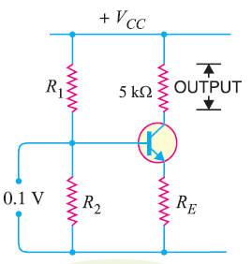
Single Stage Transistor Amplifiers

Slide 2
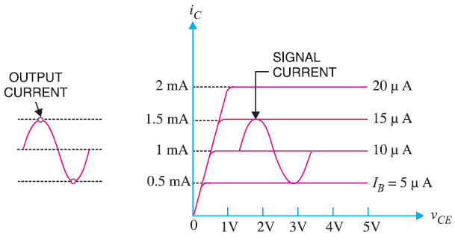
Graphical Demonstration

Slide 3
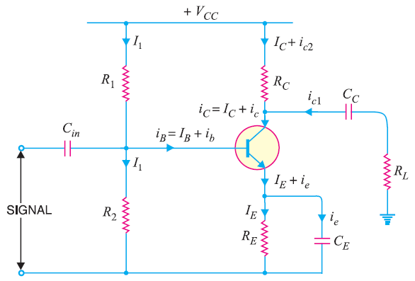
Practical Circuit of Transistor Amplifier

Slide 4
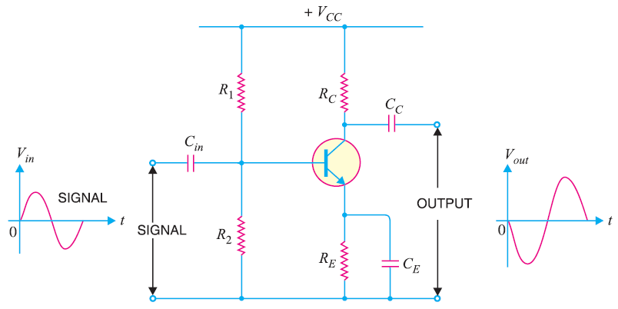

Phase Reversal in CE Connection

Slide 5
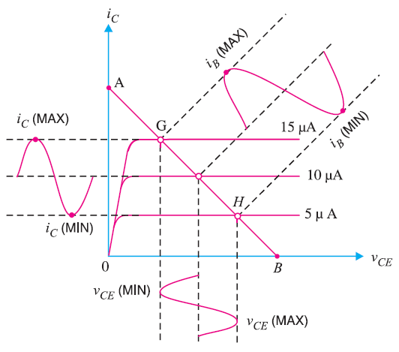
Graphical Demonstration

Slide 6
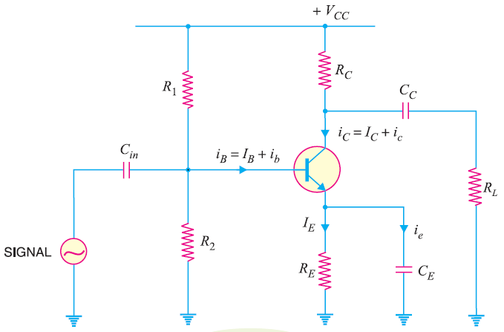
D.C. and A.C. Equivalent Circuits

Slide 7
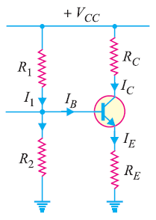
D.C. Equivalent Circuits

Slide 8
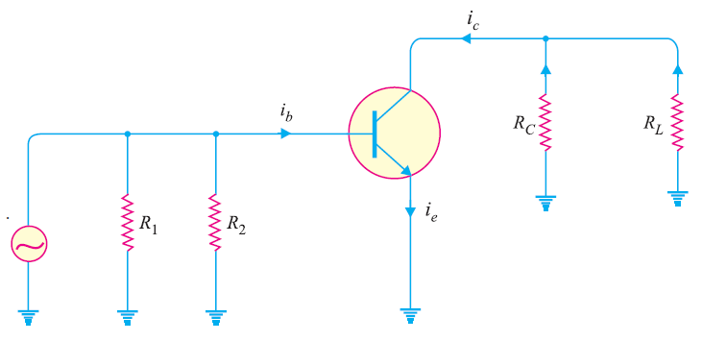
A.C. Equivalent Circuits

Slide 9
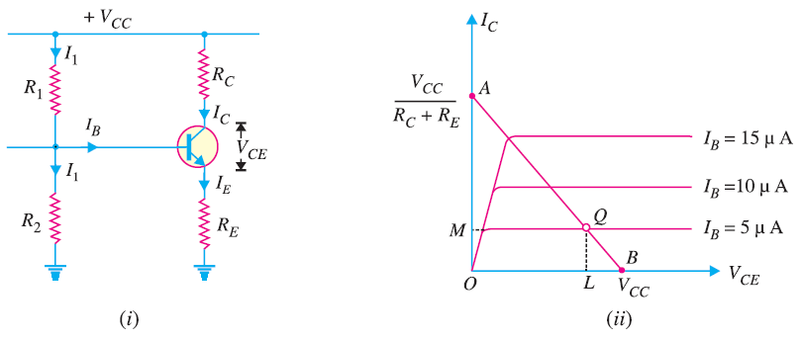

D.C. Load Line Analysis

Slide 10
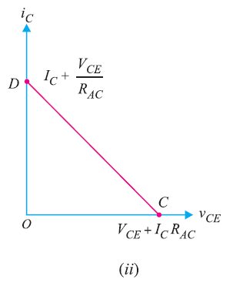
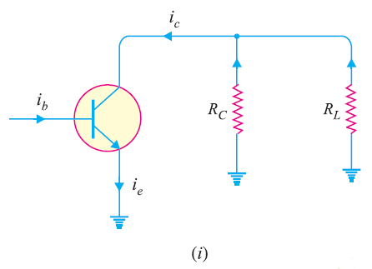

A.C. Load Line Analysis

Slide 11
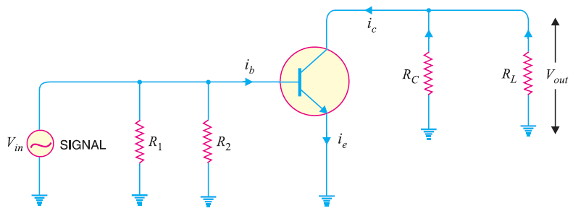

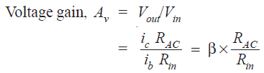
Voltage Gain

