Slide 1
North South University Department of Electrical and Computer Engineering CSE/EEE/ETE-499B Senior Design Project Spring – 2021 Advisor DR. ATIQUR RAHMAN Associate Professor Department of Electrical and Computer Engineering
Name | ID
Muhtasim Rafid Ahmed | 1530194043
Atik Mahmud | 1711633042
Fareeza Sharara karim | 1631847645

Slide 2

Introduction
Basically a wearable hardware based project is developed which is for mute, deaf and disable people using standard ASL 30 sign language.
When he/she wear the gloves then he/she moves his/her hand according to sign language then it is converting into English and the output will come through the speaker
Through this project those unable people can share anything and the most important parts are medical and educational site. They can be educated and in emergency case for medical issue they can co-operate with doctor.

Slide 3
Speaking System For physically Disable people
3
3
Create sign language
02
.
Create language Sound
01
03
Display The Language

Slide 4
Equipment’s list
Arduino Uno
Flex sensors
Speaker module
Gloves
Bread board, wire, clips, resistors
Buck Converter
Arduino software (IDE)
12V Lithium Ion Battery
Amplifier
Switch

Slide 5
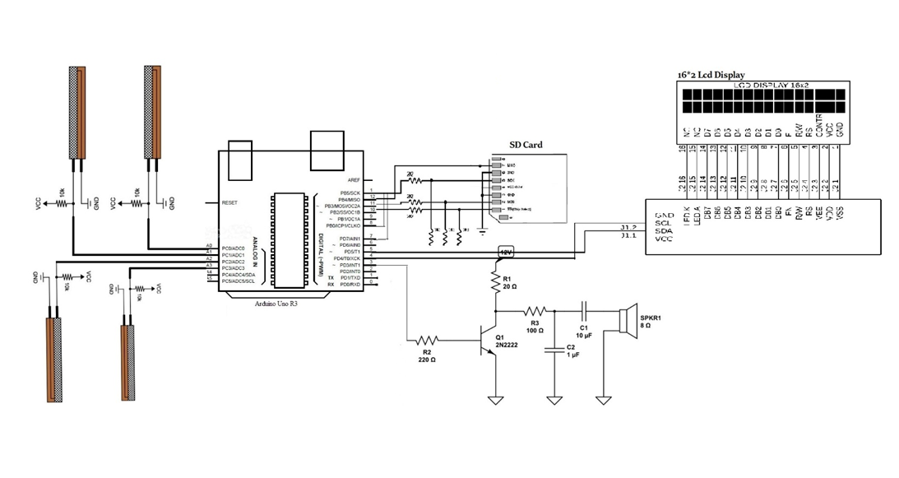
Circuit Setup

Slide 6
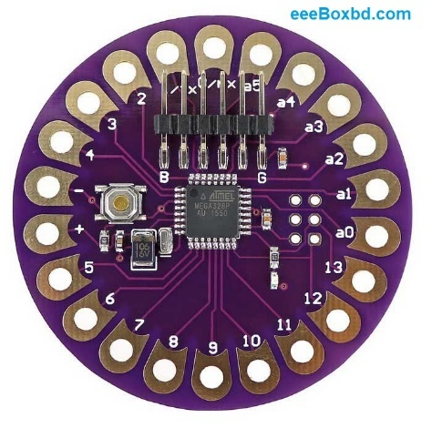
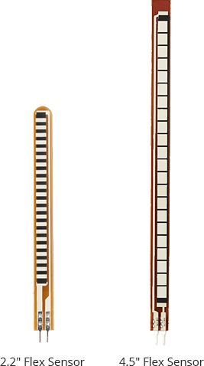
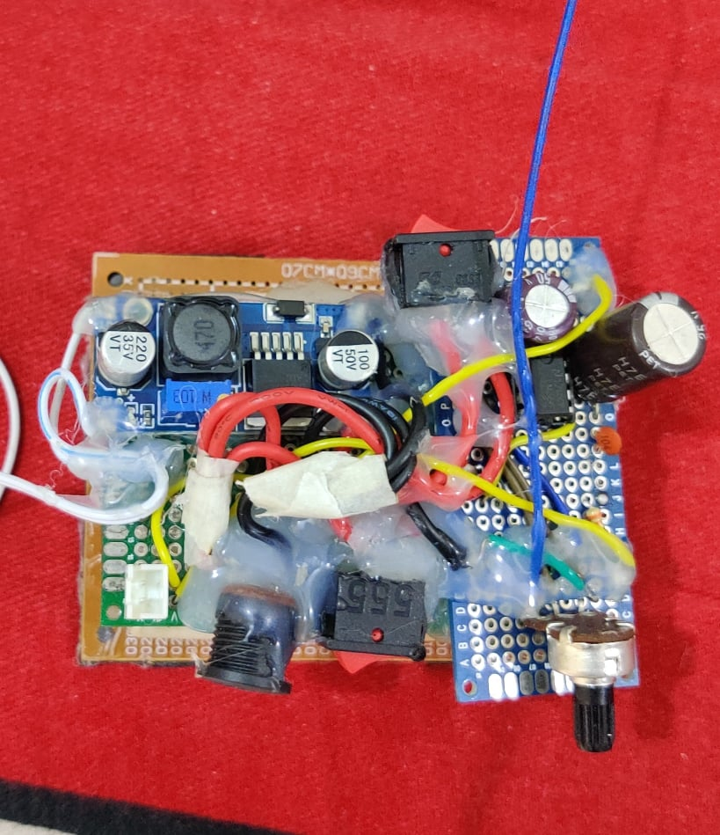
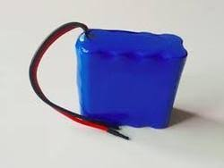
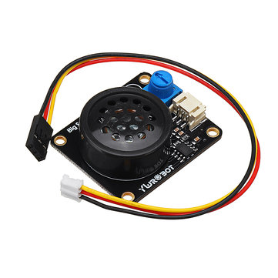
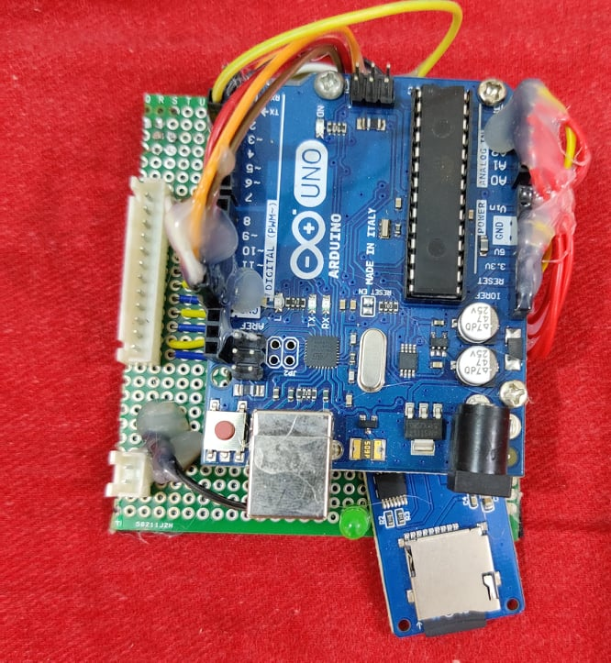
Some pictures of the tools and technologies
Arduino Lilypad
Flex Sensor
Amplifier
Battery
Speaker module
Controller

Slide 7

7
Block Diagram
Display
Power system
Controller
Sound System
Input signal 1
Input signal 2
Input signal 3
Input signal 4
Hardware
system

Slide 8
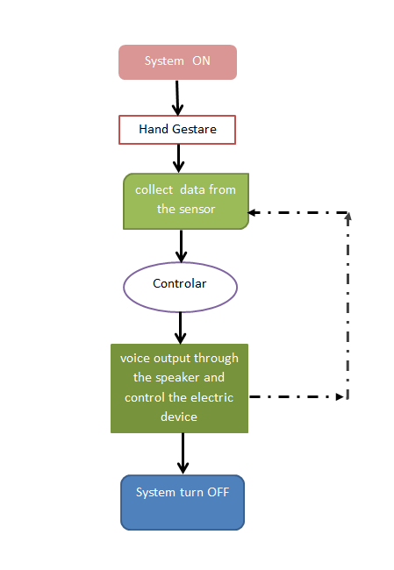
Flow Chart

Slide 9
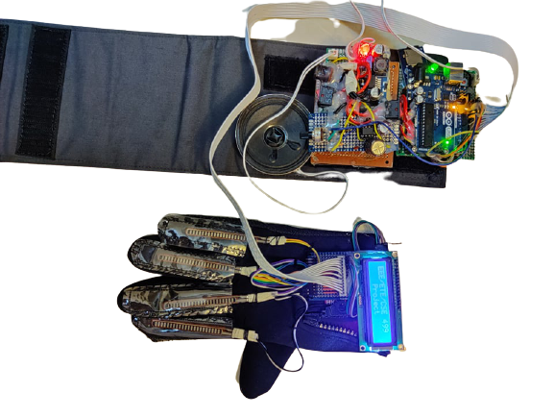
Hardware Setup

Slide 10
Output
SN | 8 bit Logic |  |  |  |  | Out put
1 | 0 | 0 | 0 | 0 | 1 | Asslamu Alikum ,Sir
2 | 0 | 0 | 0 | 1 | 0 | I Feel Bad, Need Help
3 | 0 | 0 | 0 | 1 | 1 | Thank you ,Sir
4 | 0 | 0 | 1 | 0 | 0 | I Sense problem ahead

Slide 11
Methodology used
Controller Arduino
GitHub methods
Flex sensor
Frequency converter

Slide 12
Features and Applications
Features:
Low cost
Compact System
Flexible to users
It takes less power to operate the system
Applications:
Physically challenged persons.
Conveying information related operations

Slide 13
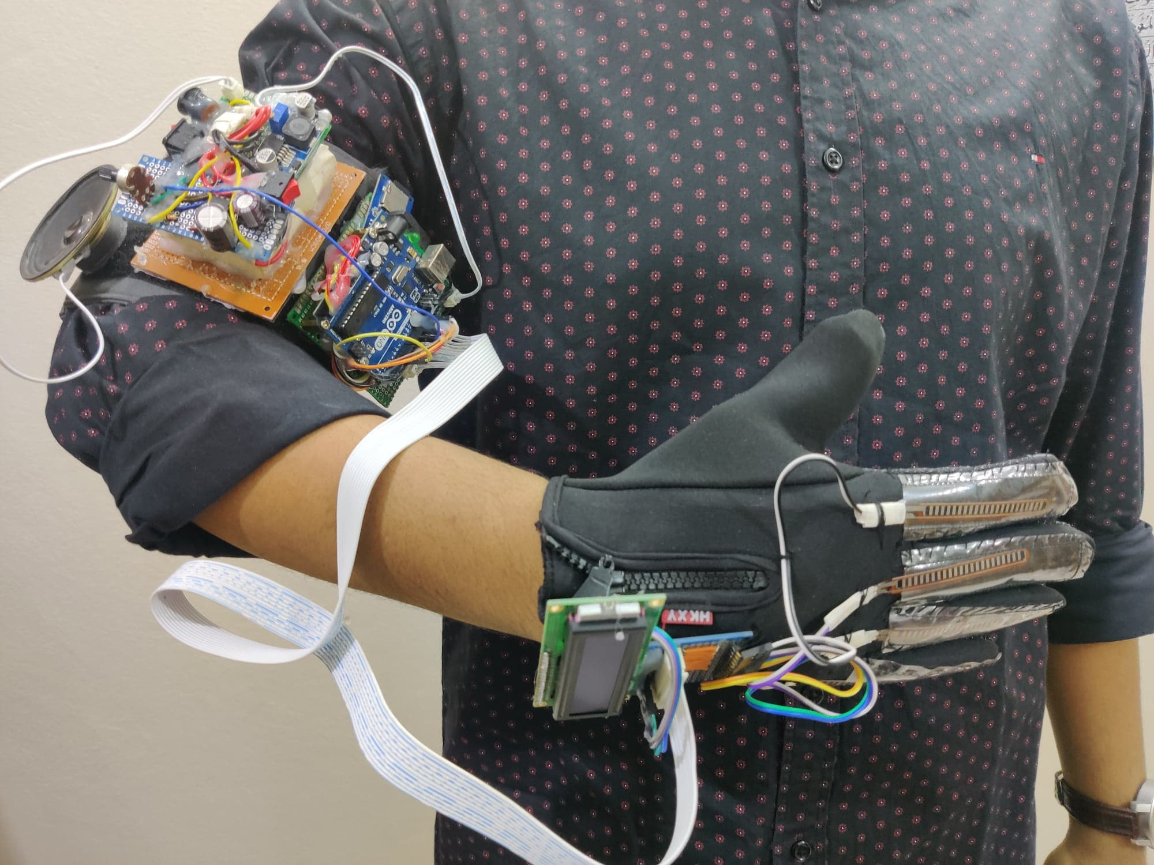
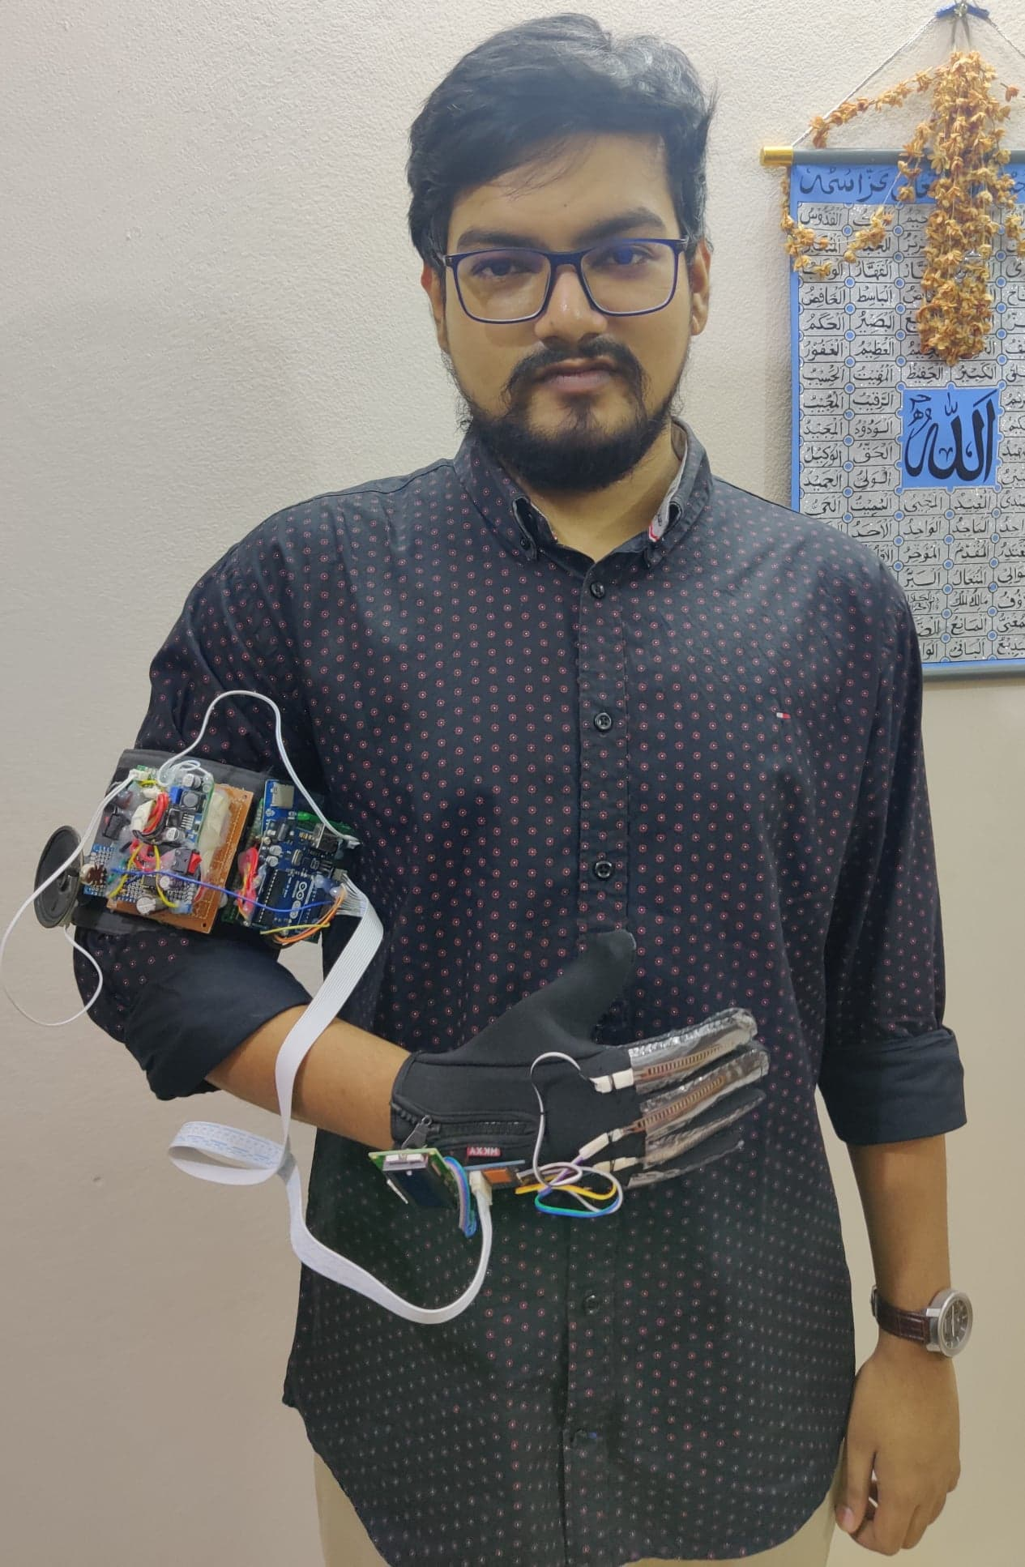
Project Implementation

Slide 14
Conclusion
The system is designed to facilitate a communication way of the deaf / mute people. Deaf people can easily communicate with normal people, easy to accomplish, easy to make change of sensor windows according to wearing hand, portable design use a 12V Lithium Ion battery and it produced an audio output.
In 499A, the device was not portable. In 499B, we tried to make the device portable so that movement can be easier and less complex.

Slide 15
Thank
You

