Slide 1
Dataset Analysis - Drug Consumption
Python for Data Analysis – DIA4
Jesse OHOUENS
Atik MOHAMED MOUKTAR

Slide 2

Table of contents
Description of the dataset
Dataset Cleaning
Data Visualisation
Prediction Models
API Flask
https://github.com/Atik14/DrugConsumption_Analysis

Slide 3
Description of the dataset
Our dataset contains information about how often a person uses different drugs.
It contains 1885 tuples that correspond to the different people surveyed.
13 personality attributes of the respondents are known:
1. ID | 2. Age
3. Gender | 4. Education
5. Country | 6. Ethnicity
7. Nscore (Neuroticism) | 8. Escore (Extraversion)
9. Oscore (Openness to experience) | 10. Ascore (Agreeableness)
11. Cscore (Conscientiousness) | 12. Impulsive (Impulsiveness)
13. Sensation Seeing

Slide 4
Description of the dataset
Everyone was asked about their last use of 19 different legal and illegal drugs.
1. Alcohol | 2. Amphetamines
3. Amyl nitrite | 4. Benzos
5. Caffeine | 6. Cannabis
7. Chocolate | 8. Cocaine
9. Crack | 10. Ecstasy
11. Heroin | 12. Ketamine
13. Legal highs | 14. LSD
15. Methadone | 16. Mushrooms
17. Nicotine | 18. Fictitious Drug Semeron
19. Volatile Substance Abuse (VSA)

Slide 5
Description of the dataset
They had a choice of 6 options for answers
For the rest of the study, it is important to specify that we take these answers in a binary way, all those from CL4 onwards are considered as drug users and the others are not. It is a rather strict sharing, but it was a choice in order to have a real idea of the regular consumers like cigarettes.
CL0 | Never Used
CL1 | Used over a Decade Ago
CL2 | Used in Last Decade
CL3 | Used in Last Year
CL4 | Used in Last Month
CL5 | Used in Last Week
CL6 | Used in Last Day

Slide 6
Dataset Cleaning
First of all, before starting the analysis, importance must be given to data cleansing. This will ensure the quality of the data to produce reliable and accurate analyses.
We must be careful with N/A values and remove data that are not relevant to the analysis such as IDs.
We have also converted the numerical values to nominal values for some classes in order to have more meaningful values.

Slide 7
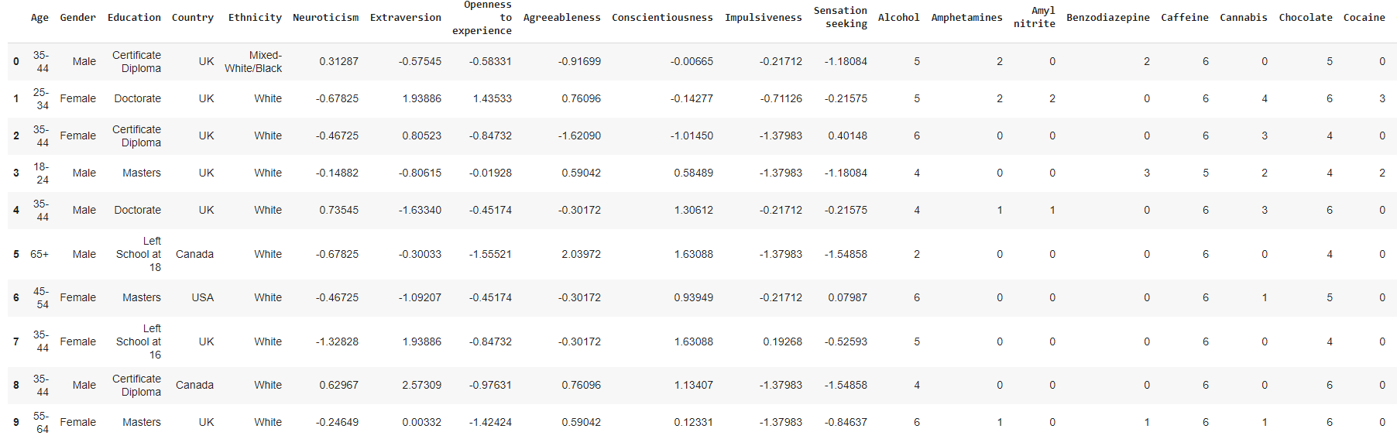
Dataset Cleaning
There is a preview of the data after cleaning it.

Slide 8
Data Visualisation
This dataset contains a lot of information about individuals.
We will thus represent these data in the form of graphs in order to better observe the distribution of the various types of individuals.

Slide 9
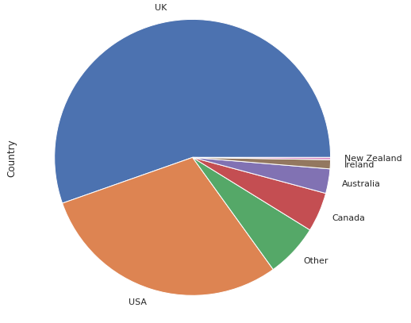
Data Visualisation
Here is a graph of the distribution of individuals according to their country.
We can see that they come mainly from the United Kingdom and the United States.
We have principally here the population of only 6 countries, so it does not represent the world population.

Slide 10
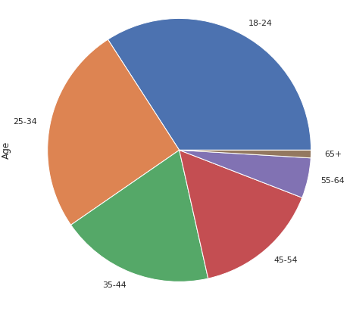
Data Visualisation
Here is a graph of the distribution of individuals according to their age group.
Most of the individuals interviewed are rather young, they are between 18 and 34 years old.

Slide 11
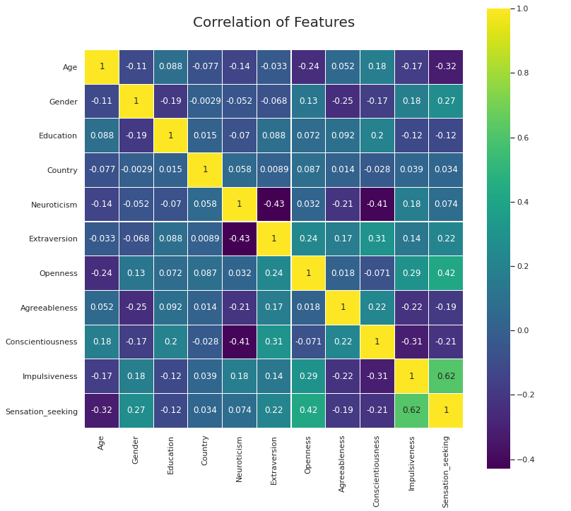
Data Visualisation
Here is a graph of correlations between the different personality attributes of an individual.
In particular, we can see that neuroticism is negatively correlated with extraversion and conscientiousness.

Slide 12
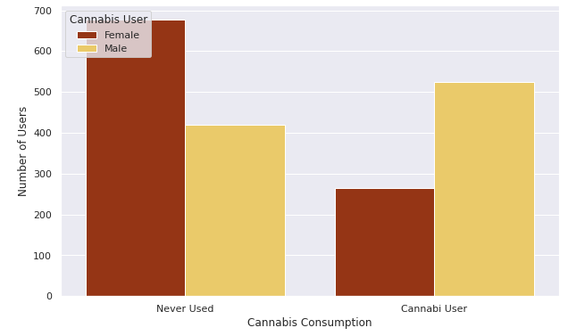
Data Visualisation
Here is a graph of cannabis use by gender.
It can be seen that men use more cannabis than women.
We considered an individual to be a cannabis user if he or she has used cannabis at least this month.

Slide 13
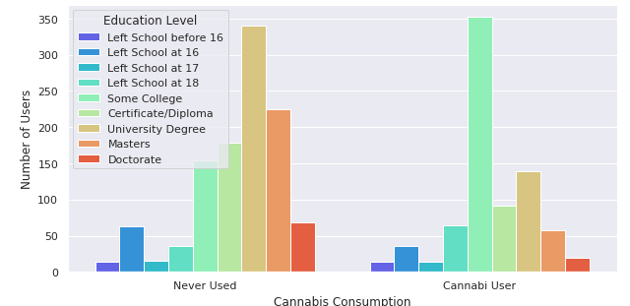
Data Visualisation
Here is a graph of cannabis use according to an individual's level of education.
It can be observed that cannabis users have mainly completed a few years of college and that non-users have mainly university degrees and masters degrees.

Slide 14
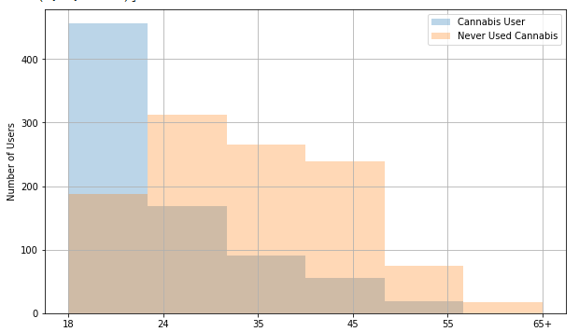
Data Visualisation
Here is a graph of cannabis use or never used cannabis according to different age groups.
It can be observed that cannabis users have mainly in the 18-24 age groups. It can already be concluded that the regular use of cannabis comes mainly from relatively young people.

Slide 15
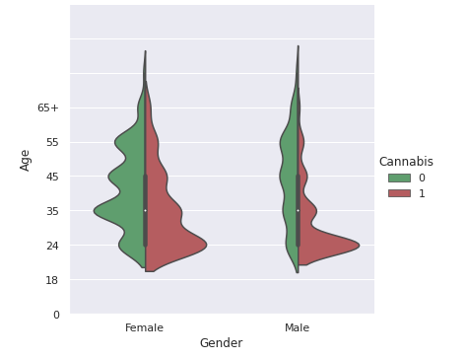
Data Visualisation
Here is a graph of cannabis use in relation to age in combination with gender.
We can observe that the previous observations are confirmed, and this allows a more global visualization of the target individual that we are gradually starting to create : "The young male" ( 0 = Not Use Cannabis, 1 = Use Cannabis )

Slide 16
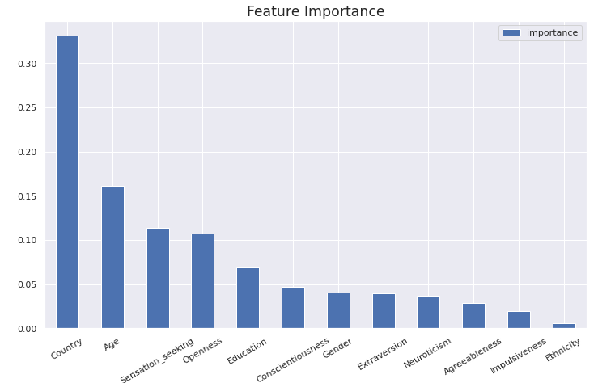
Data Visualisation
Here is a graph of the importance of different features.
We can observe that the country is an essential element in the consumption of cannabis, which is quite logical, given that some states allow it. Somewhat more generally the demographic elements are relatively more important than the other elements.

Slide 17
Prediction Models
From this dataset, there were many possible predictions according to the different drugs.
In our case, we will focus more specifically on cannabis use because it is a drug that is becoming more and more legalized in different countries, such as Canada recently in 2018.
We have therefore conducted an analysis based on an individual's attributes and the frequency with which he or she uses different drugs in order to determine if he or she is a cannabis user.

Slide 18
Prediction Models
Our Team’s goal was to find the best machine learning model to predict cannabis users when looking at features such personality traits and demographics.
Find and apply the machine learning model with the most accurate prediction the data set and predict the potential risk of cannabis use
The target prediction is to determine if the selected features influence the use of cannabis among our data respondents.

Slide 19
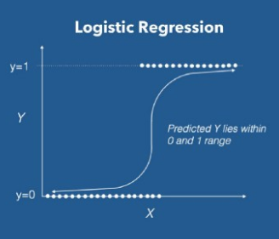
Prediction Models
Among the different possible prediction model possibilities, we chose to transform the dataset into a binary classification problem comprising 2 classes: Cannabis User and Cannabis Non-User.
To solve it, we immediately thought of using a logistic regression model.
Logistic Regression is a Machine Learning algorithm which is used for the classification problems, it is a predictive analysis algorithm and based on the concept of probability.

Slide 20
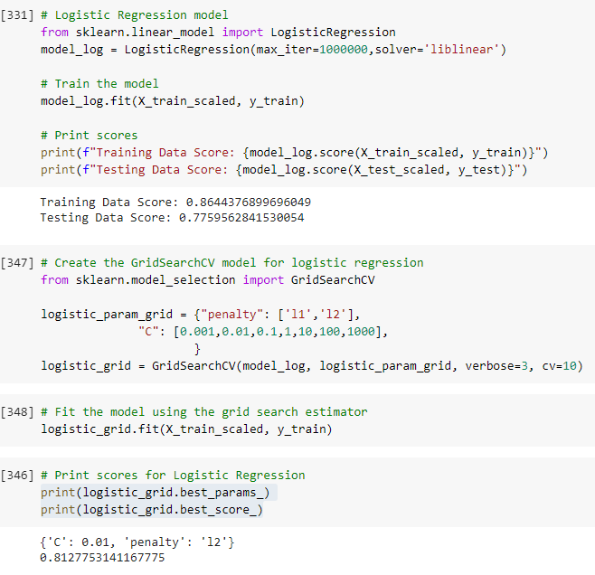
Prediction Models
Logistic Regression
Accuracy : 0.8127753141167775

Slide 21
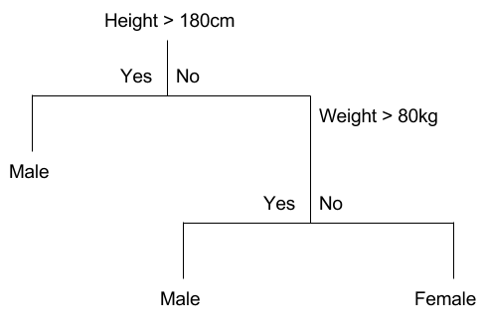
Prediction Models
Then, we also tried a Decision Tree prediction model to compare accuracies.
A Decision Tree is a simple representation for classifying examples. It is a Supervised Machine Learning where the data is continuously split according to a certain parameter.

Slide 22
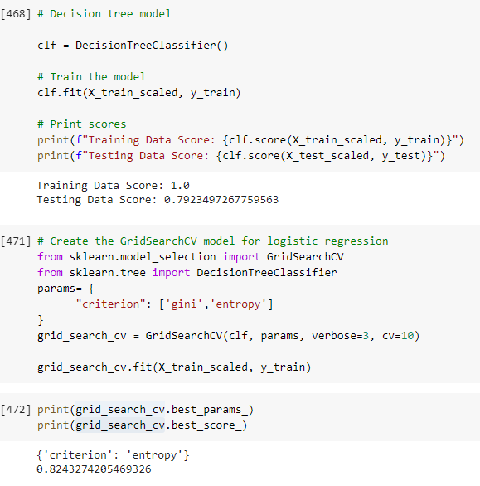
Prediction Models
Decision tree
Accuracy : 0.8243274205469326

Slide 23
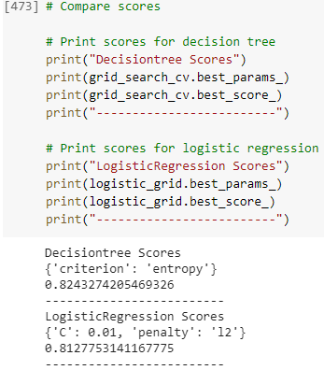
Model Results comparison
Decision Tree > Logistic Regression
This model gave us the best result.

Slide 24
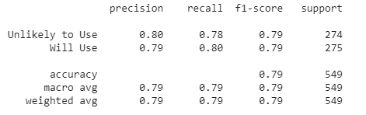
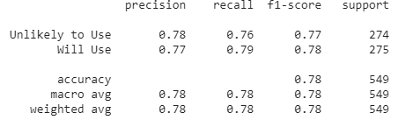
Model Results comparison
Decision Tree Model Results
Decision Tree > Logistic Regression
This model gave us the best result.
Logistic Regression Model Results

Slide 25
API
API is the acronym for Application Programming Interface, which is a software intermediary that allows two applications to talk to each other.
We defined in our API a method that takes in parameter individual's attributes and from it, it predicts whether the individual will be a cannabis user or not.
Flask is a web framework. This means flask provides you with tools, libraries and technologies that allow you to build a web application.

Slide 26

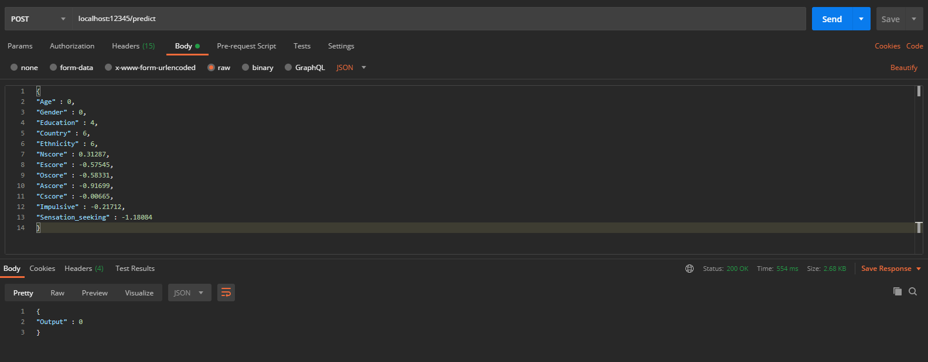
API Flask
Passing a JSON via a POST request in the following format :
{ "Age" : Number, "Gender" : Number, "Education" : Number, "Country" : Number, "Ethnicity" : Number, "Nscore" : Number, "Escore" : Number, "Oscore" : Number, "Ascore" : Number, "Cscore" : Number, "Impulsive" : Number, "SS" : Number }

Slide 27
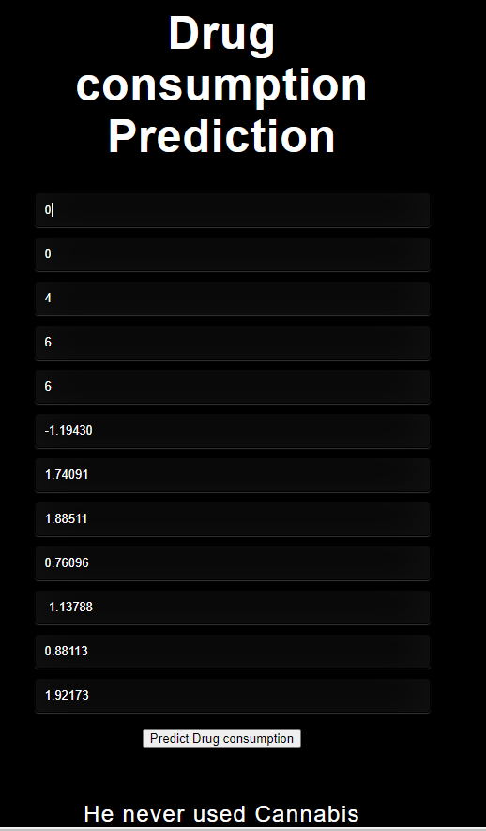
API Flask
We also tried to do a web interface, but unfortunaly it doesn’t work.

