Slide 1



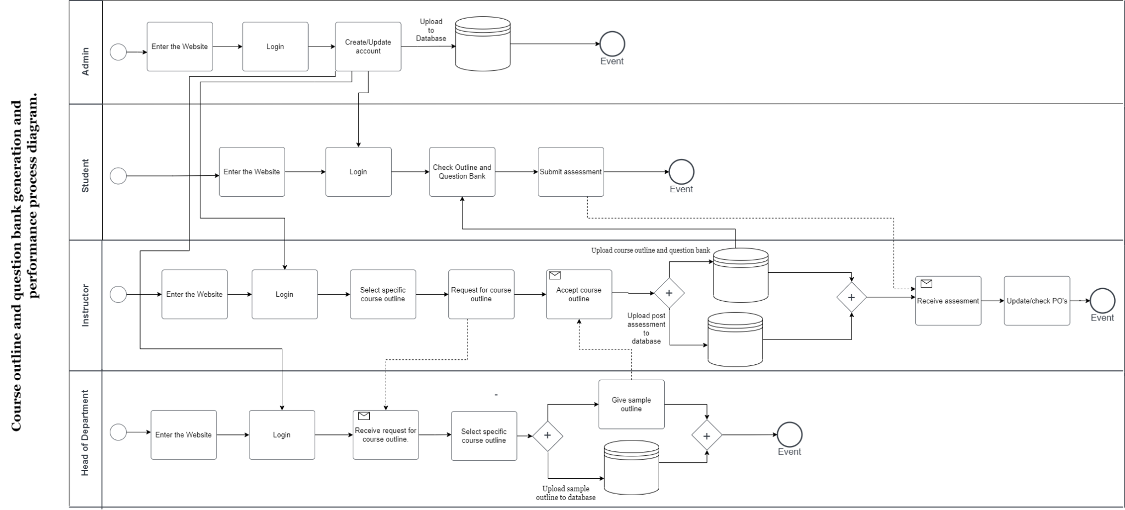
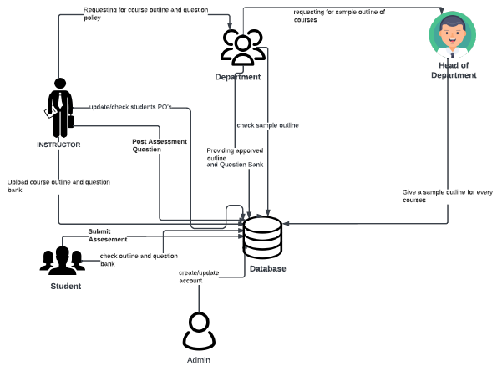
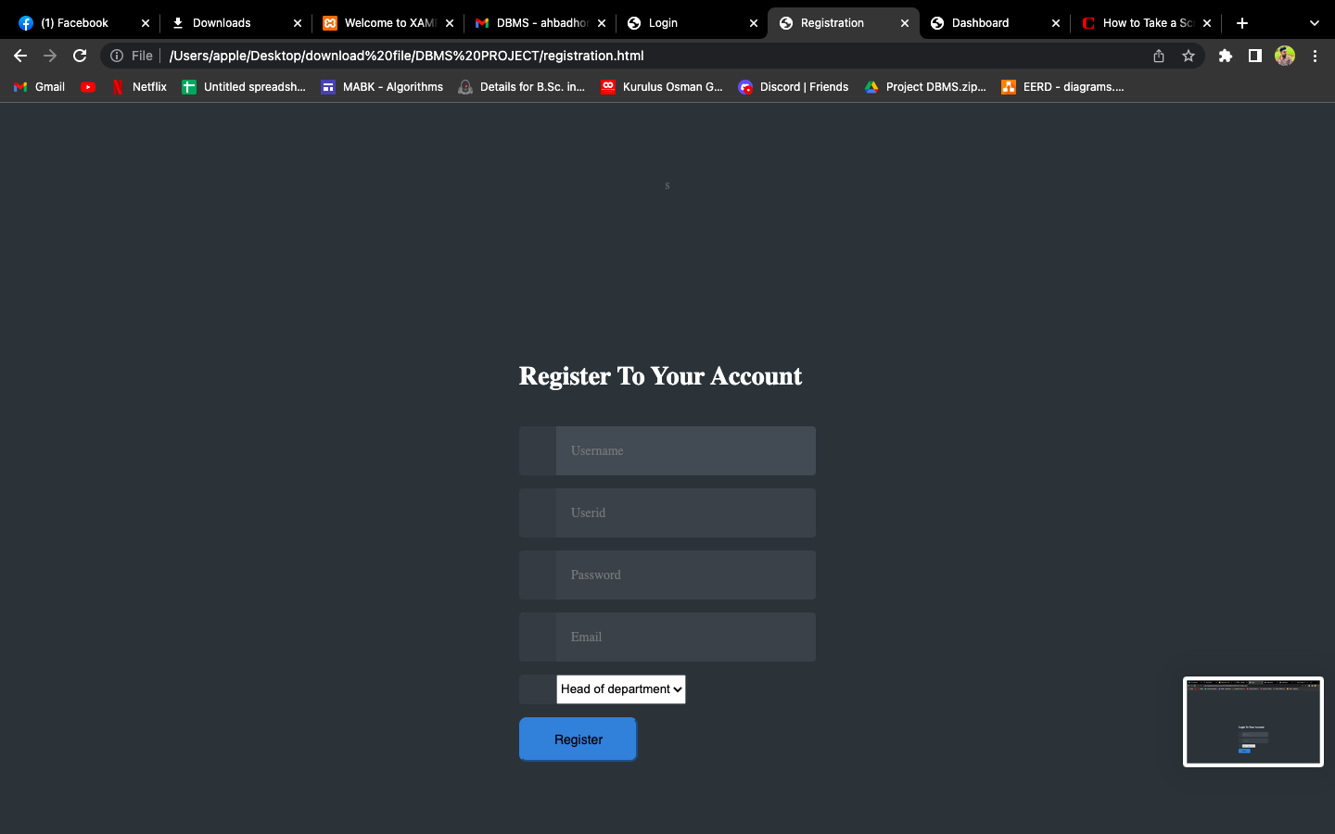



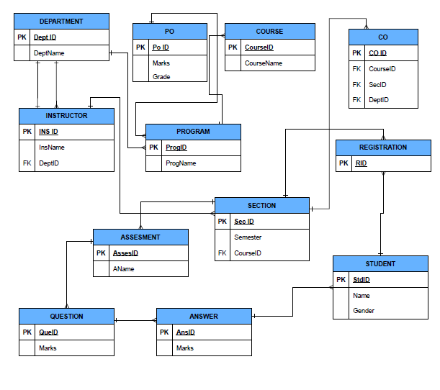
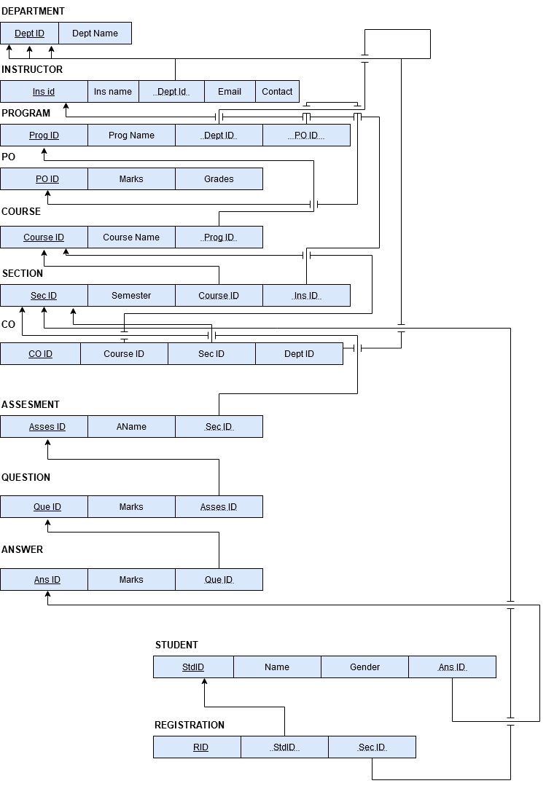
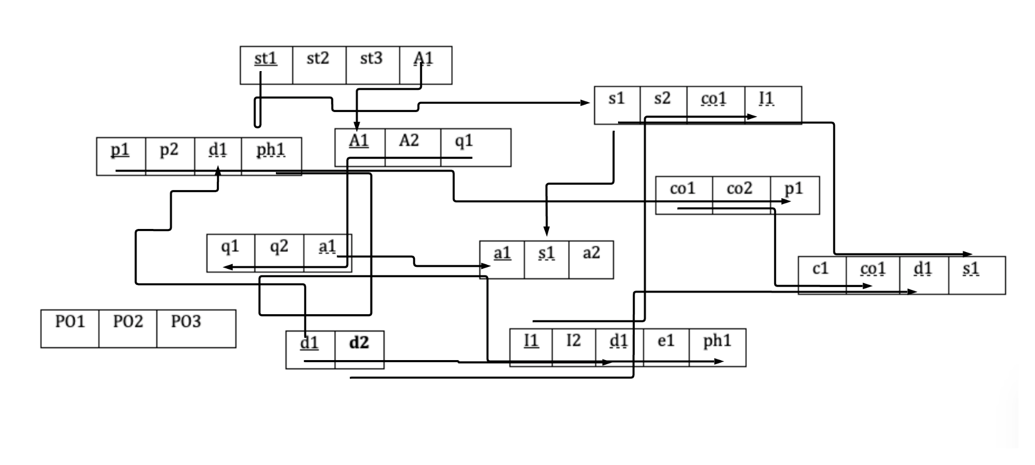
Cyber Tricks
Mohammad Abu Hasan, Atika Sultana, Farhat Lamisa, Atikul Islam and Sanjida Afrin
Department of Computer Science and Engineering, Independent University, Bangladesh (IUB)
Abstract
BUSINESS RULE
BPMN:
Measuring the output of students, faculties, departments, and
their individual courses in order to gauge their productivity in
light of the course activities' relevance to the outcomes
The software's objective is to boost productivity when creating course outlines (CO), question banks (QB), and student performance outcomes (PO). All CO, QB, and PO data is kept in the auto generating system. For each course, the faculty and HOD must update the CO, and before the semester begins, the COs must be mapped to the QB so that all students may check them.IEB must send the updated COs to the admin because it is not authorized to do so in the system. The admin will then update the COs so that the faculties can map them. According to the established curriculum framework, the faculties can update the COs. Additionally, the students can see their achieved POs for a certain evaluation they have taken.
Rich Picture:
Project Screenshot
Normalization:
EERD
Relational Schema

