Slide 1
OLIST • E-COMMERCE ANALYTICS
PROJECT STAND-UP
From Delivery to Loyalty
Customer satisfaction & seller acquisition in Brazilian e-commerce
Python • SQL • dbt • Tableau
Ilayda Sanli | 30.10.2026

Slide 2
PROJECT FRAMING
02 / 04
The questions, data & people
01 CUSTOMER EXPERIENCE
02 SELLER ACQUISITION
Are late deliveries, longer delivery times and higher freight costs associated with lower review scores?
Which lead origins and business segments move potential sellers through qualification and closed-won?
TWO DATA SOURCES / PROPOSED KPIs
OLIST BRAZILIAN E-COMMERCE
OLIST MARKETING FUNNEL
Orders, reviews, items, products, customers & sellers
KPIs
On-Time Delivery Rate (%)
Average Delivery Time (Days)
Average Freight Cost
Average Customer Review Score
Average Review Score by Product Category
Lead origin, qualification, business segment & closed-sale outcome
KPIs
Lead Conversion Rate (%)
Conversion Rate by Lead Origin (%)
Conversion Rate by Business Segment (%)
Acquired Seller Marketplace Performance
STAKEHOLDERS
CUSTOMERS
OPS / MARKETPLACE
SELLER ACQUISITION
SELLERS / CATEGORY
LEADERSHIP + DATA
Reliable delivery & fair shipping
Logistics performance
Lead quality & conversion
Category experience gaps
Priorities & trusted metrics
Keep funnel analysis separate until a reliable seller-level join is proven.

Slide 3
BUILD APPROACH
03 / 04
A clean path from raw files to insight
REPRODUCIBLE ANALYTICS PIPELINE
01
02
03
04
05
06
RAW CSVs
›
PYTHON AUDIT
›
SQL STAGING
›
DBT MODELS
›
ANALYSIS
›
TABLEAU
Source files
Schema • nulls • dates
Keys • joins • metrics
Stage → intermediate → marts
SQL + Python
KPIs • filters • story
VALIDATION GATES
GRAIN
QUALITY
JOIN SAFETY
Define table grain & KPI denominators before joins.
Test nulls, duplicates, row counts and key uniqueness.
Prove seller-level link coverage; otherwise keep funnel separate.
OUTPUT
Validated models → baseline KPIs → evidence-backed recommendations

Slide 4
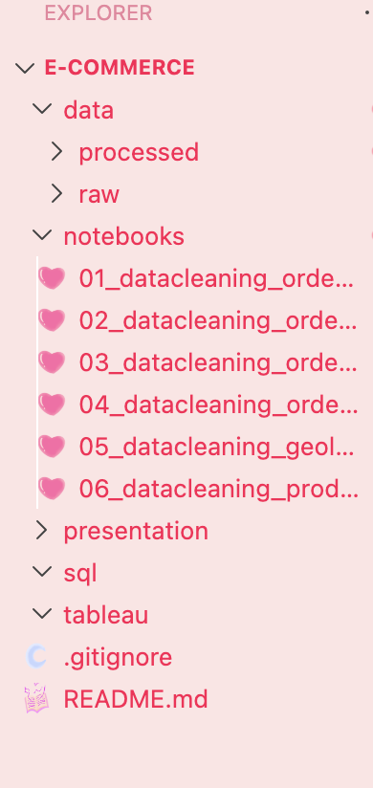
STAND-UP UPDATE
04 / 04
Evidence, progress & what to watch
GITHUB EVIDENCE
FINISHED
DOING NEXT
RISKS
✓ Project scope and business problem
✓ Research questions and hypotheses
✓ Candidate KPIs
✓ Source datasets identified
✓ Draft workflow and dashboard concept
✓ Download and profile raw CSVs
✓ Set up GitHub repo and README
→ finish cleaning the data
→ doing basic Analyses
→ Confirm schema, date coverage, and keys
→ Build first SQL joins and baseline metrics
→ Create initial dbt staging models
! Actual data quality is not yet verified
! Lead-to-seller join may be incomplete or unavailable
! KPI definitions need denominator/grain validation
! No measured findings until analysis runs
ONE INSIGHT
The project has two different units of analysis: customer orders/reviews and seller-acquisition leads. They should not be blended until the join is validated.
NEXT MILESTONE
A validated analytical dataset and one reproducible KPI result.

