Slide 1
✧
Stand-up 2 – Project Progress
From SQL Analysis to Statistical Testing
Initial SQL analysis completed • Datasets joined in SQL • SQL connected to Python • VS Code notebook expanded and organized
PROJECT WORKFLOW
SQL Analysis
Data Integration
Python
Statistical Testing
›
›
›
Completed
Completed
In progress
Next
Current focus: move the integrated data into Python and prepare for statistical testing.
STAND-UP 2 • PROJECT UPDATE
1/5
Notes:
Speaking notes (about 1 minute):
I have completed the initial SQL analysis and used SQL to join the Brazilian E-Commerce Public Dataset with the Marketing Funnel dataset. I also established the SQL connection to Python and expanded and organized my VS Code notebook. This marks the transition from the SQL phase into Python. The SQL analysis and data integration steps are complete; Python preparation is now in progress, and statistical testing is the next stage. I have not completed the statistical tests yet.

Slide 2
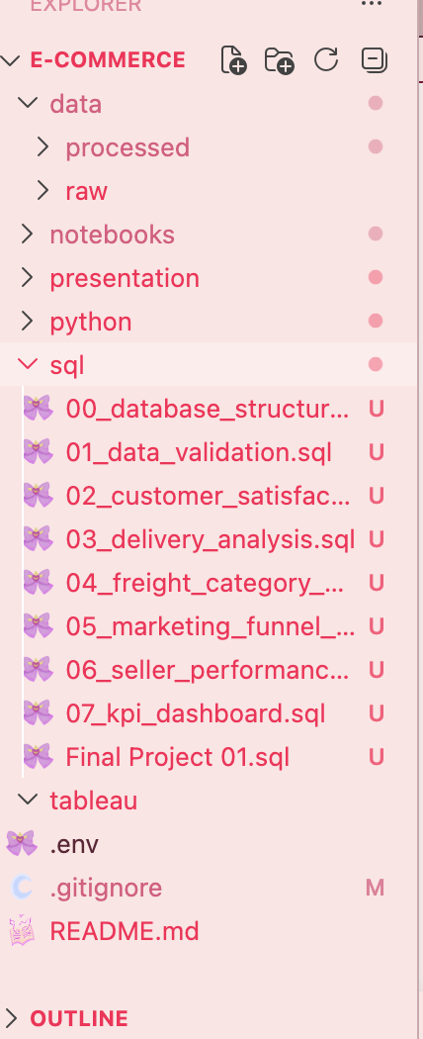
What Have I Completed?
✧
Completed deliverables and evidence of the project setup
DELIVERABLES
PROJECT EVIDENCE
• SQL analysis and analytical queries completed
• Two datasets successfully joined in SQL
• SQL connection to Python established
• VS Code notebook expanded and organized
• SQL scripts organized within the project structure
• Data dictionary documented for both datasets
STAND-UP 2 • PROJECT UPDATE
2/5
Notes:
Speaking notes (about 1 minute):
This slide summarizes the work that is already complete. The analytical SQL queries are finished, and I successfully joined the two datasets. I also connected SQL to Python, expanded and organized the VS Code notebook, and structured the SQL scripts in the project folders. I documented the structure of both datasets in a data dictionary, which I will summarize on the final slide. The large panel on the right is intentionally a placeholder: I will replace it with my own VS Code screenshot so the evidence reflects the actual project rather than a recreated or invented screenshot.

Slide 3
Challenges & Limitations
✧
What I learned while integrating the two sources
CHALLENGES ENCOUNTERED
PRELIMINARY JOIN MATCH
• Writing and organizing some SQL queries took extra effort
• The database schema included tables from other projects
• Identifying the correct tables required additional attention
Matched records
~300 / ~700
≈43% matched
Joined using seller_id across the e-commerce and marketing funnel data.
Important insight: sellers were not fully consistent across the datasets. Not all e-commerce sellers appeared in the funnel data, limiting the records available for combined analysis.
STAND-UP 2 • PROJECT UPDATE
3/5
Notes:
Speaking notes (about 1 minute 20 seconds):
I encountered a few practical challenges during the SQL work. Some queries were tricky to write and organize, and the database schema contained tables from other projects, so identifying the correct tables required careful checking. The main data limitation appeared during integration. I joined the Brazilian E-Commerce dataset and the Marketing Funnel dataset using seller_id. The preliminary figures indicate that approximately 300 out of 700 records matched, or around 43 percent. These numbers are editable and should be validated before the final presentation. The mismatch suggests that sellers were not consistently represented in both sources. This reduces the number of records available for combined analysis, so I will keep this limitation in mind when interpreting any statistical results. The chart is a simple editable shape rather than a fixed image.

Slide 4
What's Next?
✧
Moving from data integration into statistical analysis
UPCOMING TASKS
EARLY INSIGHT
01
Continue coding in Python
The SQL join revealed seller inconsistencies across the datasets. Only a portion of records could be matched.
02
Conduct statistical methods
03
Interpret statistical test results
04
Update KPIs and create early visualizations
OPEN POINTS
• Investigate unmatched seller records
• Complete statistical testing
• Update KPIs and develop visualizations
• Add final results when available
05
Connect to Tableau
STAND-UP 2 • PROJECT UPDATE
4/5
Notes:
Speaking notes (about 1 minute 15 seconds):
My next phase is focused on Python. I will continue developing the notebook, prepare and clean the joined dataset, and then conduct the Mann–Whitney U test. Once the test is complete, I will interpret the results, update the relevant KPIs, and create early visualizations. At this point, I am not presenting any statistical outcome because the testing has not yet been completed. The early insight so far is about data quality rather than performance: the join exposed inconsistencies in seller coverage between the two datasets. I still need to investigate unmatched seller records, finish the statistical testing, and add validated results when they become available.

Slide 5
Understanding Our Datasets ♡
✧
A quick data dictionary and the key relationship used in the SQL join
01 BRAZILIAN E-COMMERCE PUBLIC DATASET
02 MARKETING FUNNEL BY OLIST
9 tables
2 tables
customers
Customer information and location
marketing_qualified_leads
Potential customers and lead information
orders
Order details, status and timestamps
closed_deals
Converted leads and seller information
order_items
Products, sellers, prices and shipping
order_payments
Payment methods and amounts
order_reviews
Customer reviews and ratings
KEY CONNECTION
products
Product characteristics and categories
↔
sellers
Seller information and location
closed_deals
seller_id
sellers
seller_id
geolocation
Geographic coordinates and ZIP codes
product_category_name_translation
Portuguese-to-English category translations
seller_id links closed deals to seller information in the e-commerce dataset. This was the SQL JOIN key; seller coverage did not fully overlap.
Data dictionary documented for both sources • table descriptions shown at a high level
STAND-UP 2 • PROJECT UPDATE
5/5
Notes:
Speaking notes (about 1 minute 20 seconds):
The project uses two public datasets from Olist in Brazil. The Brazilian E-Commerce Public Dataset contains nine tables covering customers, orders, items, payments, reviews, products, sellers, geolocation, and category translations. The Marketing Funnel dataset contains two tables: marketing_qualified_leads, which stores potential customer and lead information, and closed_deals, which stores converted lead and seller information. The important connection for my analysis is seller_id. I used the seller ID in closed_deals to connect to seller information in the e-commerce dataset. This was the key used in my SQL join. The join also revealed that seller coverage is not complete across the sources, which is an important limitation for the combined analysis.

