Slide 1
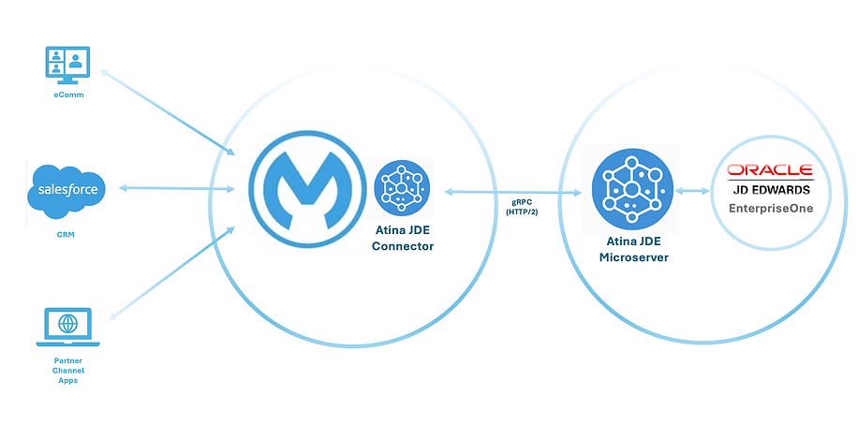
Quick Start
The MuleSoft ATINA JDE Connector requires an Atina JDE Microservice to work.

Slide 2

Quick Start – All Steps
Steps
GENERATE JDE INI FILES
GENERATE
JDE JARS LIBRARIES
MICROSERVER INSTALLATION
INSTALL MULE JDE CONNECTOR

Slide 3
Quick Start – Key Points
Key Points:
This setup requires administrative access to your JDE environment and servers.
You will need to configure JDE interoperability and network access for the microservice.
Installation involves:
Generate JDE INI Files.
Generate JARs Libraries.
Microserver Installation.
Install MULE JDE Connector
In the next slides, we will provide a detailed, step-by-step guide to deploy and configure the microservice locally.

Slide 4
Generate INI Files
GENERATE INI FILES
GENERATE
JDE JARS LIBRARIES
MICROSERVER INSTALLATION
INSTALL MULE JDE CONNECTOR

Slide 5
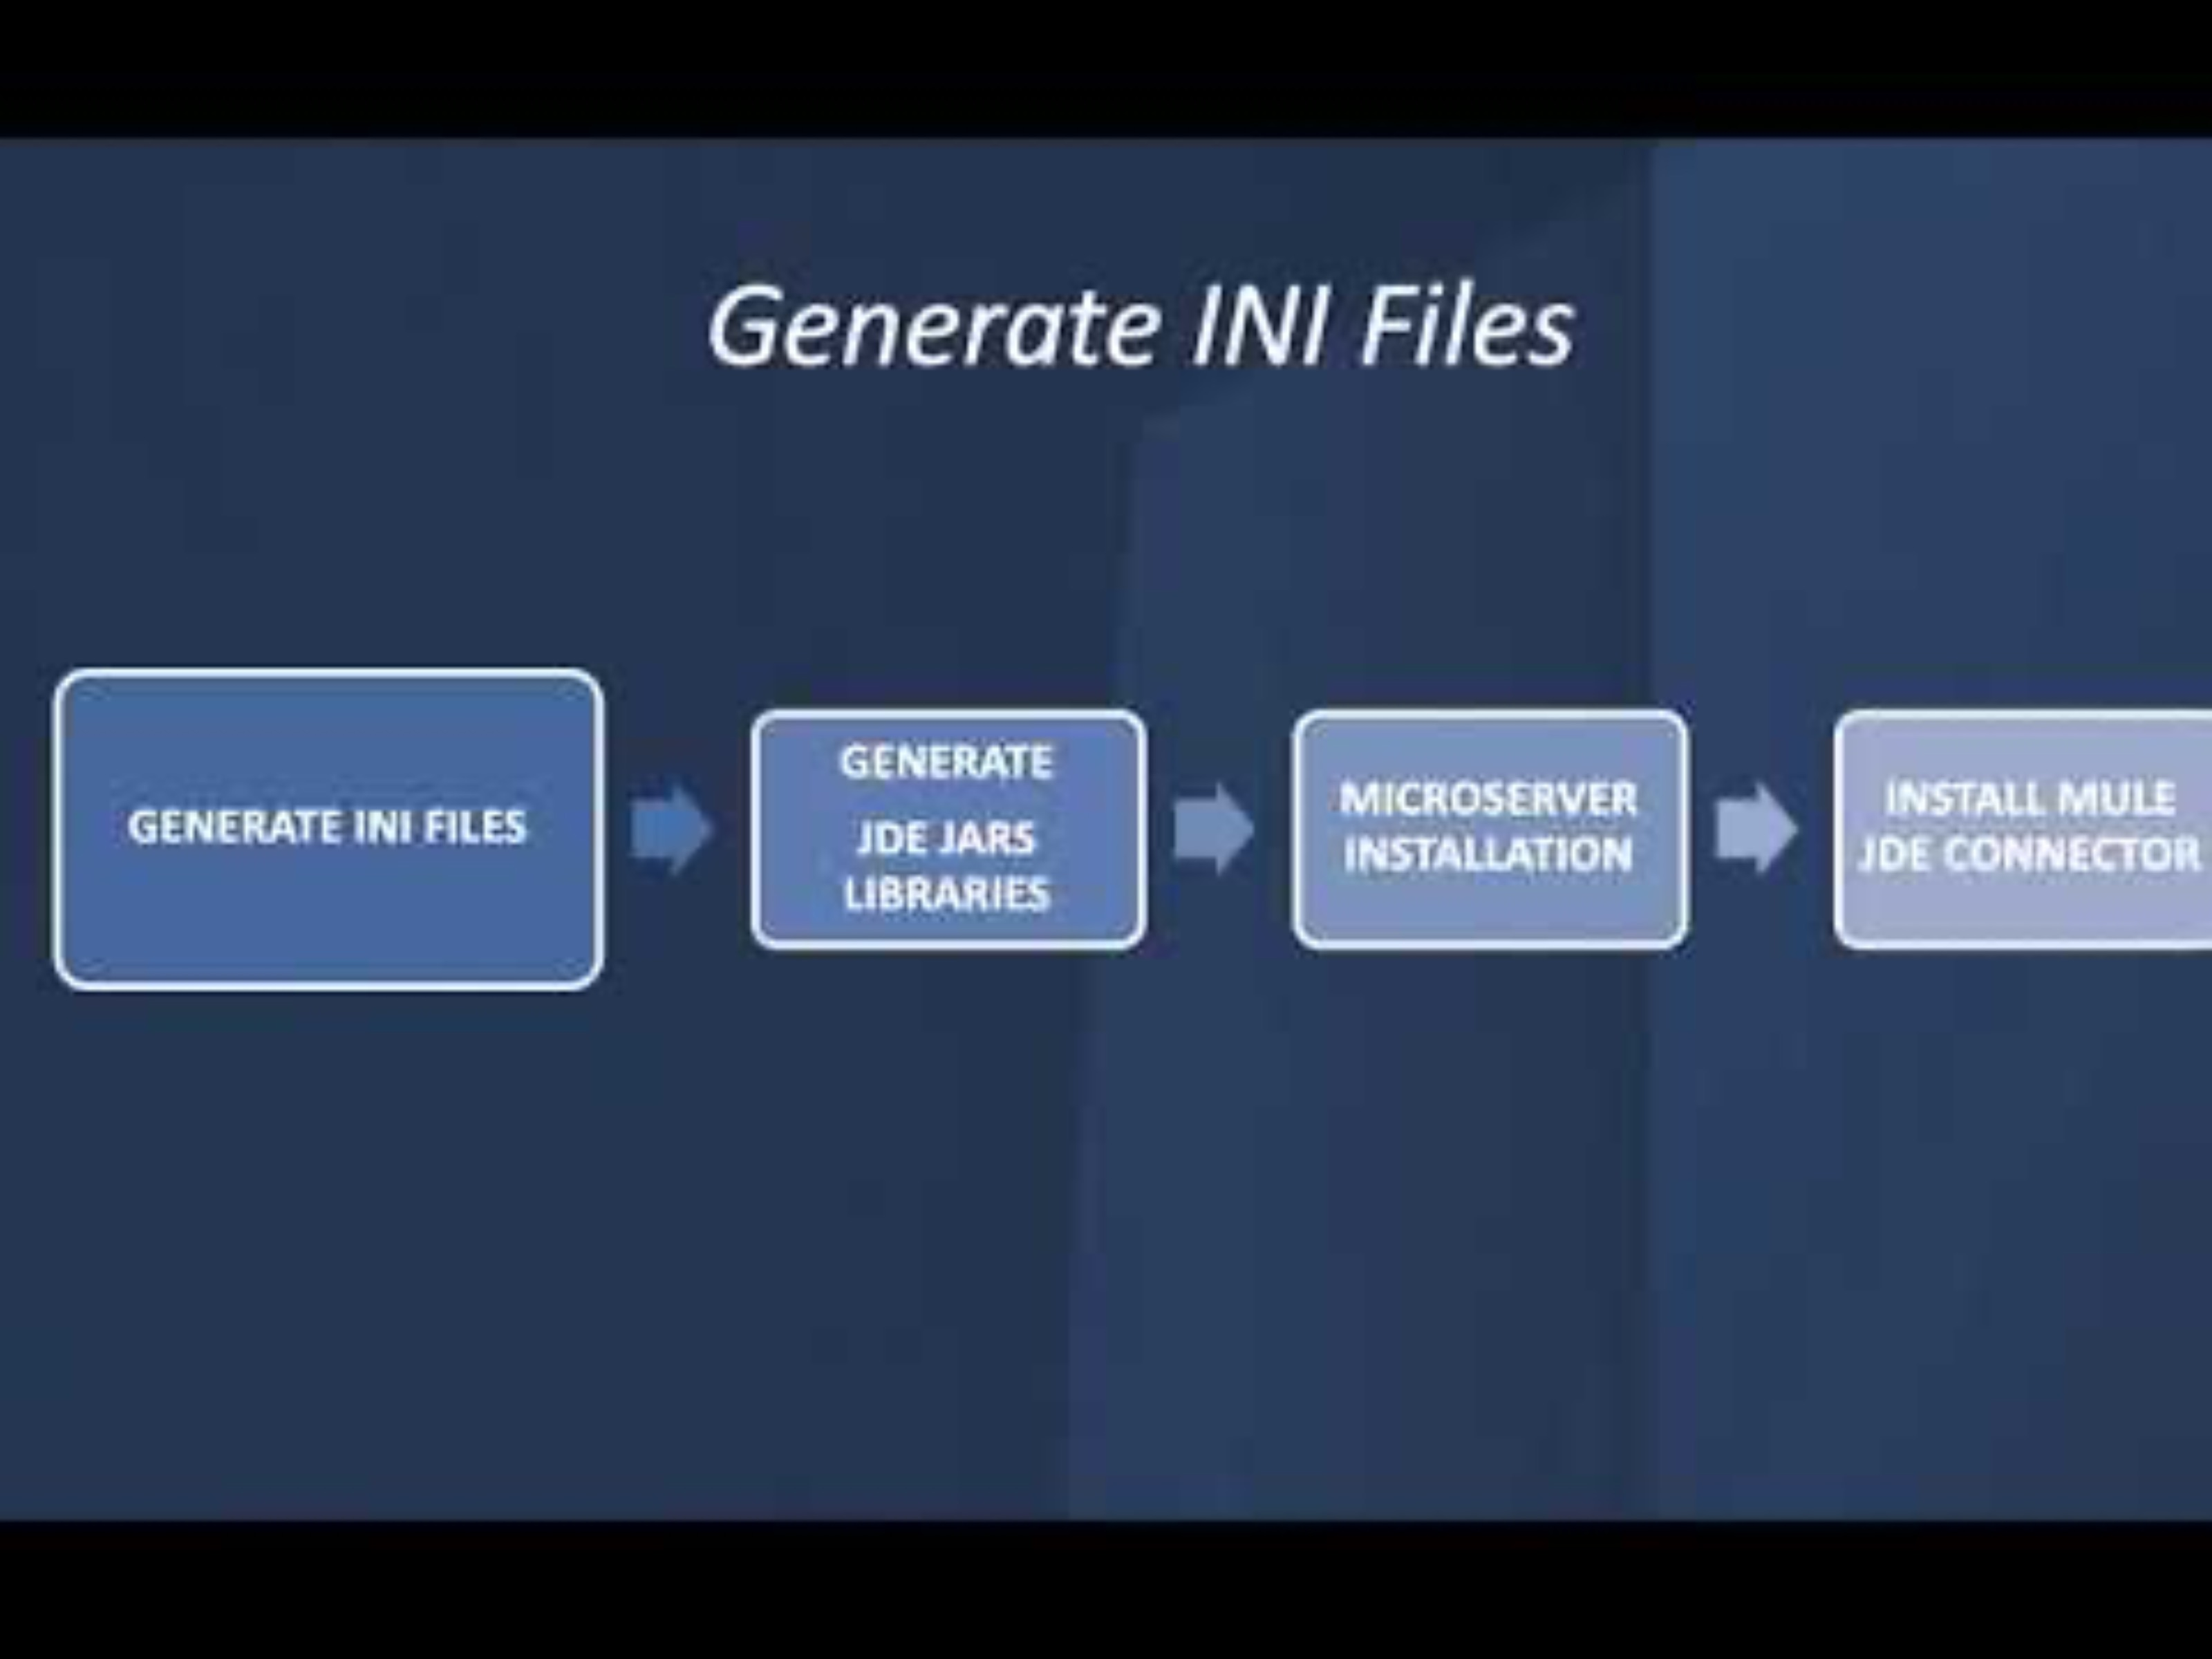
Generate INI Files
JDE INI FGENERATEILES
GENERATE
JDE JARS LIBRARIES
MICROSERVER INSTALLATION
INSTALL MULE JDE CONNECTOR
JDE Atina Generate Configuration Files Tool - Using the Java CLI Application
It help to you to generate a base INI files. It takes all information from JDE Enterprise Server Manager using REST API for Server Manager. This tool will require to select the HTML Client instance according to your environment.
Prerequisites
OpenJDK 8 installed (required by the tool)
Network access and Credentials to JDE Server Manager
Download The Tool
Run Generation

Slide 6
STEP 1 - Generate INI Files - Download
Download The Tool
Step 1 - Download the tool
Linux
curl "https://jfrog.atina-connection.com/artifactory/libs-release-local/com/atina/jd-create-ini-files/1.0.0/jd-create-ini-files-1.0.0.jar"
-o jd-create-ini-files-1.0.0.jar
Run Generation
Windows PowerShell
curl.exe "https://jfrog.atina-connection.com/artifactory/libs-release-local/com/atina/jd-create-ini-files/1.0.0/jd-create-ini-files-1.0.0.jar"
-o "jd-create-ini-files-1.0.0.jar"

Slide 7
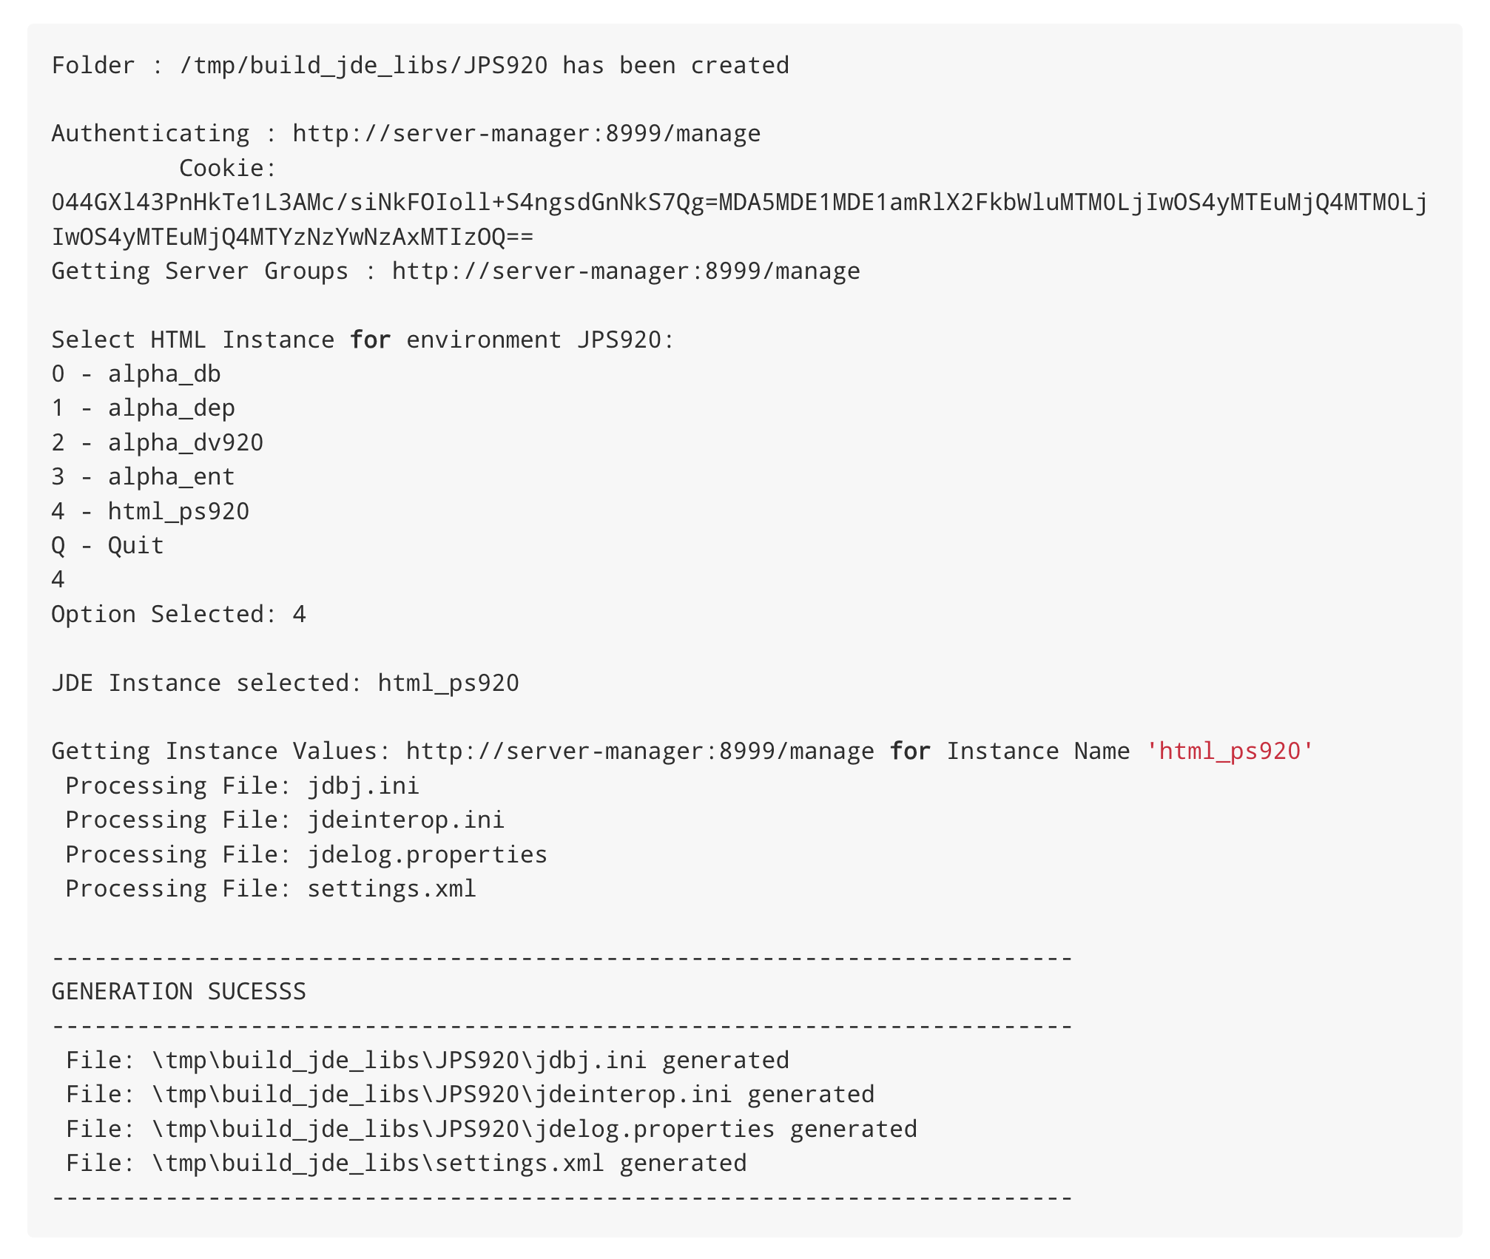
STEP 2 - Generate INI Files - Run
Download The Tool
Step 2 - Run (interactive: you’ll be asked to pick the HTML instance):
Command:
java -jar jd-create-ini-files-1.0.0.jar \
-u <jde_admin> \
-p <password> \
-s http://<server-manager-host>:8999/manage \
-e <ENV ex. JDV920>
Run Generation
Review the generated INI files to verify that the values are correct

Slide 8
GENERATE JARs Libraries
GENERATE INI FILES
GENERATE
JDE JARS LIBRARIES
MICROSERVER INSTALLATION
INSTALL MULE JDE CONNECTOR

Slide 9
Quick Start – Understanding the Setup
Custom Setup - Create JARs Libraries
GENERATE JDE INI FILES
GENERATE
JDE JARS LIBRARIES
MICROSERVER INSTALLATION
INSTALL MULE JDE CONNECTOR
This tool packages the JD Edwards libraries into deployable JAR files that are required by the Atina JDE Microservice. It simplifies dependency management and ensures that all necessary classes are available at runtime.
The tool will generate the following artifacts:
JDEAtinaOverrideServicesConstants-1.0.0.jar. Provides local override of web service properties, avoiding the need to modify JDE configuration.
jde-lib-wrapped-1.0.0.jar: Bundles the core JD Edwards interoperability libraries required for integration.
StdWebService-1.0.0.jar: Includes wrappers for standard JD Edwards web services.
Create Constants Properties
Download Constants Library
Download Tool
Create Required Folders
Prerequisites
OpenJDK 8 installed (required by the tool)
Maven 3.8.1 or higher
Access and Credentials to JDE Deployment Server
Copy Deployment Files
Define Local Repository
Generate Bundles

Slide 10
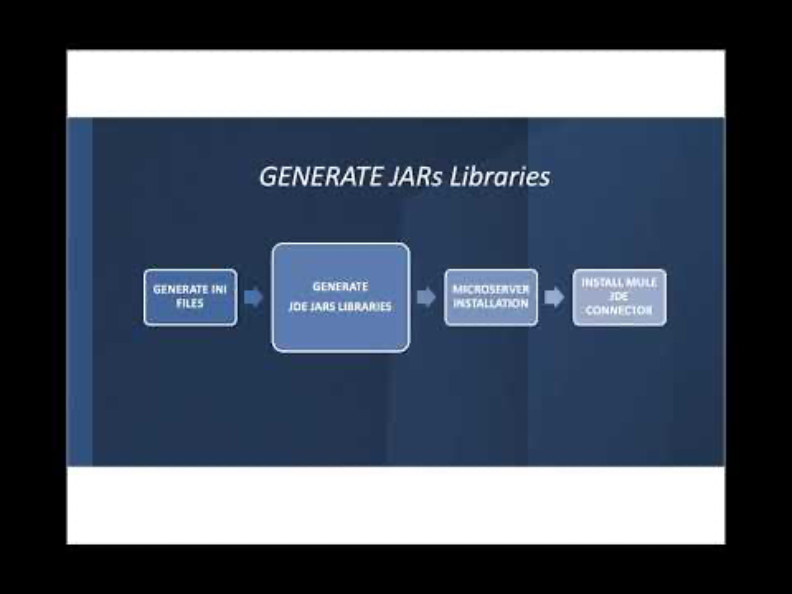
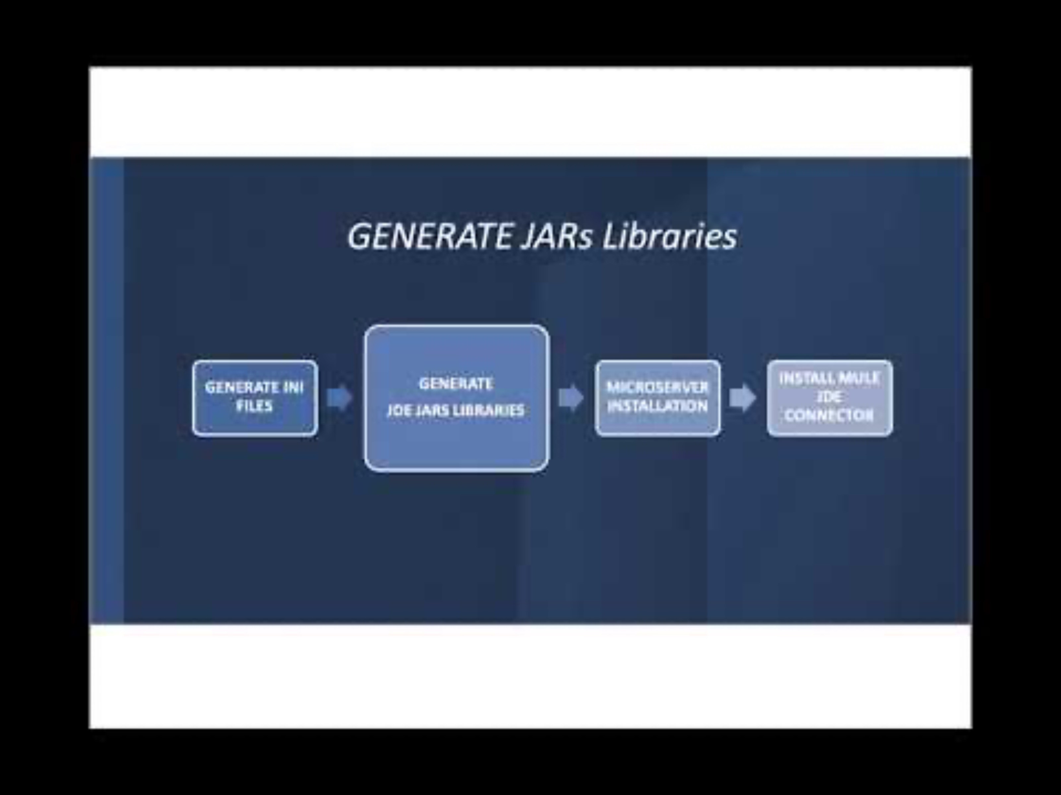
Quick Start – Understanding the Setup
Custom Setup - Create JARs Libraries
GENERATE JDE INI FILES
GENERATE
JDE JARS LIBRARIES
MICROSERVER INSTALLATION
INSTALL MULE JDE CONNECTOR
This tool packages the JD Edwards libraries into deployable JAR files that are required by the Atina JDE Microservice. It simplifies dependency management and ensures that all necessary classes are available at runtime.
Create Constants Properties
Download Constants Library
Download Tool
Create Required Folders
Copy Deployment Files
Define Local Repository
Generate Bundles

Slide 11
STEP 1 – Create JARs Libraries - Properties
Step 1 - Create the service-constants.properties File
Create Constants Properties
In this step, you’ll define runtime parameters for JD Edwards Web Services by creating the service-constants.properties configuration file.
Download Constants Library
nano /tmp/build_jde_libs/service-constants.properties
Download Tool
Create Required Folders
Copy and paste the following content into the file:
Copy Deployment Files
J0100002_MAX_ROWS=10
J0000110_MAX_ROWS=10
J0100004_MAX_ROWS=10
J0400002_MAX_ROWS=10
J4200010_SOE_MBF_VERSION=
J4200010_BYPASS_WARNINGS=2
J4200010_PREFIX_5=ATINA
J4200010_PREFIX_2=ATINA
J4200050_MAX_ROWS=10
J0100022_MAX_ROWS=10
J0100007_MAX_ROWS=10
J4300010_PO_MBF_VERSION=ZJDE0001
J4300010_BYPASS_BSFN_WARNINGS=1
J4300010_PREFIX_1=
Define Local Repository
Generate Bundles

Slide 12
STEP 2 – Create JARs Libraries – Download Library
Step 2 - Download the JDEAtinaOverrideServicesConstants Library
Create Constants Properties
The system requires a supporting library to override default JD Edwards service properties with the values defined in your service-constants.properties file. This enables more flexible and file-driven configuration without modifying JDE directly.
Download Constants Library
Download Tool
Linux
curl -L https://jfrog.atina-connection.com/artifactory/libs-release-local/com/atina/JDEAtinaOverrideServicesConstants/1.0.0/JDEAtinaOverrideServicesConstants-1.0.0.jar --output /tmp/build_jde_libs/JDEAtinaOverrideServicesConstants-1.0.0.jar
Create Required Folders
Copy Deployment Files
Ensure this JAR file is located in the /tmp/build_jde_libs/ folder along with the service-constants.properties file.
The system will automatically detect the presence of this library and use it to load web service configuration from the local file instead of querying JDE’s internal property store.
Define Local Repository
Generate Bundles

Slide 13
STEP 3 – Create JARs Libraries – Download Tool
Step 3 - Download the tool Create Jars File
Create Constants Properties
Linux
curl https://jfrog.atina-connection.com/artifactory/libs-release-local/com/atina/jd-create-jar-files/1.0.0/jd-create-jar-files-1.0.0.jar --output jd-create-jar-files-1.0.0.jar
Download Constants Library
Download Tool
Create Required Folders
Copy Deployment Files
Define Local Repository
Generate Bundles

Slide 14
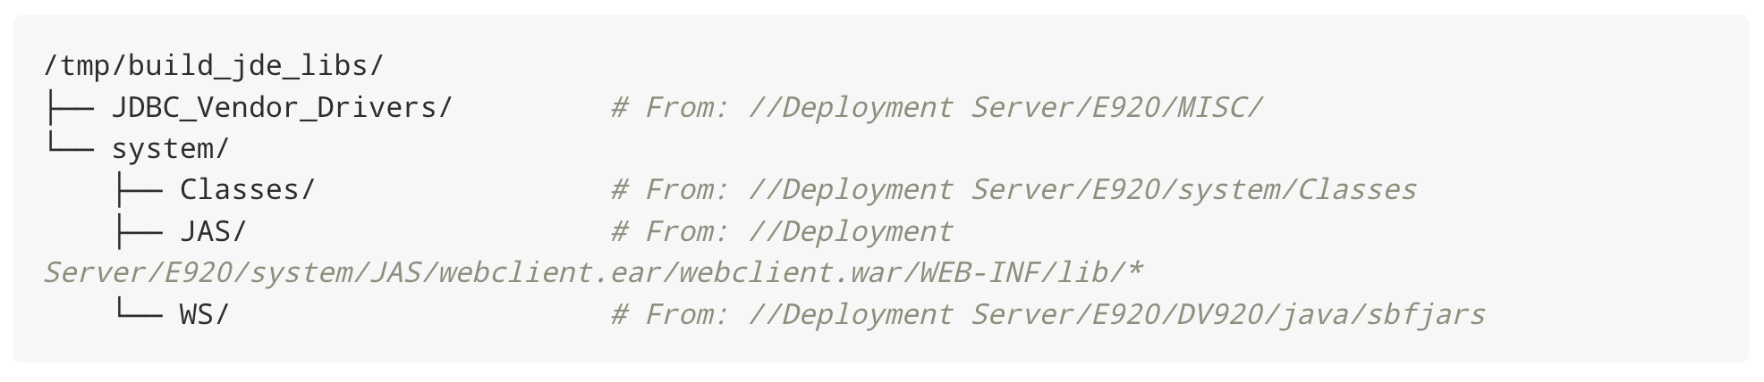
STEP 4 – Create JARs Libraries – Create Folders
Step 4 – Adding required Folder Structure
Create Constants Properties
Create the following directory layout and populate it with the required files from the deployment server:
Download Constants Library
Download Tool
Create Required Folders
Copy Deployment Files
mkdir -p /tmp/build_jde_libs/JDBC_Vendor_Drivers \
/tmp/build_jde_libs/system/Classes \
/tmp/build_jde_libs/system/JAS \
/tmp/build_jde_libs/system/WS
Define Local Repository
Generate Bundles

Slide 15
STEP 5 – Create JARs Libraries – Copy Files
Step 5 – Copy Deployment Server Files
In this step, you will copy the required JDE libraries from the Deployment Server into your local directory structure.
Create Constants Properties
Download Constants Library
JDBC Vendor Drivers
cp -rv ~/atina/E1_DeploymentServer/E920/MISC/* /tmp/build_jde_libs/JDBC_Vendor_Drivers/
Download Tool
System/Classes
Create Required Folders
cp -rv ~/atina/E1_DeploymentServer/E920/system/Classes/* /tmp/build_jde_libs/system/Classes/
Copy Deployment Files
System/JAS
cp -rv ~/atina/E1_DeploymentServer/E920/system/JAS/webclient.ear/webclient.war/WEB-INF/lib/* /tmp/build_jde_libs/system/JAS/
Define Local Repository
system/WS
Generate Bundles
cp -rv ~/atina/E1_DeploymentServer/E920/DV920/java/sbfjars/* /tmp/build_jde_libs/system/WS/

Slide 16
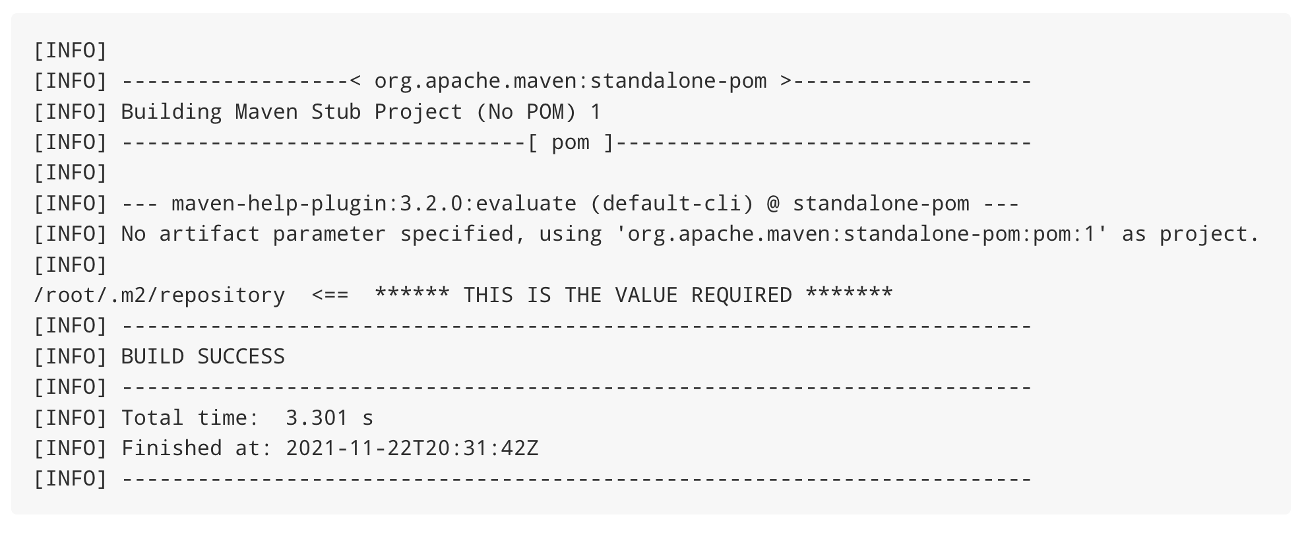
STEP 6 – Create JARs Libraries – Define Repository
Step 6 – Define Local Repository
Create Constants Properties
Running this command, you can get where the current local repository is defined:
Download Constants Library
mvn help:evaluate -Dexpression=settings.localRepository
Download Tool
In this output we see /root/.m2/repository
Create Required Folders
Copy Deployment Files
Define Local Repository
Generate Bundles
The value returned here (e.g., /root/.m2/repository) will be used in the next step, so make sure to copy it for reference.

Slide 17
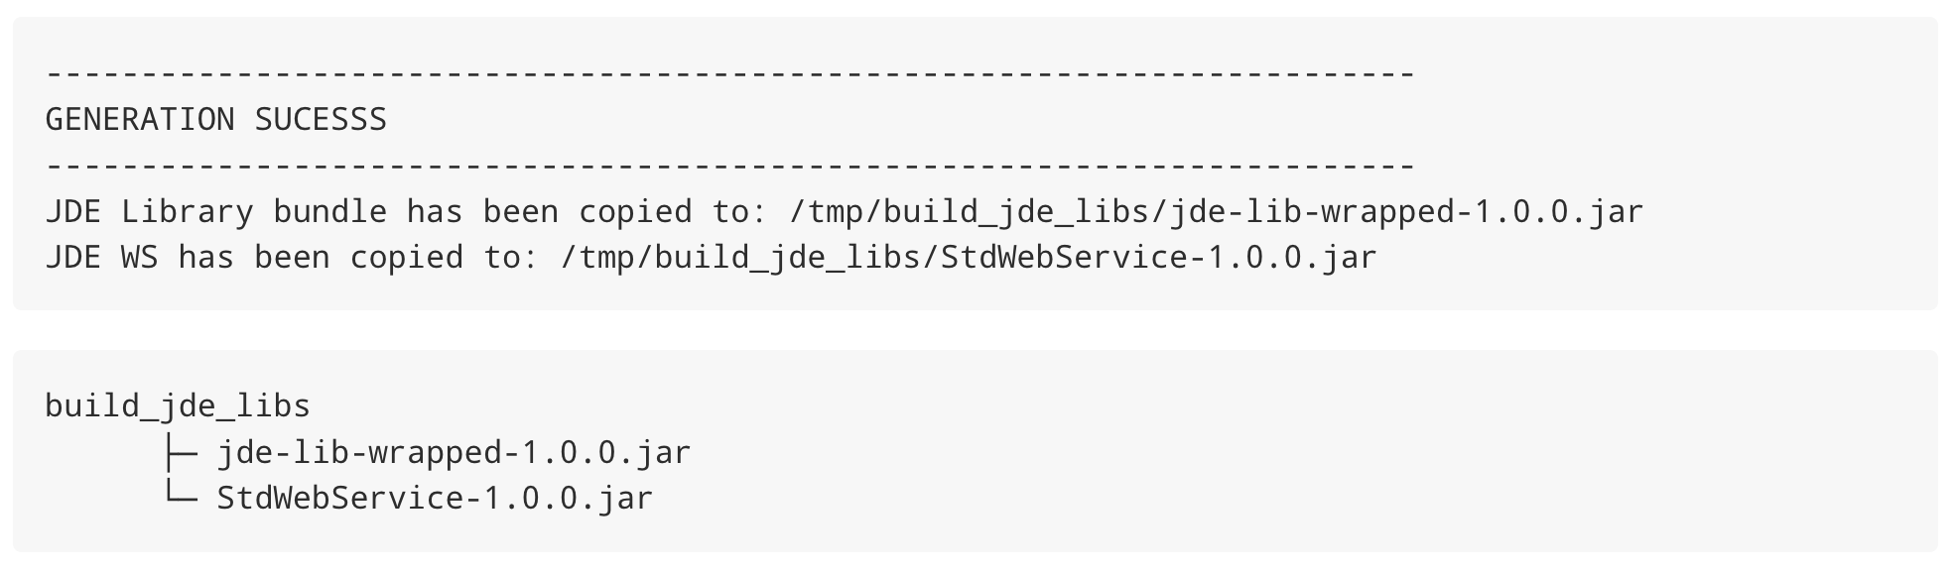
STEP 7 – Create JARs Libraries – Generate Bundles
Step 7 – Execute the JAR Tool to Generate the Bundles
Create Constants Properties
Command:
java -jar jd-create-jar-files-1.0.0.jar \
-r /root/.m2/repository
Download Constants Library
Download Tool
This command runs the tool and specifies the Maven local repository path (identified in previous step).
Create Required Folders
Once completed, the following files will be created:
Copy Deployment Files
Define Local Repository
Generate Bundles

Slide 18
Microserver Installation
GENERATE INI FILES
GENERATE
JDE JARS LIBRARIES
MICROSERVER INSTALLATION
INSTALL MULE JDE CONNECTOR

Slide 19
Custom Setup – Microserver Installation
GENERATE JDE INI FILES
GENERATE
JDE JARS LIBRARIES
MICROSERVER INSTALLATION
INSTALL MULE JDE CONNECTOR
This section explains how to deploy the Atina JDE Microservice using Docker and Docker Compose. You’ll configure environment variables, initialize the container, and run a basic test to validate connectivity with JD Edwards.
Prerequisites
OpenJDK 8 installed (required by the tool)
Maven 3.8.1 or higher
Docker Required to deploy the microservices, which are containerized
Download Docker Compose
Configure Environment Var
Initialize The Container
Check Microservice Startup
Verify Microserver

Slide 20
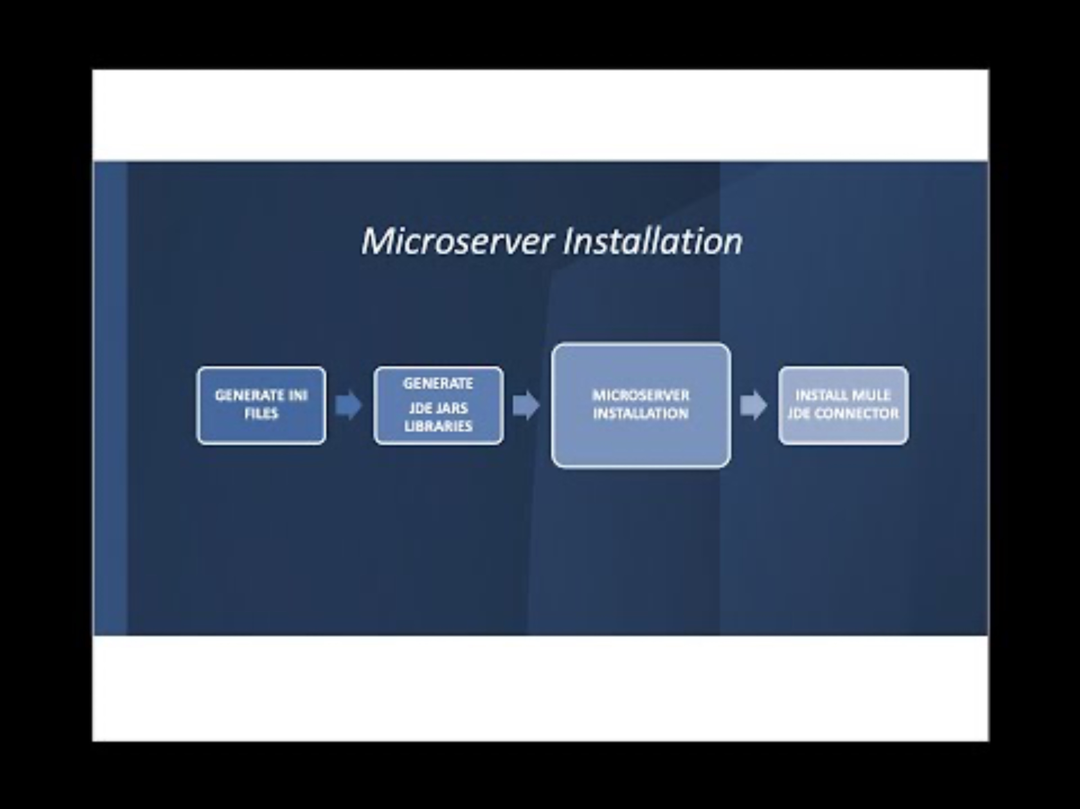
Custom Setup – Microserver Installation
GENERATE JDE INI FILES
GENERATE
JDE JARS LIBRARIES
MICROSERVER INSTALLATION
INSTALL MULE JDE CONNECTOR
This section explains how to deploy the Atina JDE Microservice using Docker and Docker Compose. You’ll configure environment variables, initialize the container, and run a basic test to validate connectivity with JD Edwards.
Download Docker Compose
Configure Environment Var
Initialize The Container
Check Microservice Startup
Verify Microserver

Slide 21
STEP 1 – Microserver Installation - Download
Step 1 - Download Docker Compose Files
Download Docker Compose
curl https://jfrog.atina-connection.com/artifactory/libs-release/com/atina/jd-docker-files/1.0.0/jd-docker-files-1.0.0.zip --output jd-docker-files-1.0.0.zip
Configure Environment Var
Initialize The Container
Unzip it
Check Microservice Startup
unzip jd-docker-files-1.0.0.zip
Verify Microserver

Slide 22
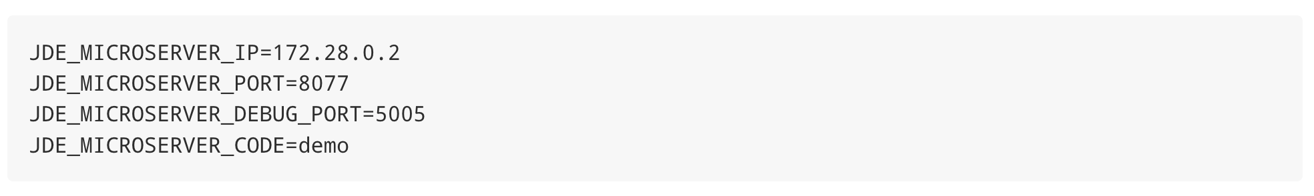
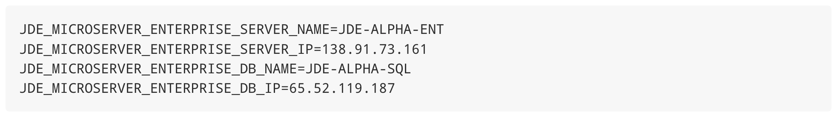
STEP 2 – Microserver Installation - Configuration
Step 2 - Configure Environment Variables
Download Docker Compose
Inside jd-docker-files-1.0.0 folder, Edit the .env file and set the values according to your infrastructure:
Configure Environment Var
Code: Each customer must use the license code provided by Atina. This value is mandatory for the service to start correctly.
Initialize The Container
Check Microservice Startup
This section defines the network and database endpoints used by the microservice to interact with the JDE EnterpriseOne system
Verify Microserver
JDE_MICROSERVER_ENTERPRISE_SERVER_NAME: The logical name of the JDE Enterprise Server.
JDE_MICROSERVER_ENTERPRISE_SERVER_IP: The server’s IP address or DNS-resolvable name.
JDE_MICROSERVER_ENTERPRISE_DB_NAME: The name of the database as defined in JDE’s OCM (Object Configuration Manager) as a Data Source.
JDE_MICROSERVER_ENTERPRISE_DB_IP: The database server’s IP address or DNS-resolvable name.
The database name must match the Data Source name defined in the JDE OCM. Incorrect names may lead to failed connections or incorrect environment targeting.

Slide 23
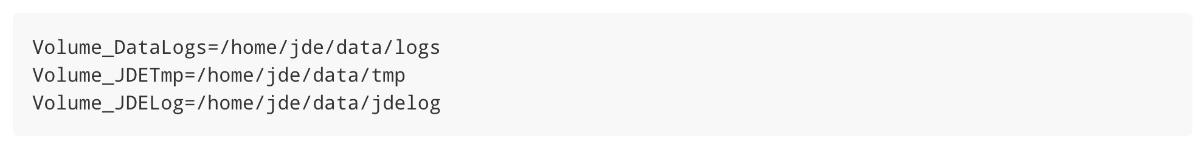
STEP 2 (C) – Microserver Installation - Volumes
Step 2 – (Cont.) Create volumes folders
Download Docker Compose
Create the following directories:
Configure Environment Var
Initialize The Container
Check Microservice Startup
Verify Microserver Deplo
mkdir -p ~/jde/data/logs \
~/jde/data/tmp \
~/jde/data/jdelog

Slide 24
STEP 3 – Microserver Installation – Initalize Docker
Step 3 - Initialize the Container
Download Docker Compose
Create the container without starting it:
Configure Environment Var
docker-compose -f docker-compose.yml up --no-start
Initialize The Container
Copy the configuration and JAR files that were previously generated:
docker cp /tmp/build_jde_libs/service-constants.properties jd-atina-microserver:/var/jdeatinaserver
docker cp /tmp/build_jde_libs/JPS920 jd-atina-microserver:/tmp/jde/config
docker cp /tmp/build_jde_libs/JDV920 jd-atina-microserver:/tmp/jde/config
docker cp /tmp/build_jde_libs JDEAtinaOverrideServicesConstants-1.0.0.jar jd-atina-microserver:/tmp/jde
docker cp /tmp/build_jde_libs/jde-lib-wrapped-1.0.0.jar jd-atina-microserver:/tmp/jde
docker cp /tmp/build_jde_libs/StdWebService-1.0.0.jar jd-atina-microserver:/tmp/jde
Check Microservice Startup
Verify Microserver Deplo
Start the Container
docker-compose -f docker-compose.yml start

Slide 25
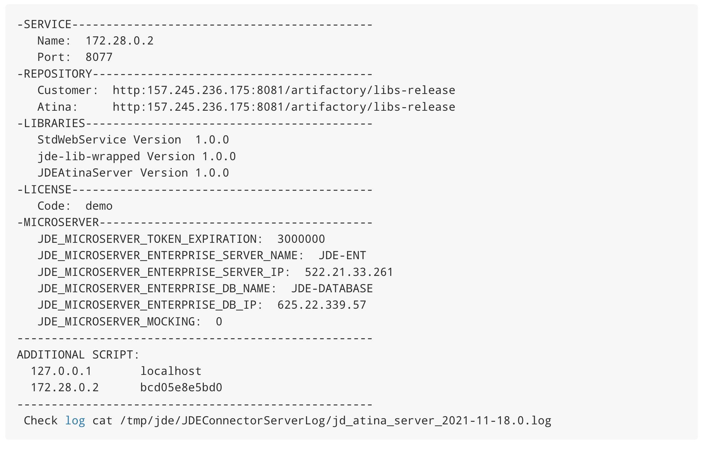
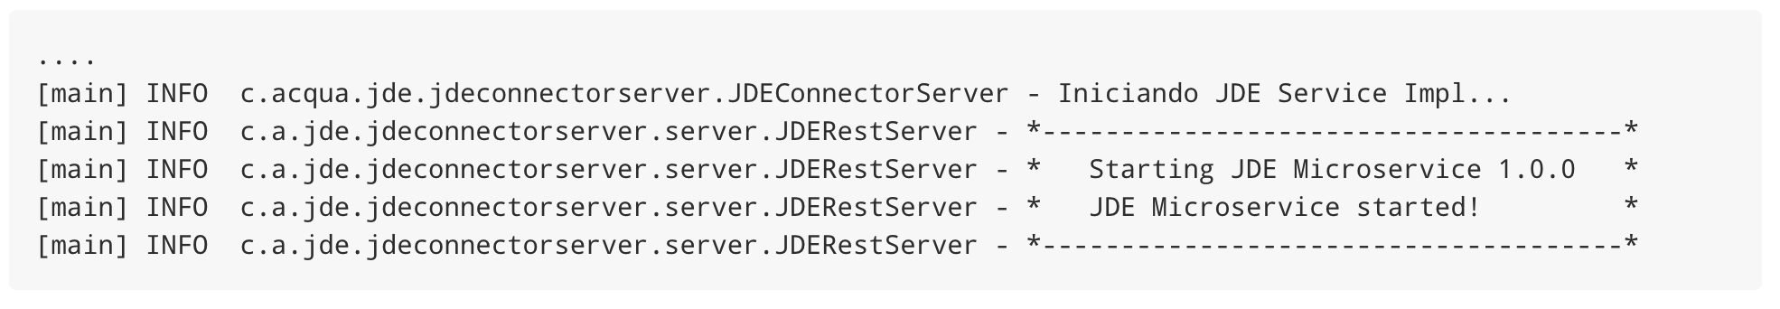
STEP 4 – Microserver Installation - Check
Step 4 - Check the microservice startup log
Download Docker Compose
docker exec -it jd-atina-microserver cat /tmp/start.log
Configure Environment Var
Initialize The Container
Check Microservice Startup
Verify Microserver Deplo
docker logs jd-atina-microserver

Slide 26
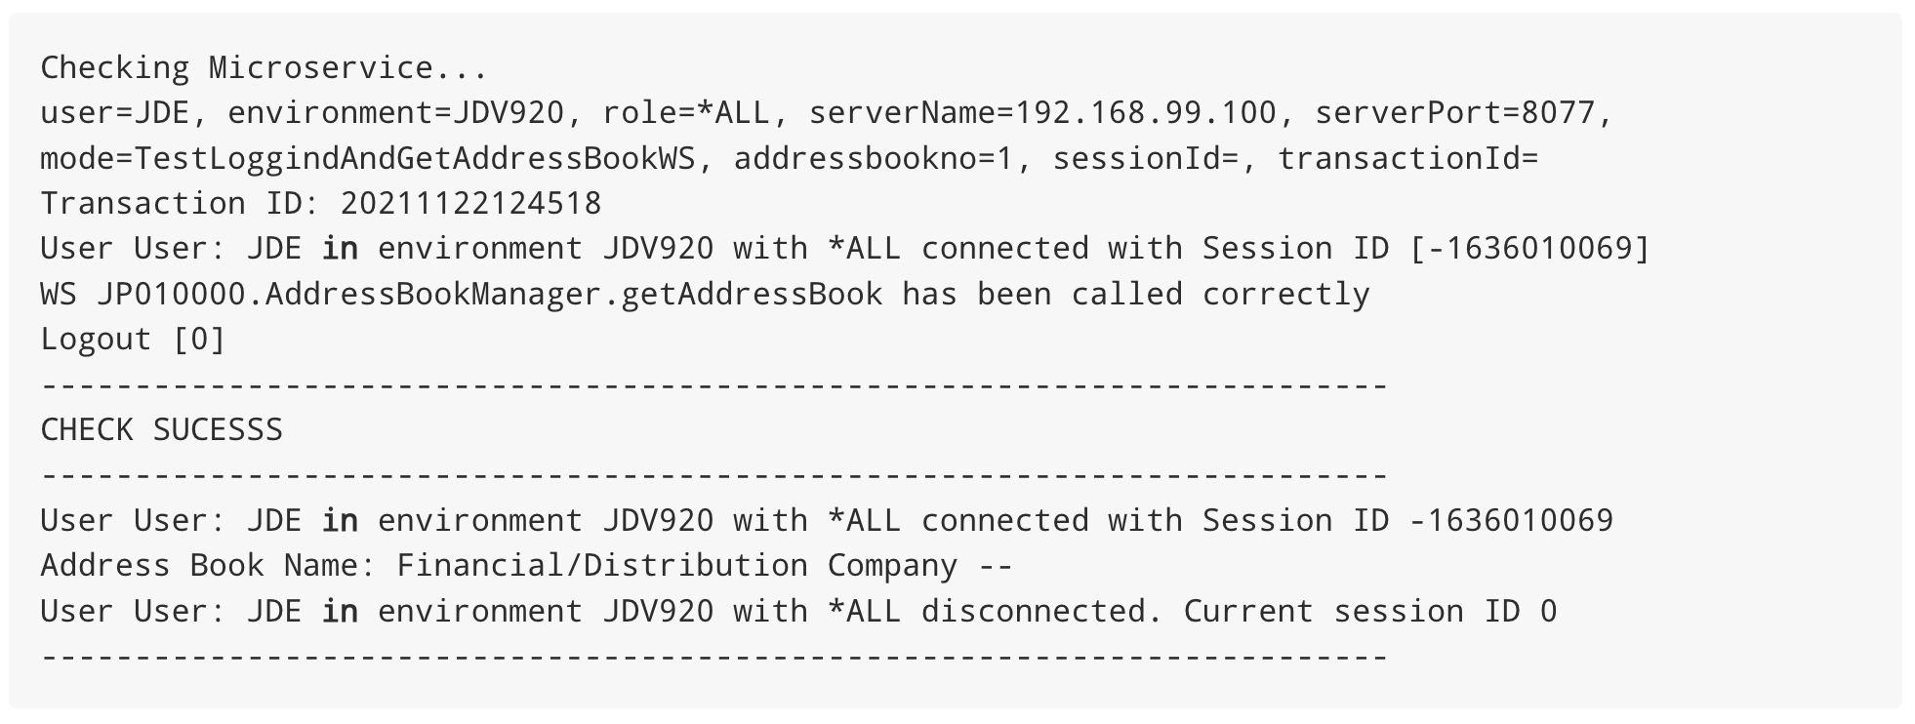
STEP 5 – Microserver Installation - Validate
Step 5 - Validating the Microservice Deployment
Download Docker Compose
Once the microservice is deployed and running, you can use the JD Atina Check Microservice Tool to validate that it can connect to JD Edwards and invoke a basic web service.
Configure Environment Var
Download the Check Tool
curl https://jfrog.atina-connection.com/artifactory/libs-release-local/com/atina/jd-check-microservice/1.0.0/jd-check-microservice-1.0.0.jar --output jd-check-microservice-1.0.0.jar
Initialize The Container
Check Microservice Startup
Run the test
Verify Microserver
java -jar jd-check-microservice-1.0.0.jar -u JDE -w XXXXXX -e JDV920 -r *ALL -s localhost -p 8077 -m TestLoggindAndGetAddressBookWS -a 28 -n "Prueba - Argentina - 28 "
If everything is correctly configured, you will see output like the following

Slide 27
Install Mule JDE Connector
GENERATE INI FILES
GENERATE
JDE JARS LIBRARIES
MICROSERVER INSTALLATION
INSTALL MULE JDE CONNECTOR

Slide 28
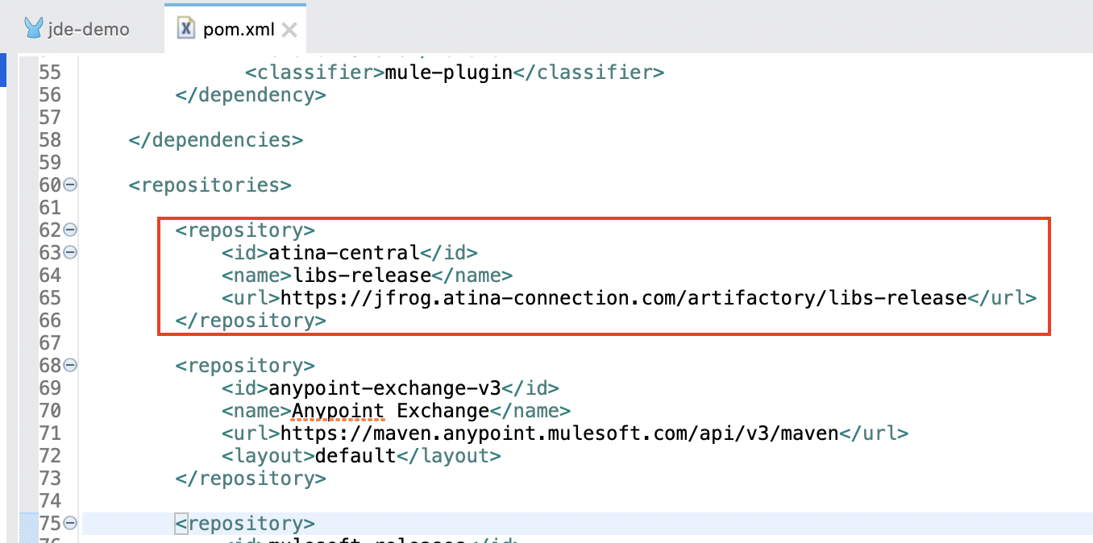
STEP 1 – Install Mulesoft JDE Connector – Define Repository
1 - Configure Maven Repository
After create your Mulesoft project, add the Atina repository to your pom.xml (within <repositories>):
<repository>
<id>atina-central</id>
<name>libs-release</name>
<url>https://jfrog.atina-connection.com/artifactory/libs-release</url>
</repository>

Slide 29
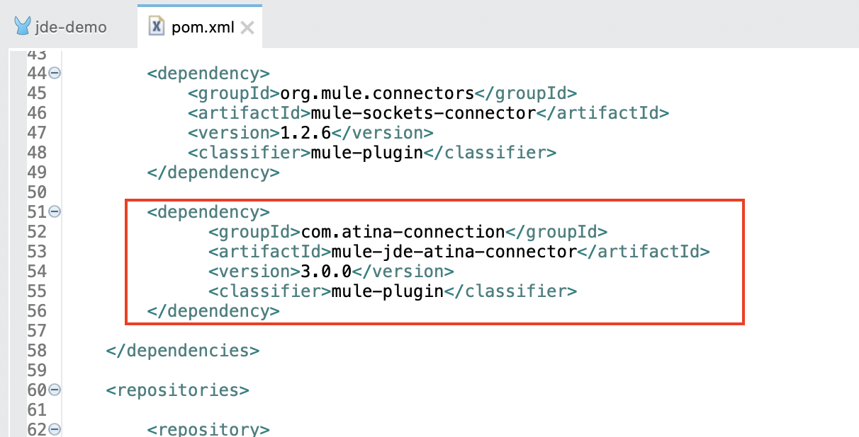
STEP 2 – Install Mulesoft JDE Connector – Define Dependency
2. Declare the Connector Dependency
Inside the <dependencies> section of your pom.xml, add:
<dependency>
<groupId>com.atina-connection</groupId>
<artifactId>mule-jde-atina-connector</artifactId>
<version>3.0.0</version>
<classifier>mule-plugin</classifier>
</dependency>

Slide 30
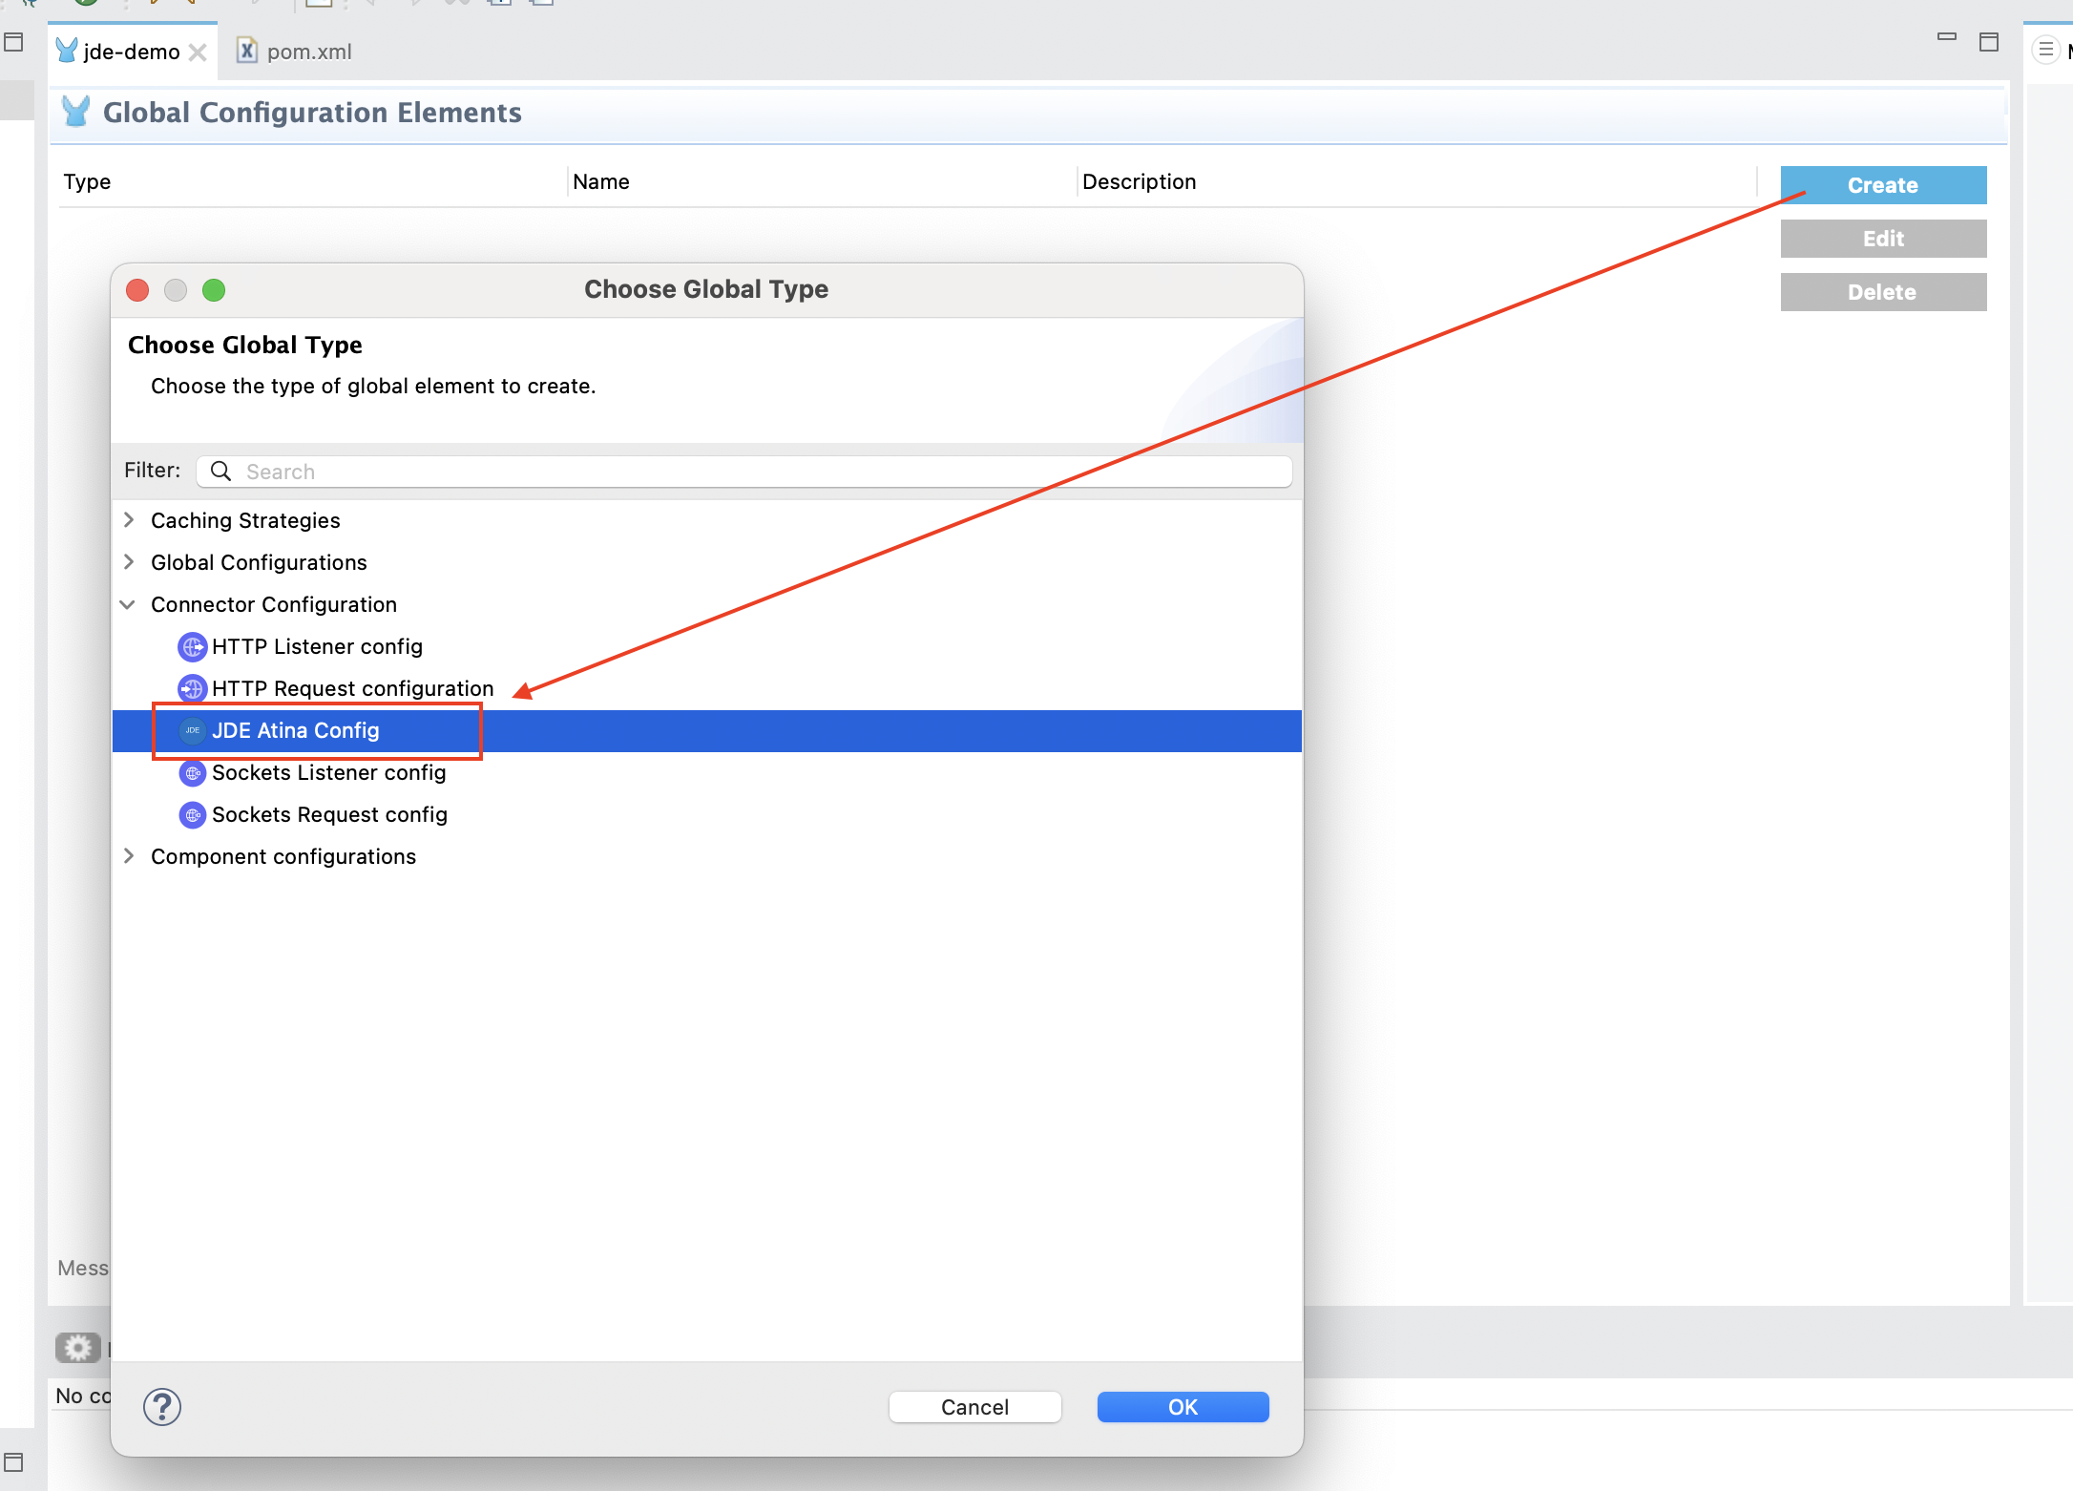
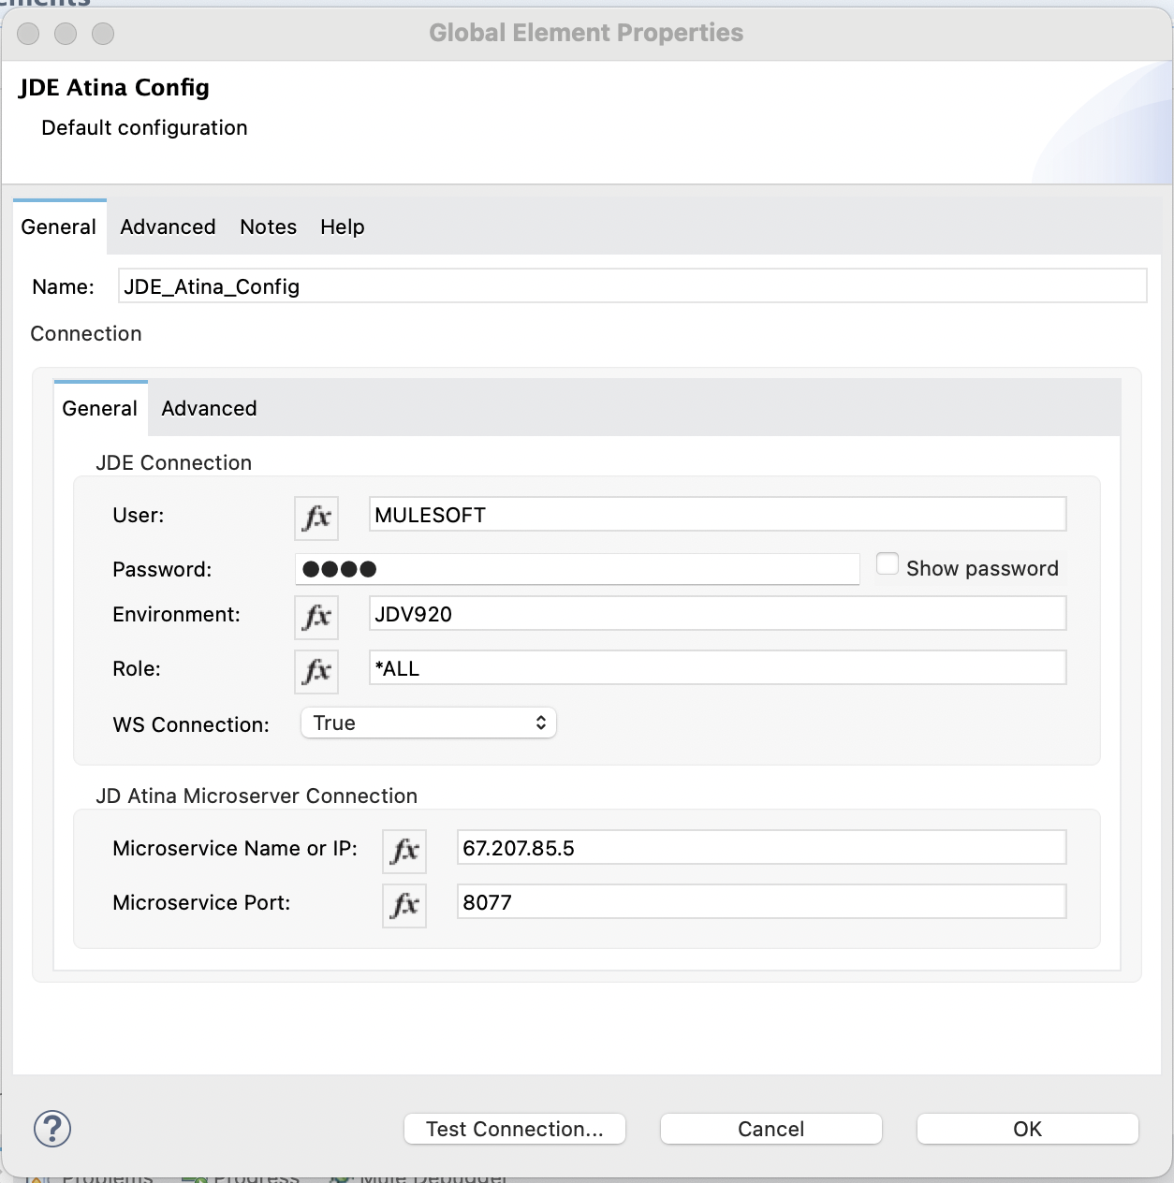
STEP 3 – Install Mulesoft JDE Connector – Define Global Configuration
3. Define the Global Connector Configuration
In your Mule project, create or open a flow file (e.g. jde-demo.xml), then:

