Slide 1
Syllabus
Unit-V
GEOTHERMAL ENERGY: Origin, Applications, Types of Geothermal Resources, Geothermal power generation, Relative Merits and Demerits.
OCEAN ENERGY: Ocean Thermal Energy; Open Cycle & Closed Cycle OTEC Plants, Environmental Impacts, Challenges and applications.
FUEL CELLS: Introduction, Applications, Classification, Different Types of Fuel Cells Such as Phosphoric Acid Fuel Cell, Alkaline Fuel Cell, PEM Fuel Cell, MC Fuel Cell.

Slide 2
UNIT V
Part-A (I)
Geothermal energy
Origin
Types of geothermal resources
Geothermal power generation
Relative Merits and Demerits

Slide 3
Geothermal energy:
Geothermal energy is the thermal energy present in the interior of the earth.
Volcanoes etc. are visible signs of large amounts of heat lying in the earth interior.
Although the amount of thermal energy with in the earth is very large, but useful geothermal energy can be extracted at only certain suitable sites.
Advantages of geothermal energy:
It is a reliable source of energy.
Its availability is independent of weather.
It is the least polluting.
It is cheaper than other energy sources.
Disadvantages of geothermal energy:
Geothermal energy is available as low-grade heat, that is temperature of geothermal fluid is low.
Removal of heated water from the hydrothermal reservoir may lead to land subsidence or seismic imbalance.
Drilling and blasting of wells may cause instability of land structure and may develop risk of any earthquake or seismic imbalance.
Geothermal energy cannot be transported over long distances (less than 30 km).

Slide 4
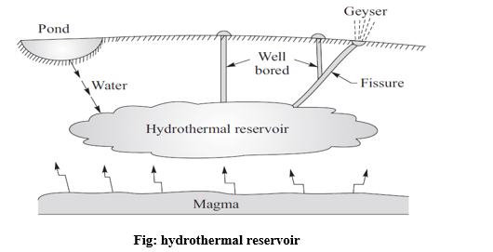
Geothermal Sources:
The sites where geothermal energy is available near the surface and is relatively more concentrated, its extraction and use may be considered feasible.
Those sites are known as geothermal sources or geothermal regions or geothermal fields.
Geothermal energy can be extracted from earth’s interior in the form of heat.
Geothermal sources are therefore of four basic kinds:
Magma resources
Geopressured resources
Petrothermal resources
Hydrothermal resources
Magma resources:
These consist of partially or completely molten rock with temperature in excess of 650⁰C, which may be available at moderate depths.
Geopressured resource:
Geopressured resource is hot water or brine trapped underground at the depth of about
2400–9l00 m with temperature at about l60°C.
The pressure of the water is about l000 bar.

Slide 5
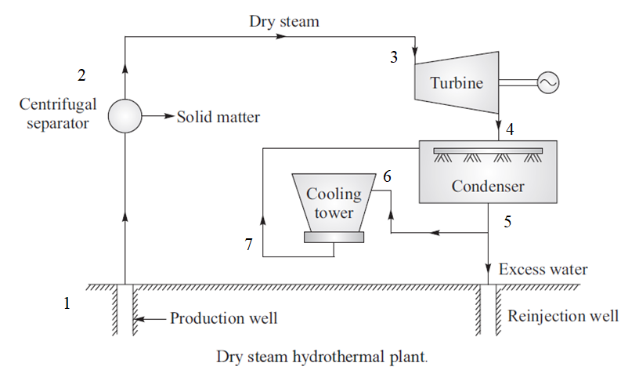
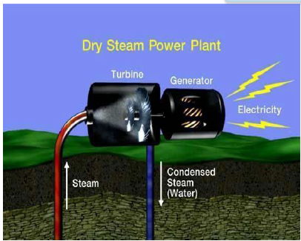
Petrothermal (or) Hot dry rocks (Hot rocks):
Hot dry rocks or petrothermal resources consist of high-temperature rocks ranging from 90 to 650°C.
Hydrothermal resources:
Hydrothermal resources contain superheated water, steam or both in fractured or porous rock, but further trapped by a layer of impermeable rock.
Hydrothermal resource may give dry and pure steam with temperature above 240°C.
Hydrothermal resources are classified into two types:
          Vapour-dominated system
          Liquid-dominated system
Vapour-dominated system or dry steam hydrothermal plant:
In these systems, the water is vaporized into steam that reaches the surface in a relatively dry condition at about 205°C and rarely above 8 bar.
This steam is the most suitable for use in turbo electric power plants with the least cost.

Slide 6
Liquid-dominated system:
The water temperature in the reservoirs is about 100°C, but water does not boil as it is under pressure.
As the water comes to the surface, there will be pressure drop and rapid boiling of water takes place which flashes into a mixture of hot water and steam.
This hot water can be utilized to generate electric power.
Further this liquid-dominated system is again classified into two types.
  Liquid dominated high-temperature plant or system
  Liquid dominated low-temperature plant or system
Liquid dominated high-temperature plant or system:
The type of plant or system is used where hydrothermal reservoir has temperature and pressure of 230°C and 40 atm respectively.
Flashed steam system again classified into two types:
  Single flash steam system
  Double flash steam system

Slide 7
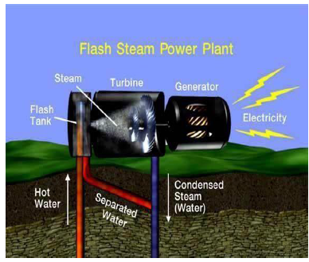
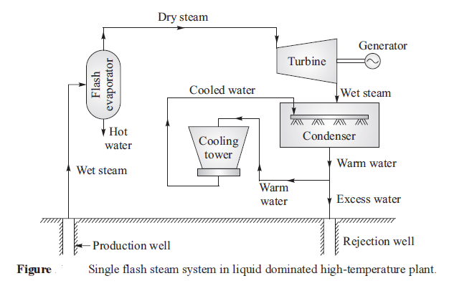
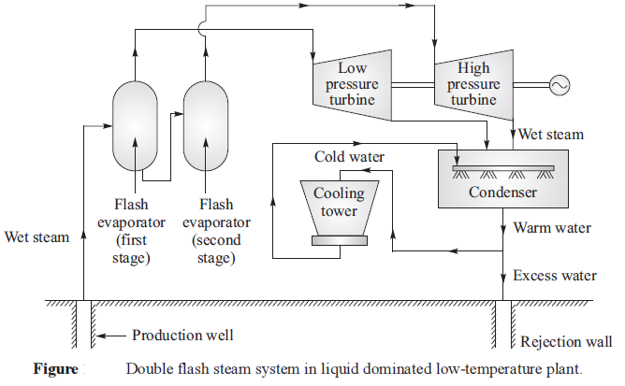
Single flash steam system:
Figure show a schematic diagram for the single flashed system.
Double flash steam system:
Figure show a schematic diagram for the double flashed system.

Slide 8
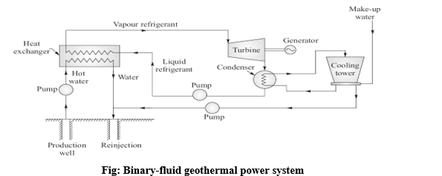
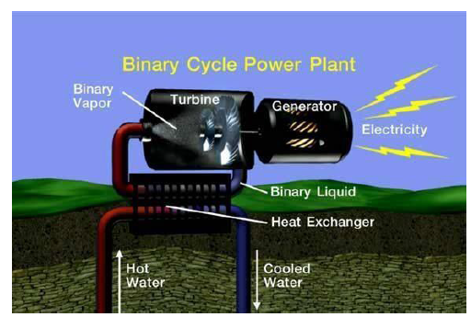
Liquid dominated low-temperature plant or system or binary cycle system:

Slide 9
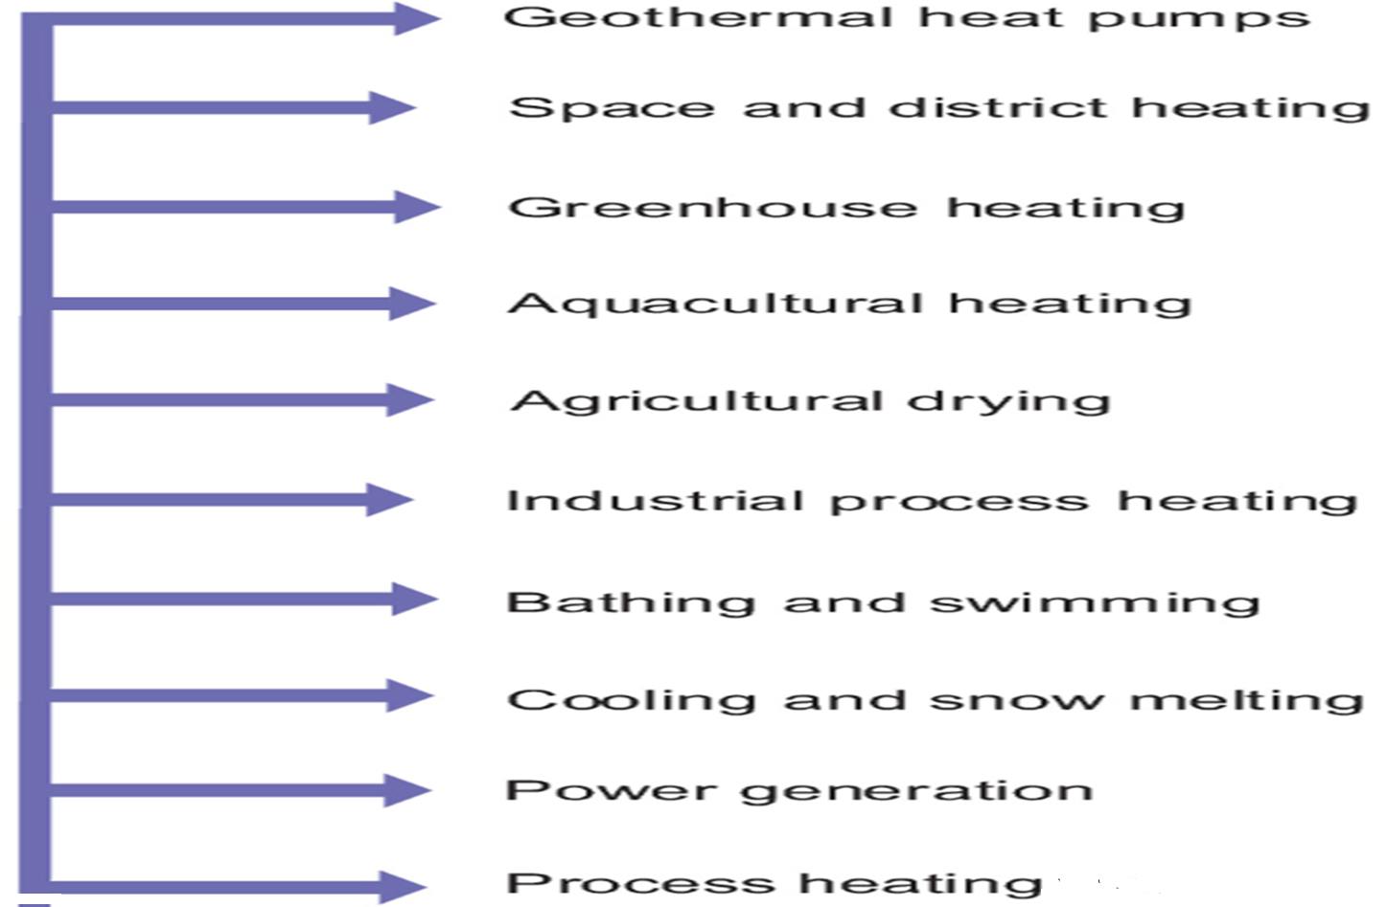
Applications of geothermal energy:

Slide 10
UNIT V
Part-A (I)
Ocean energy
Ocean thermal energy
Open cycle OTEC plants
Closed cycle OTEC plants
Environmental impacts
Challenges
Applications

Slide 11
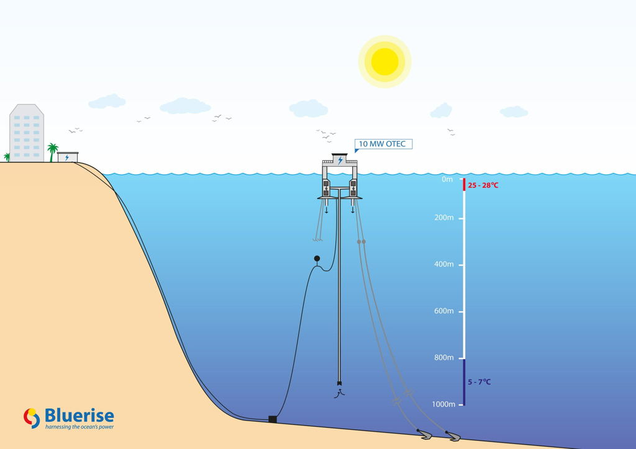
Introduction to ocean thermal energy:
The energy in the ocean waves is a converted form of concentrated solar energy.
So, ocean thermal energy is created by solar energy when ocean water absorbs solar radiation.
The energy which comes from the sun is transferred through complex wind electromagnetic wave interactions.
The effect of Earth’s temperature variation due to solar heating combined with a multitude of atmospheric phenomena (variation in temperature and pressure).
It is used to power generation or wind current, around the globe.
This process of conversion is called ocean thermal energy conversion (OTEC).

Slide 12
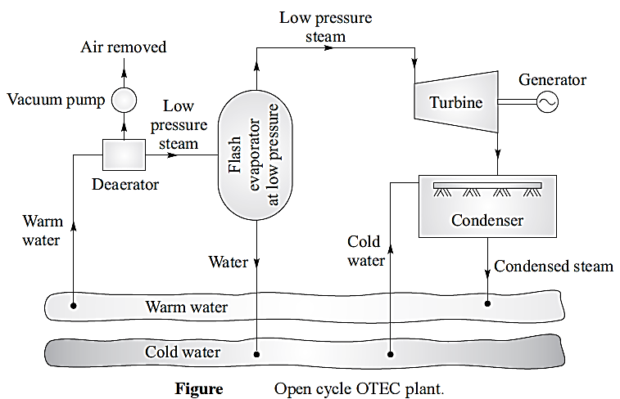
OTEC systems (or) Types of OTEC power plants:
              (Or)
Ocean thermal energy conversion systems:
OTEC plants can operate using open cycle or closed cycle.
The open cycle is also known as the Claude cycle while the close cycle is also known as Anderson cycle.
Open cycle or Claude cycle:
Warm water from the top surface is evaporated to obtain low pressure steam by using a flash evaporator maintained at partial vacuum as water can evaporate at the lower temperature when pressure is lower than atmospheric pressure.
The low pressure steam obtained from flash evaporator is expanded in a turbine to extract mechanical energy.
The steam after energy removal in turbine is condensed into water in a condenser which is cooled by cold water drawn from the depths in the ocean.
The working of an open cycle OTEC plant is shown in figure.

Slide 13
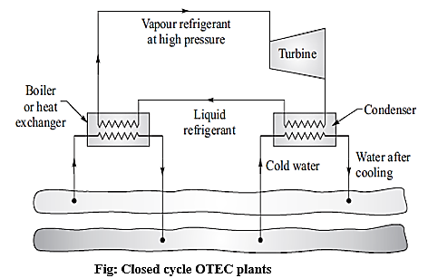
Closed cycle or Anderson cycle:
In the closed cycle, warm surface water is used to evaporate a low boiling point refrigerant (ammonia or freon) and refrigerant vapour is made to flow through the turbine to extract energy.
The vapour coming out from the turbine after performing work is cooled and condensed in a condenser cooled by cold water pumped from the ocean depths.
The closed cycle is shown in figure.
Such plant is much compact in size and less costly compared to open cycle OTEC plant.
Advantages of OTEC plants:
Renewable
Pollution free
Continuous
Desalination
Ecofriendly
Disadvantages of OTEC plants:
Capital investment is high
Efficiency is low
Harmful efficiency on marine life

Slide 14
Environmental impacts of ocean thermal energy conversion (OTEC):
No air pollution
Renewable and sustainable
Reduces fossil fuel dependence
Marine life disturbance
Discharge of cold water
Chemical leakage risk
Noise pollution
Visual impact
Applications of ocean thermal energy conversion (OTEC):
Electricity Generation
Desalination of Seawater
Air Conditioning and Cooling
Aquaculture (Fish Farming)
Hydrogen Production

Slide 15
UNIT V
Part-B
Fuel cells
Introduction
Classification
Different types of fuel cells
  Phosphoric acid fuel cell
  Alkaline fuel cell
  PEM fuel cell
  MC fuel cell
Applications

Slide 16
Fuel cell:
Fuel cell is a device converts chemical energy into electrical energy.
It requires continuous supply of a fuel and an oxidant to generate D.C. electric power.
Types of fuel cells:
1. A primary fuel cell is a fuel cell in which the reactants (fuel and oxidant) are passed through the cell only once and the products of reactants are discarded. Hydrogen–oxygen fuel cell is a primary fuel cell.
Examples:
Hydrogen-Oxygen fuel cell
Alkaline fuel cell
Polymer electrolyte fuel cell
Molten carbonate fuel cell
Solid oxide fuel cell
2. A secondary fuel cell is a cell in which the reactants (fuel and oxidant) are passed through the cell many times. The products of the reactants are regenerated by thermal, electrical or photochemical methods. These fuel cells are also called regenerative or reversible fuel cells.
Examples:
Regenerative fuel cell
Reversible fuel cell
Fossil fuel cell
Hydro carbon fuel cell
Petro-chemical fuel cell

Slide 17
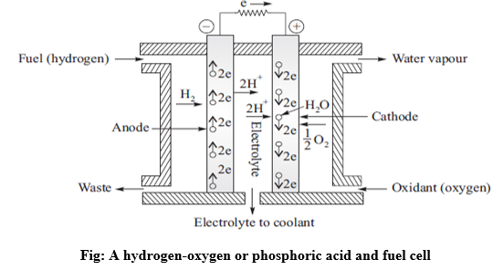
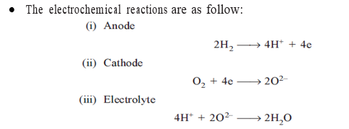
A hydrogen-oxygen or phosphoric acid and fuel cell:
Working principle:
A fuel cell converts chemical energy of a fuel directly into electrical energy.
Fuel gas diffuses through the anode and it gets oxidized.
On oxidation, the fuel gas releases electrons to the external circuit.
The fuel cell consists of two electrochemically conducting electrodes separated by an electrolyte.
The arrangement of fuel cell components is shown in figure.
The electrochemical reactions are as follow:

Slide 18
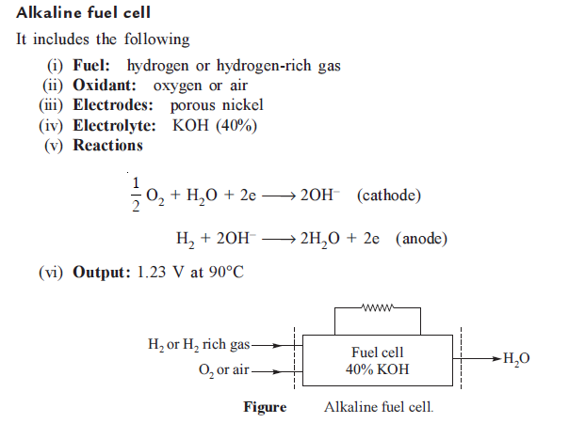
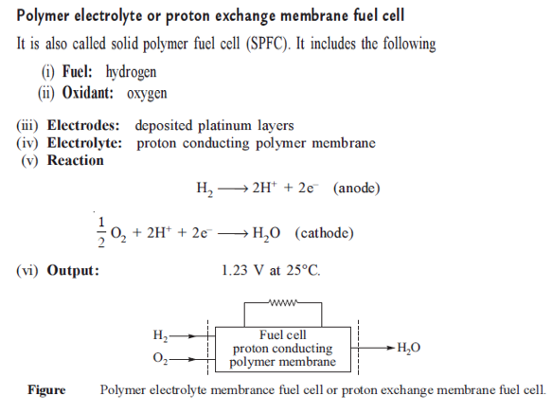

Slide 19
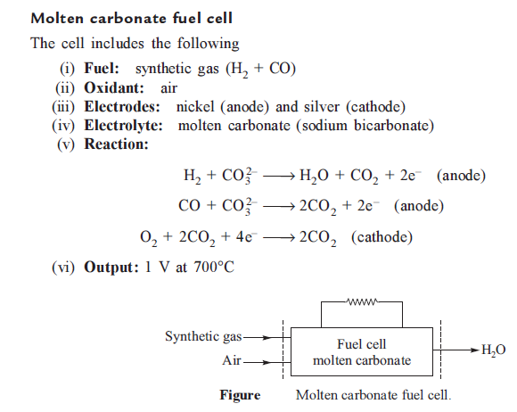
Applications of fuel cells:
Transportation: Fuel cells can power vehicles, such as buses, trains, planes, and personal cars.
Backup power: Fuel cells can provide emergency backup power for facilities that are critical to the grid, such as data centers, hospitals, and prisons.
Spacecraft: Fuel cells power the electrical systems on spacecraft.
Electronic devices: Small fuel cells can power devices like cell phones and laptops.

Slide 20
Descriptive questions
Elaborate the various types of geothermal energy sources.
Illustrate the vapour dominated power plant.
Demonstrate the single flash steam system.
Discuss the double flash steam system.
Explain the working of open cycle OTEC plant.
Elaborate the working of closed cycle OTEC plant.
Discuss the ocean thermal energy affects on environmental impact.
Classify and describe different kinds of fuel cells.
Describe a H₂-O₂ fuel cell with sketch.
Listout the applications of fuel cell.
Short answer questions
Define geothermal energy.
Listout the application of geothermal energy sources.
What is the working principle of ocean thermal energy conversion.
List any two applications of OTEC.
Define fuel cell.
Assignment questions
Elucidate the hot rocks, hot springs and geysers.
Describe origin of geothermal energy sources.
Discuss the challenges for operating OTEC plants.
Derive the equation for efficiency of fuel cell.

