Slide 2
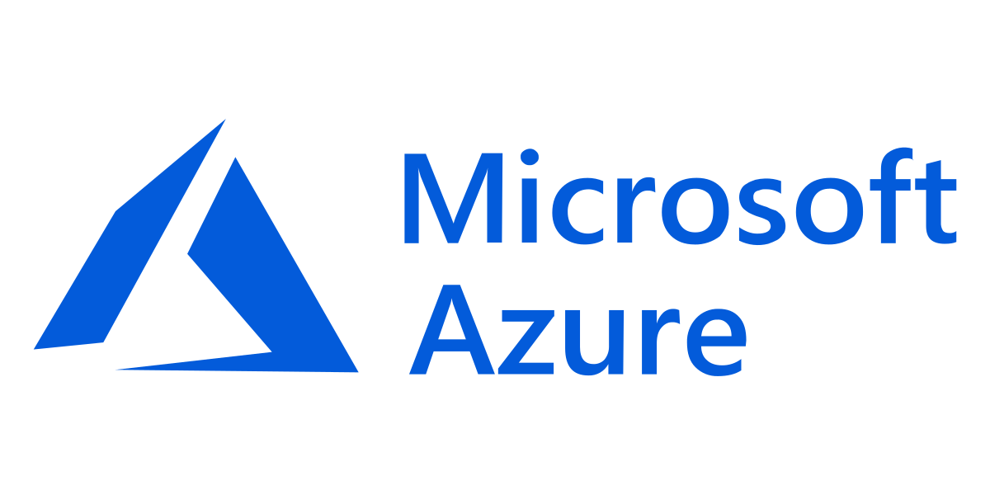
Read and write data in Azure Databricks
Atique Abdullah
P200043
Mussa Masood
P200599
Notes:
Link to published module on Learn: https://docs.microsoft.com/en-us/learn/modules/learn-pr/wwl-data-ai/read-write-data-azure-databricks/

Slide 3
Learning objectives
What is Azure Databricks
Databricks Clusters
Databricks notebook
Libraries
Tokens
Spark

Slide 4
What is Azure
Azure is a cloud computing platform and set of services provided by Microsoft. It allows users to build, deploy, and manage applications and services through a global network of Microsoft-managed data centers.
Notes:
Microsoft Azure Account: You will need a valid and active Azure account for the Azure labs. If you do not have one, you can sign up for a free trial
If you are a Visual Studio Active Subscriber, you are entitled to Azure credits per month. You can refer to this link to find out more including how to activate and start using your monthly Azure credit.
If you are not a Visual Studio Subscriber, you can sign up for the FREE Visual Studio Dev Essentials program to create Azure free account.

Slide 5
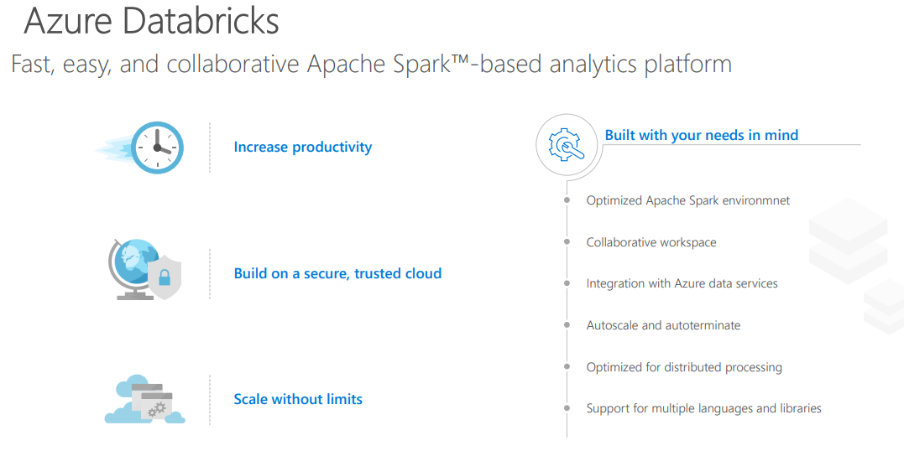

Slide 6
What is Azure Data Bricks
Azure Databricks is a collaborative, cloud-based data analytics platform that provides a unified workspace for data engineers, data scientists, and machine learning practitioners to work together on big data and machine learning projects.
Azure Databricks offers a collaborative workspace where teams can easily share and collaborate on notebooks, code, and data visualizations. The platform also provides an extensive library of pre-built machine learning algorithms and data processing functions, enabling you to quickly build and deploy sophisticated analytics applications.

Slide 7
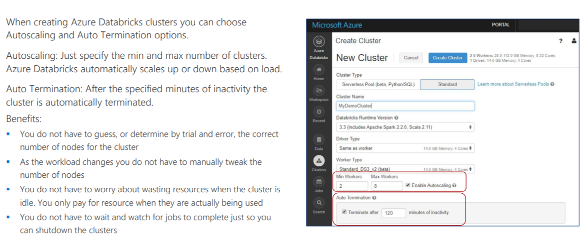
Databricks clustering
Notes:
To complete this lab, you will need to deploy an Azure Databricks workspace in your Azure subscription.

Slide 8
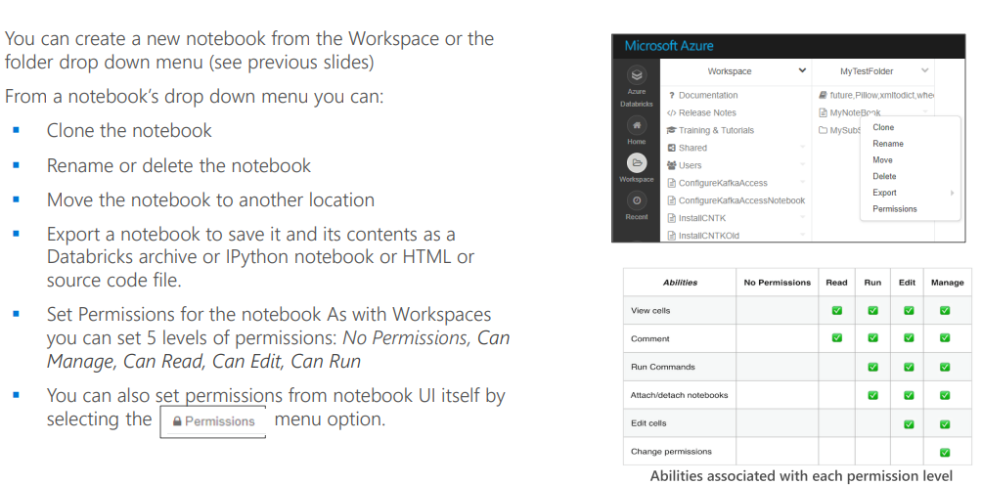
Data bricks notebook

Slide 9
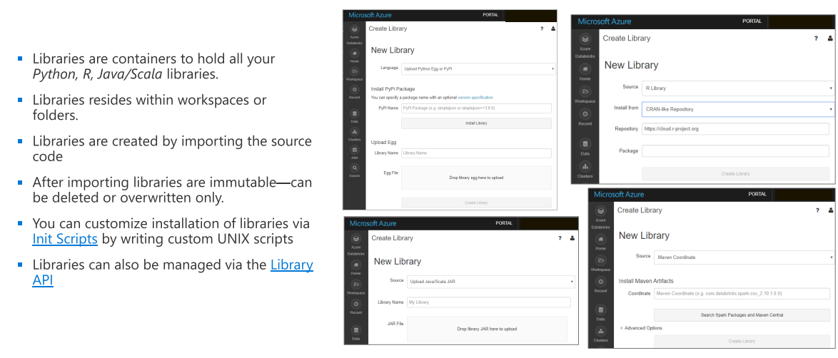
Libraries

Slide 10
Tokens
In Azure Databricks, there are two types of tokens that can be used for authentication and authorization purposes:
Personal Access Tokens: Personal Access Tokens (PATs) are tokens associated with a user account in Azure Databricks. These tokens are primarily used to authenticate and authorize API requests made to the Databricks REST API. PATs can be created and managed from the Databricks user interface, and they provide access to resources based on the user's permissions and role assignments within the Databricks workspace.
Azure Active Directory Tokens: Azure Active Directory (Azure AD) tokens are used for authentication and authorization when using Azure Databricks with Azure AD integration. With Azure AD integration enabled, users can authenticate to Databricks using their Azure AD credentials, and Azure AD tokens are obtained and used for authorization. Azure AD tokens allow users to access resources in Azure Databricks based on their assigned roles and permissions in Azure AD.

Slide 11
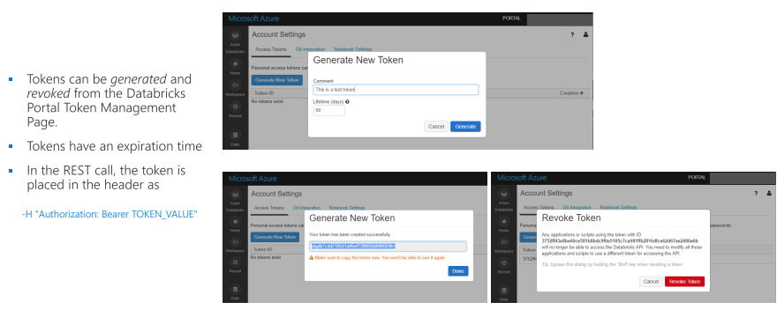

Slide 12
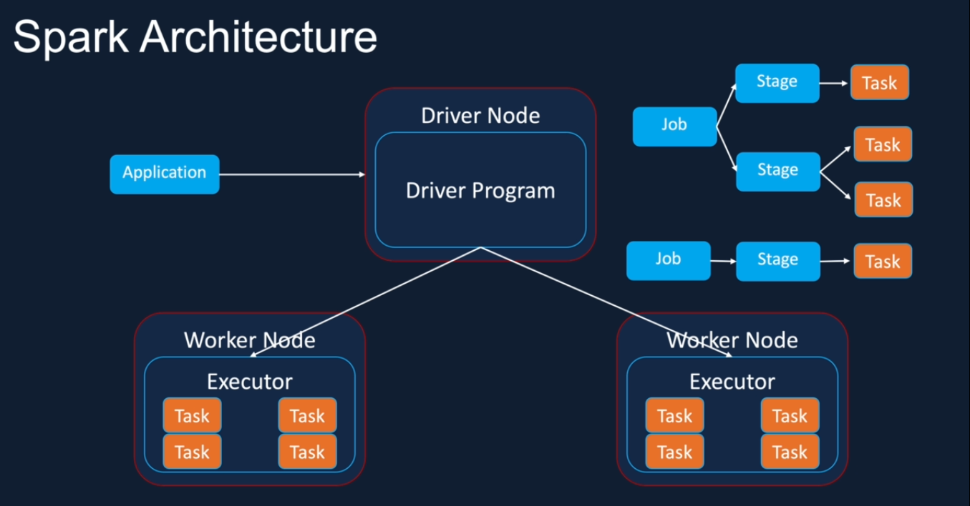
Sparks

Slide 13
The End

