Slide 1
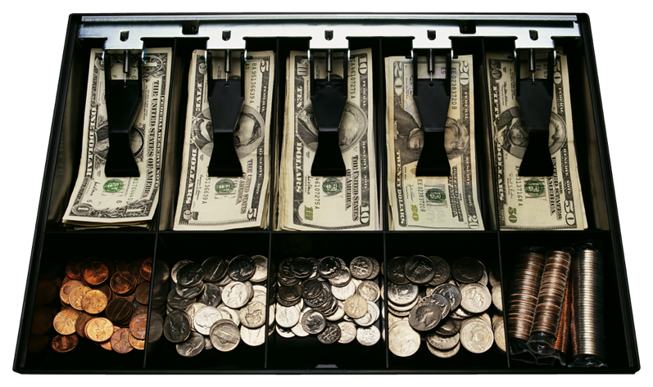
Array-Based Sequences
© 2013 Goodrich, Tamassia, Goldwasser
Array-Based Sequences
Notes:
Vectors

Slide 2
Python Sequence Classes
Python has built-in types, list, tuple, and str.
Each of these sequence types supports indexing to access an individual element of a sequence, using a syntax such as A[i]
Each of these types uses an array to represent the sequence.
  An array is a set of memory locations that can be addressed using consecutive indices, which, in Python, start with index 0.
A
0
1
2
i
n
© 2013 Goodrich, Tamassia, Goldwasser
Array-Based Sequences

Slide 3
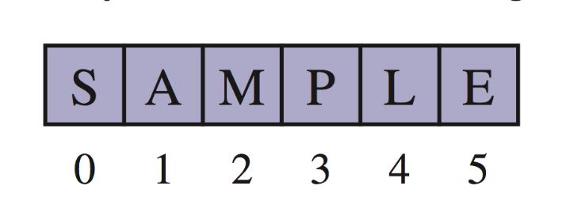
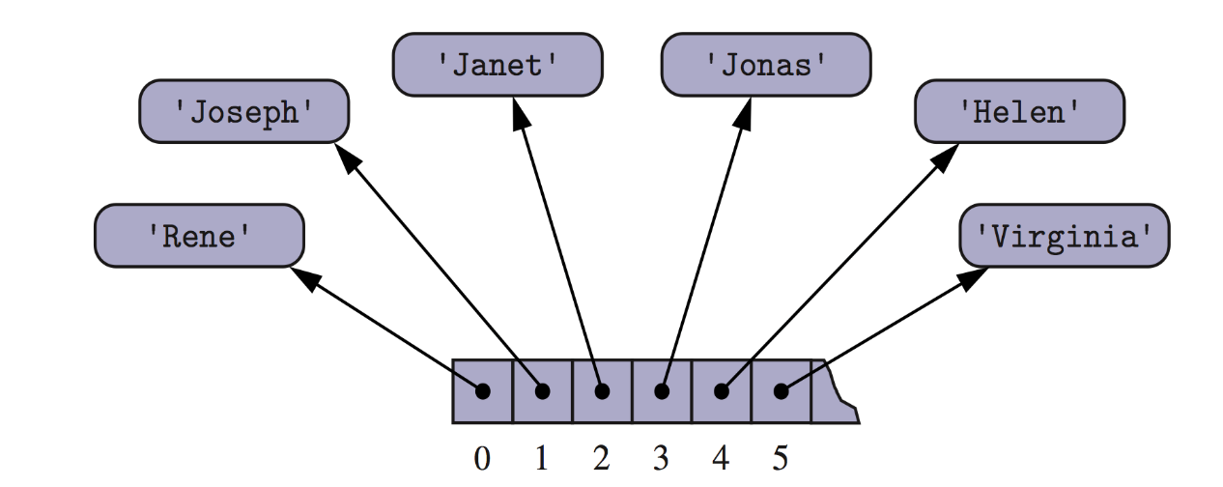
Arrays of Characters or Object References
A compact array stores primitive elements, such as characters (for a string).
An array can also store references to objects.
  Each element in memory for an array isn’t big enough to store a string, so references / pointers to the string are used
© 2013 Goodrich, Tamassia, Goldwasser
Array-Based Sequences

Slide 4
Compact Array ADT – no pointers
Python provides an Abstract Data Type (ADT) for one dimensional arrays named array.
The constructor for the array class requires a type code as a first parameter, which is a character that designates the type of data that will be stored in the array.
this allows for the correct allocation of memory
As an array increases in size so the allocated memory increases dynamically
© 2013 Goodrich, Tamassia, Goldwasser
Array-Based Sequences

Slide 5
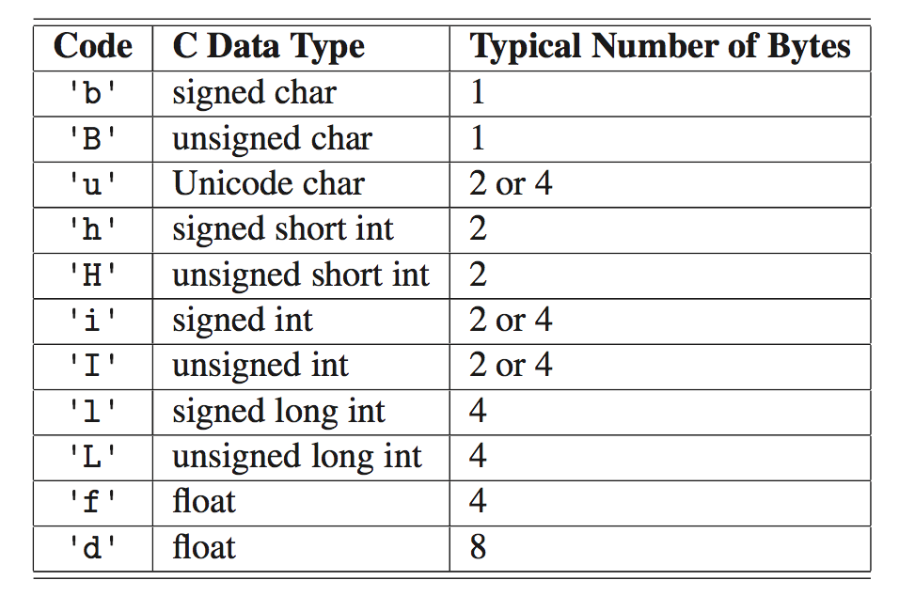
Type Codes in the array Class
Python’s array class has the following type codes:
© 2013 Goodrich, Tamassia, Goldwasser
Array-Based Sequences

Slide 6
The array Class – array1.py
from array import *
Some array methods:
  buffer_info() – gives the address & size of the array
  reverse() – reverses the order
  A= array(‘i’ ,[]) – creates a blank array
  append() – adding an element to the end of the array
Have a look at the video on reading data into an array from users and searching an array for an element
© 2013 Goodrich, Tamassia, Goldwasser
Array-Based Sequences

Slide 7
Pythons List Class (see list1.py)
We can use Python’s list class to implement dynamic arrays
Its an ADT that is implemented using an array structure to store items in a list
Creating a Python list:
  myList = [4, 12, 2, 34, 17]
  This calls the list() constructor
  The array is initially created bigger than needed so that it can expand as needed
  len(myList) – will return the number of elements in the array and NOT the size of the underlying array
    Running time is O(n)
© 2013 Goodrich, Tamassia, Goldwasser
Array-Based Sequences

Slide 8
Adding items to the end
myList.append(18)
  Adds the element to the end of the array
  If the underlying memory allocated gets full
    a new array is created with additional capacity
    the items from the original array are copied across
    the original array is removed
  Uses O(1) time
Sorting a list
myList.sort()
© 2013 Goodrich, Tamassia, Goldwasser
Array-Based Sequences

Slide 9
Inserting items
Items can be inserted anywhere in a list
In an operation insert(i, o), we are inserting the value o into position i
myList.insert(5, 44) – inserts 44 at position 5
BUT position 5 might contain a value
So we need to make room for the new element by shifting forward the elements from position 5 to the end
So that means shifting n − i elements A[i], …, A[n − 1]
In the worst case (i = 0 – from the first element), this takes O(n) time
© 2013 Goodrich, Tamassia, Goldwasser

Slide 10
Insertion items
A
0
1
2
i
n
A
0
1
2
i
n
A
o
0
1
2
i
n
Array-Based Sequences
© 2013 Goodrich, Tamassia, Goldwasser

Slide 11
Element Removal
Python has a few methods for element removal:
  myList.pop() – removes the last element from the list / array – an O(1) operation
  myList.pop(k) – removes element k from the list - the time efficiency is O(n-k) – the amount of moving depends on k, at worst if the first element needs to be removed this would be O(n)
  myList.remove(val) – removes a specific value NOT a specified index. Removes the first occurrence – always O(n) – it locates the position of the element to remove then carries on through to shift the rest up
A
o
0
1
2
i
n
A
0
1
2
i
n
A
0
1
2
i
n
© 2013 Goodrich, Tamassia, Goldwasser
Array-Based Sequences

Slide 12
Adding one list to the end of another
myList.extend(xtrList)
  This is the same as using append to add each element of xtrList to myList
    for element in xtrList:
    myList.append(element)
  The time depends on the number of elements in xtrList
  extend is preferred – it is a Python method and is more efficient for various reasons – see explanation in text
© 2013 Goodrich, Tamassia, Goldwasser
Array-Based Sequences

Slide 13
Slicing the List
mySlice = myList[x:y]
  Starting at element x, take y number of elements and store them in a new List
  The slice will have be stored at a different memory location and is therefore independent of the original list
  Extra memory space is allocated for future additions to the new list
© 2013 Goodrich, Tamassia, Goldwasser
Array-Based Sequences

Slide 14
Using Comprehension syntax
Using comprehension syntax – more efficient – EG creating a new list
  Common practice to initialize a list to 0’s
  Lst = [0 for n in range(max)]
  Rather than
  Lst=[]
  for n in range(max):
  Lst.append(0)
© 2013 Goodrich, Tamassia, Goldwasser
Array-Based Sequences

Slide 15
Performance - reminder
In an array based implementation of a dynamic list:
  The space used by the data structure is O(n)
  Indexing the element at I takes O(1) time
  Appending an element takes O(1) time
  len, insert, pop and remove run in O(n) time in worst case
In an add operation, when the array is full, instead of throwing an exception, we can replace the array with a larger one…
© 2013 Goodrich, Tamassia, Goldwasser
Array-Based Sequences

Slide 16
Two Dimensional Arrays
Lists, tuples and strings are one dimensional
  Similar to a row in a table
Many apps need multi-dimensional arrays
  Similar to rows and columns in a table – a matrix
  Elements are accessed using 2 indices – one for the row and one for the column
    EgArray[i][j] where i refers to the row and j refers to the column
  myArray[1][2]
Python doesn’t support multi-dimensional arrays
  They are implemented as a list of lists
© 2013 Goodrich, Tamassia, Goldwasser
Array-Based Sequences

Slide 17
Two Dimensional Arrays
  Assume the data below represents the number of customers visiting 5 stores (columns) over the weekend – Friday, Saturday and Sunday (rows)
  Cust[1][4] stores 75 (row 1, col 4 – starting at 0)
  The data is stored as follows:
    Cust = [[22,18,70,5,33],[45,32,83,12,75],[4,88,45,66,61]]
  2D arrays are usually manipulated with loops
22 | 18 | 70 | 5 | 33
45 | 32 | 83 | 12 | 75
4 | 88 | 45 | 66 | 61
© 2013 Goodrich, Tamassia, Goldwasser
Array-Based Sequences

Slide 18
Python Implementation
  Be careful of copying arrays
    cpy_a = a
      Results in cpy_a pointing to the same memory address of a, so changes to the one affects the other
  Work through the code in array2.py to get a feel of 2Dim arrays
    Printing elements
    Calculating a sum
    Initializing the matrix to 0’s
© 2013 Goodrich, Tamassia, Goldwasser
Array-Based Sequences

