Slide 1
Olist Marketing and Retail Analytics
By Atish Kumar Mistry

Slide 2
Agenda
Objectives
Background
Data Illustration
Key Insights
Recommendations
Appendix –
Data Sources
Data Methodology

Slide 3
Objectives
To identify the top 20 products contributing to the revenue and top 20 products that are majorly sold in quantity.
To identify the Product Categories that majorly contribute to the business.
Conduct Market basket analysis to understand purchase behavior by revealing which items are most likely to be bought individually or in combination with other products

Slide 4
Background
OList, an e-commerce company experiencing recent losses, aims to manage its inventory more effectively to cut unnecessary costs.
To effectively meet customer demands, the company needs to maintain substantial quantities of products in its warehouses, which requires careful management.
Given that the cost of storing large volumes of inventory contributes significantly to the company's expenses, strategic inventory planning is crucial to optimizing these costs

Slide 5
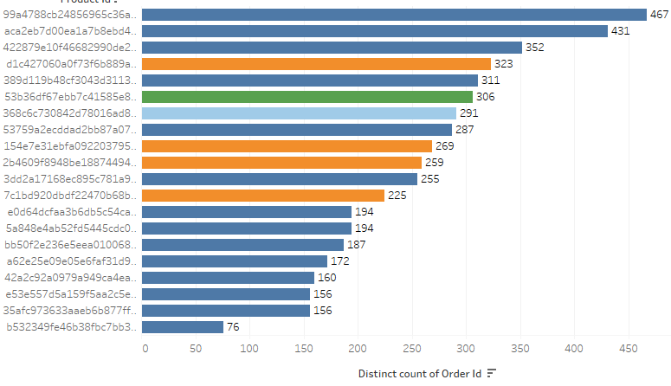
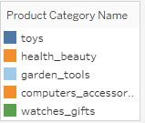
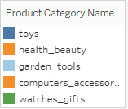
Top 20 Most Ordered Products
The highest ordered product is from the Toys category and has been ordered 467 times.
Most of the products in the Top 20 that are frequently ordered belong to the Toys category.

Slide 6
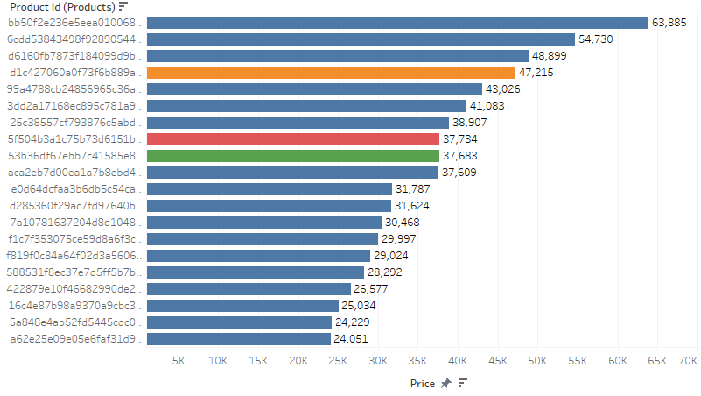
Top 20 Revenue Generators
The highest revenue generated is 63, 885 which belongs to the Toys Category.
Most of the products in the Top 20 list generating high revenue belong to the Toys category followed by health_beauty.

Slide 7
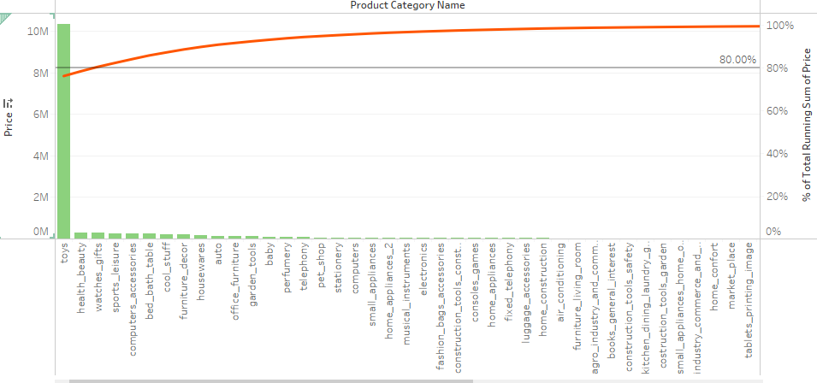
Revenue Pareto Analysis
Toys, health_beauty, and watches_gift combine generate 80.54% of the revenue.
Toys alone generate 76.21% of the revenue.

Slide 8
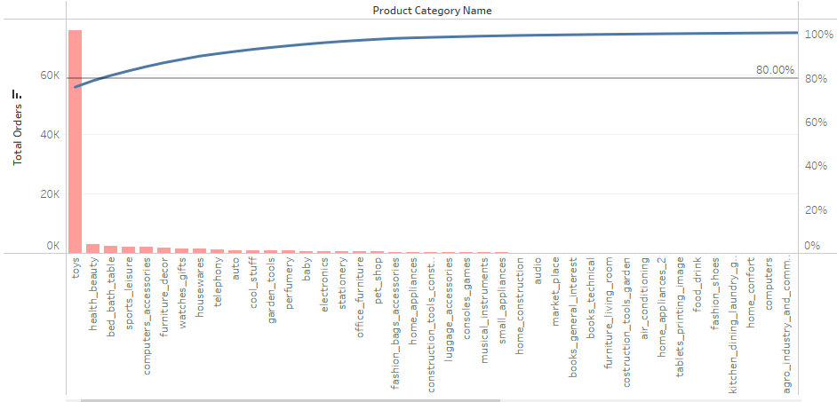
Quantity Pareto Analysis
Toys, health_beauty and bed_bath_table make up 81.21% of the total orders.
Toys alone has 75.93% of the total orders.

Slide 9
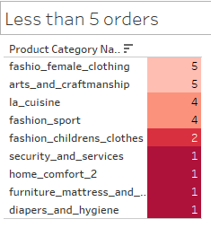
Product Categories ordered > 5 times
Apart from these Product Categories, every Category is ordered more than 5 times.

Slide 10
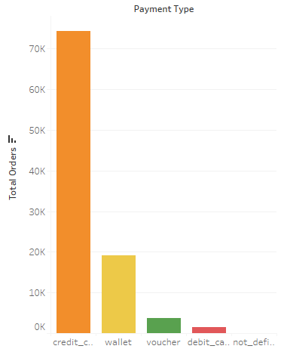
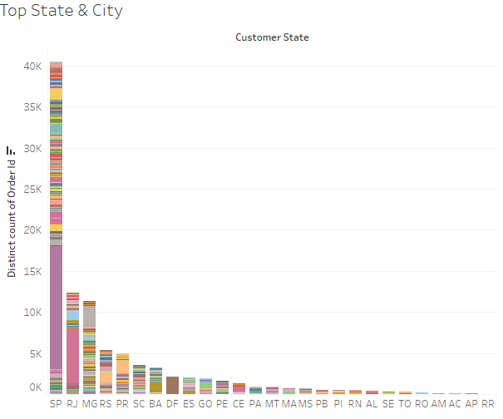
Majority of the payments are made via Credit Cards.
State SP stands out in terms of most orders placed.
Sau Paulo & Rio de Janeiro are the top 2 cities in terms of orders placed.

Slide 11
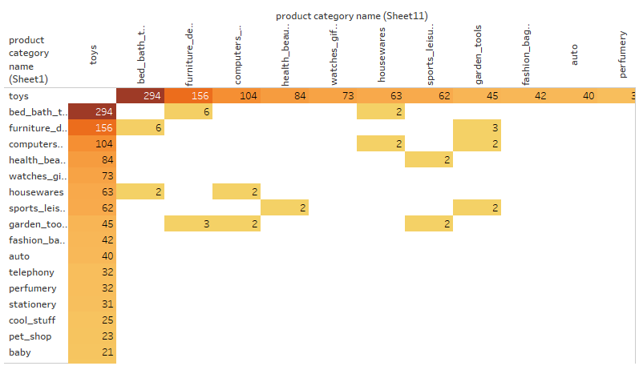
Market Basket Analysis
Market Basket Analysis is conducted to identify which product categories are frequently purchased together.
Toys are the most ordered category along with the categories of bed_bath_table, furniture_decor, computers_accessories, and health_beauty respectively.

Slide 12
Key Insights
Among all the Product Categories Toys (76.21%) is majorly responsible for Revenue generation and also the most bought Product Category.
Apart from Toys, the products from the categories of bed_bath_table, furniture_decor, computers_accessories and health_beauty are the most frequently ordered. The above categories with Toys or/and with each other are most frequent in customers’ baskets.
State SP stands out in terms of the highest number of products ordered and the city Sau Paulo in State SP contributes the most.
Credit Card is the most preferred mode of payment and accounts for 87.66% of Total payments.

Slide 13
Appendix - Data Sources
The data was sourced from O List Retail dataset.
Here is an overview of our data dictionary:
Order Information: Includes details like order ID, order status, and the timestamp when the order was placed.
Order Item Information: Contains specifics such as item ID, seller ID, item price, and shipping charges.
Customer Information: Encompasses data such as customer ID, city, and state.
Payment Information: Covers aspects like payment method and payment amount.
Product Information: Provides details including the product ID, category name, and product dimensions.

Slide 14
Appendix - Data Methodology
A comprehensive evaluation of the OList Retail Dataset was carried out, encompassing the following steps :
The dataset was cleaned and transformed using the Python (Numpy and Pandas), the missing values for the various columns were imputed.
The duplicate records were discarded and only the first occurrence was kept.
The Cleaned dataset was imported to Tableau to perform further Data Analysis
A new dataset consisting of order id and product category name was created for Market Basket Analysis.
Various visualizations and Market Basket Analysis was conducted in Tableau.

Slide 15
Thank You

