Slide 1
Git Group Assignment
Group 2
Topic - Git reset

Slide 2
Group Members
→ Aman Kumar
→ Anuj Tomar
→ Atisha Shaurya
→ Shubham Bagrodia
Repo link: https://github.com/Atisha-Shaurya/GitAssignment_G2.git

Slide 3
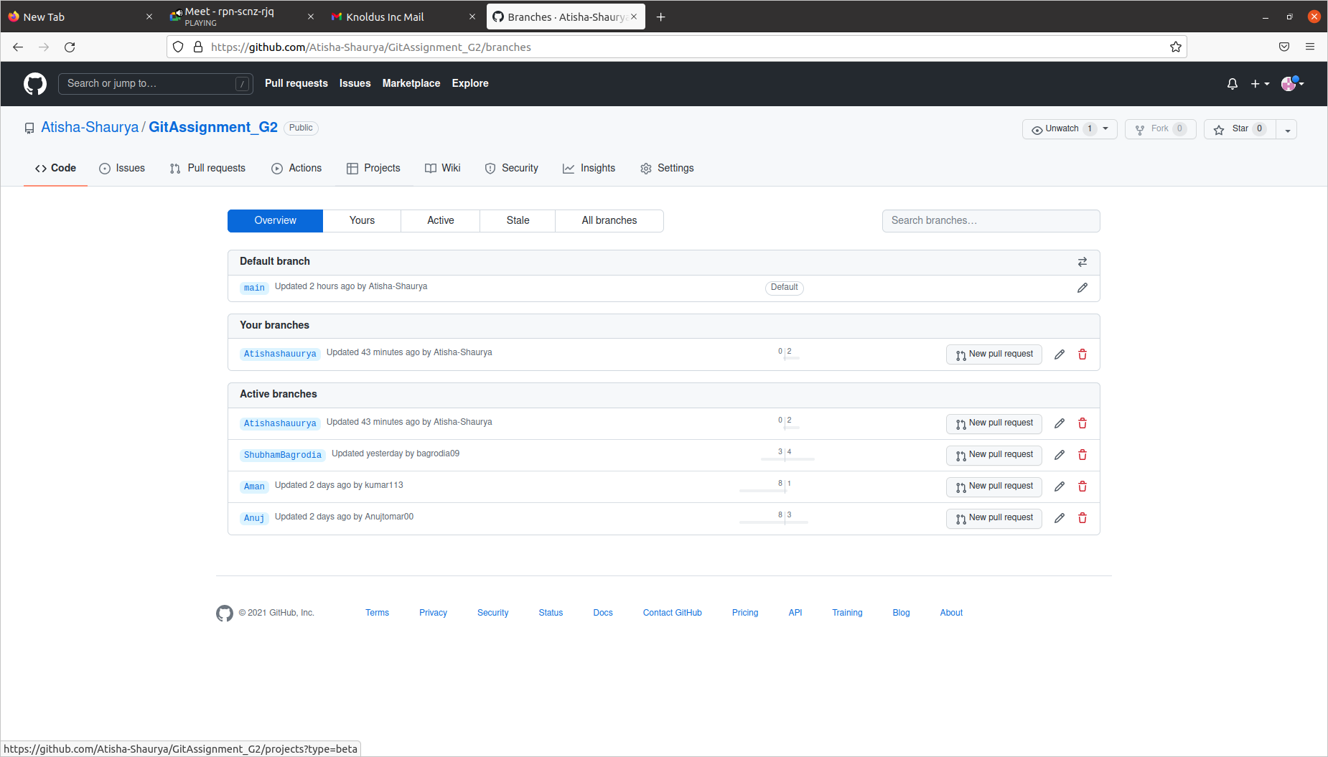
Commit by all the Developers in the Github Repository.

Slide 4
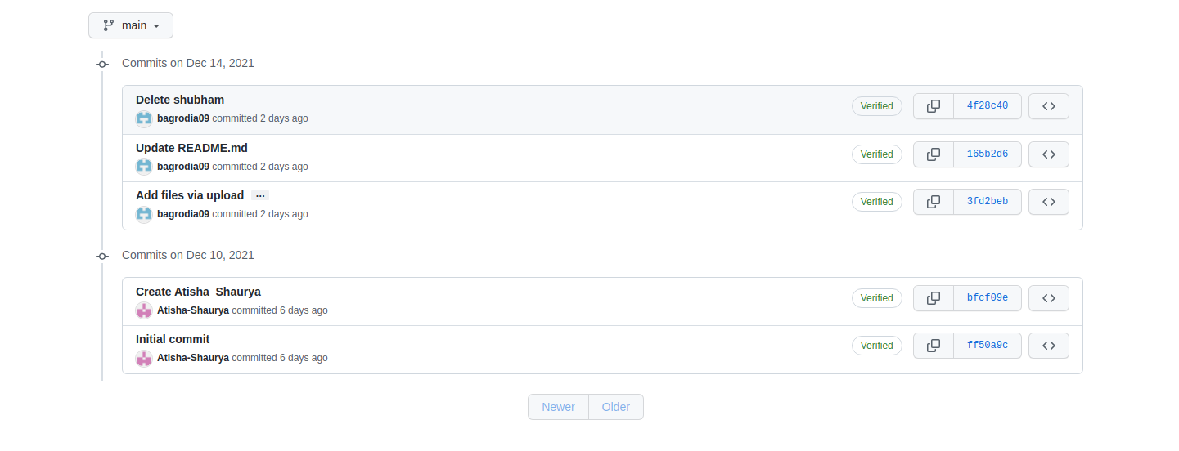
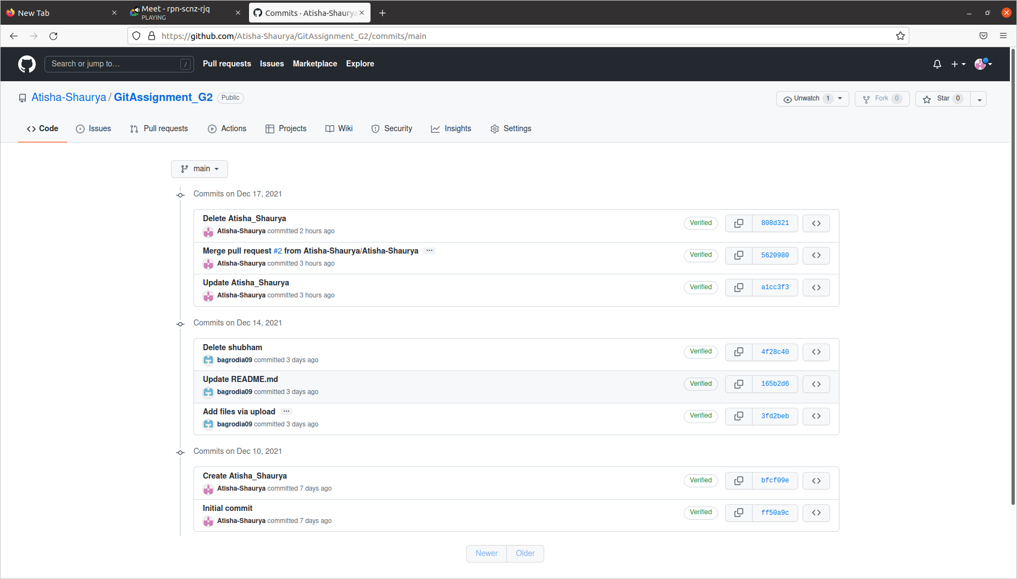

Slide 5
What is reset?
The term reset stands for undoing changes. The git reset command is used to reset the changes. The git reset command has three core forms of invocation. These forms are as follows.
Soft
Mixed
Hard
It acts as a time machine for Git.

Slide 6
Git Reset Head (Git Reset Soft)
The soft option does not touch the index file or working tree at all, but it resets the Head as all options do. When the soft mode runs, the refs pointers updated, and the resets stop there. It will act as git amend command. It is not an authoritative command. Sometimes developers considered it as a waste of time.

Slide 7
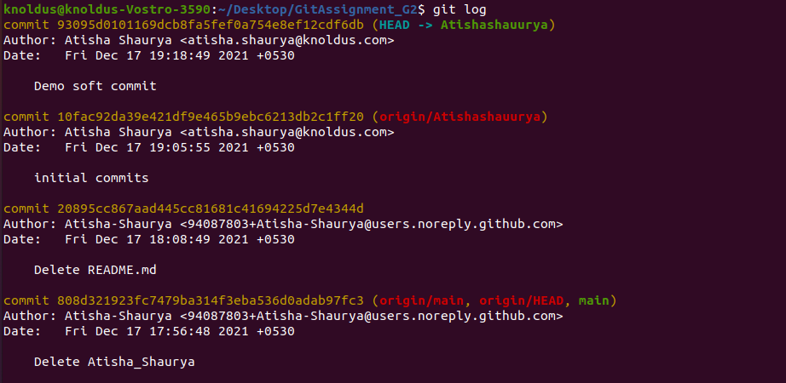
Example of reset soft command
From the below output, you can see that the current position of the HEAD is on commit 93095d0101169dcb8fa5fef0a754e8ef12cdf6db commit. But, I want to switch it on my older commit 10fac92da39e421df9e465b9ebc6213db2c1ff20. Since the commit-sha number is a unique number that is provided by sha algorithm. To switch the HEAD, run the below command:
$ git reset --soft 10fac92da39e421df9e465b9ebc6213db2c1ff20

Slide 8
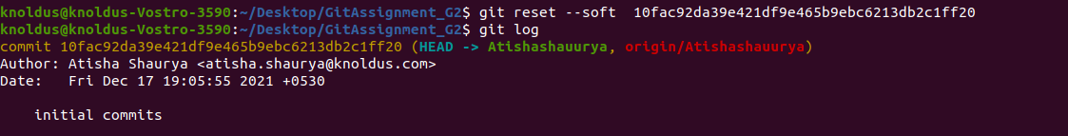
The above command will shift my HEAD to a particular commit. Consider the below output:

Slide 9
Git Reset Mixed
A mixed option is a default option of the git reset command. If we would not pass any argument, then the git reset command considered as --mixed as default option. A mixed option updates the ref pointers. The staging area also reset to the state of a specified commit. The undone changes transferred to the working directory.
Command for Git Reset Mixed is :
$ git reset
or
$ git reset --mixed

Slide 10
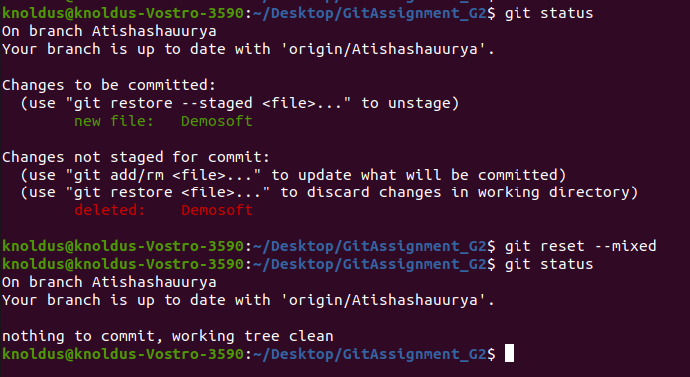
Example of reset mixed command
Generally, the reset mixed mode performs the below operations:
It will move the HEAD pointer
It will update the Staging Area with the content that the HEAD is pointing to.

Slide 11
Git Reset Hard
It will first move the Head and update the index with the contents of the commits. It is the most direct, unsafe, and frequently used option. The --hard option changes the Commit History, and ref pointers are updated to the specified commit. Then, the Staging Index and Working Directory need to reset to match that of the specified commit. Any previously pending commits to the Staging Index and the Working Directory gets reset to match Commit Tree. It means any awaiting work will be lost.
Command for Git Reset Hard is:
$ git reset --hard

Slide 12
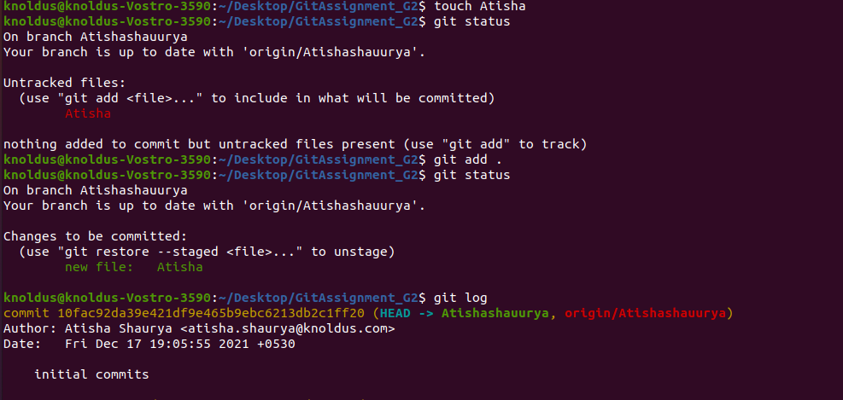
Example of reset hard command
In the above output, I have added a file named Atisha. I have checked the status of the repository. We can see that the current head position yet not changed because I have not committed the changes. Now, I am going to perform the reset --hard option.

Slide 13
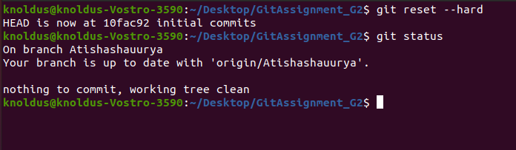
The above output is displaying the status of the repository after the hard reset. We can see there is nothing to commit in my repository because all the changes removed by the reset hard option to match the status of the current Head with the previous one. So the file Atisha has been removed from the repository.

Slide 14
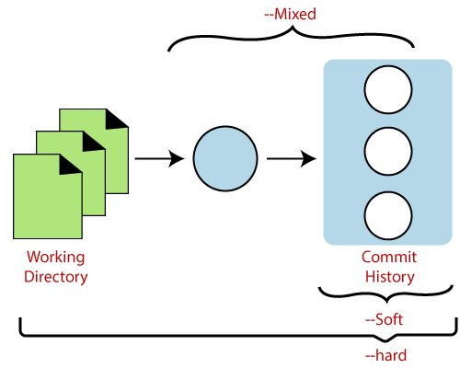
Git Reset

Slide 15
THANK YOU !

