Slide 1
CS626 - Speech, Natural Language Processing, and the Web
Assignment-1b POS Tagging using CRF
Group 41
Aryan Bhosale, 210040024, Mechanical
Atishay Jain, 210050026, CSE
Faizan Ansari, 210100058, Mechanical
Areeb Asgar , 210100022, Mechanical
Date: 02/10/24

Slide 2
Problem Statement
Objective: Given a sequence of words, produce the POS tag sequence using Conditional Random Field (CRF)
Input: The quick brown fox jumps over the lazy dog
Output:The_{DET} quick_{ADJ} brown_{ADJ} fox_{NOUN} jumps_{VERB} over_{ADP} the_{DET} lazy_{ADJ}dog_{NOUN}
Dataset: Brown corpus
Use Universal Tag Set (12 in number)
NOUN: nouns ; VERB: verbs ; ADJ: adjectives ;
ADV: adverbs ; PRON: pronouns ; DET: determiners and articles
ADP: prepositions and postpositions ; NUM: numerals
CONJ: conjunctions ; PRT: particles
‘.’ : punctuation marks ; X: other categories like abbreviations or foreign words
k-fold cross validation (k=5)

Slide 3
Data Processing Info (Pre-processing)
A list of dataset with the universal tagset was created using brown.tagged_sents(tagset='universal') (inbuilt command).
Features extracted :
Bias
Word (current, prev and next)
Word.lower (current, prev and next)
1 to 4 prefix letters
1 to 4 suffix letters
Word.length
Is_unknown (checks if the word is in the vocab)
Others(isdigit, islower, istitle, isupper, contains_hyphen)

Slide 4
Overall performance
Precision (round off to 3 decimal places): 0.954
Recall (round off to 3 decimal places) : 0.931
F-score (3 values - round off to 3 decimal places)
F₁-score : 0.942
F_{0.5}-score : 0.949
F₂-score : 0.935
NOTE: All these are using macro average (not weighted)

Slide 5
Per POS performance
.
P: 1.000, R: 1.000, F1: 1.000
ADJ
P: 0.945, R: 0.932, F1: 0.938
ADP
P: 0.979, R: 0.983, F1: 0.981
ADV
P: 0.947, R: 0.936, F1: 0.941
CONJ
P: 0.994, R: 0.997, F1: 0.995
DET
P: 0.994, R: 0.995, F1: 0.995
NOUN
P: 0.972, R: 0.979, F1: 0.976
NUM
P: 0.980, R: 0.990, F1: 0.985
PRON
P: 0.991, R: 0.988, F1: 0.990
PRT
P: 0.944, R: 0.945, F1: 0.945
VERB
P: 0.981, R: 0.979, F1: 0.980
X
P: 0.720, R: 0.442, F1: 0.548

Slide 6
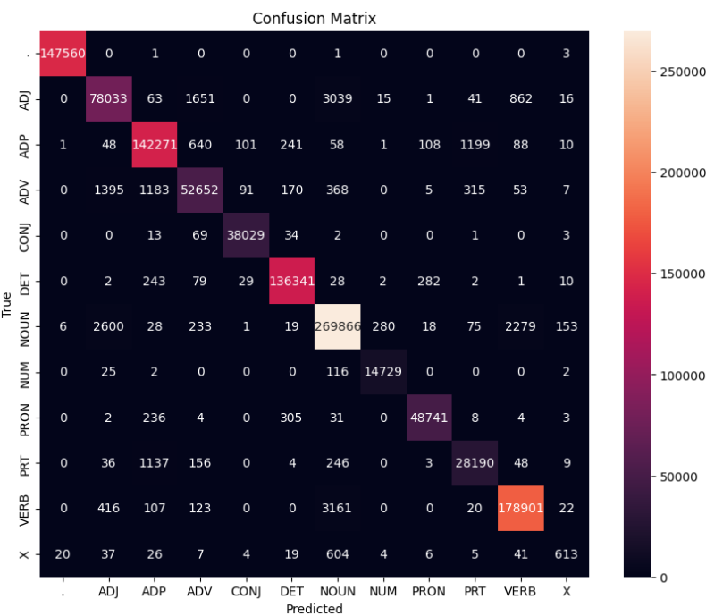
Confusion Matrix (12 X 12)

Slide 7
Interpretation of confusion (error analysis)
Most confused tag: X (P: 0.720, R: 0.442, F1: 0.548)
Then she said, “Allons”, and we got up and went to my hotel without another word.
Code Mixing: “Allons” is an unknown word (French) but has been tagged as a noun (most common)
ADJ ( P: 0.945, R: 0.932, F1: 0.938 ) - Mostly Confused with NOUN
Example: One could hear a very faint, ladylike sigh of relief. “ladylike” is an adjective (ADJ) , incorrectly tagged as a NOUN.
Adjective-Noun Positioning: Adjectives typically precede nouns in English, but sometimes two nouns can occur one after the other (e.g., "family car," "computer science"). This is more likely than two adjectives occurring together.
The features in our model also take into account previous and next word features.
‘Faint’ is already tagged as an ADJ and ‘ladylike’ follows it, i.e. it would have mistaken it as a noun.
Since "ladylike" is placed between the adjective "faint" and the noun "sigh," the model might have mistaken it for a noun because it’s adjacent to both.

Slide 8
Interpretation of confusion (error analysis)
Specific Examples
At Shawomet , women and children fled in terror across the Bay. “Shawomet” is a NOUN, incorrectly tagged as a VERB.
Feature selection: Our model considers upto last 4 letters of suffixes. Since Shawomet ends with ‘met’ which is a verb, we can attribution this incorrect tagging to it.
He left in a storm for Pocasset, December 4, 1638. “storm” is a NOUN, incorrectly tagged as a VERB.
Ambiguity: ‘Storm’ can function as both a noun (the natural phenomenon) and a verb (to move angrily)
Complex Sentence Structure: The model might have struggled with the complexity of the sentence structure, specifically the multiple prepositional phrases ("in a storm" and "for Pocasset"). Here, ‘in a storm’ can also be taken as an idiomatic phrase denoting the person’s state of anger.
I'm willing to stake my political career on it. “stake” is a VERB, incorrectly tagged as a NOUN.
Ambuguity: "Stake" can also be a noun, as in "a wooden stake" or "a financial stake." The model might have encountered more frequent noun usage in training data.
Words like "political career" following "stake" could confuse the model. (e.g., "financial stake in a political career")

Slide 9
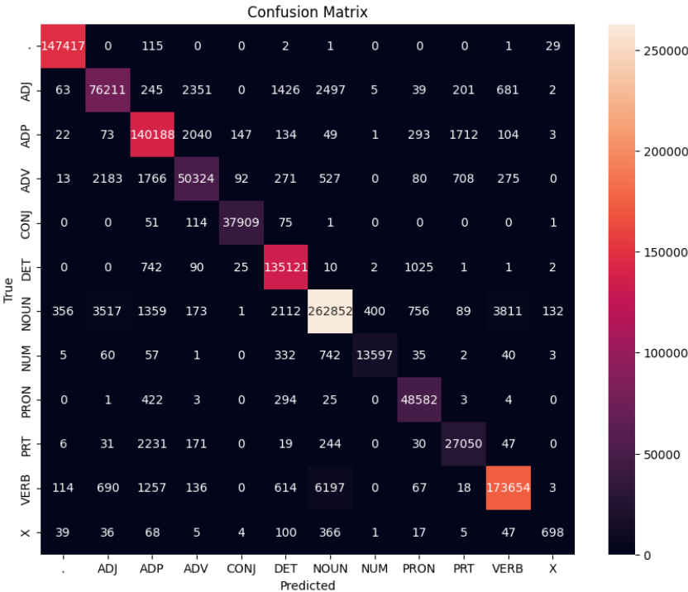
Comparison with HMM
CRF
Overall Performance
(P: 0.954, R: 0.931, F1: 0.942)
HMM
Overall Performance
(P: 0.94, R: 0.91, F1: 0.927)
Overall CRF outperforms HMM. We can observe that the predictions are more concentrated in the right bucket as compared to HMM, with lesser number of words being incorrectly tagged

Slide 10
Comparison with HMM
Most Confused in CRF | Most Confused tags in HMM
X (P: 0.720, R: 0.442, F1: 0.548) | X (P: 0.800 , R: 0.504, F1: 0.618)
ADJ (P: 0.945, R: 0.932, F1: 0.938) | ADV (P: 0.908, R: 0.895, F1: 0.901)
PRT (P: 0.944, R: 0.945, F1: 0.945) | PRT (P: 0.908, R: 0.907, F1: 0.907)
CRF being better than HMM
Code-mixing: Mi diapiace, Signora, ma insomma. While HMM confused them to be NOUNs, CRF is able to correctly tag such Spanish words as ‘X’
He ceased weeping . “weeping” is a verb, but it has been incorrectly tagged as a Noun by HMM but is tagged as VERB by CRF
HMM being better than CRF
The quick brown fox jumps over the lazy dog. CRF tags ‘jumps’ as NOUN, whereas HMM correctly tags is as VERB
Examples where both have similar performance
It's nothing to fool with. “fool” is a VERB, incorrectly tagged as a NOUN by both CRF and HMM.

Slide 11
Challenges faced
Finding good features and appropriate hyperparameters for crfsuite
The model made mistakes on relatively simpler sentences while it was able to perform well on more complicated sentences
Mastering theoretical concepts and debugging to ease out implementation issues

Slide 12
Work Distribution
Word to Feature Extraction – Faizan
Training CRF and evaluation – Atishay
UI – Areeb
Error Analysis - Aryan

Slide 13
References
https://www.cs.columbia.edu/~jebara/6772/papers/crf.pdf
https://aclanthology.org/N03-1028
CRF Library : python-crfsuite
https://pypi.org/project/python-crfsuite/
Brown Corpus Data
http://www.nltk.org/nltk_data
GUI
https://streamlit.io/

Slide 14
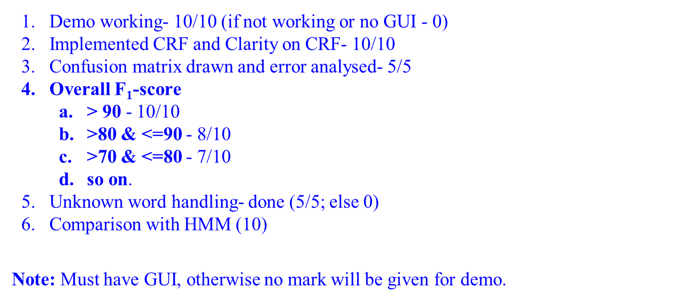
Marking Scheme (50)

