Slide 1
Assignment-3 Named Entity Identification
Group 41
Aryan Bhosale, 210040024
Atishay Jain, 210050026
Faizan Ansari, 210100058
Areeb Asgar , 210100022
Date: 4/11/24

Slide 2
Problem Statement
Perform Named-Entity Identification using SVM classifier with appropriate feature engineering
Technique to be used: SVM classifier
Dataset: CoNLL-2003 NER Data; https://paperswithcode.com/dataset/conll-2003 and
https://huggingface.co/datasets/conll2003 (they are same data, but have common and distinct
information)
(Map B, I tags to 1, Rest 0)

Slide 3
Problem Statement
Input: A sentence
Output: Name-No Name tagged for each word in the sentence
Example:
Input: Washington DC is the capital of United States of America
Output: Washington_1 DC_1 is_0 the_0 capital_0 of_0 United_1 States_1 of_1 America_1

Slide 4
Data Processing Info (Pre-processing)
Conll2003 dataset taken using load_dataset function of datasets module of huggingface
Each sentence from it is processed word by word, considering each word as a token

Slide 5
Feature Engineering
Basic word based features
Word is lowercase
Is the word a title?
All letters are capital?
All letters are lowercase?
First letter of word (prefix),
First 2 letters of word (prefix)
Last letter of word (suffix)
Last 2 letters of word (suffix)
Is the word a stopword?
Is it a punctuation?

Slide 6
Feature Engineering
Features based on position in sentence
Is the word in beginning of sentence?
Is the word in end of sentence?
Contextual features
Previous word
Is previous word a title?
Next word
Is next word a title?

Slide 7
SVM Implementation
Used sklearn module to import SVM
From sklearn.svm, used LinearSVC method
Every word of a sentence is converted into a dictionary of features
Every such dictionary is vectorized using DictVectorizer

Slide 8
Overall performance
Precision = 0.9834
Recall = 0.9831
F1-score = 0.9832

Slide 9
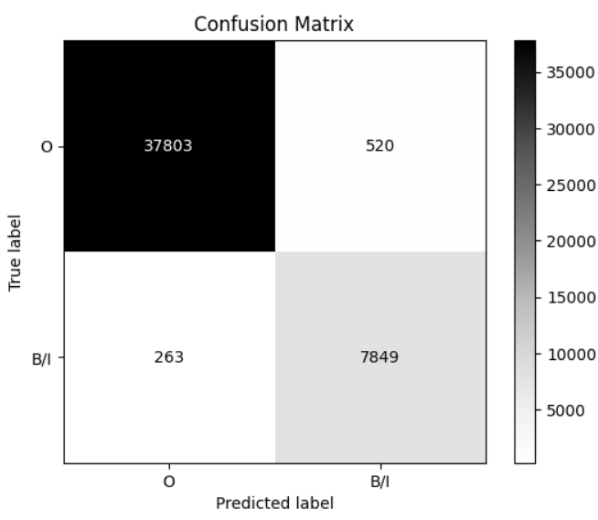
Confusion Matrix

Slide 10
Error analysis
Model generally identifies words that start with a capital letter or appear at beginning of sentence as named entities
For classifying United States of America. It is classifying of as ‘O’. Possible reasons are:
1. Of tagged as ‘O’ many times in the dataset (model is maybe ignoring stop words).
2. The model is not getting enough context.
When we try to classify “bank of japan” all are tagged as “O”. But capitalising the first letter gives all as ‘1’. This highlights the importance of the feature istitle().

Slide 11
Error analysis
When all words are capital in a sentence or all letters are capital in a word, the model often labels most of them incorrectly
Tends to ignore years, probably taking its digits as irrelevant
Named entities without capitalization are difficult to recognize

Slide 12
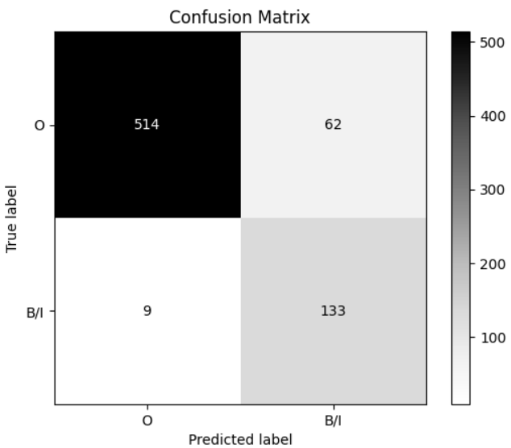
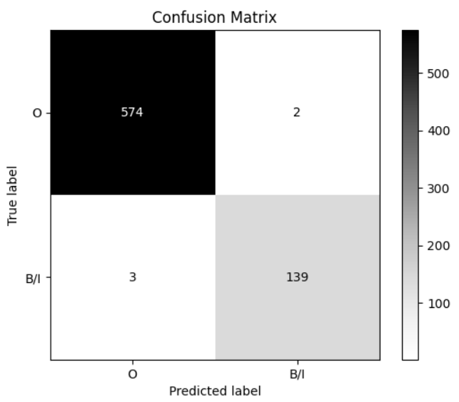
Comparison with ChatGPT
Compared ChatGPT with SVM model on ~ 50 sentences (~800 words) from test dataset of conll2003
ChatGPT (F1 score : 0.91)
SVM (F1 Score : 0.99)

Slide 13
Comparison with ChatGPT
Similar Outputs
Peter Blackburn
ChatGPT : Peter, Blackburn
SVM : Peter, Blackburn
Tokyo is the capital of Japan
ChatGPT : Tokyo, Japan
SVM : Tokyo, Japan

Slide 14
Comparison with ChatGPT
Different Outputs
AL-AIN , United Arab Emirates 1996-12-06
ChatGPT : AL-AIN, United Arab Emirates, 1996-12-06
SVM : AL-AIN, United Arab Emirates
SOCCER - JAPAN GET LUCKY WIN, CHINA IN SURPRISE DEFEAT
ChatGPT : JAPAN, CHINA
SVM : JAPAN, LUCKY, CHINA
Leonardo da Vinci
ChatGPT : Leonardo, Vinci
SVM : Leonardo, da, Vinci

Slide 15
Learnings
Effective feature engineering (such as capitalization, word length, word position, punctuation etc) is important for recognizing named entities accurately
Trying out different combinations of features helped to improve model performance and also helped in getting idea of which features had more influence for NER
Managing multiword entities and tagging each components in such words or phrases was a difficult task
Understood model’s performance using confusion matrix to target specific error types
Observed model struggle with sentences with all capital words, labelling them incorrect sometimes

Slide 16
Evaluation Scheme
Demo working- 10/10 (if not working or no GUI - 0)​
SVM implementation and Feature Selection - 10/10​
Confusion matrix drawn and error analysed- 10/10​
Overall F1-score ​
> 90 - 10/10​
>80 & <=90 - 8/10 ​
>70 & <=80 - 7/10​
so on.​
Comparison with ChatGPT (10)​​
Note: Must have GUI, otherwise no mark will be given for demo.​

