Slide 1
Course Project Mid-Project Presentation
Group 41
Aryan Bhosale, 210040024
Atishay Jain, 210050026
Faizan Ansari, 210100058
Areeb Asgar , 210100022
Date: 4/11/24

Slide 2
Paper Selection
“SpeechTokenizer: Unified Speech Tokenizer for Speech Large Language Models”,
Xin Zhang, Dong Zhang, Shimin Li, Yaqian Zhou, Xipeng Qiu
International Conference on Learning Representations (ICLR) 2024
SpeechTokenizer, a unified speech tokenizer for speech large language models. SpeechTokenizer adopts the Encoder-Decoder architecture with residual vector quantization (RVQ). Unifying semantic and acoustic tokens, it disentangles different aspects of speech information hierarchically across different RVQ layers.

Slide 3
Project Overview
Input: Speech sample in English
Output: Corresponding text transcription of the speech
Use SpeechTokenizer to extract discrete speech tokens which can be used as input to ASR models instead of continuous representations - Mel-Frequency Cepstral Coefficients and Filterbanks

Slide 4
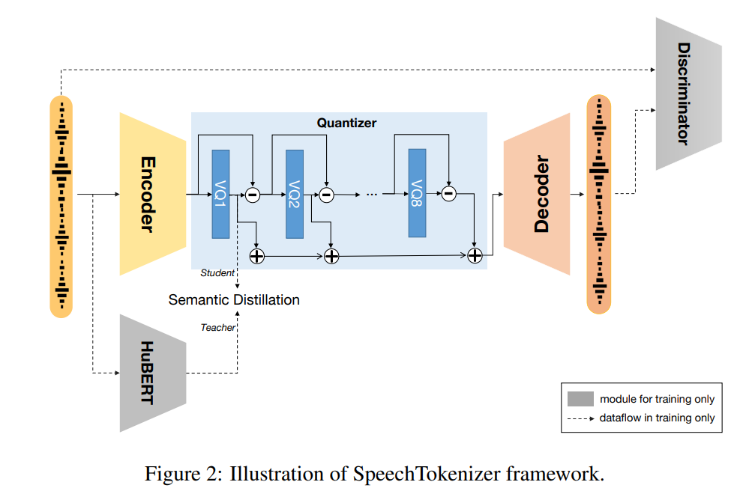
Aim of the paper
Proposes unified speech tokens: Combines semantic and acoustic tokens to create a more efficient and effective speech representation using semantic distillation
SLMTokBench: Establishes the first benchmark to assess the suitability of speech tokens for speech language models based on mutual information
Superior Performance: Outperforms existing models like EnCodec in speech reconstruction and VALL-E in zero-shot Text-to-Speech tasks

Slide 5
Why SpeechTokenizer?
Implementation
The unified speech tokens proposed here outperform existing models in speech reconstruction and Text-to-Speech (TTS) tasks
Using semantic distillation it is able to extract semantic and acoustic content from speech. We believe this can help in achieving great results in automatic speech recognition tasks as well
We intend to use these speech tokens as input for an ASR pipeline using ASR recipe from Speechbrain library.
We intend to use SpeechTokenizer speech tokens as input for an ASR pipeline using ASR recipe (BiLSTM) from Speechbrain library.
Librispeech: Training and validation would be performed on the train-clean-100 and devclean subsets and testing will be conducted on the test-clean and test-other subsets

Slide 6
Additional reasons
Efficient Data Representation
Discrete tokens provide a more compact representation of speech data, which can lead to lower storage requirements and reduced computational costs
Enhanced Generalization Capabilities
Using discrete tokens can improve the generalization capabilities of ASR models across different domains and languages.
Robustness Against Overfitting
In scenarios where training data is limited or noisy, discrete tokens help mitigate overfitting issues.

Slide 7
Timeline
Week 1 (11th Nov): Understand SpeechTokenizer code and ASR Librispeech recipe in SpeechBrain
Week 2 (18th Nov): Write code to extract tokens from SpeechTokenizer and provide them as input for ASR pipeline and set up losses (CTC Loss) for ASR
Week 3 (25th Nov): Perform hyperparameter (lr, batch-size) tuning to help the model converge

