Slide 1
text data
numerical data
Option 1:
term frequency + linear layers
tokenize
normalization
text encoding
Option 2:
Linear layer
embedding + 1d conv layers
text encoder
concatenation
prediction head

Slide 2
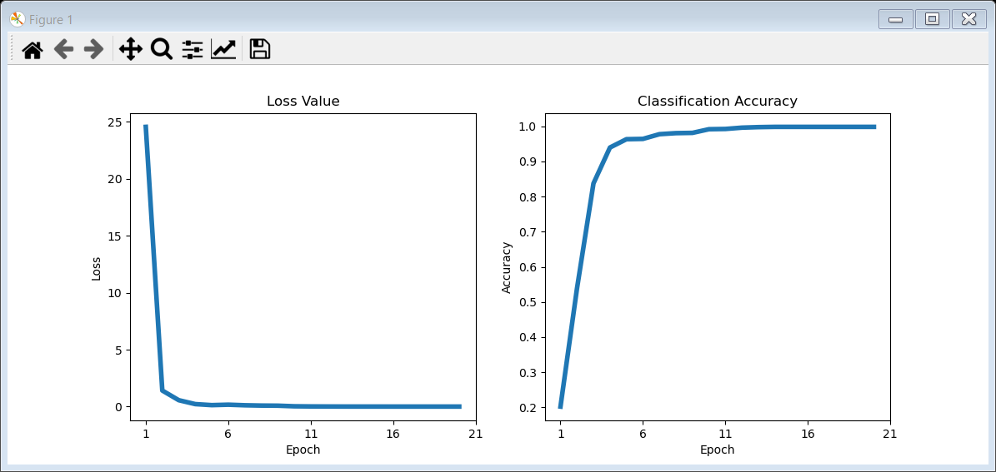
Linear Model
Train for 20 epochs
Test accuracy = 0.6

Slide 3
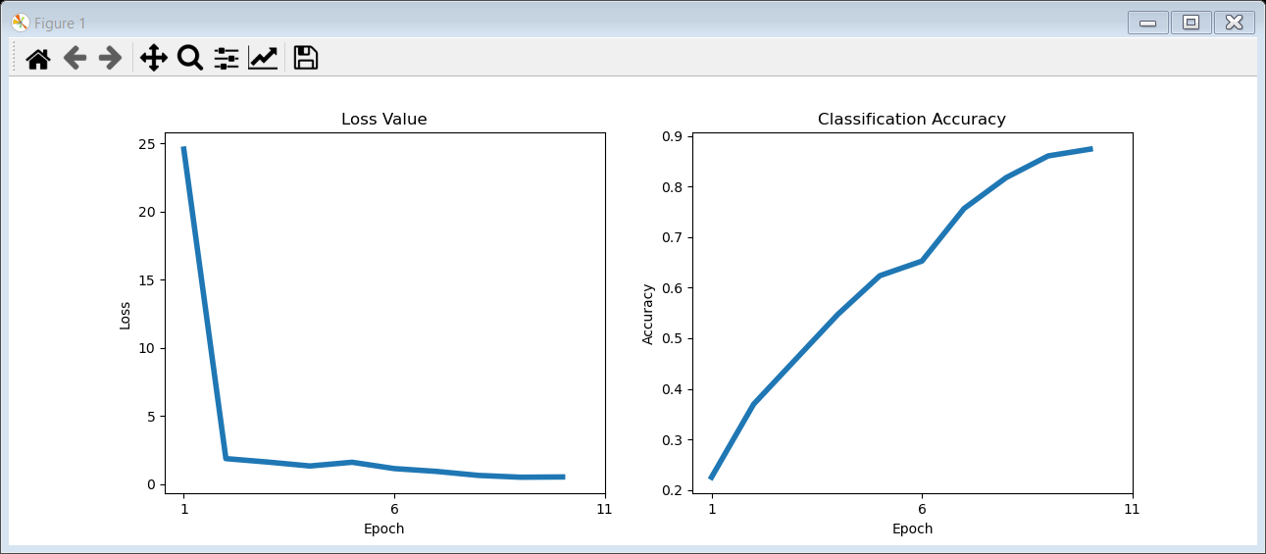
CNN Model
Train for 10 epochs
Test accuracy = 0.33

