Slide 1
text data
numerical data
tokenize
normalization
bag of word
(term frequency)
encoder
concatenation
prediction head

Slide 2
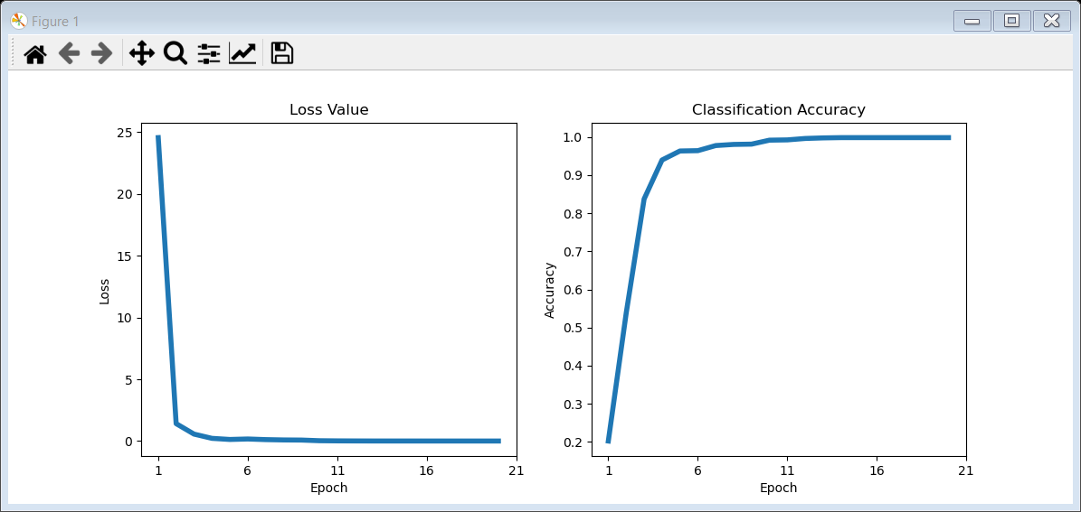
Linear Model
Train for 20 epochs

Slide 3
1D CNN Model
Train for 20 epochs

