Slide 1

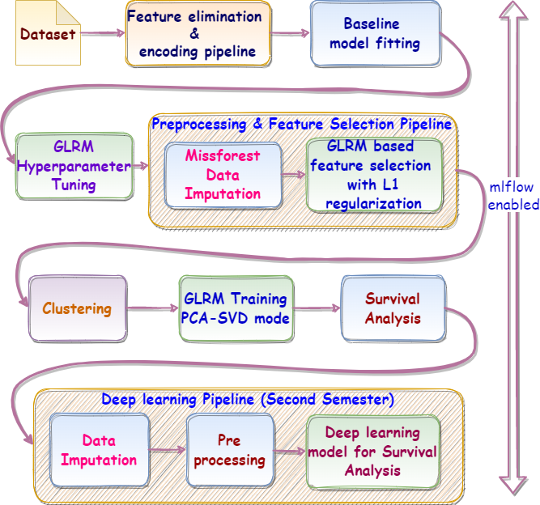
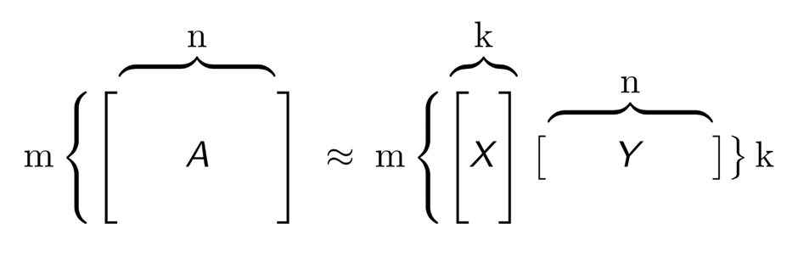

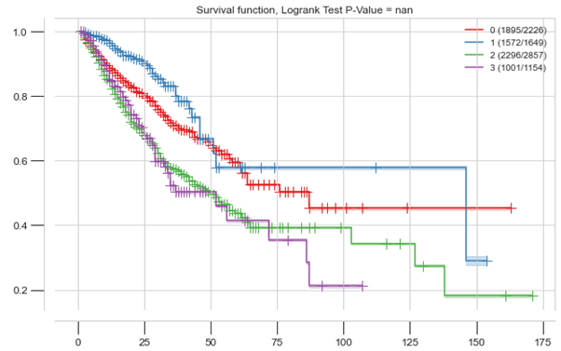
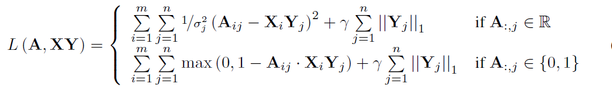
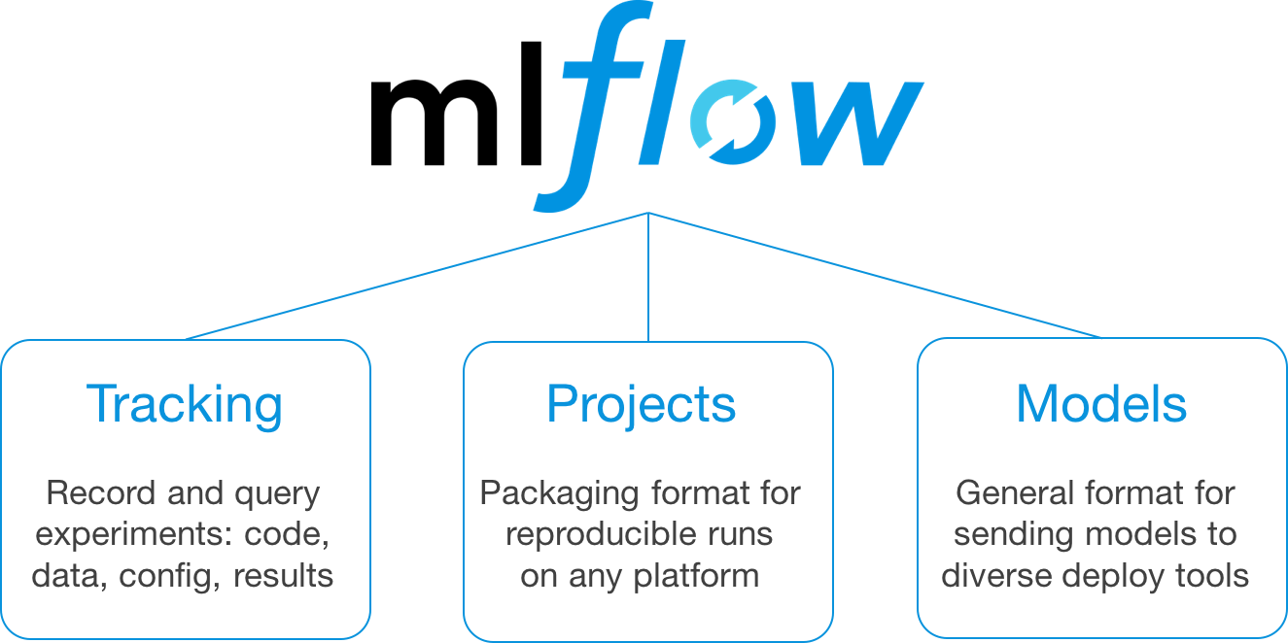
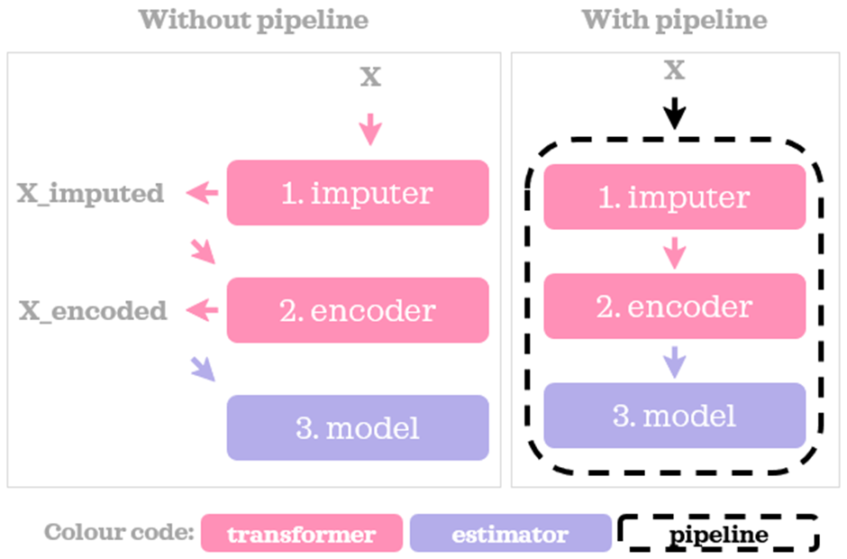

Deep Learning Models for Survival Analysis
Guide: Sudarshan N S Acharya
Team: Srikanth Shenoy (211057033), Vidyashree S (211058026), KM Vijaylakshmi (211057011)
OVERVIEW
APPROACH
Generalized Low Rank Model (GLRM)
Kaplan-Meier Estimator
Survival analysis is a field of statistics that focuses on analyzing the expected time until a certain event happens. The goal of survival analysis is to estimate, interpret and compare survivor and/or hazard functions. and to assess the relationship of explanatory variables to survival time.
GLRM is a lossy matrix factorization technique & new machine learning approach for reconstructing missing values & identifying important features in mixed data
Non parametric method used to measure the fraction of subjects who survived for a certain amount of survival time t under the same circumstances
Survival probability at any particular time is the number of subjects surviving divided by the number of people at risk
AIM
Estimation of mortality risk by finding the expected lifetime of patients in different cohorts is useful in clinical practice, especially in emergency units for
Triage and resource allocation
Determine appropriate levels of care & prepare discussions with patients/families around expected outcomes
Compressed representation as numeric tables X and Y where
k is a small user-specified number
Y = archetypal features created from columns of A
X = row of A in reduced feature space
GLRM can approximately reconstruct A from product XY
TECHNICAL OBJECTIVES
Compare missforest and GLRM data imputation
Baseline predictive model with gradient boosting
Pipelines for imputation, feature elimination & selection
Feature extraction & model fitting with GLRM after hyperparameter tuning
Clustering with gap statistic criteria for identifying clusters
Survival Analysis & plotting Kaplan-Meier curves
Deep learning model for survival analysis
Manage ML lifecycle & models with mlflow
GLRM – A loss function viewpoint
Each row of Y is an archetypal sample and every column of X corresponds to archetypal feature.
The approximation is captured by loss function minimized subject to column constraints k
L1 regularization is applied for feature selection & only SVD-PCA loss function is evaluated for training
MLOps with mlflow
Significantly enhances the ability of Data Science/ML teams in tracking params, metrics & ML models.
Facilitates ML model versioning to streamline performance tuning and retraining efforts for ML models in production
PIPELINING
Mitigate complexity & streamline processing by making transformation & estimation workflow easier to read, understand, maintain, enhance & debug
Enforce the order of execution & prevent data leak by architecture
DATA
Dataset contains a mixture of continuous & categorical data
Of a total of 115 features, only 33 are useful
31 of the 33 features have missing data up to 50%
K-Means Clustering & Gap statistic
Gap statistic is better measure than elbow & silhouette score
K is obtained by comparing cluster compactness with a null reference distribution of the data, i.e. a distribution with no obvious clustering.
Optimal number of clusters is the value for which cluster compactness on the original data falls the farthest below reference curve
DATA IMPUTATION
Univariate imputation methods fail to work with high degree of missing data.
Missforest is applied initially to impute the data.
Later it was found GLRM's in built imputation gives slightly better results than Missforest
FUTURE WORK
Implement Deep learning model on the imputed data
Estimate & interpret survival/hazard functions from survival data & evaluate the relationship of explanatory variables to survival time

