Slide 1



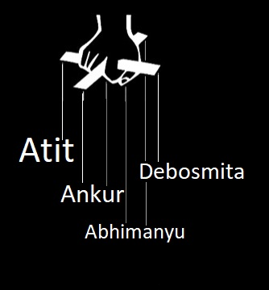
Orchestration Using
by

Slide 2
On master: → puppetserver
On agent: → puppet-agent
Master
puppet.master.local
Send certificate to master
Accept Agent’s certificate and send it’s own certificate
Agent
puppet.agent.local

Slide 3

Master
puppet.master.local
Send certificate to master
Accept Agent’s certificate and send it’s own certificate
Agent
puppet.agent.local

Slide 4
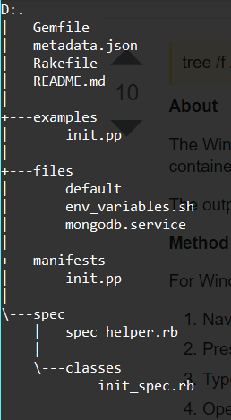
Puppet Modules
puppet module generate <Username>-<ModuleName>
e.g. puppet module generate foo-devOps
Run following command to find modules path puppet –-configprint modulepath For our system: /etc/puppetlabs/code/modules/
Place ‘site.pp’ in a manifest folder for a specific environment like:
/etc/puppetlabs/code/environments/production/manifest/site.pp
External modules from Puppet-Forge can be downloaded like: puppet module install pupetlabs-<ModuleName> --version <Version>
e.g. puppet module install puppetlabs-vcsrepo --version 2.2.0

Slide 5
Thank You

