Slide 1
Puppet
Abhimanyu Jataria
Ankur Garg
Atit Shetty
Debosmita Das

Slide 2
How To Achieve High Performance?
Tens of thousands of LOC deployed every day to production.
Developers push code to production several times a day.
Need of the hour:
Automate code deployments
Version Control

Slide 3
What is Puppet ?
Configuration Management tool.
Used for:
Server Configuration Management
Deployment
Application Orchestration

Slide 4
How Puppet Works?
Facts
Pull
Over
SSL
Catalog
Puppet uses pull model.
A daemon running on every agent
Daemon checks master on regular interval for any new instructions for them.
If there are, new instructions executed on daemon’s machine
Status Reports
Contains configuration for different hosts
Run as daemon on Master Server
Puppet Clients Hosts
Puppet Master
Puppet Agent 1
Notes:
Can be added to this slide :
Node sends ‘Facts’ which contains its state information to master.
Master collects it with a utility named Facter
Master compiles a Catalog specifying how node should be configured
Configuration changes reported back to master by ‘Reports’
Puppet’s open API ‘Report’ creates overall report which can send data to 3rd party data collector.

Slide 5
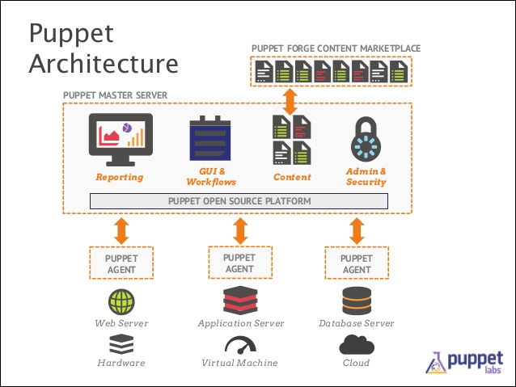
Puppet Architecture

Slide 6
Demo
Now let’s have a look at a short clip on Puppet ..
https://www.youtube.com/watch?v=JAZOt7IV15I

Slide 7
Strengths
Idempotent, model-based configuration management.
Uses HTTP (over SSL), so can benefit from load balancers.
Huge library of reusable modules on the Puppet Forge.
Agent can run on *Nix, Linux and Windows.
Strong reporting and analytics – stats on configuration logs, timing, resources & changes.
Enterprise as well as open source GUIs, to visualize state of all nodes.
Very good documentation and strong community support.
Modules can be tested using Rspec before deploying on production.

Slide 8
Limitations
Puppet uses Ruby DSL for programming, which can be difficult for new users.
Puppet needs to be installed on all the nodes, along with system specific configurations
Certificate management can be difficult with multiple masters.
The changes might not be evident instantaneously due to PULL strategy.
A daemon needs always to be in running state in each agent.
Master requires good system configuration for running.
Notes:
Uses a language based on Ruby, but uses a customized Domain Scripting Language (DSL) closer to JSON for working within it
Not good for orchestration – main purpose of master is to generate configuration which is then run on nodes – master usually not used to delegate tasks.

