Slide 1
Computer Networks Lesson (1)
Falls under the Tech-Aware initiative
❝Tech Together, Aware Forever! ❞
Presenter: Atiya Alkhodari

Slide 2
WHOAMI?
Email: atiyakhodari999@gmail.com
Covering: Computer Networks, College Admission, GUI, AI,…

Slide 3
INTRODUCTION
01
NETWORKING BASICS
02
TYPES OF NETWORKS
03
NETWORK DEVICES
04
NETWORKS SECURITY
05
Networking overview and the basic principals. Importance of networks.
Covering OSI Model briefly. Explaining Protocols and their pivotal role.
Introducing LANs and WANs networks. Explain the concept of Network Topologies
Discuss common networking devices like Routers, Switches, and Modems. Discussing their basic functions.
Highlighting the importance of Networks Security and some basic security measures such as Firewalls and Encryption.

Slide 4
01
INTRODUCTION
In this part of the lesson. We’re going to be discussing Networking Fundamentals

Slide 5
ABOUT Networking
In the modern digital age, networking is an indispensable part of our daily lives. It is the foundation upon which the global information infrastructure is built, enabling communication, data exchange, and the sharing of resources across the world. Whether you're sending an email, streaming a video, or accessing a website, networking is at the core of these activities, making it a critical field of study and practice.

Slide 6
THE ORIGINS OF THE INTERNET
COLD WAR
The Cold War was the incentive to create a decenteralized and robust communication system.
So, the Internet was primarily conceived as a solution to create a network that could withstand disruptions caused by a military conflict.
Internet was first introduced back in the 1960s.
1990s
The 1990s saw the commercialization and global expansion of internet, transforming it into the global communication and information-sharing platform.

Slide 7

What Do I Really Need To Create A Network?

Slide 8
Fundemental Network Components
Hardware
Software
01
02
03
03
Network Devices
Network Cabiling
Network Software
Cloud Software
Including Computer, Modems, Routers, Switches, and Acess Points, NICs,…
Encompassing Ethernet and Fiber Optic Cables, and Wireless Access Points
Including Protocols, Firewalls, Network Management, Services and Applications
Virtualization technologies like VMware and virtual private networks VPNs,
Cloud Computing.

Slide 9
02
Networking Basics
In this section, we will delve deeper inside the realm of networking!
We will cover the OSI Model and its layers and Networking protocols

Slide 10
What is the OSI Model?
Brief Definition:
Layers (From the lowest to the Highest):
The OSI (Open Systems Interconnection) model is a conceptual framework used to understand and standardize how different networking protocols and functions interact in a computer network. It divides network communication into seven distinct layers, each with a specific role in the communication process.
Physical Layer: This layer deals with the physical connection between devices.
Data Link Layer: Responsible for establishing a reliable link between two directly connected nodes.
Network Layer: This layer is responsible for routing data packets between different networks.
Transport Layer: Ensures end-to-end communication between devices.
It's worth noting that OSI being a conceptual framework that describes how different network protocols and layers interact in a network communication system means that it’s not a physical representation of computer networks, nor does it dictate a specific shape.
We will cover the rest of the layers later

Slide 11
The Role of Network Protocols
Network protocols are a set of rules outlining how connected devices communicate across a network to exchange information easily and safely. Protocols serve as a common language for devices to enable communication irrespective of differences in software, hardware, or internal processes.
Unified Processes
01
It facilitates the communication between incompatable devices or systems by following common communication processes.
Safe and Convenient
02
High level of Security, Efficiency, and Scalability. In addition, its predictable behavior and troubleshooting tools that we
could use.

Slide 12
Common Networking Protocols
Networking protocols are essential for the communication and data exchange between devices on a network. The importance of specific protocols can vary depending on the context and the type of network, but here are five of the most important networking protocols you need to know:
Internet Protocol (IP):
IPv4: The fourth version of the Internet Protocol is still widely used for routing data packets across the internet. It assigns unique IP addresses to devices and facilitates the routing of data between them.
IPv6: With the exhaustion of IPv4 addresses, IPv6 was introduced to provide a vastly expanded address space. It is crucial for the continued growth of the internet.
Unfortunately IPv6 was not designed to be IPv4 compatible, meaning that you cannot use IPv6 on IPv4-supported machines.

Slide 13
Transmission Control Protocol (TCP):
TCP is a reliable, connection-oriented protocol that ensures the delivery of data packets in a specific order and handles error-checking and retransmission of lost packets. It is vital for applications requiring guaranteed and orderly data delivery, such as web browsing and email.
User Datagram Protocol (UDP):
UDP is a connectionless, lightweight protocol that provides fast data transmission but does not guarantee packet delivery or order. It is used for real-time applications like video streaming, online gaming, and voice over IP (VoIP).
Hypertext Transfer Protocol (HTTP):
HTTP is the foundation of data communication on the World Wide Web (WWW). It defines how web browsers and web servers communicate, allowing the retrieval and display of web pages and resources.
Simple Mail Transfer Protocol (SMTP):
SMTP is a protocol used for sending email messages over the internet. It governs how email clients and servers interact to send and receive email. SMTP is essential for electronic communication.
HTTPS (Hypertext Transfer Protocol Secure) is a secure version of HTTP, providing encrypted communication for secure data transmission over the internet. It’s immune to man-in-the-middle and sniffing attacks.

Slide 14
03
TYPES OF NETWORKS
This Section is mainly about different Networks Catigories & Classifications

Slide 15
TYPES OF NETWORKS based on Geographical Area
NAME | ABOUT
PAN | Personal Area Network
LAN | Local Area Network
WAN | Wide Area Network

Slide 16
PAN (Personal Area Network):
A PAN is the smallest type of network, typically covering a very short range, usually within a few meters.
It's designed for personal devices like smartphones, laptops, and wearable technology to communicate with one another.
Bluetooth and Wi-Fi Direct are examples of technologies used in PANs.
LAN (Local Area Network):
A LAN covers a limited geographic area, such as a home, office, or campus.
It connects multiple devices and computers in close proximity, allowing them to share resources like files, printers, and internet access.
Ethernet and Wi-Fi are common technologies used in LANs.
WAN (Wide Area Network):
WANs cover a much larger geographic area, often spanning cities, countries, or even the entire globe.
They connect LANs that are geographically separated, enabling long-distance communication.
The internet itself is the largest example of a WAN, but private networks, like those used by corporations, can also be WANs.
Technologies such as leased lines, satellite links, and virtual private networks (VPNs) are used to create and connect WANs.
These network types vary in terms of their coverage area, purpose, and the technologies used to establish and maintain connections.

Slide 17
TYPES OF NETWORKS based on Network Topology
NAME | ABOUT
Linear Topology | Devices are connected in a linear or sequential manner, with each device connecting to two others.
Bus Topology | Personal Area Network
Star Topology | Devices are connected to a central hub or switch.
Ring Topology | Wide Area Network

Slide 18
Star Topology:
Devices are connected to a central hub or switch.
Each device has its cable link to the central hub.
Easy to set up and manage, making it ideal for small to medium-sized networks.
If the central hub fails, it can disrupt the entire network, although this is less likely with modern, reliable hubs or switches.
Ring Topology:
Devices are connected in a closed loop, with each device connecting to exactly two others.
Data circulates around the ring.
Even data distribution with predictable data path.
Vulnerable to disruption if one device or connection fails; the entire network can be affected.
Bus Topology:
All devices are connected to a single central cable or bus.
Data travels along the bus, and devices receive and process data based on their unique addresses.
Simple and cost-effective for small networks.
Susceptible to signal collisions, which can lead to performance issues, and a failure in the central cable can bring down the entire network.
Linear Topology (Daisy-Chain):
Devices are connected in a linear or sequential manner, with each device connecting to two others.
Data travels from one end to the other.
Simple setup, suitable for small networks with a clear start and end point.
Susceptible to disruption if any device or connection in the chain fails.

Slide 19
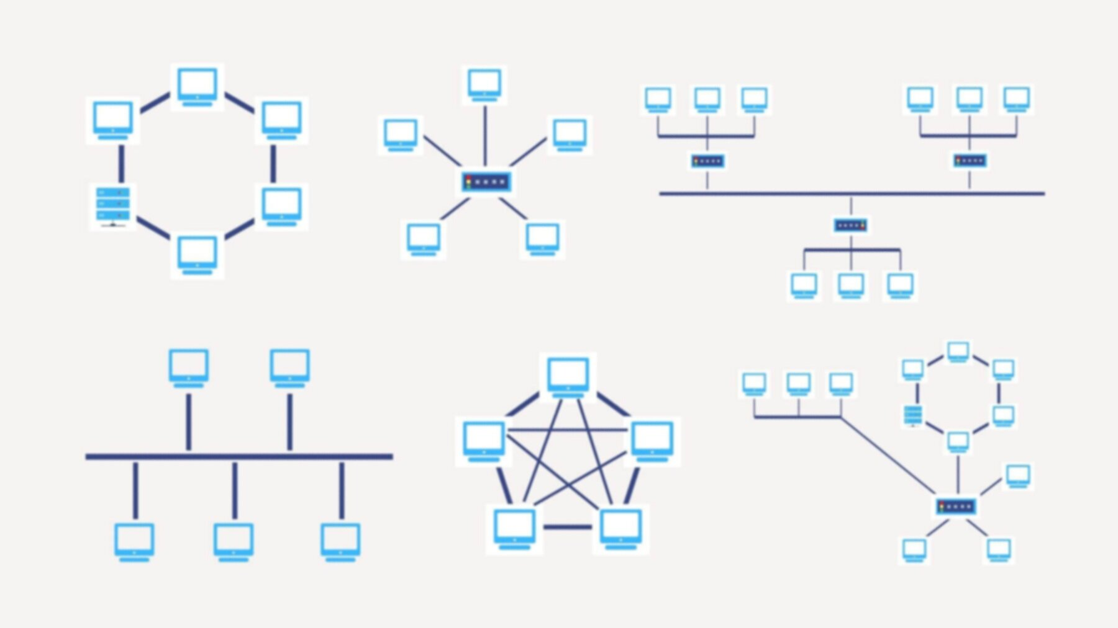
TOPOLOGIES DIAGRAM

Slide 20
NETWOK DEVICES
04
Discussing Routers, Network Switches, Modems, Access Points, and NICs

Slide 21
Router:
Connects and manages data between different networks.
Assigns IP addresses and handles network security.
Often includes features like NAT and firewalls.
Switch:
Connects devices within a local network.
Uses MAC addresses to efficiently forward data.
Enhances local network performance.
Modem:
Converts digital data for internet transmission.
Establishes the link between your network and your internet service provider.
Types include DSL, cable, and fiber optic modems.
Access Point (AP):
Provides wireless connectivity to wired networks.
Broadcasts the network's name (SSID) for Wi-Fi devices to connect.
Extends network coverage in homes and offices.
Network Interface Card (NIC):
Hardware that enables device connection to networks.
Available in wired (Ethernet) and wireless (Wi-Fi) versions.
Each NIC has a unique MAC address for device identification.

Slide 22
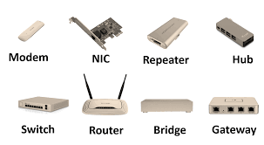
NETWORKING DEVICES DIAGRAM

Slide 23
05
NETWORKS SECURITY
In the last section of this lesson, we’re talking about security!

Slide 24
ENCRYPTION:
Function: Encryption is a security measure that converts data into an unreadable format, known as cipher-text, to protect it from unauthorized access during transmission or storage. It ensures that even if data is intercepted, it remains confidential.
TYPES:
SSL/TLS (Secure Sockets Layer/Transport Layer Security): Commonly used for securing web traffic (HTTPS), SSL/TLS encrypts data exchanged between a user's web browser and a web server.
VPN (Virtual Private Network): VPNs establish encrypted tunnels over public networks, allowing secure communication between remote devices and corporate networks.
End-to-End Encryption: Ensures that data remains encrypted from the sender's device until it reaches the recipient's device. Messaging apps like WhatsApp and Signal use this approach.
BEST PRACTICE:
Implement encryption for sensitive data both in transit and at rest.
Use strong encryption algorithms and protocols.
Regularly update encryption keys and certificates.
Educate users about the importance of encryption and secure practices.

Slide 25
FIREWALLS:
Function:
Firewalls are network security devices or software that act as a barrier between a trusted network and untrusted networks, controlling incoming and outgoing traffic based on predefined security rules.
TYPES:
Network Firewalls: Protect entire networks by inspecting and filtering traffic at the network level.
Host-Based Firewalls: Installed on individual devices, they control traffic at the device level.
Next-Generation Firewalls (NGFWs): Combine traditional firewall functions with advanced security features like intrusion detection and application-layer filtering.
BEST PRACTICE:
Configure firewalls to block unnecessary ports and services.
Regularly update firewall rules to reflect changing security requirements.
Implement intrusion detection and prevention features in NGFWs for real-time threat detection.
Monitor firewall logs for signs of suspicious activity.

Slide 26
THANKS!
Does anyone have any questions?
Presenter: Atiya Samih Alkhodari
atiyakhodari999@gmail.com

