Slide 1
System Test and Interface Design
Alec Shunnarah (ASS0009)
Don Tran (DZT0021)

Slide 2
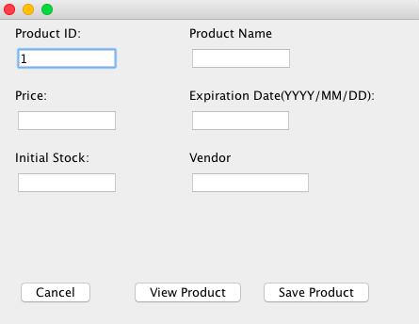
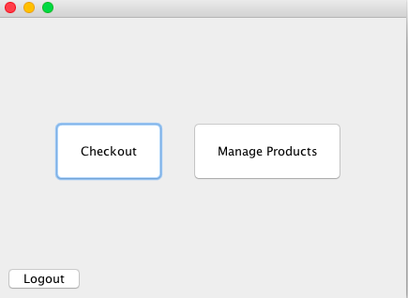
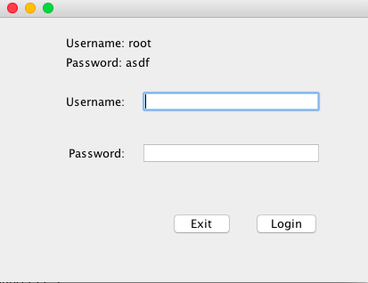
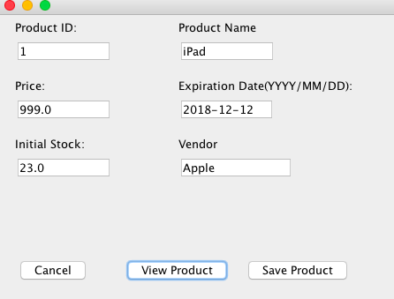
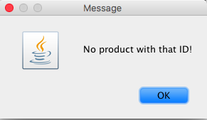
Use Case 1: View Product
If not exists
Step 1: Login with Username/Password
Step 2: Select Manage Products
Step 3: Input Product ID
Step 4: Select View Product
Step 5: Product information is displayed

Slide 3
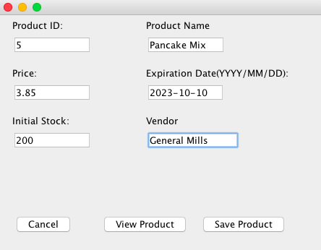
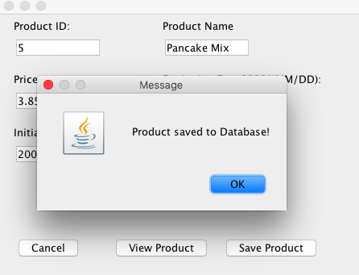
Use Case 2: Add New Product/Save Product
Step 1: Login with Username/Password
Step 2: Select Manage Products
Step 3: Input new or existing Product ID
Step 4: Update any fields
Step 5: Message Dialog is displayed

Slide 4
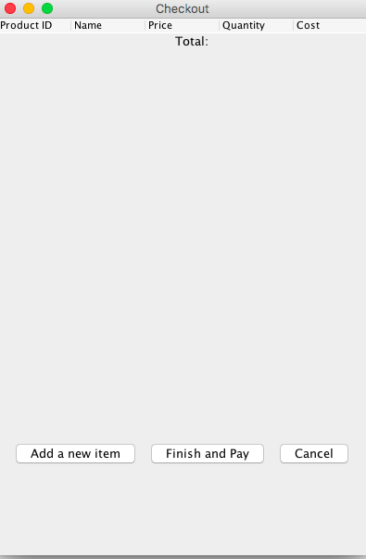
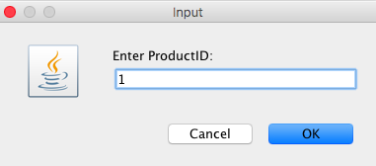
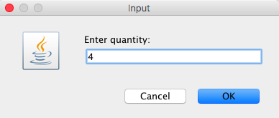
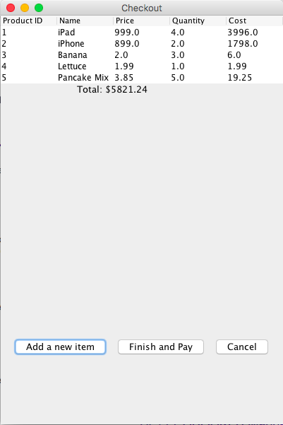
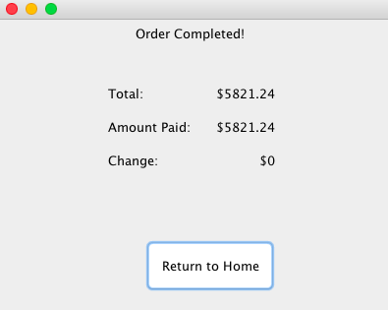
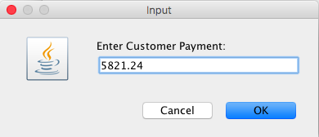
Use Case 4: Checkout Order
Step 1: Login with Username/Password
Step 2: Checkout
Step 3: Checkout List is Displayed
Step 4: Select Add a new item
Step 5: Input dialog box for Product ID
Step 6: Select OK
Step 7: Input dialog box Quantity of item
Step 8: Select OK
Step 9: Repeat/Continue Adding items
Step 10: Select Finish and Pay
Step 11: Input dialog box Payment amount
Step 12: Select OK
Step 13: Order Complete screen displayed
Step 14: Select Return Home

