Slide 1
King County Housing Renovation

Slide 2

Hello!
I am Andrew Smith
I am here on behalf of North Star Consulting to
present information related to housing in
King County, WA.

Slide 3
King County, Washington
1
Why live here?

Slide 4
It’s big!
King County is the home to Seattle, Washington
Recent population estimates: 2,233,163
12th-most populous county in the US!
Named for Martin Luther King Jr. (since 2005), in a state named after George Washington, great namesakes to have!

Slide 5
Housing Data
What sort of data do we have on the houses in this large county?

Slide 6
House Features
Sale Price
Square Footage of the Lot
Waterfront View
Number of Views of the House
House Build Year
Location (Zipcode, Latitude and Longitude)
Square Footage of the Living Area and Lot of the nearest 15 Neighbors
Number of Bedrooms & Bathrooms
Square Footage of the Living Area
Number of Floors
House Condition
House Grade
House Renovation Year
Sale Date
So which features can we change with a renovation?

Slide 7
What do they mean?
Living Area Square Footage
The square footage throughout the entire house, including a basement if there is one.
House Condition
Scale of 1 (being Poor) to 5 (being Very Good) of how well maintained the house is, in terms of deterioration and repairs.
House Grade
Scale of 1 to 13 of the building standards of the home. This includes things such as meeting building codes, as well as the quality of the materials, construction, fixtures, and overall design of the home.

Slide 8
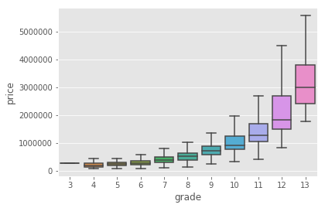
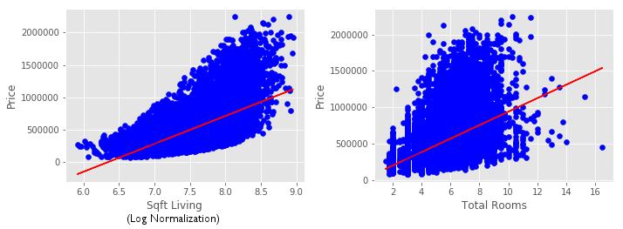
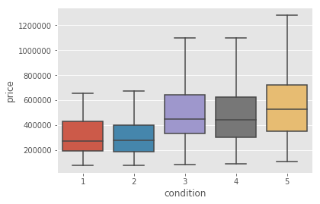
What effect do they have?

Slide 9
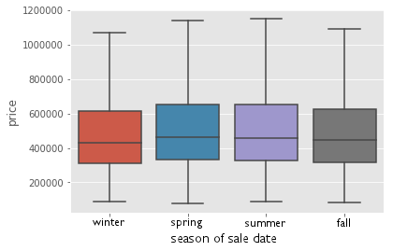
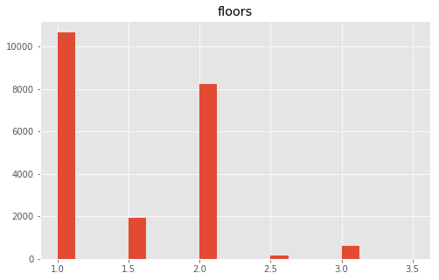
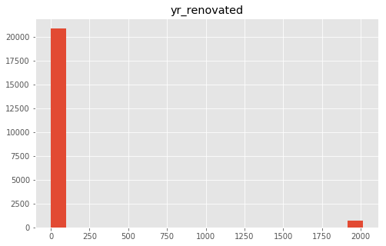
What effect do they have?

Slide 10
Summary
Suggested Features
Living Area Square Footage, Total Number of Rooms, House Grade, House Condition have most consistent data, provide increase in sale price in that order.
Other Variable Features
House Renovation Year, Number of Floors, Sale Date either don’t provide enough data, or not enough change in sale price to warrant putting effort into.
Non-Variable Features
While Square Footage of the Lot, Waterfront View, Number of Views of the House, House Build Year, Location (Zipcode, Latitude and Longitude), Square Footage of the Living Area and Lot of the nearest 15 Neighbors all certainly have a marked increase in home sale price, they are not things that can be changed during a home renovation.

Slide 11
Future Work
Further investigate chosen house features to ensure they aren’t too correlated with each other. Obtain data on other house features that can be changed during a renovation (having a pool, having a garage) to see what effect they might have on the overall sale price.

Slide 12
Thank you for your time!

