Slide 1
King County Housing Renovation

Slide 2

Hello!
Andrew Smith
North Star Consulting

Slide 3
King County, Washington
1
Why live here?

Slide 4
It’s big!
King County is the home to Seattle, Washington
Recent population estimates: 2,233,163
12th-most populous county in the US!
Named for Martin Luther King Jr. (since 2005), in a state named after George Washington, great namesakes to have!

Slide 5
Housing Data
What sort of data do we have on the houses in this large county?

Slide 6
House Features
Sale Price
Square Footage of the Lot
Waterfront View
Number of Views of the House
House Build Year
Location (Zipcode, Latitude and Longitude)
Square Footage of the Living Area and Lot of the nearest 15 Neighbors
Number of Bedrooms & Bathrooms
Square Footage of the Living Area
Number of Floors
House Condition
House Grade
House Renovation Year
Sale Date
So which features can we change with a renovation?

Slide 7
What do they mean?
Living Area Square Footage
Square Footage of Entire House
Includes Basement
House Condition
Scale of 1 to 5
Poor to Very Good
Home Maintainance
Home Deterioration and Repairs
House Grade
Scale of 1 to 13
Building Standards
Includes:
Meeting Building Codes
Quality of Materials
Quality of Construction
Bathroom/Kitchen Fixtures
Overall Home Design

Slide 8
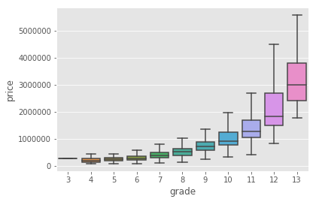
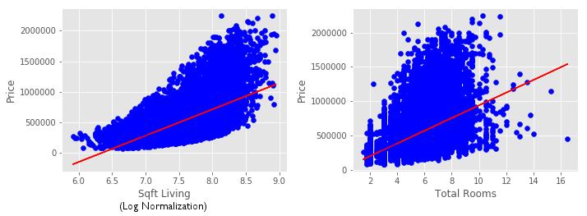
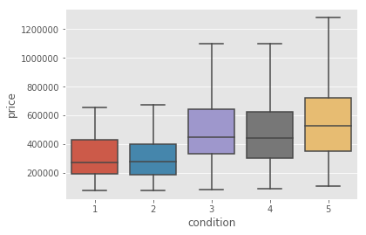
What effect do they have?

Slide 9
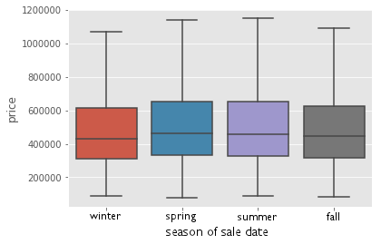
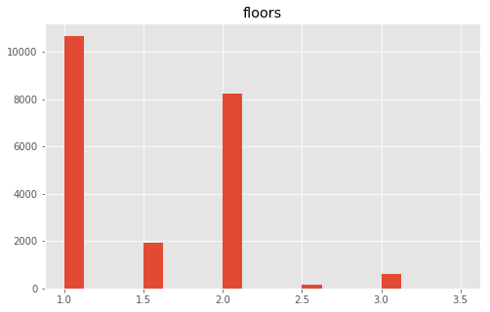
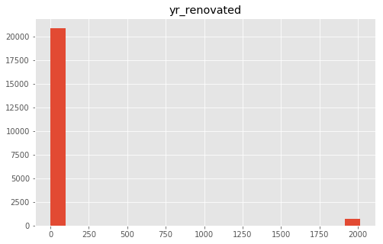
What effect do they have?

Slide 10
Summary
Suggested Features
Living Area Square Footage
Total Number of Rooms
House Grade
House Condition
Most consistent data
Provide increase in sale price in that order.
Other Variable Features
House Renovation Year
Number of Floors
Sale Date
Don’t provide enough data, or not enough change in sale price
Non-Variable Features
Square Footage of the Lot
Waterfront View
Number of Views of the House
House Build Year
Location (Zipcode, Latitude and Longitude)
Square Footage of the Living Area and Lot of the nearest 15 Neighbors
Cannot be changed via renovation, despite showing increase in sale price.

Slide 11
Future Work
Further investigate chosen house features
Look for links between features to ensure they aren’t affecting each other
Obtain data on other house renovation options:
Adding a Pool
Adding a Garage or increasing its size
Check what effect they have on the sale price

Slide 12
Thank you for your time!

