Slide 1
Board Game Statistics & Rating Prediction
Andrew Smith
North Star Consulting

Slide 2
Why Board Games?
Golden Age
Exploding Popularity
10s of Thousands

Slide 3
Methodology
Explore & Format Data
Data Visualization & Analysis
Feature Engineering
Model Creation & Testing
Final Model Selection & Tuning

Slide 4
Features
Year Published
Minimum & Maximum Players
Playing Time
Minimum Age
Average Weight (Complexity)
Average Rating
84 Categories
Reduced to 40
Combinations:
Wargame
Educational
Historical
Culture
Transportation
51 Mechanics
Reduced to 45
Combination:
Movement

Slide 5
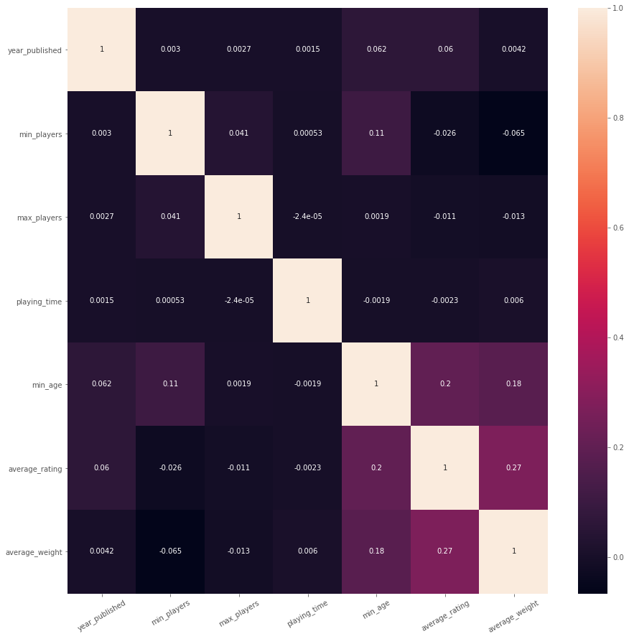
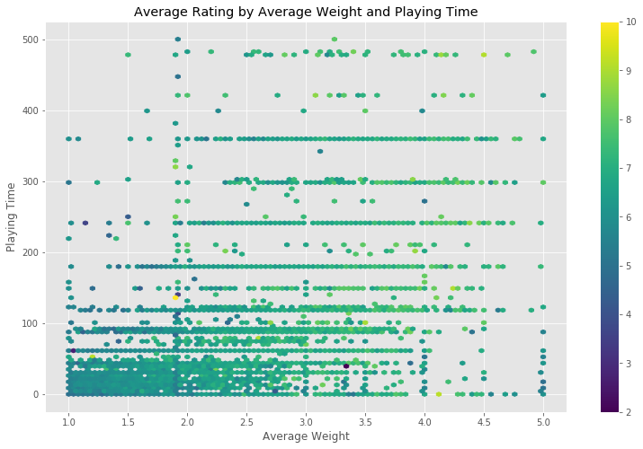
Visualizations
Base Feature Correlation Matrix

Slide 6
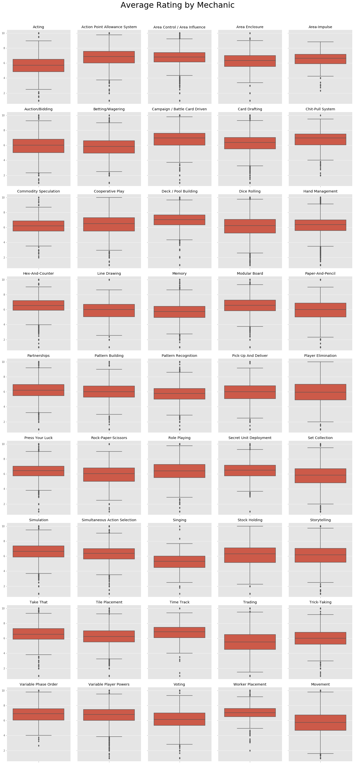
Visualizations

Slide 7
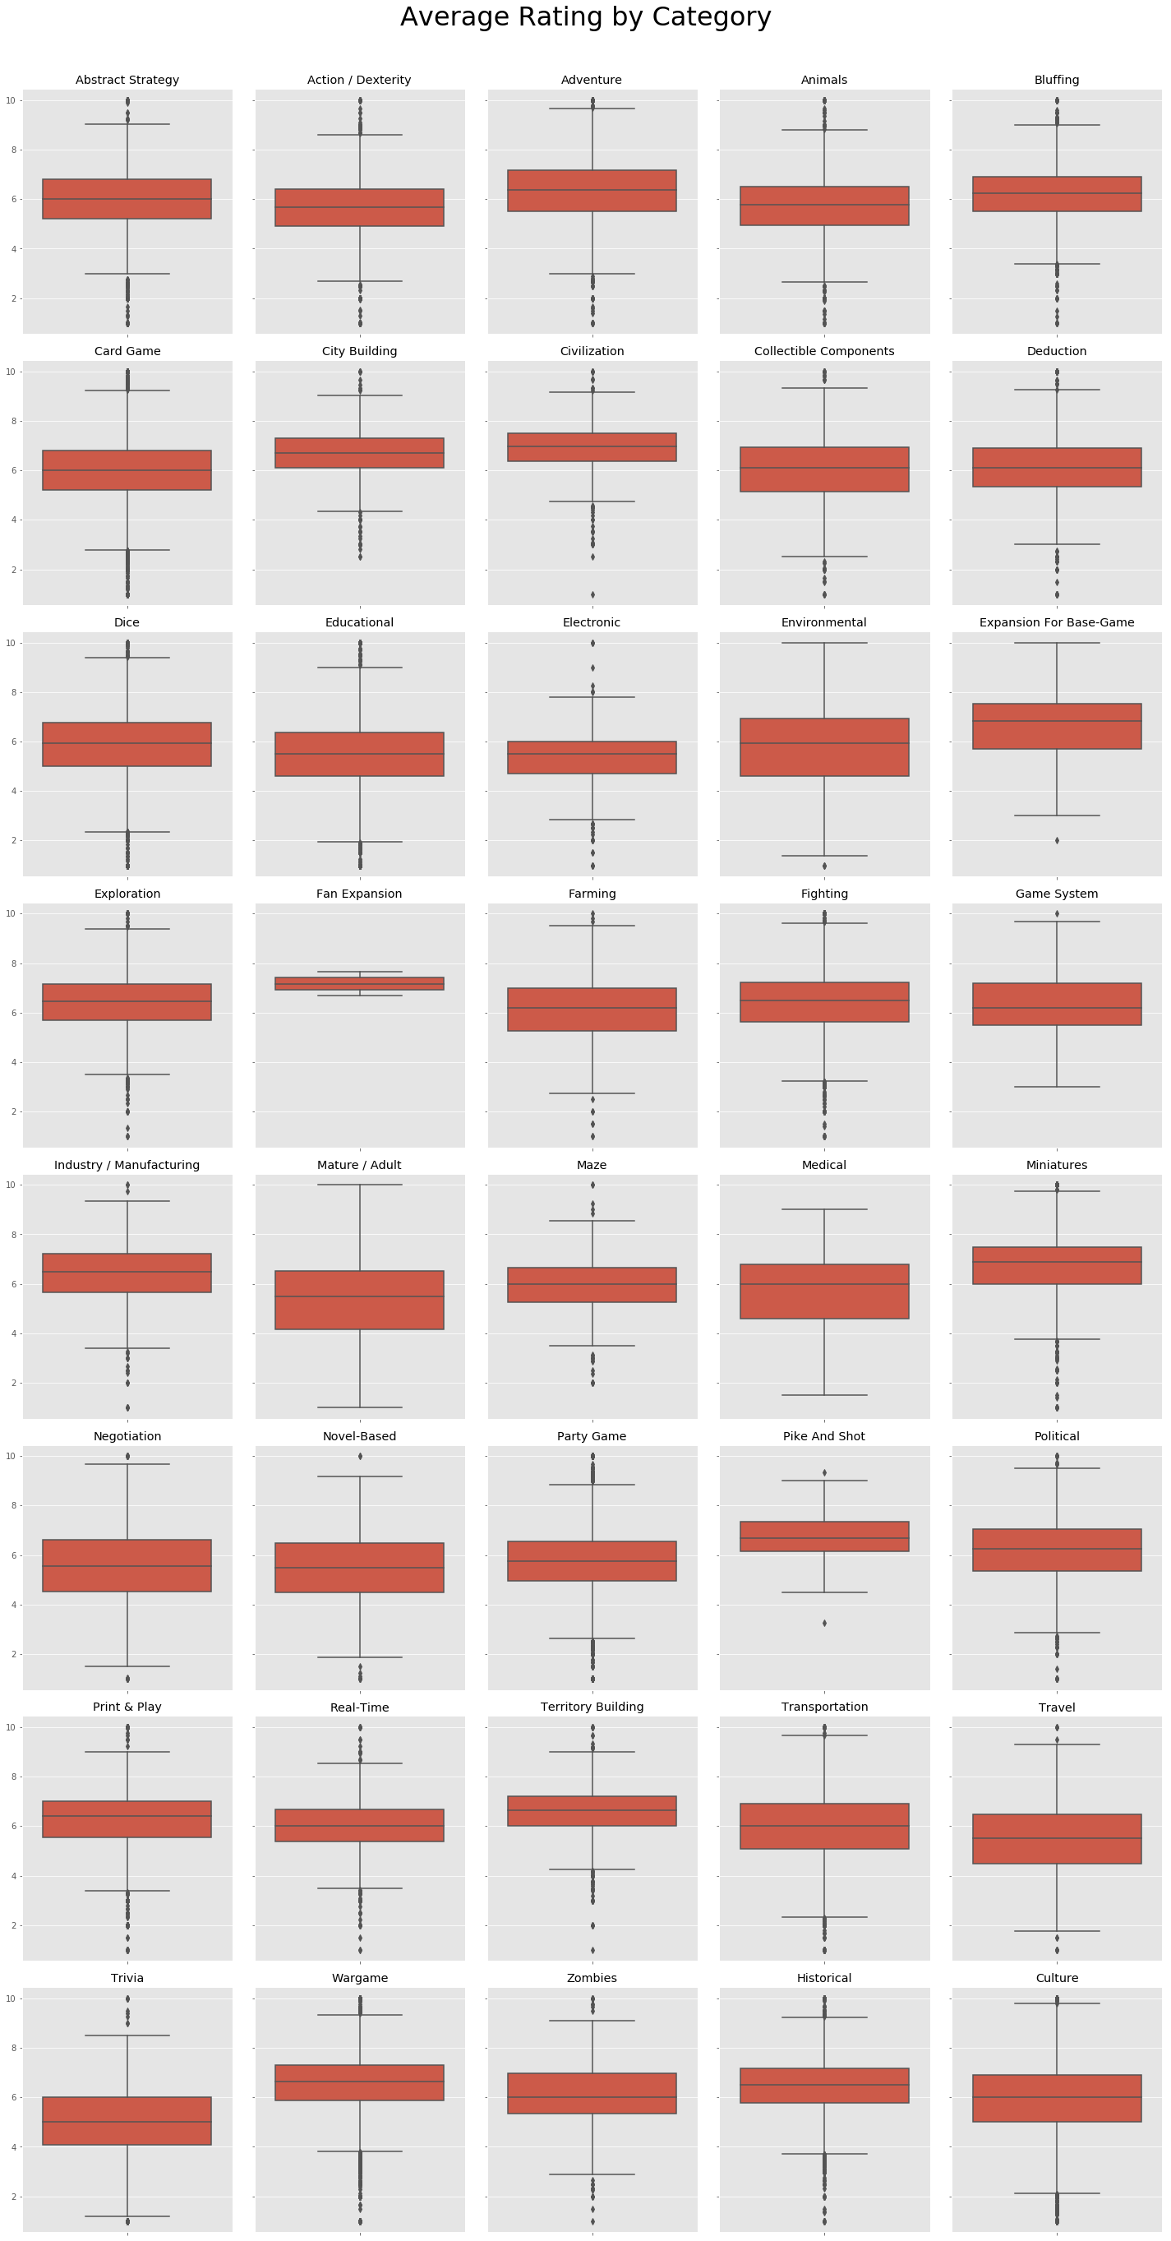
Visualizations

Slide 8
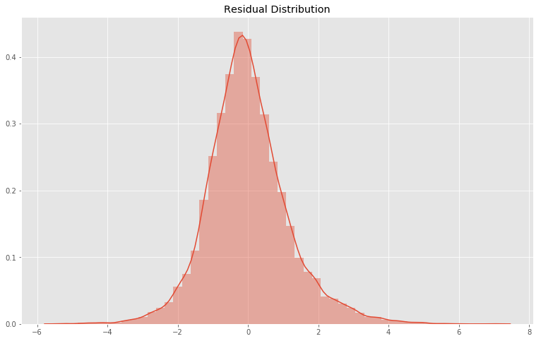
Final Model & Results
Final Model: Gradient Boosting Regressor
Results:
No Overfitting
R2 Differential: 0.0141
RMSE Differential: 0.0014
Average Error in Testing Set: 1.1579
Approximate Margin of Error: 11.5%

Slide 9
Future Work
Personally Scrape Data
Get games added since data set creation
Get User Data (specific ratings, ownership)
Improve Model
Create Recommendation System

Slide 10
Credits
Data Set: https://www.kaggle.com/mandshaw/games-0918
Data Source: https://boardgamegeek.com/
Project Notebook: https://github.com/Atksmith88/board-game-statistics

Slide 11

THANKS!
Any questions?
You can find me at:
Github: Atksmith88
Email: atksmith88@gmail.com

