Slide 1
Introduction to R/Shiny
Clark Richards and Chantelle Layton
2019-11-01

Slide 2
What is Shiny?
“Shiny is an open source R package that provides an elegant and powerful web framework for building web applications using R. Shiny helps you turn your analyses into interactive web applications without requiring HTML, CSS, or JavaScript knowledge”
https://shiny.rstudio.com
2 essential elements:
- a user interface, i.e. `ui`
- a `server`, which contains the code for the app

Slide 3
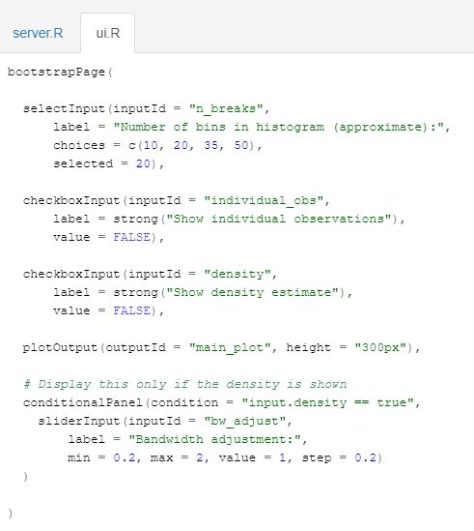
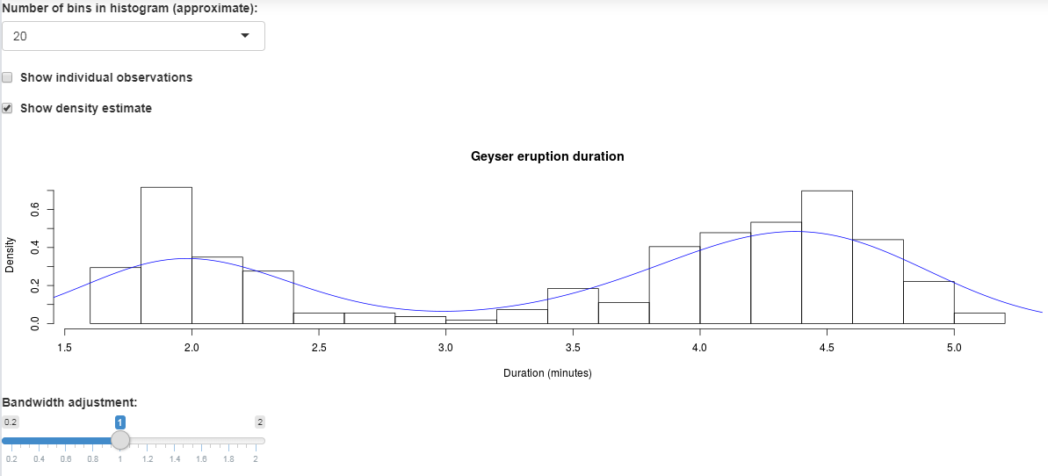
UI: user interface

Slide 4
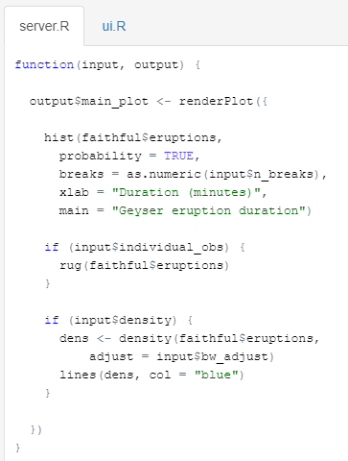
Server: the code that runs the app
Normal R code that performs the numeric/data/plotting tasks that the app is designed to use

Slide 5

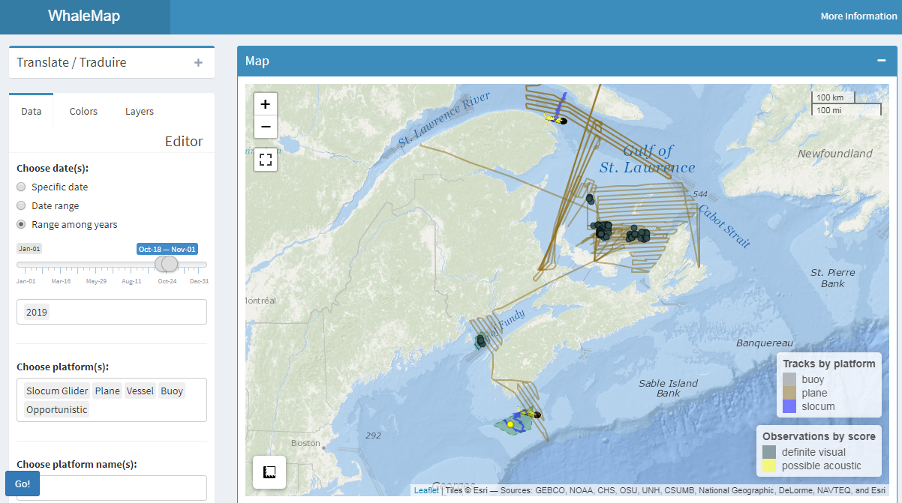
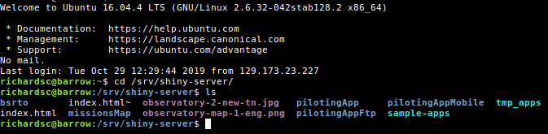
How to use Shiny?
With Rstudio, on a local machine:
Shinyapps.io (free, but limited bandwidth)
Shiny-server
E.g. Dal/DFO https://whalemap.ocean.dal.ca/WhaleMap/
New DFO shiny server initiative …

