Slide 1
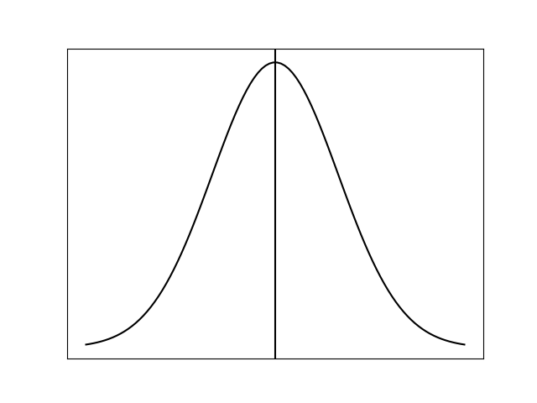

























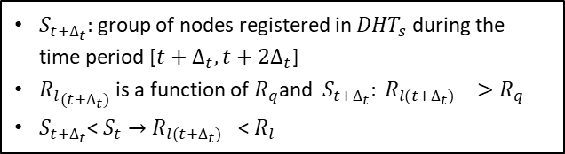


Work_Queue_Management.png
$$t$$
$$t+∆_{t}$$
$$t+{2∆}_{t}$$
Worker node
Worker Pool
$${DHT}_{w}$$
Worker Pool
$${DHT}_{w}$$
Worker Pool
$${DHT}_{w}$$
Node in worker queue ${DHT}_{q}$ before t
Worker node leaving ${DHT}_{w}$at $t+∆_{t}$
Node joining ${DHT}_{w}$at $t+∆_{t}$
Node joining ${DHT}_{q}$at $t+∆_{t}$ with normal score
Node joining ${DHT}_{q}$at $t+∆_{t}$ with low score
Worker node leaving ${DHT}_{w}$at $t+{2∆}_{t}$
Worker Queue
${DHT}_{q}$ at $t$
Worker Queue
${DHT}_{q}$ at $t+∆_{t}$
Worker Queue
${DHT}_{q}$ at $t+{2∆}_{t}$
Node joining ${DHT}_{w}$at $t+{2∆}_{t}$
Node joining ${DHT}_{q}$at $t+{2∆}_{t}$ with normal score
Node joining ${DHT}_{q}$at $t+2∆_{t}$ with low score
C
D
threshold
C
A
D
B
A
Nodes joining tertiary queue ${DHT}_{s}$during [$t,t+∆_{t}$]
B
Nodes joining tertiary queue ${DHT}_{s}$during [$t+∆_{t},t+{2∆}_{t}$]
$s_{t}:$group of nodes registered in ${DHT}_{s}$ during the time period [$t,t+∆_{t}$]
At $t+∆_{t}$, each node assigned a score and joins ${DHT}_{q}$ with ranking defined by score
A – D randomly as members of z are selected to have a score close to threshold${ R}_{q}.$
Remaining nodes ($S_{t}$- z) are given have a lower score closed to${ R}_{l(t)}$
$R_{l(t)}$is a function of${ R}_{q}$and $S_{t}:{ R}_{l(t)}>R_{q}$
C
D
A
B
$R_{q}$= threshold
A
$$S_{t+∆_{t}}$$
B
$$s_{t}$$
$$R_{q}$$
E
C
E
$R_{l(t)}$= f($R_{q}$, $S_{t}$)
D
E
$S_{t+∆_{t}}:$group of nodes registered in ${DHT}_{s}$ during the time period [$t+∆_{t},t+{2∆}_{t}$]
${R_{l}}_{(t+∆_{t})}$ is a function of $R_{q}$and $S_{t+∆_{t}}: {R_{l(t+∆_{t})}}_{}>R_{q}$
$S_{t+∆_{t}}$< $S_{t}$ $→$ ${R_{l(t+∆_{t})}}_{}$< $R_{l}$
$$R_{l(t)}$$

Slide 2

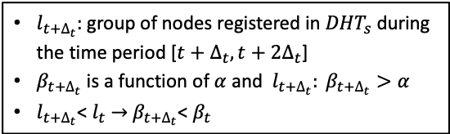














Work_Queue_Management.png
$$t$$
$$t+∆_{t}$$
$$t+{2∆}_{t}$$
Worker node
Worker pool
$${DHT}_{w}$$
Worker pool
$${DHT}_{w}$$
Worker pool
$${DHT}_{w}$$
Node in worker queue
Worker node leaving ${DHT}_{w}$at $t+∆_{t}$
Node joining ${DHT}_{w}$at $t+∆_{t}$
Node joining ${DHT}_{w}$at $t+∆_{t}$ with normal score
Node joining ${DHT}_{w}$at $t+∆_{t}$ with low score
Worker node leaving ${DHT}_{w}$at $t+{2∆}_{t}$
Worker queue
${DHT}_{q}$ at $t$
Worker queue
${DHT}_{q}$ at $t+∆_{t}$
Worker queue
${DHT}_{q}$ at $t+{2∆}_{t}$
Node joining ${DHT}_{w}$at $t+{2∆}_{t}$
Node joining ${DHT}_{w}$at $t+{2∆}_{t}$ with normal score
Node joining ${DHT}_{w}$at $t+2∆_{t}$ with low score
C
D
threshold
C
A
D
B
A
Nodes joining tertiary queue ${DHT}_{s}$during [$t,t+∆_{t}$]
B
Nodes joining tertiary queue ${DHT}_{s}$during [$t+∆_{t},t+{2∆}_{t}$]
$l_{t}:$group of nodes registered in ${DHT}_{s}$ during the time period [$t,t+∆_{t}$]
At $t+∆_{t}$, each node assigned a score and joins ${DHT}_{q}$ with ranking defined by score
A – D randomly selected to have a score closed to threshold $α.$
Remaining nodes (E) are given have a lower score closed to $β$
$β_{t}$ is a function of $α$and $l_{t}: β_{t}>α$
C
D
A
B
$α$ = threshold
A
$$l_{t+∆_{t}}$$
B
$$l_{t}$$
$$α$$
E
C
E
$β_{t}$ = f($α$, $l_{t}$)
D
E
$l_{t+∆_{t}}:$group of nodes registered in ${DHT}_{s}$ during the time period [$t+∆_{t},t+{2∆}_{t}$]
$β_{t+∆_{t}}$ is a function of $α$and $l_{t+∆_{t}}: β_{t+∆_{t}}>α$
$l_{t+∆_{t}}$< $l_{t}$ $→$ $β_{t+∆_{t}}$< $β_{t}$
$$β_{t}$$

Slide 3


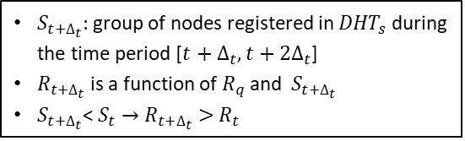





Work_Queue_Management.png
$$t$$
$$t+∆_{t}$$
$$t+{2∆}_{t}$$
Worker node leaving ${DHT}_{w}$at $t$
Worker pool
$${DHT}_{w}$$
Worker pool
$${DHT}_{w}$$
Worker pool
$${DHT}_{w}$$
Node joining ${DHT}_{w}$at $t$
Worker node leaving ${DHT}_{w}$at $t+∆_{t}$
Node joining ${DHT}_{w}$at $t+∆_{t}$
Node joining ${DHT}_{q}$at $t+∆_{t}$ with normal score
Node joining ${DHT}_{q}$at $t+∆_{t}$ with low score
Worker node leaving ${DHT}_{w}$at $t+{2∆}_{t}$
Worker queue
${DHT}_{q}$ at $t$
Worker queue
${DHT}_{q}$ at $t+∆_{t}$
Worker queue
${DHT}_{q}$ at $t+{2∆}_{t}$
Node joining ${DHT}_{w}$at $t+{2∆}_{t}$
Node joining ${DHT}_{q}$at $t+{2∆}_{t}$ with normal score
Node joining ${DHT}_{q}$at $t+2∆_{t}$ with low score
C
C
A
$$R_{q}$$
A
B
Nodes joining tertiary queue ${DHT}_{s}$during [$t,t+∆_{t}$]
B
Nodes joining tertiary queue ${DHT}_{s}$during [$t+∆_{t},t+{2∆}_{t}$]
$S_{t}:$group of nodes registered in ${DHT}_{s}$ during the time period [$t,t+∆_{t}$]
At $t+∆_{t}$, each node is assigned a score and joins ${DHT}_{q}$ with ranking defined by its score
A – C are randomly selected to have a score close to threshold $R_{q}.$
The remaining nodes (D) are given a lower score close to $R_{t}$
$R_{t}$ is a function of $R_{q}$and $S_{t}: R_{t}<R_{q}$
C
B
A
A
$$S_{t+∆_{t}}$$
B
$$S_{t}$$
D
$$R_{q}$$
D
C
D
$S_{t+∆_{t}}:$group of nodes registered in ${DHT}_{s}$ during the time period [$t+∆_{t},t+{2∆}_{t}$]
$R_{t+∆_{t}}$ is a function of $R_{q}$and $S_{t+∆_{t}}$
$S_{t+∆_{t}}$< $S_{t}$ $→$ $R_{t+∆_{t}}>$ $R_{t}$
$$R_{t}∝ (R_{q}, S_{t})$$

Slide 4
















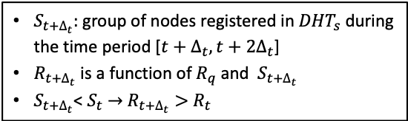


Work_Queue_Management.png
$$t$$
$$t+∆_{t}$$
$$t+{2∆}_{t}$$
Worker node leaving ${DHT}_{w}$at $t$
Worker pool
$${DHT}_{w}$$
Worker pool
$${DHT}_{w}$$
Worker pool
$${DHT}_{w}$$
Node joining ${DHT}_{w}$at $t$
Worker node leaving ${DHT}_{w}$at $t+∆_{t}$
Node joining ${DHT}_{w}$at $t+∆_{t}$
Node joining ${DHT}_{q}$at $t+∆_{t}$ with normal score
Node joining ${DHT}_{q}$at $t+∆_{t}$ with low score
Worker queue
${DHT}_{q}$ at $t$
Worker queue
${DHT}_{q}$ at $t+∆_{t}$
Worker queue
${DHT}_{q}$ at $t+{2∆}_{t}$
Worker node leaving ${DHT}_{w}$at $t+{2∆}_{t}$
Node joining ${DHT}_{w}$at $t+{2∆}_{t}$
Node joining ${DHT}_{q}$at $t+{2∆}_{t}$ with normal score
Node joining ${DHT}_{q}$at $t+2∆_{t}$ with low score
C
C
A
$$R_{q}$$
A
B
Nodes joining tertiary queue ${DHT}_{s}$during [$t,t+∆_{t}$]
B
Nodes joining tertiary queue ${DHT}_{s}$during [$t+∆_{t},t+{2∆}_{t}$]
$S_{t}:$group of nodes registered in ${DHT}_{s}$ during the time period [$t,t+∆_{t}$]
At $t+∆_{t}$, each node is assigned a score and joins ${DHT}_{q}$ with ranking defined by its score
A – C are randomly selected to have a score close to threshold $R_{q}.$
The remaining nodes (D) are given a lower score close to $R_{t}$
$R_{t}$ is a function of $R_{q}$and $S_{t}: R_{t}<R_{q}$
C
B
A
A
$$S_{t+∆_{t}}$$
B
$$S_{t}$$
D
$$R_{q}$$
D
C
D
$S_{t+∆_{t}}:$group of nodes registered in ${DHT}_{s}$ during the time period [$t+∆_{t},t+{2∆}_{t}$]
$R_{t+∆_{t}}$ is a function of $R_{q}$and $S_{t+∆_{t}}$
$S_{t+∆_{t}}$< $S_{t}$ $→$ $R_{t+∆_{t}}>$ $R_{t}$
$$R_{t}∝ (R_{q}, S_{t})$$

Slide 5
Work_Queue_Management.png
$$t$$
$$t+∆_{t}$$
$$t+{2∆}_{t}$$
Worker node leaving ${DHT}_{w}$at $t$
Worker pool
$${DHT}_{w}$$
Worker pool
$${DHT}_{w}$$
Worker pool
$${DHT}_{w}$$
Node joining ${DHT}_{w}$at $t$
Worker node leaving ${DHT}_{w}$at $t+∆_{t}$
Node joining ${DHT}_{w}$at $t+∆_{t}$
Node joining ${DHT}_{q}$at $t+∆_{t}$ with normal score
Node joining ${DHT}_{q}$at $t+∆_{t}$ with low score
Worker node leaving ${DHT}_{w}$at $t+{2∆}_{t}$
Worker queue
${DHT}_{q}$ at $t$
Worker queue
${DHT}_{q}$ at $t+∆_{t}$
Worker queue
${DHT}_{q}$ at $t+{2∆}_{t}$
Node joining ${DHT}_{w}$at $t+{2∆}_{t}$
Node joining ${DHT}_{q}$at $t+{2∆}_{t}$ with normal score
Node joining ${DHT}_{q}$at $t+2∆_{t}$ with low score
C
C
A
$$R_{q}$$
A
B
Nodes joining tertiary queue ${DHT}_{s}$during [$t,t+∆_{t}$]
B
Nodes joining tertiary queue ${DHT}_{s}$during [$t+∆_{t},t+{2∆}_{t}$]
$S_{t}:$group of nodes registered in ${DHT}_{s}$ during the time period [$t,t+∆_{t}$]
At $t+∆_{t}$, each node is assigned a score and joins ${DHT}_{q}$ with ranking defined by its score
A – C are randomly selected to have a score close to threshold $R_{q}.$
The remaining nodes (D) are given a lower score close to $R_{t}$
$R_{t}$ is a function of $R_{q}$and $S_{t}: R_{t}<R_{q}$
C
B
A
A
$$S_{t+∆_{t}}$$
B
$$S_{t}$$
D
$$R_{q}$$
D
C
D
$S_{t+∆_{t}}:$group of nodes registered in ${DHT}_{s}$ during the time period [$t+∆_{t},t+{2∆}_{t}$]
$R_{t+∆_{t}}$ is a function of $R_{q}$and $S_{t+∆_{t}}$
$S_{t+∆_{t}}$< $S_{t}$ $→$ $R_{t+∆_{t}}>$ $R_{t}$
$$R_{t}∝ (R_{q}, S_{t})$$

